Slide 1
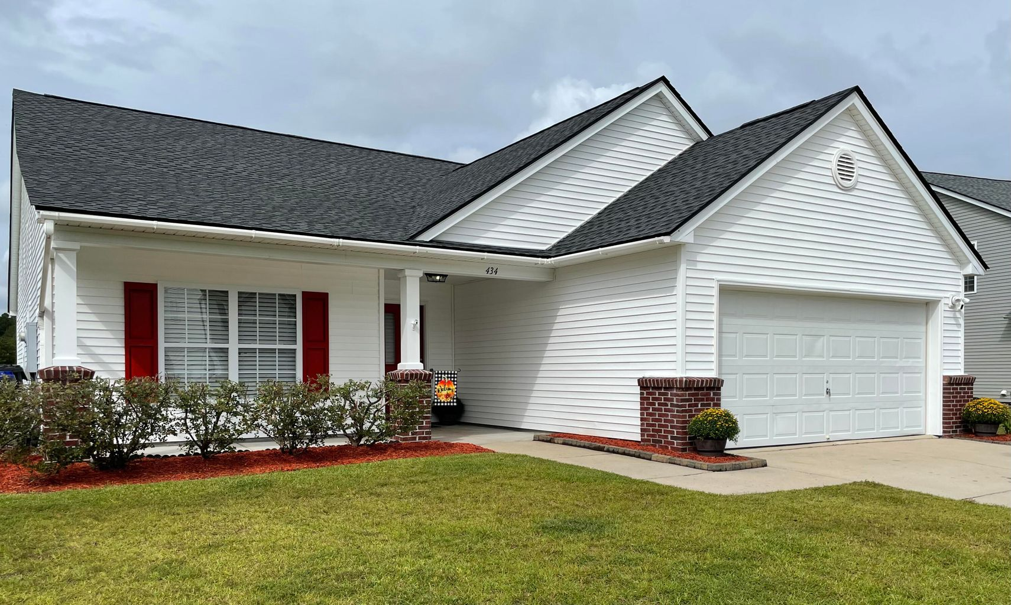
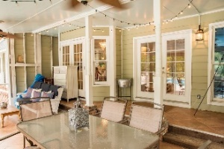
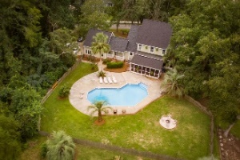
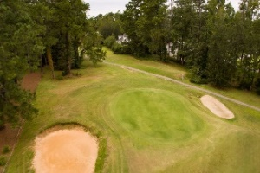


COMING FRIDAY IN WEATHERSTONE!
434 Dovetail Circle
Summerville, SC 29483 · MLS# 21025689 · $299,000
3 Bedrooms | 2 Baths | 1,730 Sq Ft
Beautiful one story Chesapeake floor plan, 3BD, 2BA home with 2 car garage, in the center of Summerville and near the pool.
New flooring throughout, no carpet. Home has an open floor plan with vaulted ceilings in kitchen, a spacious great room, large bedrooms, walk-in closets, screened-in porch and full front porch.
Eat-in kitchen comes with stainless steel appliances including refrigerator, built-in microwave and pantry. Owner's suite has trey ceiling, walk-in closet and a garden tub in Master Bath.
Enjoy your evenings on the screened in back porch. All the conveniences and close to shopping. Walking distance to Azalea Square shopping, restaurants, and I-26. Set up your showing now.
This won't last long.
JACKIE LAWSON, REALTOR®
(843) 568-1250 · jlawsonhomes@gmail.com · CharlestonListingsforSale.com
AgentOwned Realty Co. Premier Group, Inc. · 141 A N. Main Street · Summerville, SC 29483

