Slide 1
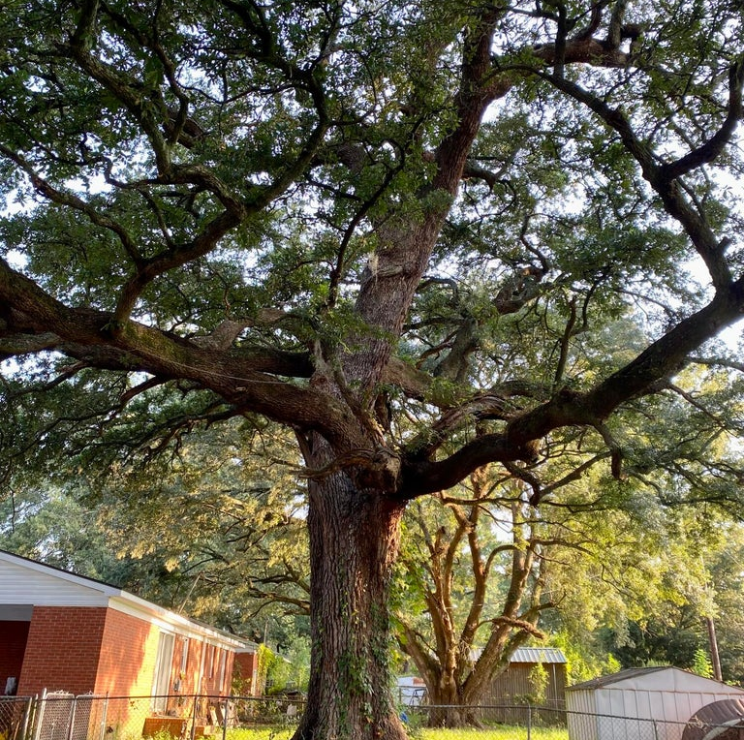
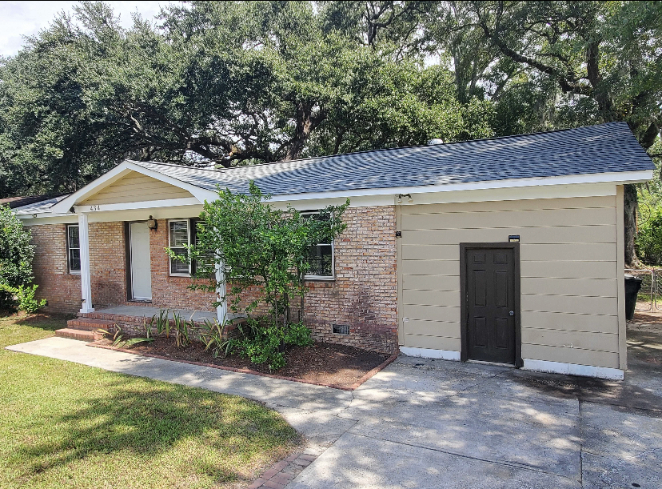
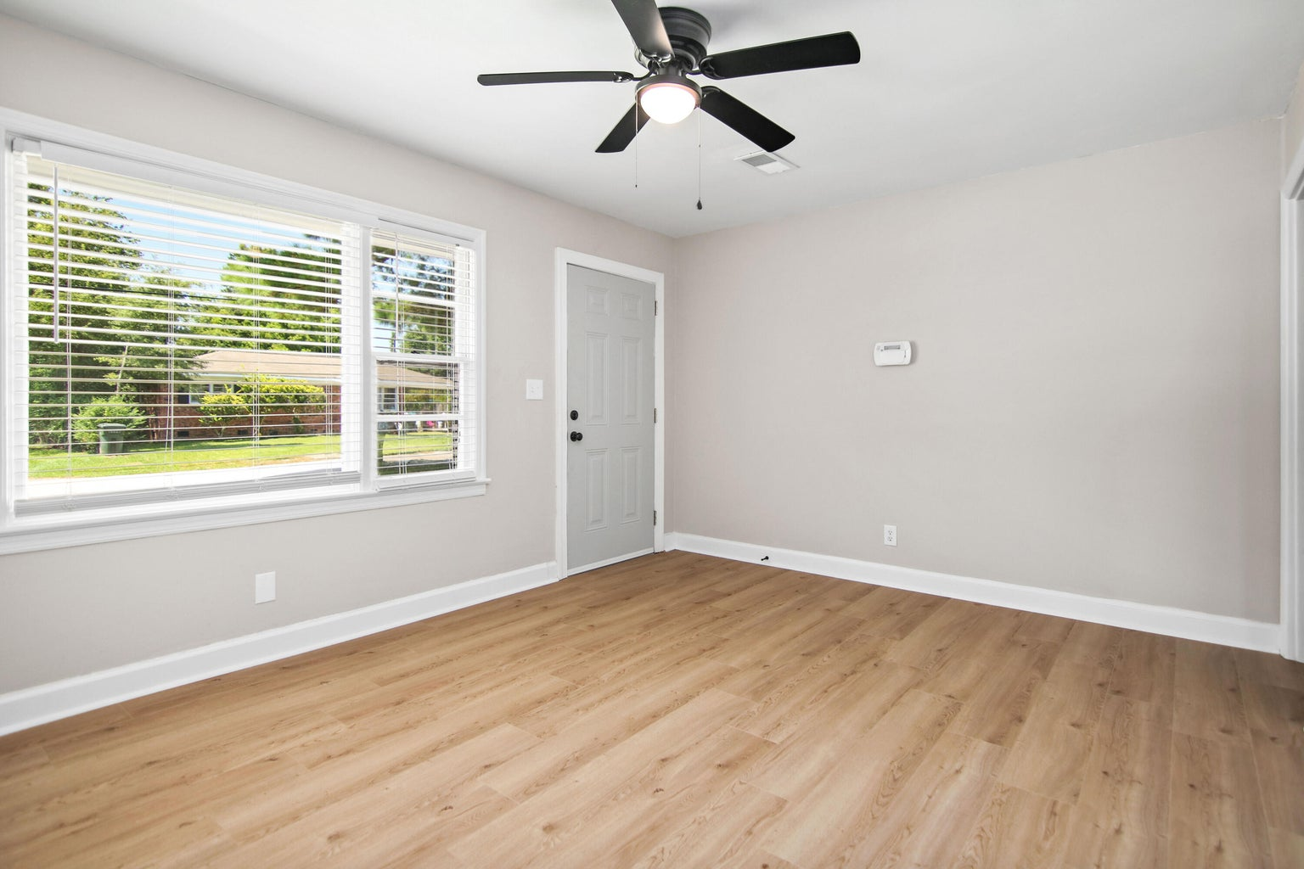



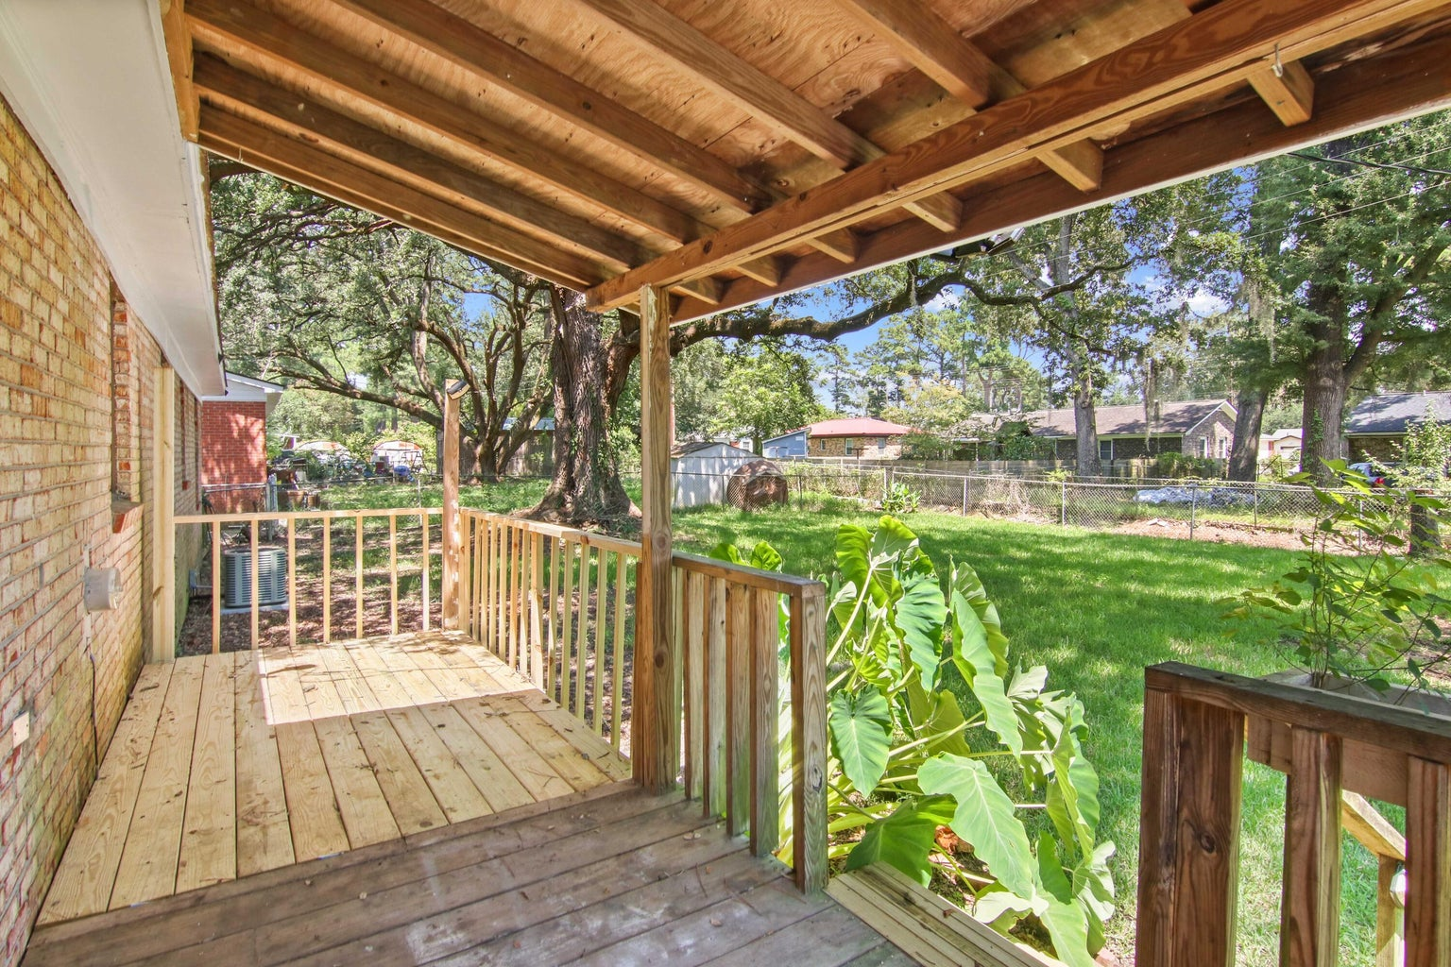
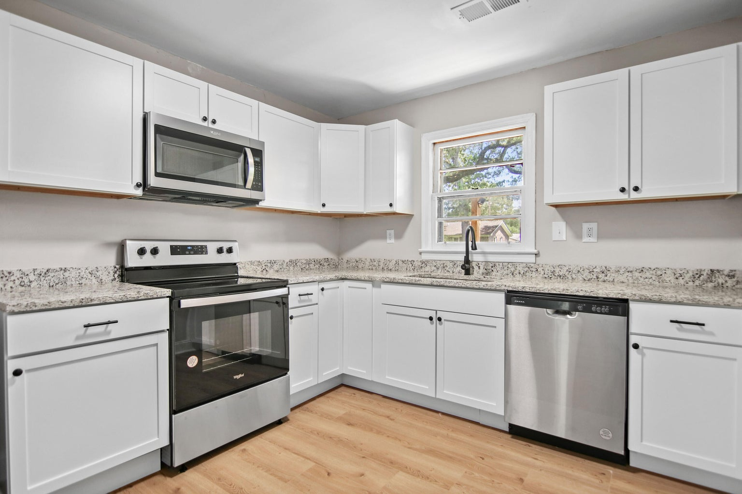

NEW INCENTIVES!
BRAND NEW ARCHITECTURAL ROOF!
434 Mary Scott Drive
Boulder Bluff
Goose Creek, SC 29445
MLS# 23019609 | $265,000
1,000 SF
3 BEDS
1 BATH
Susan Stanley
843-323-5573
susancstanley@gmail.com

