Slide 1
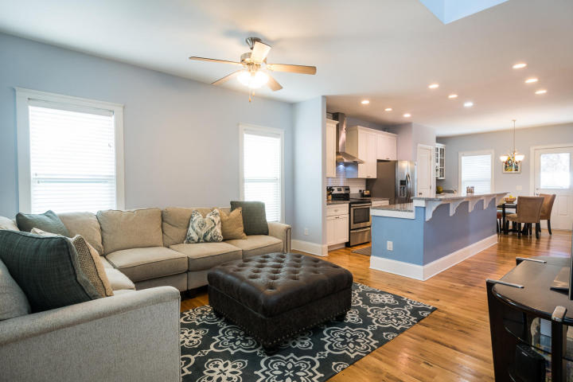
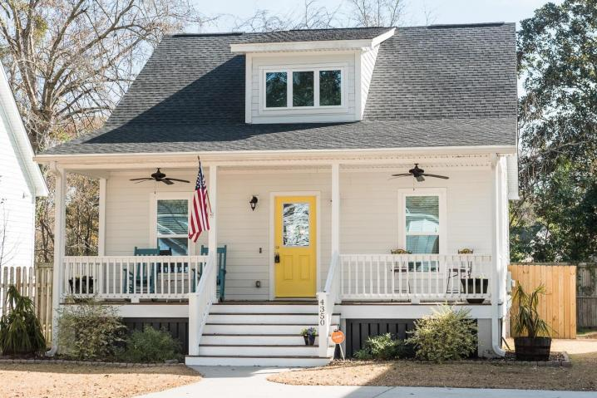
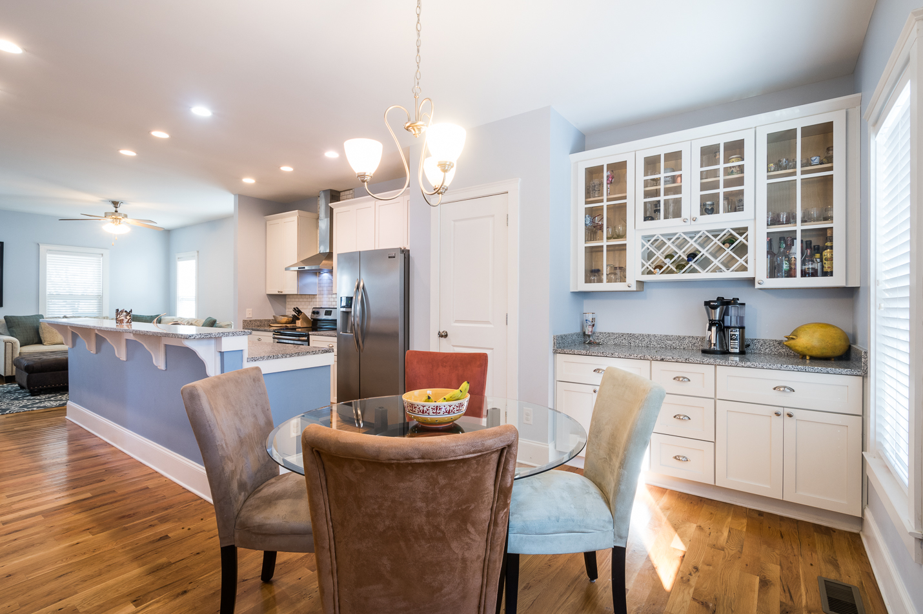
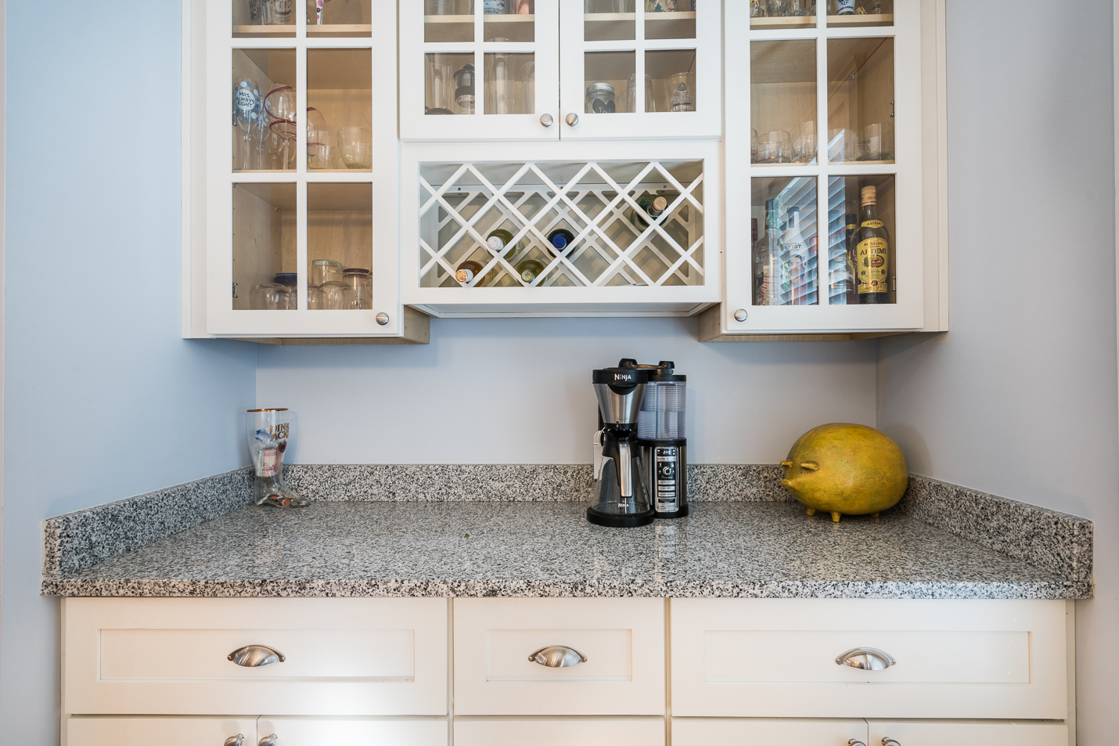
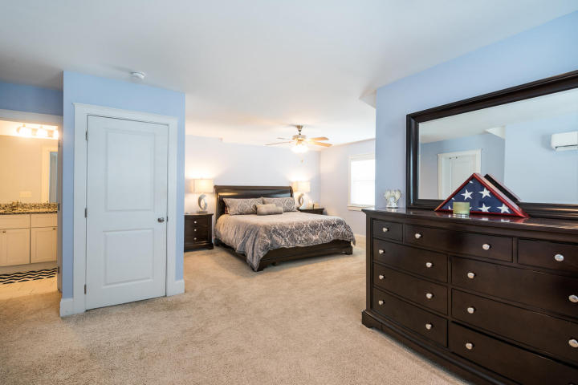
Beautiful open-concept home in a lovely neighborhood.
9-Food+ ceilings throughout, custom kitchen, all wood cabinets.
This home is a must see! Bring your buyers for a vist!
4350 Rugheimer Avenue | Park Circle asking: $315,900 MLs: 18000445
Connie Dittrich, Realtor, ABR, CNE, SFR
Carolina One Real Estate 843-475-7993 cdittrich@carolinaone.com

