Slide 1
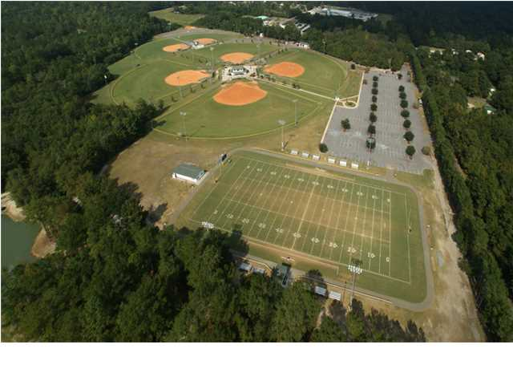
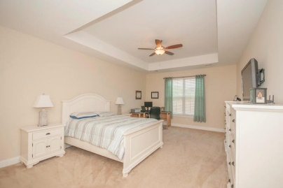
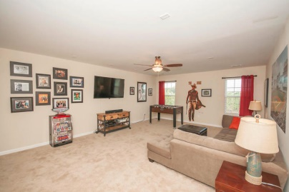
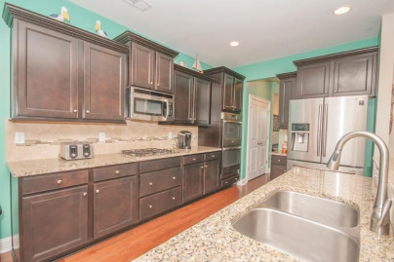
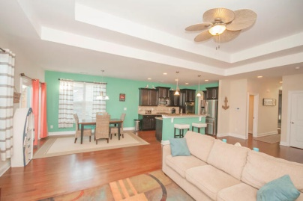
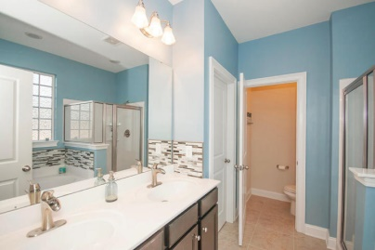
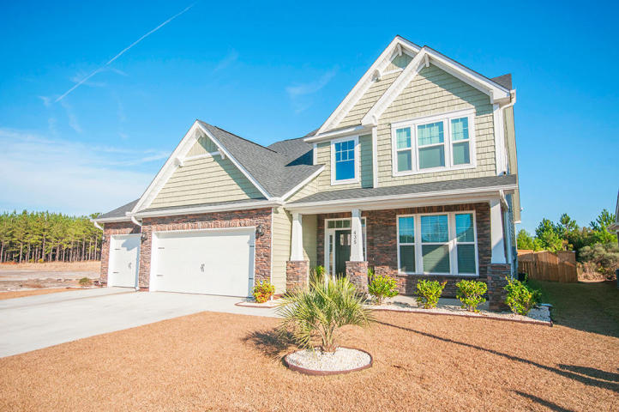
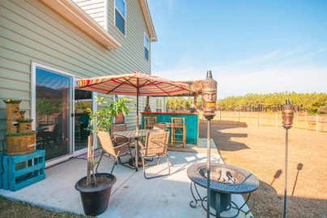
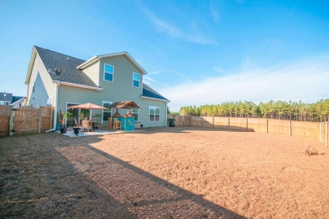


435 Spectrum Road
Cane Bay Plantation | Summerville | MLS# 14031598 | $267,900
New Price & $2,000 Closing Costs
Better than new and over $13,000 LESS than new construction pricing for this same floor plan!!! Great living spaces both inside and out. As you enter, notice the 2-story foyer, separate Formal Dining room and hardwoods throughout the main level. Continue into the Great room where you will feel the beach-like vibe with beautiful colors in the open concept. You will love cooking or entertaining in the gourmet chef's kitchen with gas cook-top, S/S appliances, double oven, granite counters, tile back-splash and beautiful cabinetry. A large Eat-In area off of the kitchen as well as bar-height counter space for extra seating gives you plenty of options. Don't miss the butlers pantry with wine fridge and built-in wine rack as well as a spacious double-door pantry. Also on the main level is a wonderful Master retreat with trey ceiling and extra room for a sitting area. The bathroom offers a modern, contemporary feel with cool colors, upgraded faucets and beautiful tile back splash. There is also a large walk-in closet and separate shower and garden tub. Upstairs you will find a huge bonus room/loft with two closets that is a great flex space. There are also 3 additional bedrooms offering plenty of closet space as well as a full bathroom. Back downstairs you will find a guest bathroom and a laundry room with a separate sink and cabinets for extra storage. You will LOVE the 3-car garage with added built-in storage. The owner's favorite place is the private backyard retreat where they have created a fun place to hang out and entertain. They have brought the beach to Summerville with the addition of a floating 12x8 deck and hand built TIKI HUT, sand included! Even the hand made nautical motif signs are included! There is also a double door entryway on one side of the privacy fence if you need to store a boat or anything too large for the garage. Magnolia at Cane Bay is a sidewalk community with a wonderful neighborhood pool. New Price plus $2500 seller paid closing costs.
View a virtual tour at http://zyndicate.co/435Spectrum-branded.html
Beth Mandell
M 843-900-1296 | O 843-871-2121
bmandell@century21properties.com
www.bestcarolinahomedeals.com
Century 21 Properties Plus of Summerville | 118 W Richardson Ave | Summerville, SC 29483

