Slide 1
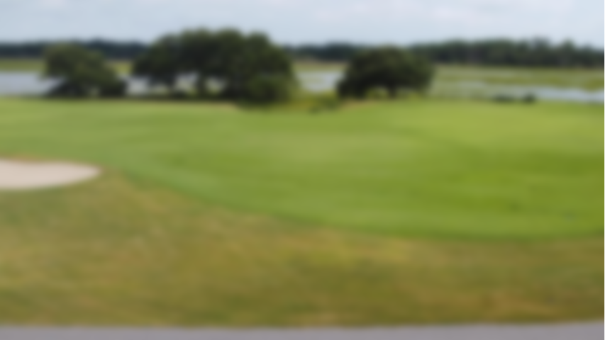
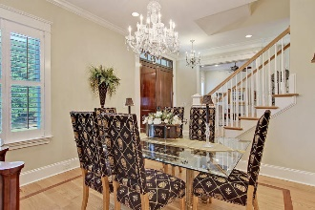
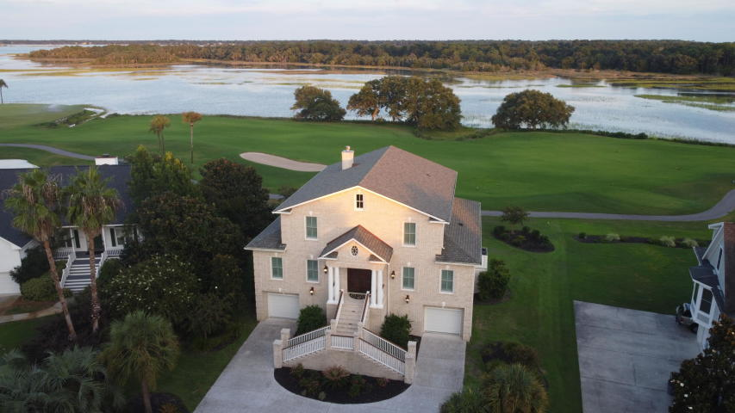
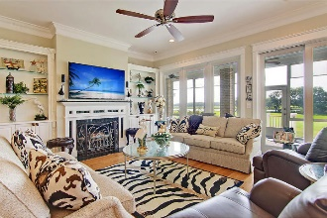
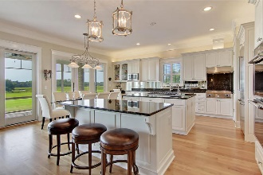
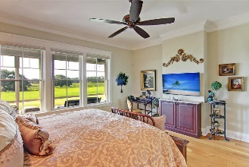
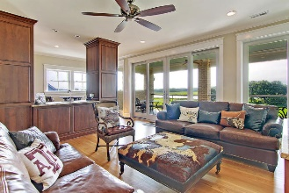
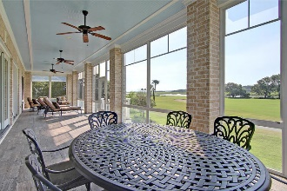
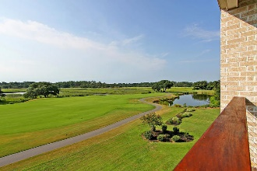
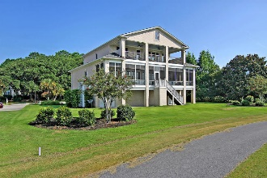


Improved Price for Majestic River View Home
4366 Hope Plantation Drive
Kiawah River Estates | Johns Island, SC 29455
MLS# 20022642 | $1,229,000
Majesty, Moonrise, Marsh, River, Magic; these are just a few things you will experience here. 4366 Hope Plantation Drive is perfectly situated near the middle of the 18th fairway of Kiawah Island Golf Resort's Oak Point Golf Course in the tranquil gated community of Kiawah River Estates. This home offers the highest views in the neighborhood and unquestionably some of the best! From its 1300+ square feet of porch and veranda you will have the best views of the prettiest hole on Oak Point with Haulover Creek, the Kiawah River, and Kiawah and Seabrook Islands as a backdrop. The lower porch is screened and has EZ Breeze removable panels. The upper veranda is open with stainless steel cables, and both feature beautiful Ipe rails, ceramic wood plank tile flooring, and ceiling fans. They run the full length of the home and are over 11' wide, offering plenty of room for furniture and entertaining. Breathtaking views can be seen from one end of the house to another on each level. The entire back of the house is an expanse of tall windows and doors, and spectacular unobstructed views.
There are too many details to list here…check out the listing to read more!
Take a virtual tour: https://my.matterport.com/show/?m=YjS4VfmJvLP
Lee Lindler
Cell (843) 637-0803 | lee@akersellis.com
Akers Ellis Real Estate LLC | 3730 Bohicket Road, Suite 5 | Johns Island, SC 29455
akersellis.com

