Slide 1
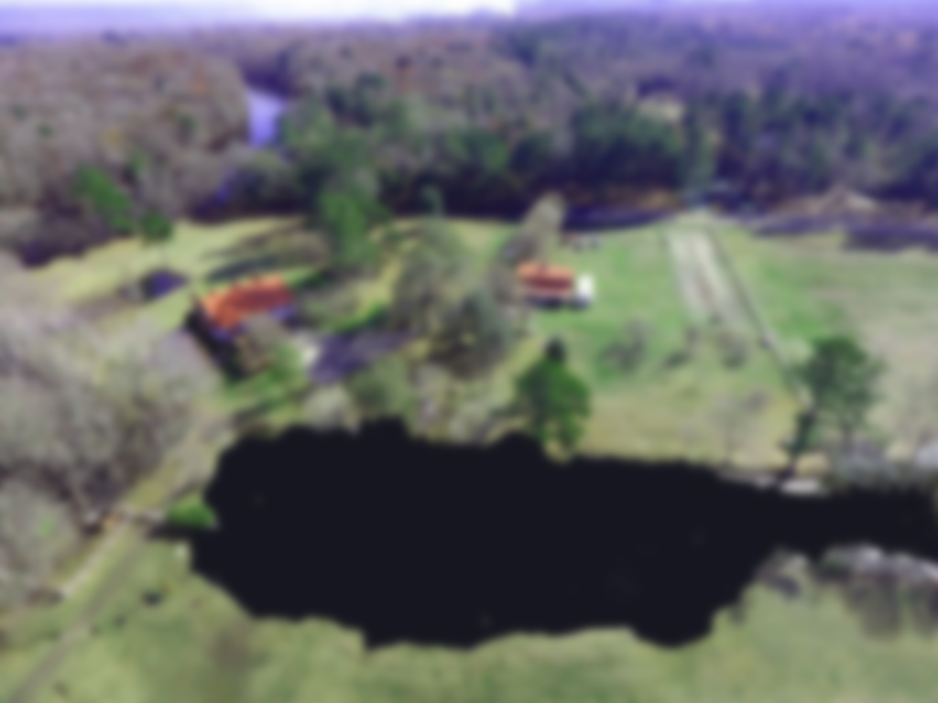
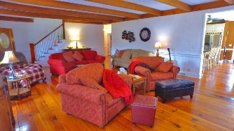
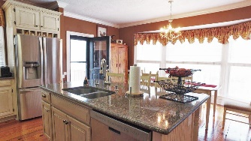
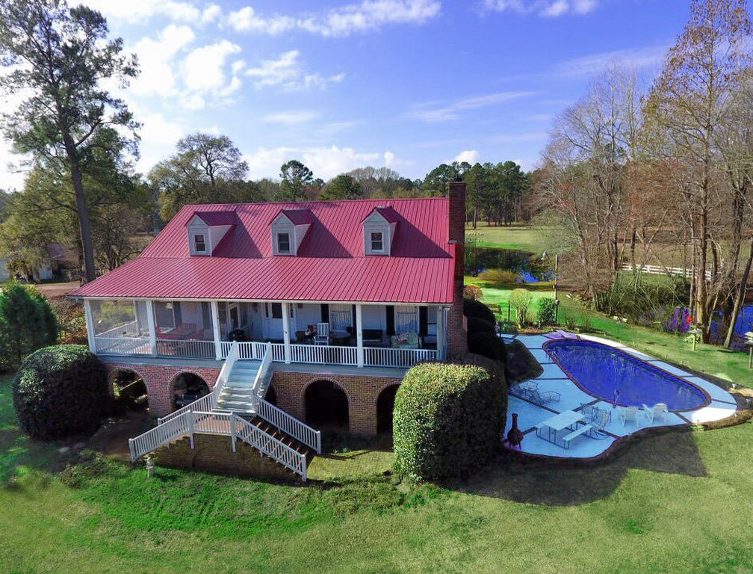
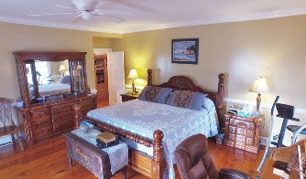
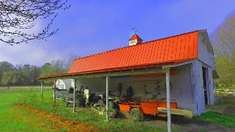
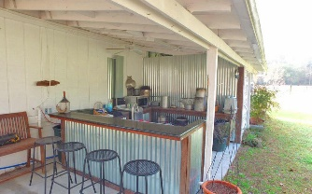
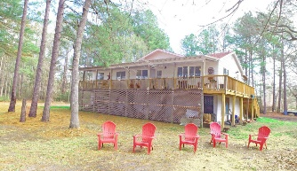
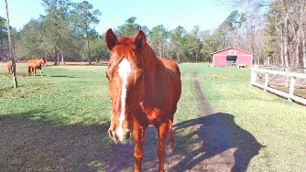
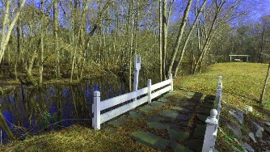
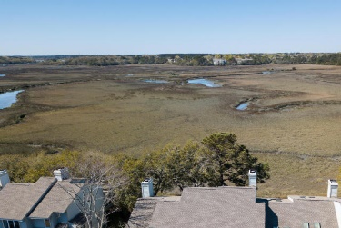
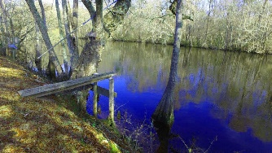
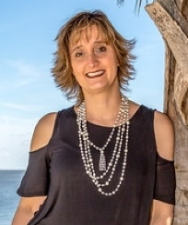

Edisto River Estate Open House
19th & 20th ~ 2 to 5pm ~ Light snacks
Realtors: Leave your card for chance to win gas card
436 Arrowhead Ln
Round O, SC 29474 ~ $1,600,000 ~ MLS# 18005145
28.9 acres | 10 beds | 5 baths | 6,900 (total sqft)
Edisto River Waterfront plantation. This ONE OF KIND property offers Main home with 6 Bedrooms, Pool, river front, Guest house, horse barn, outdoor kitchen, tractor shed, planting shed, fenced pasture, duck pond, 694 ft of riverfront on the Edisto River, MIL suite (2 bedrooms) on 1st floor of main house, Guest house (4 bedrooms), lots of indoor storage area & much much more. Whether you are lounging by the pool or fishing off the dock this property will allow you to enjoy the best of the outdoors. The property has a main house (5500 sqft) with 6 bedrooms, 2 full kitchens, 2 living areas, and Guest house (1400) has 4 bedrooms, 2 baths, full kitchen, dining area and living area. 2 wells, 4 septics are on the property.
Lake Homes Realty, LLC
Elloree, SC 29047
www.SCLakeLife.com
Kristie Anderson
(803) 387-9459
kristie@sclakelife.com

