Slide 1
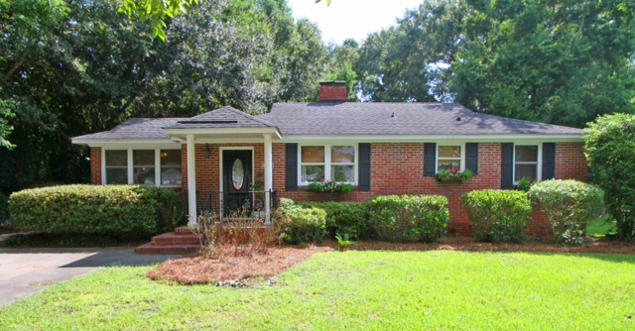
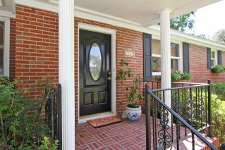
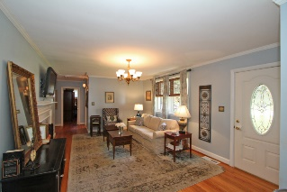
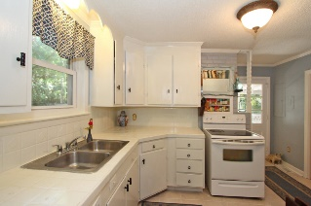
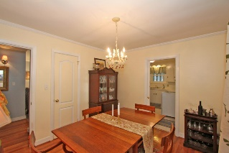
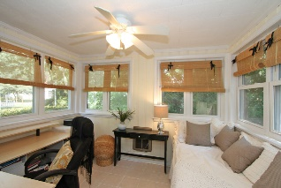
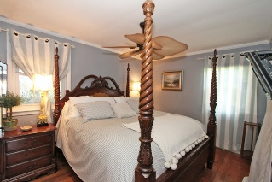
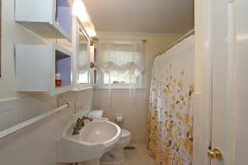
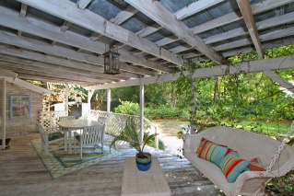
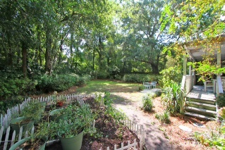
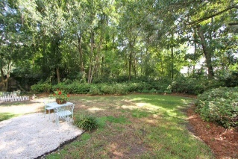


436 Carol Street Woodland Shores Annex Charleston MLS# 15023833 $289,000
James Island Gem
Open House This Weekend
Join me Saturday or Sunday 1-2:30
This must see charming brick ranch sits on a quiet cul-de-sac in the heart of James Island and just minutes from restaurants, the Terrace Theater, the County Park, and the Municipal Golf Course! Welcomed by a wonderful wood burning fire place, this home features hardwoods in the den and bedrooms, and tile in the baths, kitchen, and sunroom. Private fenced yard with mature landscaping and covered patio gives you the perfect place to relax and unwind! This home is a must see and won't last long!
Sarah Ellen Lacke
Cell - (843) 607-4330
sarahellen.lacke@carolinaone.com
www.selacke.com
Carolina One Real Estate 1265 Folly Rd Charleston, SC 29412

