Slide 1
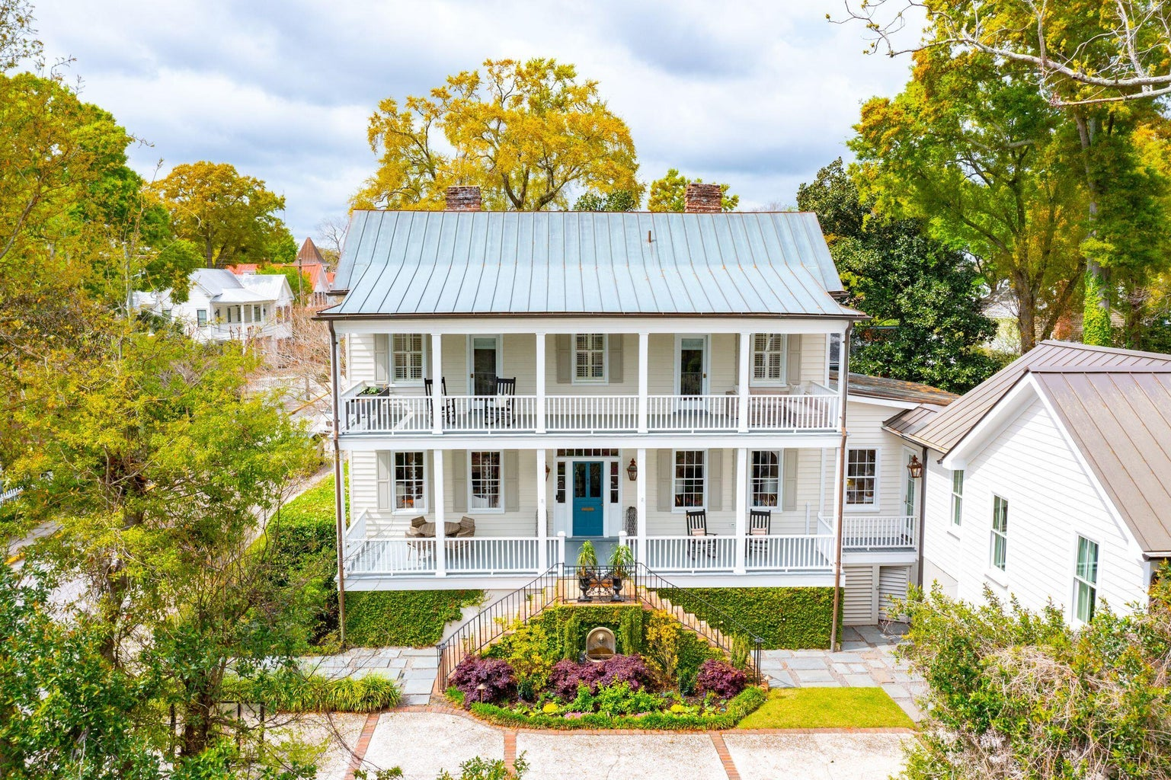
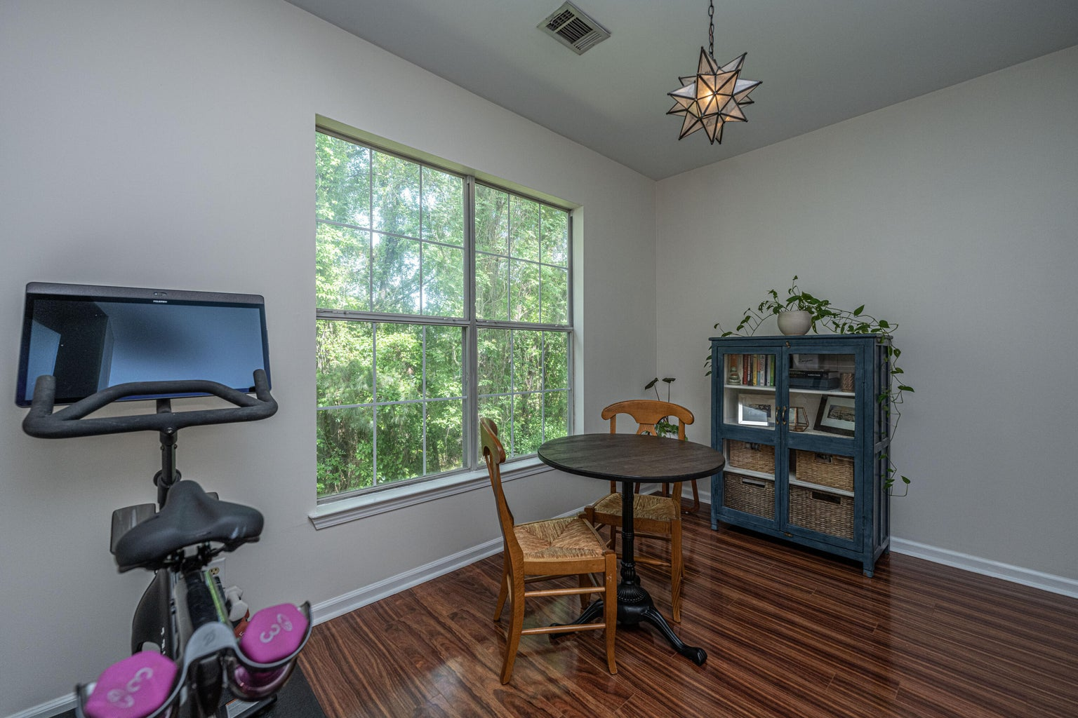
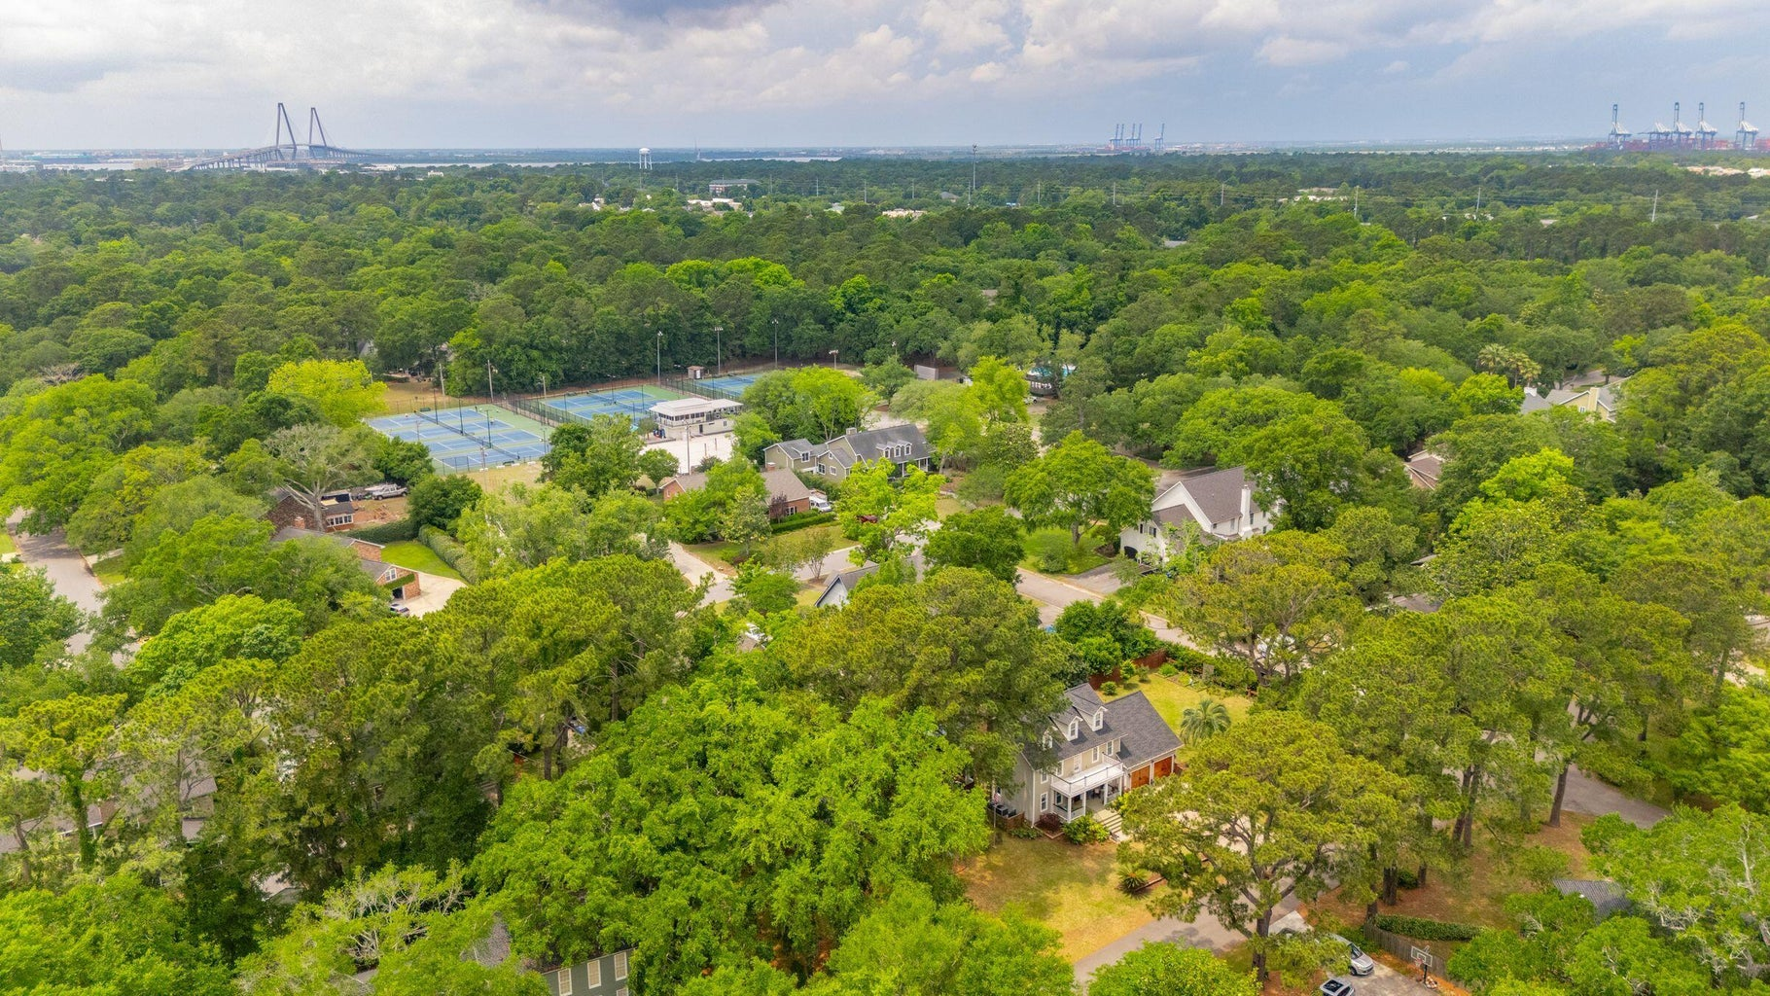
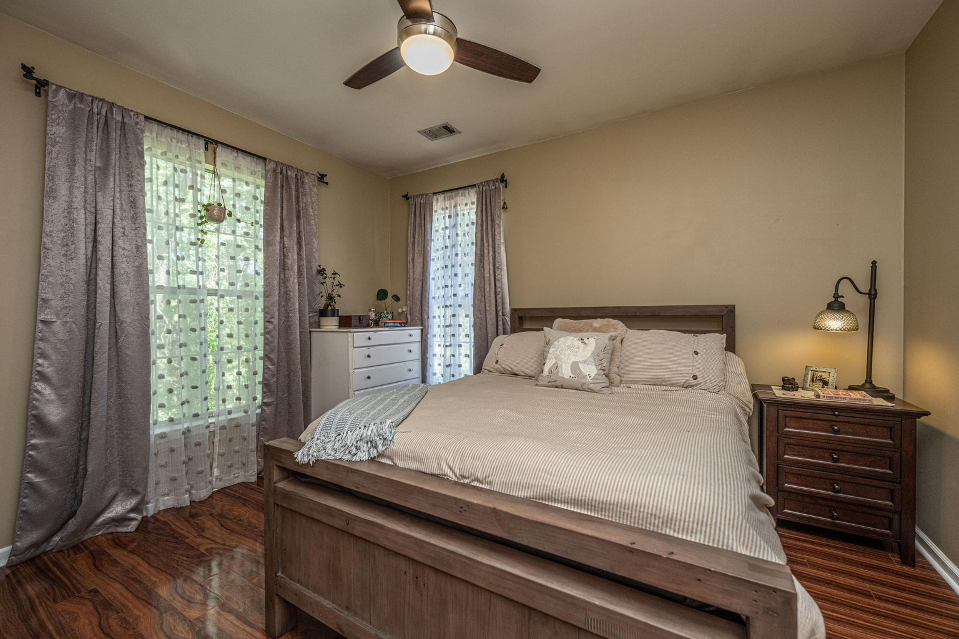
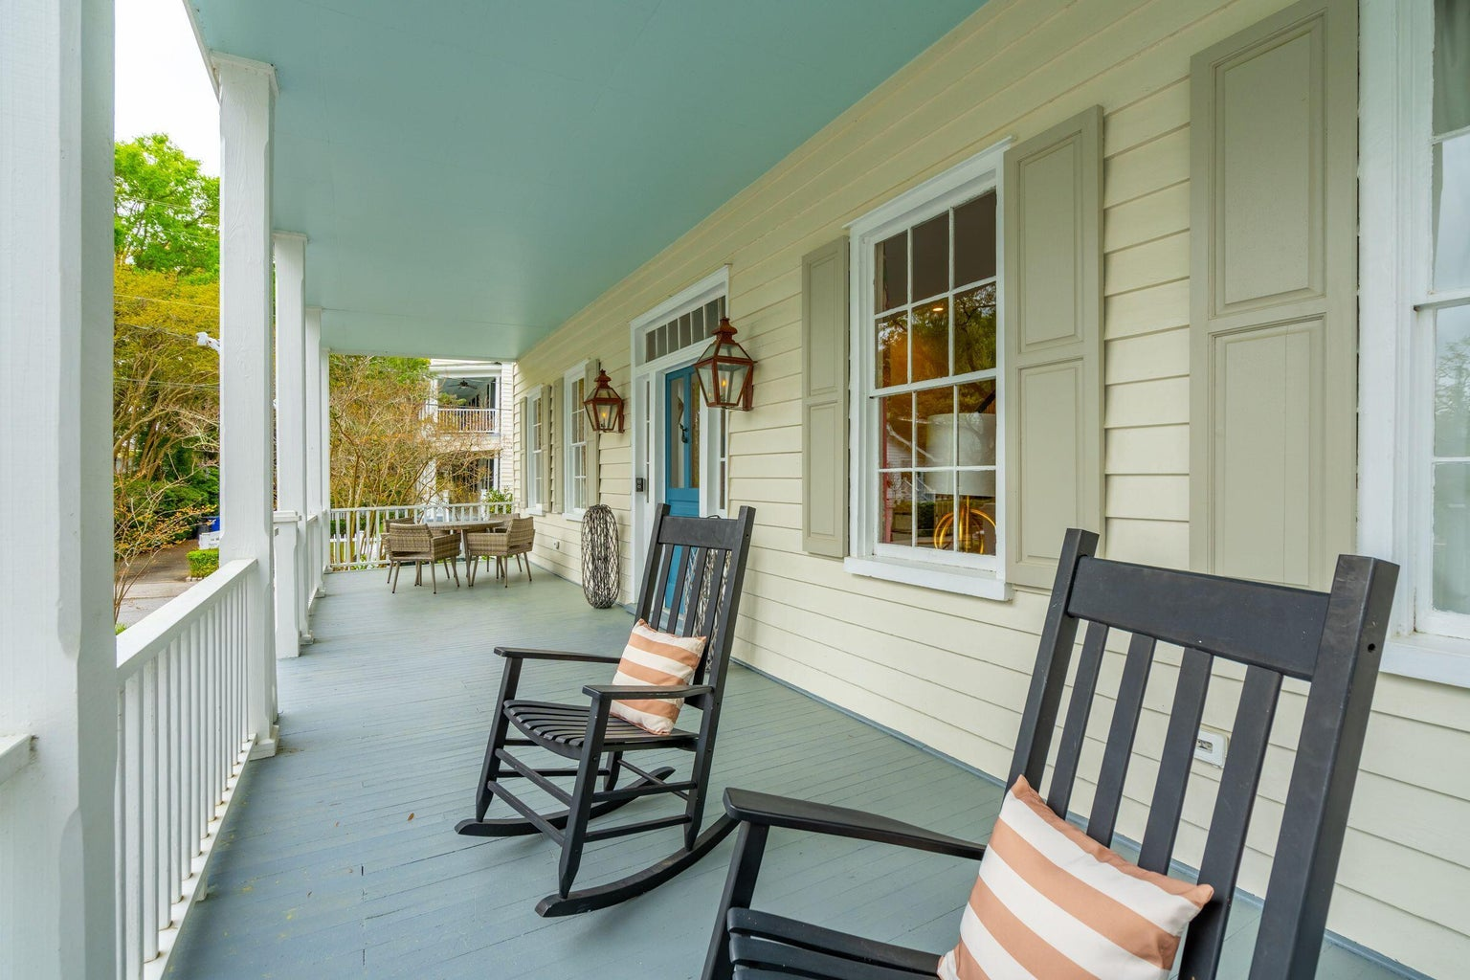
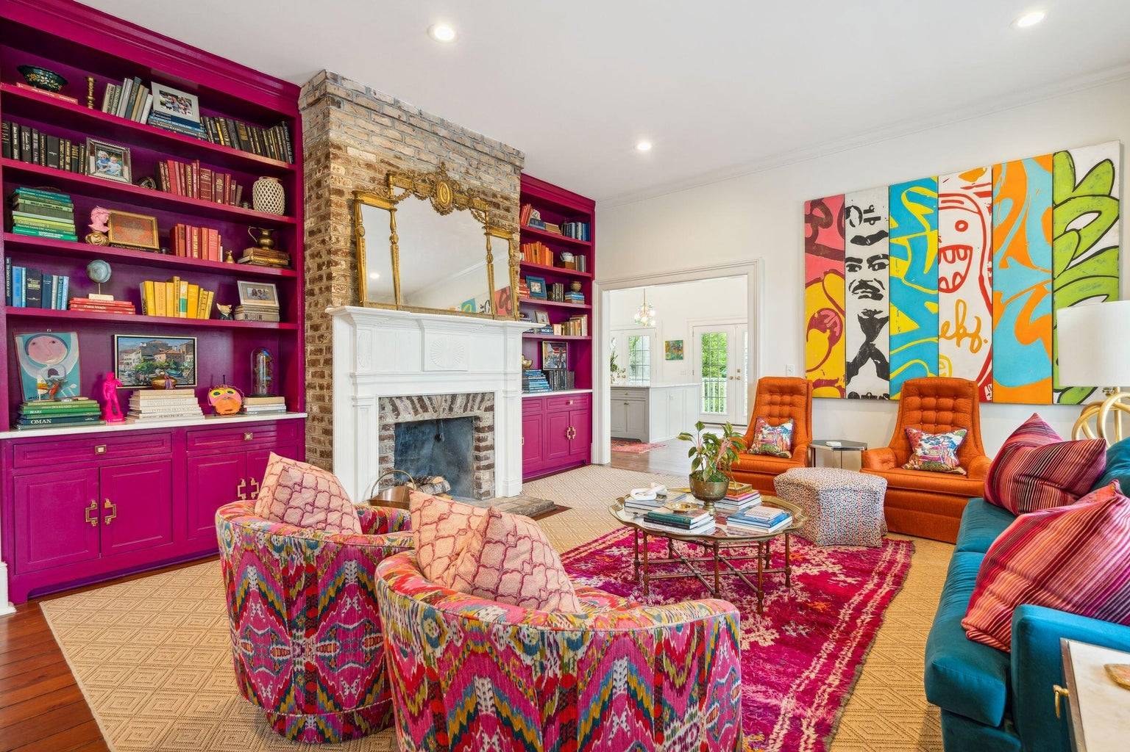
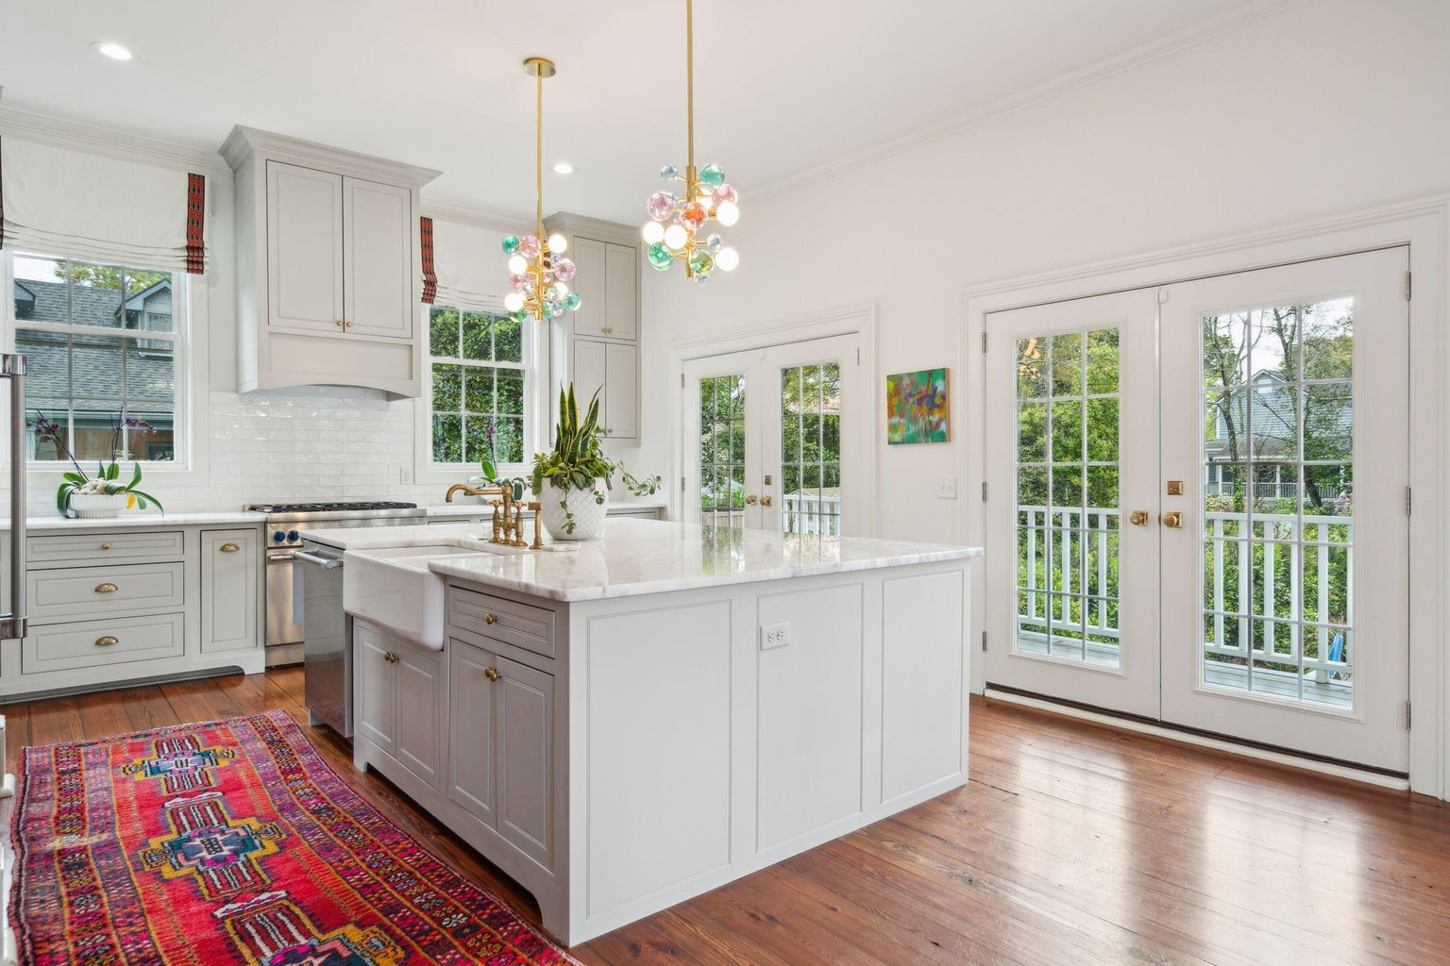
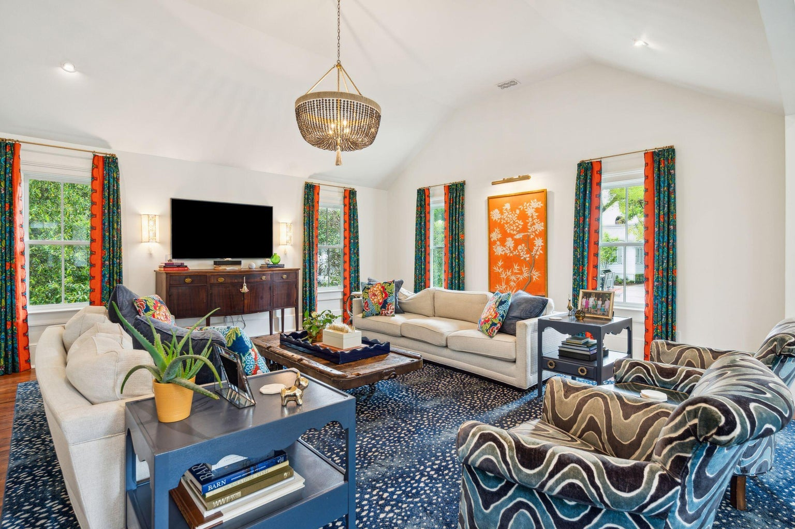



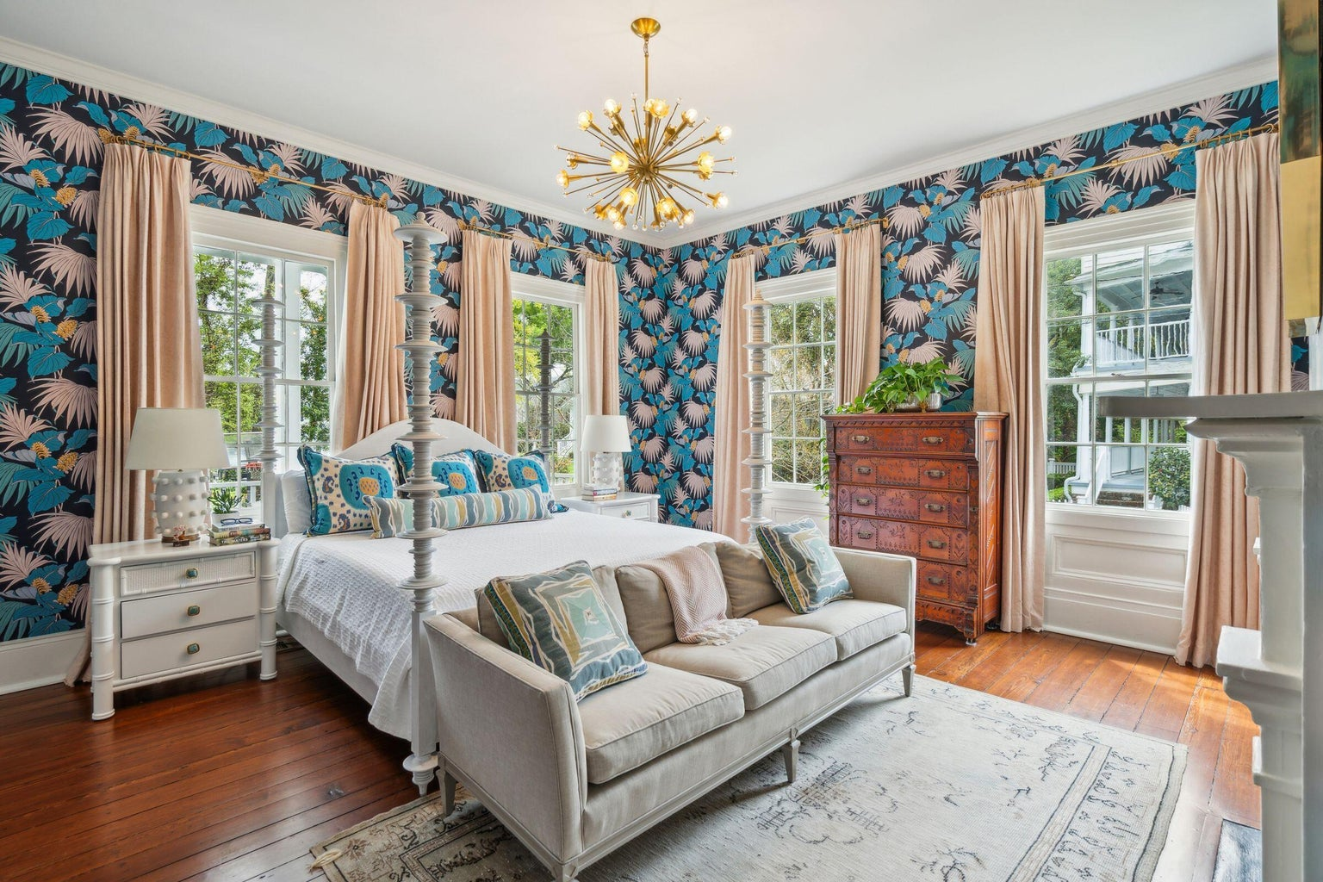
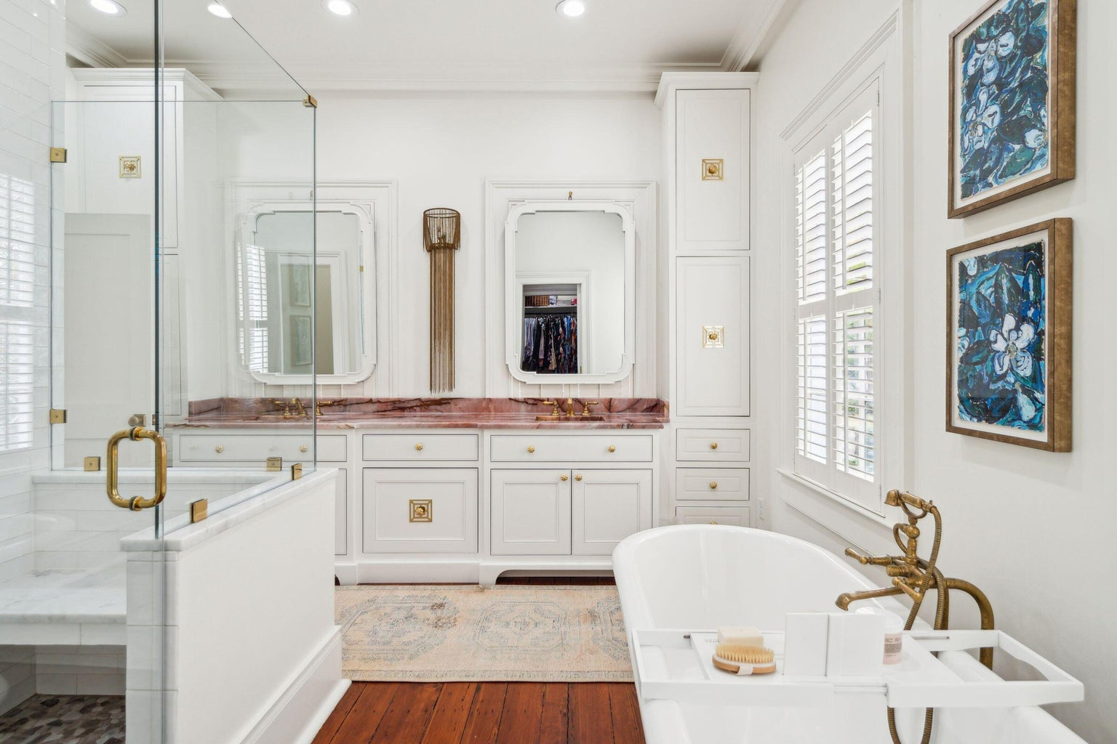
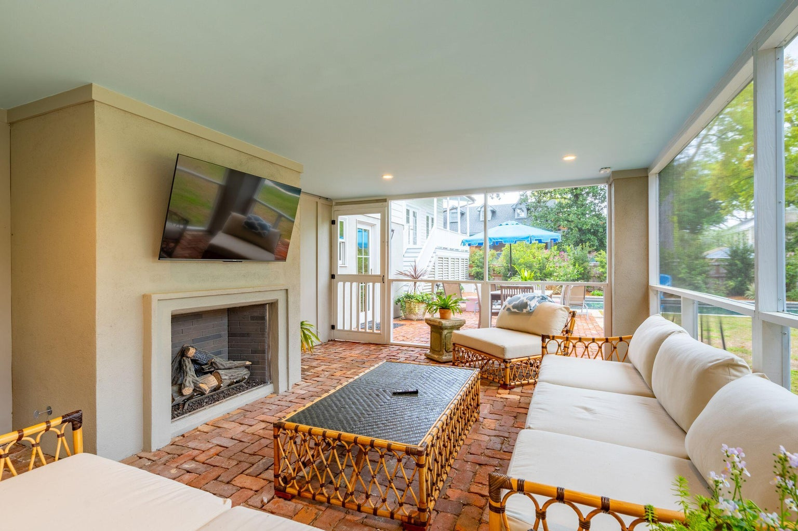
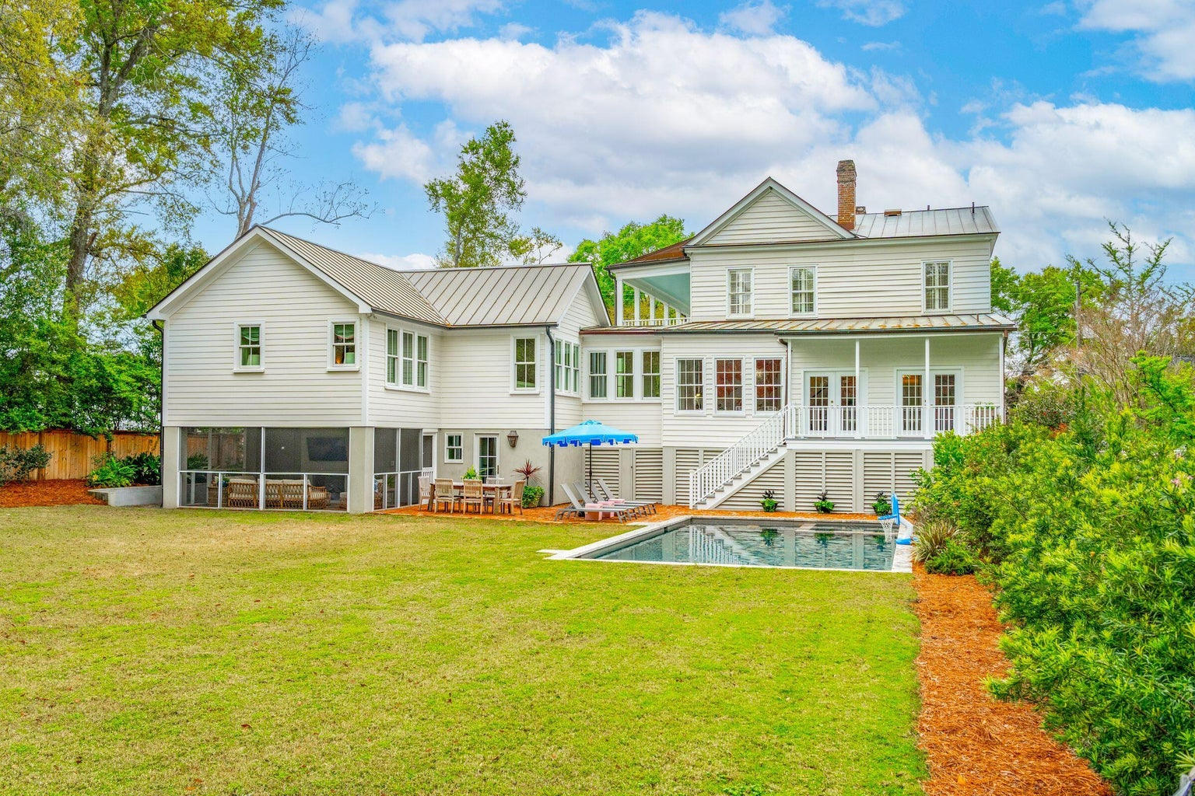



Historic Elegance with Modern Luxury
436 Church Street
Old Village | Mount Pleasant, SC 29464 | MLS# 24007878 | $6,825,000
Nestled in the heart of Mount Pleasant's Historic Old Village, this exquisite home, dating back to the 1850s and architecturally framed by majestic double portico porches spanning 803 square feet, has been transformed into a masterpiece that seamlessly blends historic elegance with modern luxury. Boasting an impressive 4,491 square feet of living space, including six bedrooms, four full baths and two half baths, this home exudes timeless charm, while offering all the amenities of contemporary living. Upon entering, one is immediately struck by the home's captivating character, highlighted by a majestic fireplace and gleaming heart pine floors.
The gourmet kitchen, a true culinary haven, features high ceilings and large windows that flood the space with natural light, complemented by luxurious Carrera Marble countertops, a spacious butler pantry, and an open dining area, perfect for hosting gatherings or enjoying quiet mornings with family.
Completely updated by the previous owners in 2020 with interior designs by Beau Clowney, the current owners continued the wonderful preservation and improvement of this home with a gorgeous 1,000+ square foot addition, professional decorating including high end finishes, lighting and wallpaper by designer Virgina Norment, and an outdoor space that truly compliments this beautiful Lowcountry home.
This home features a primary bedroom on the first floor with large walk in closets and a beautiful ensuite situated away from the main living area for an owners' retreat. Three spacious bedrooms upstairs and flex space for a library or office open to the second story porch for added outdoor living.
Situated on nearly half an acre of land, beautifully landscaped and transformed into a wonderful private retreat, the property offers an outdoor oasis complete with a saltwater 18x36 pool, hot tub, guest suite with screened in porch and fireplace, and wide open outdoor space ideal for entertaining or simply unwinding in the serene surroundings.
4
3
1,844
Descending into the 1,370 square foot basement reveals yet another dimension of this extraordinary residence. Far from ordinary, this expansive space invites endless possibilities, from a hobbyist's haven to the ultimate game room.
Conveniently located just minutes from the vibrant Shem Creek waterfront district and within walking distance of the Pitt Street Bridge, this historic gem offers the best of both worlds - a tranquil retreat steeped in Charleston's rich heritage, yet close to the bustling energy of city life. This is a rare opportunity to own a piece of history on one of the Historic Old Village's most sought after streets, where timeless elegance meets modern sophistication.
Video Tour
Noah Moore
843-412-0263
nmoore@carolinaoneplus.com
www.pressonmooregroup.com
Carolina One Real Estate
1503 Palm Blvd
Isle of Palms, SC 29451-2280

