Slide 1
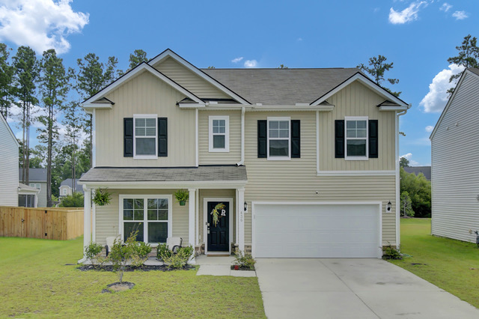
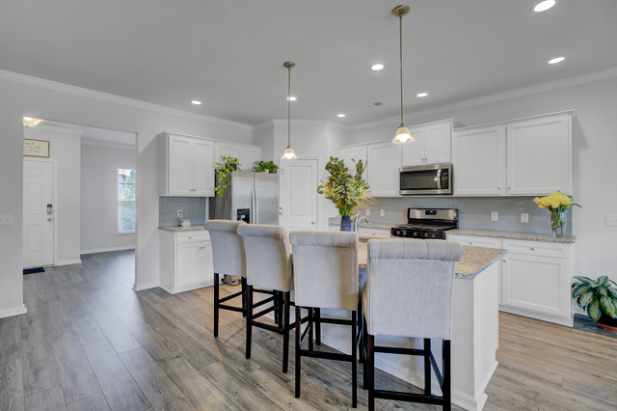
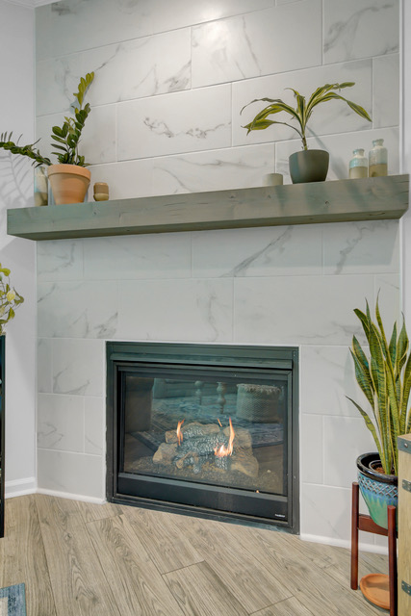
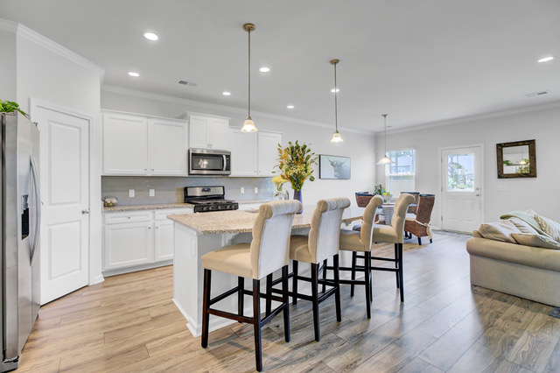
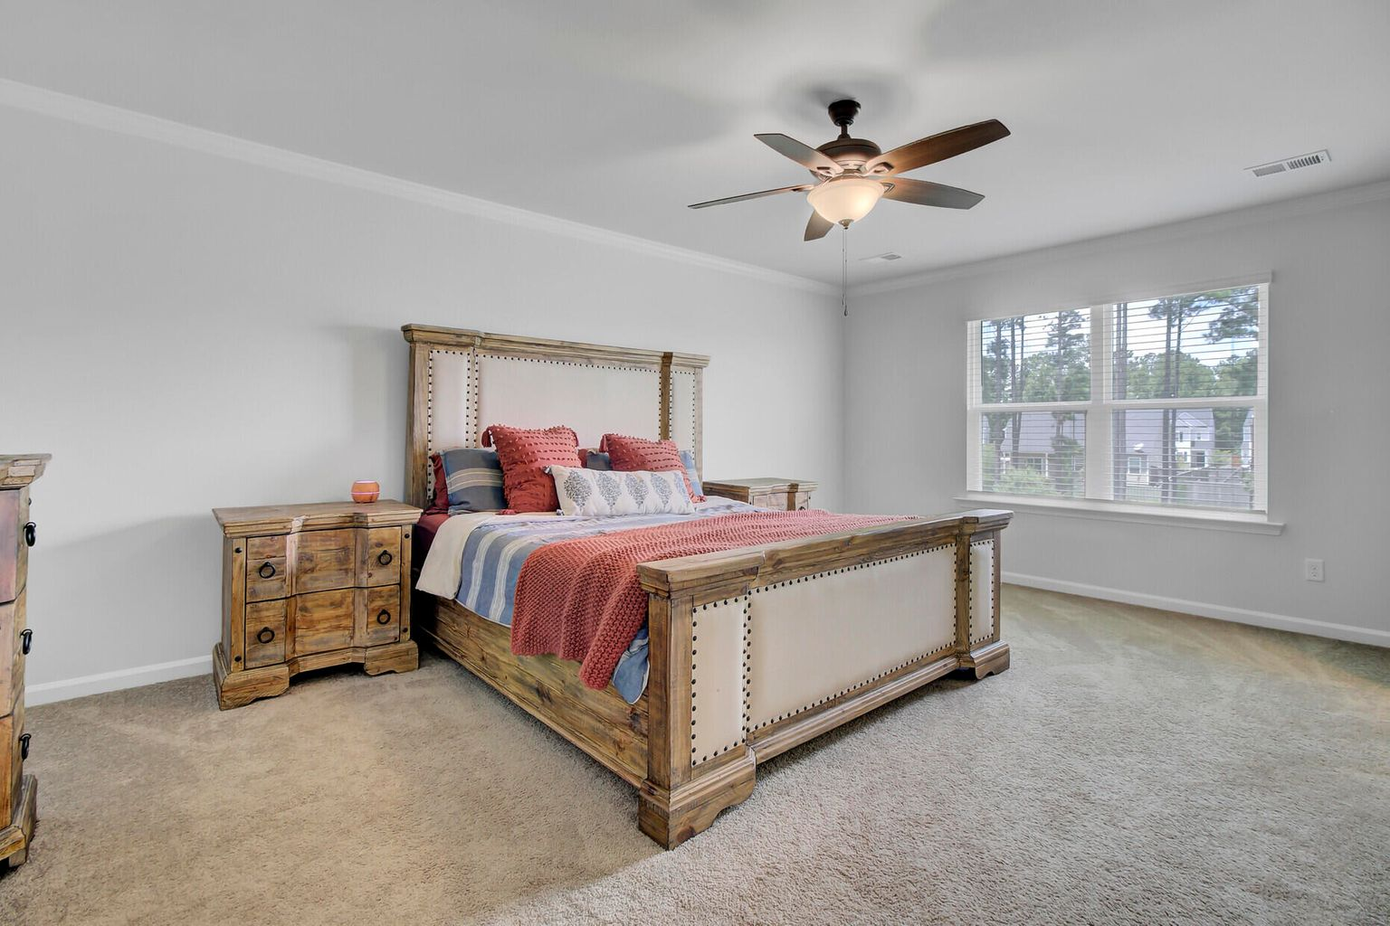
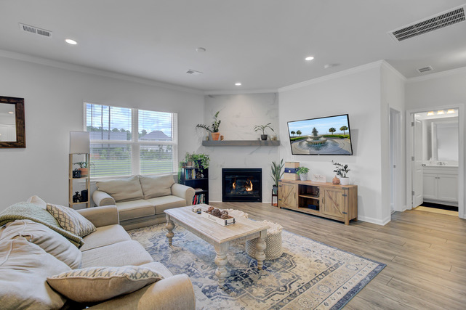
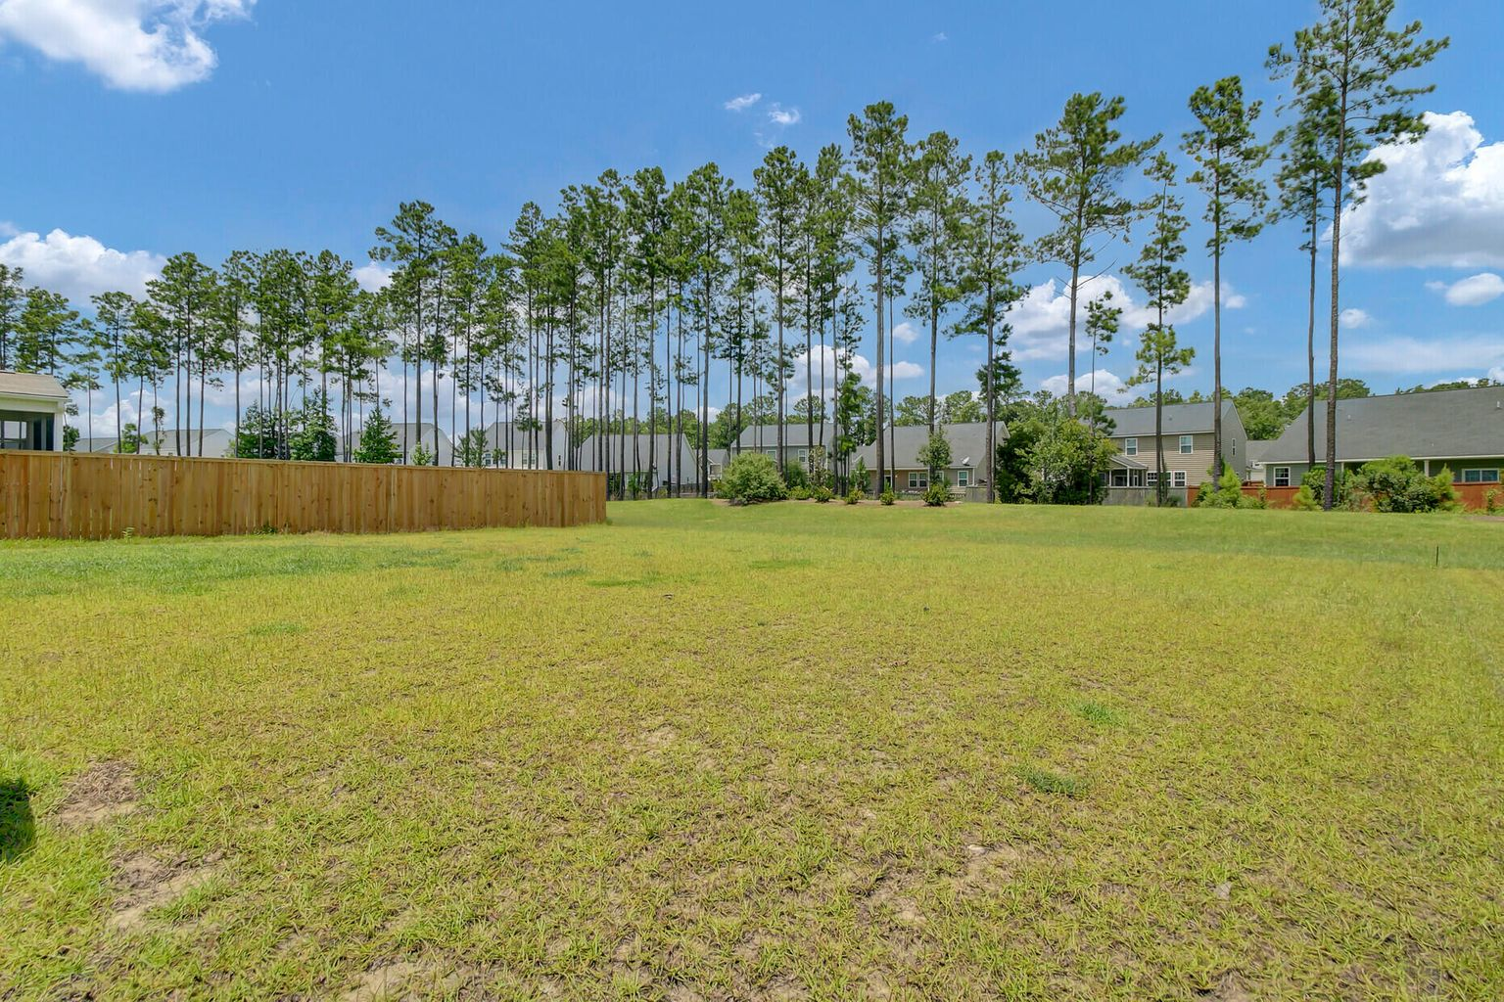


Huge Savings For Your Buyer! 3% Closing Cost Assistance To The Buyer
436 Silent Bluff Drive
Summerville, SC 29486
5 Bedrooms | 3 Baths | 2,640 SF
$434,900
This aggressively priced 5 Bedroom one year old home is now being offered with 3% closing cost assistance to the Buyer! The savings are HUGE if the buyer elects to use a couple points to BUY DOWN their interest rate!
Sample Scenario: A first time home buyer uses Home One Mortgage Program (3% down) and opts to use 2 points to buy down the rate. Savings of $263 per month! $3,156 per year! $94,680 SAVED over the life of the loan!!Similar savings regardless of loan program. Think of how BENEFICIAL this is for first time home buyers, Veterans, or ANYONE financing their next home! Don’t let this opportunity pass you by.
Call me today with any questions about this stunning home or schedule a tour through Showing Time!
Virtual Tour
Ellen O'Neil
Broker/Owner, ABR, e-PRO, CNE
Charleston Realtor of Distinction
(843) 300-8530
www.EllenONeilProperties.com

