Slide 1
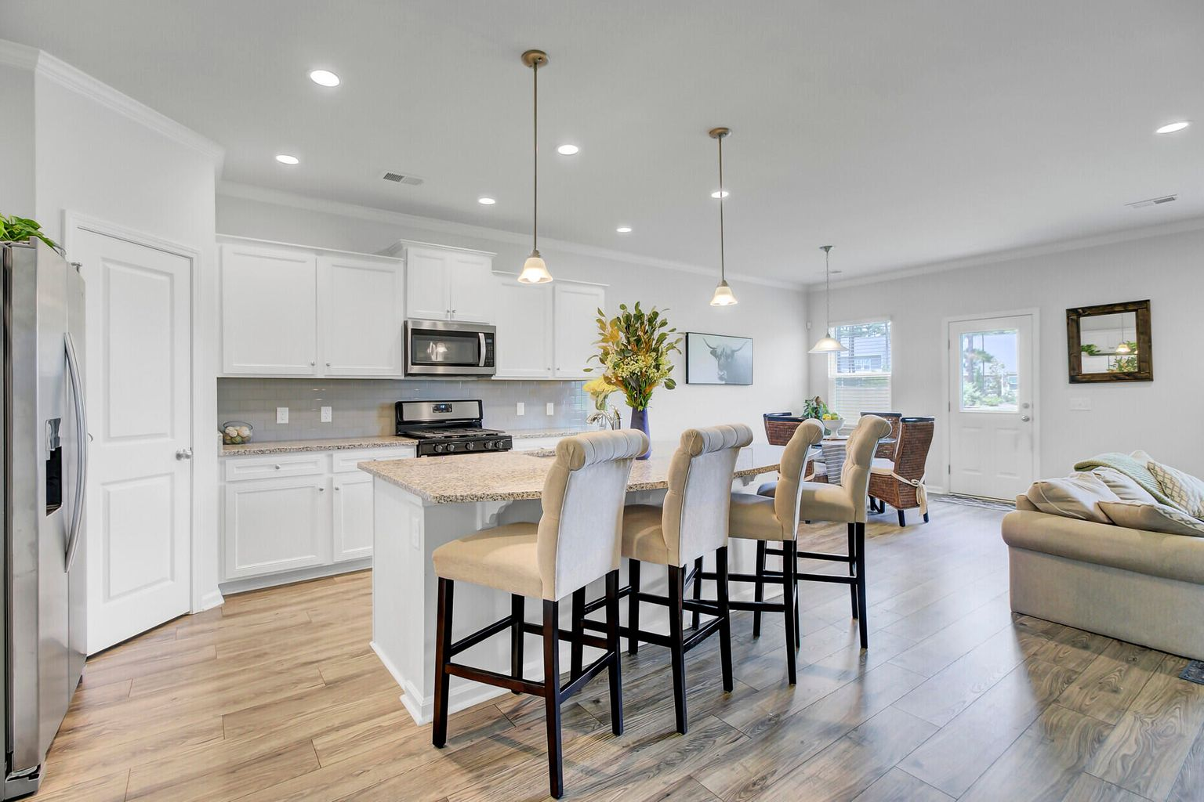
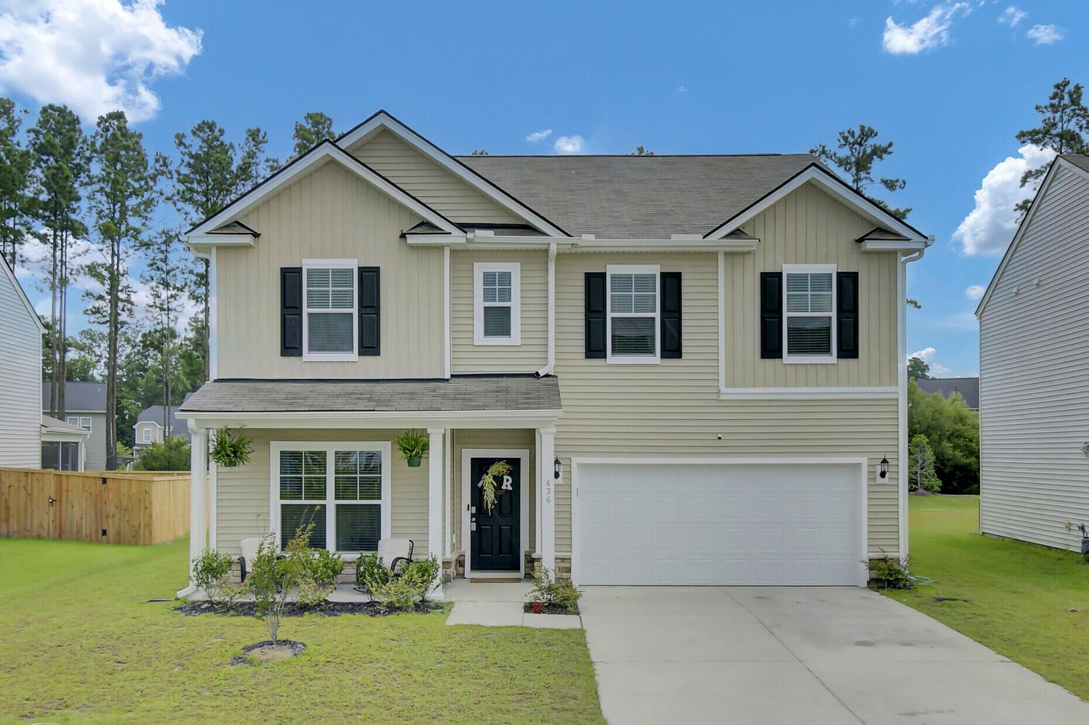
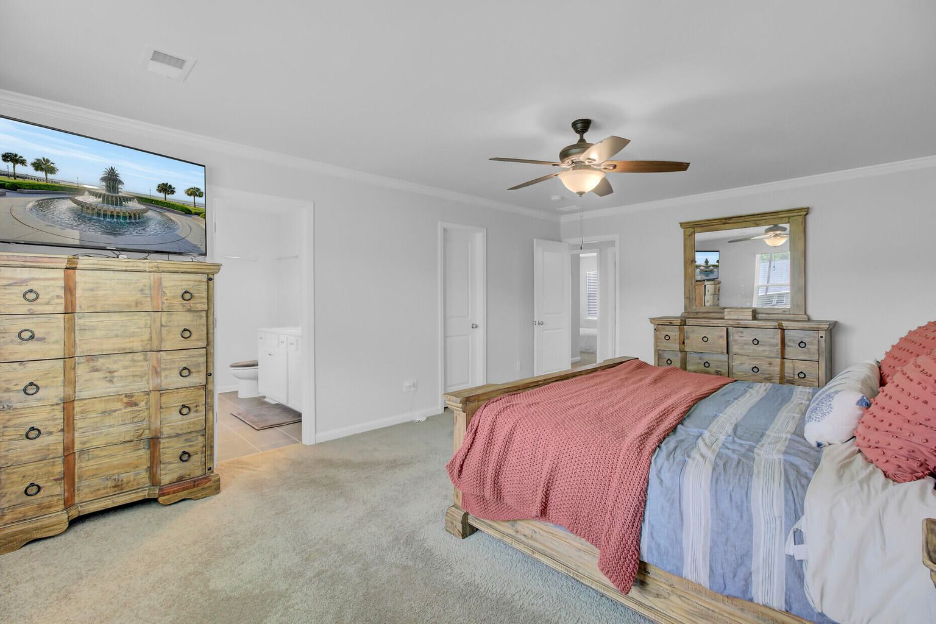
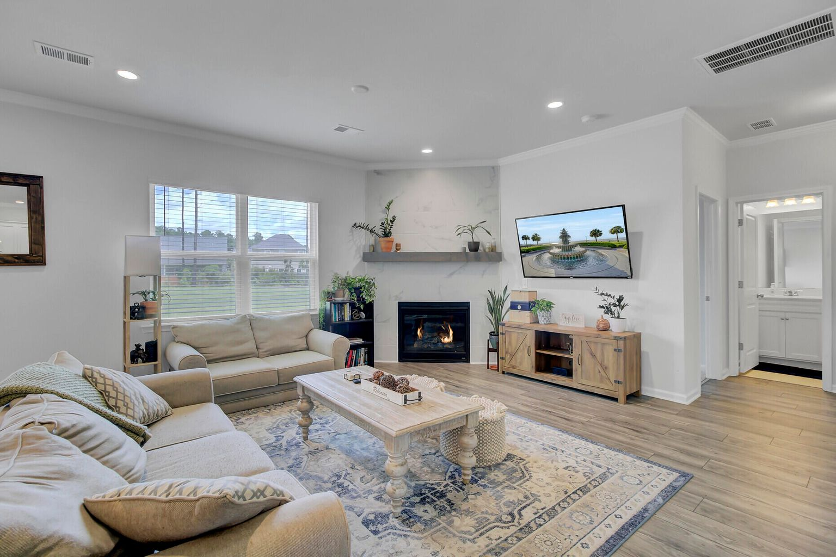
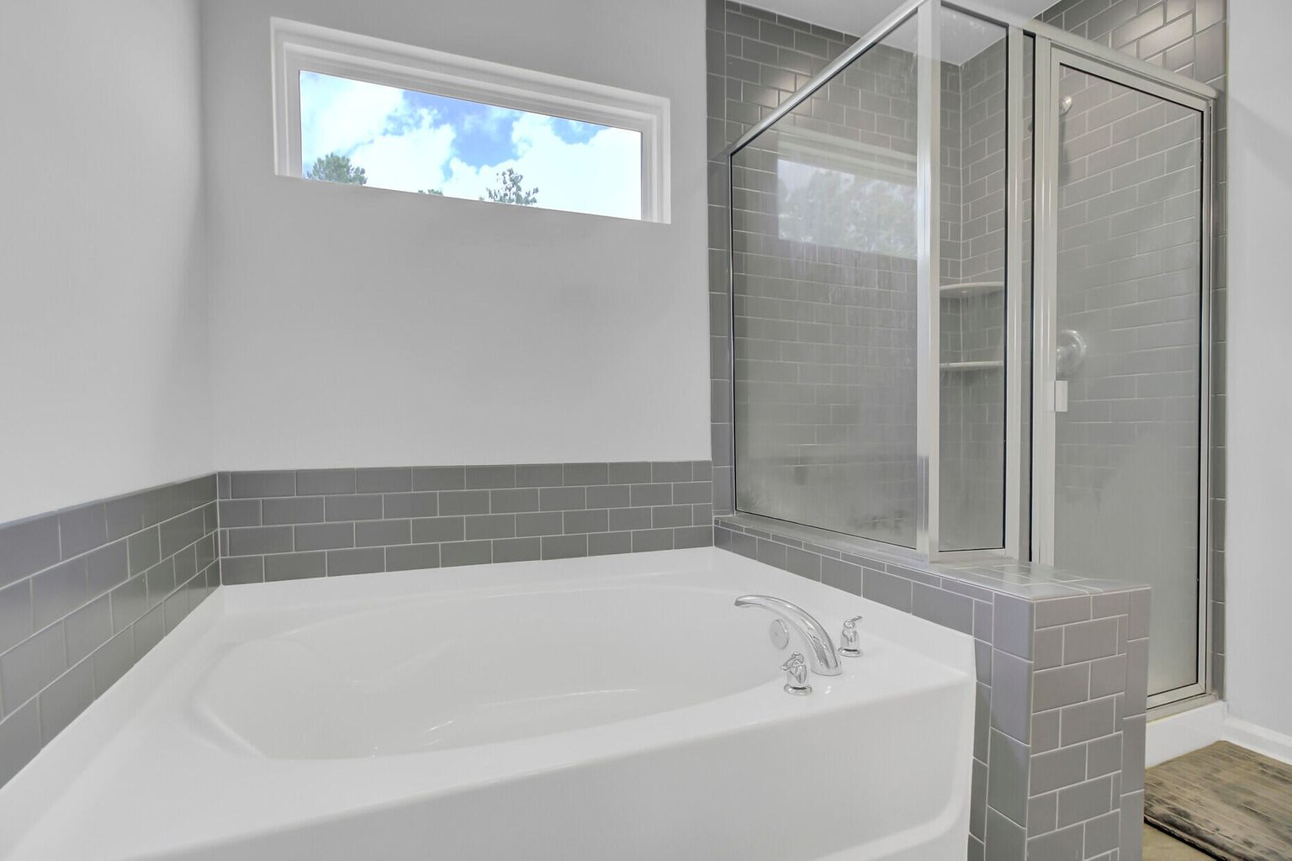
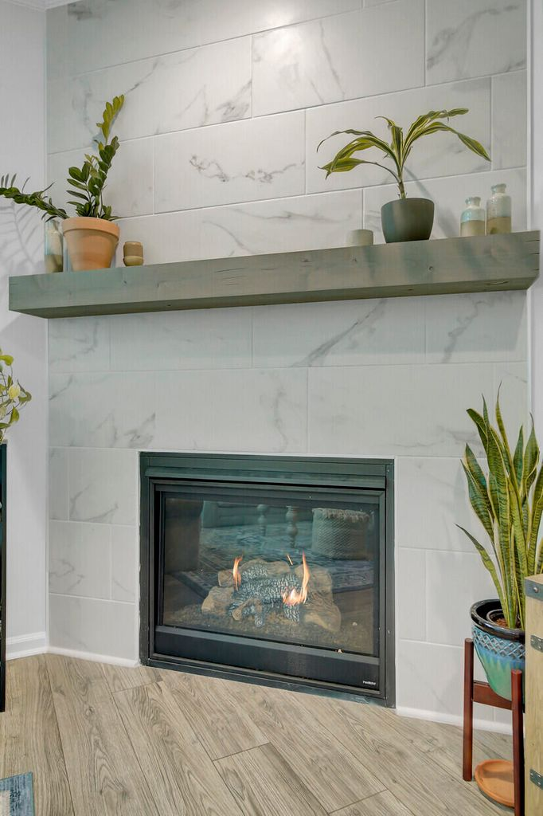
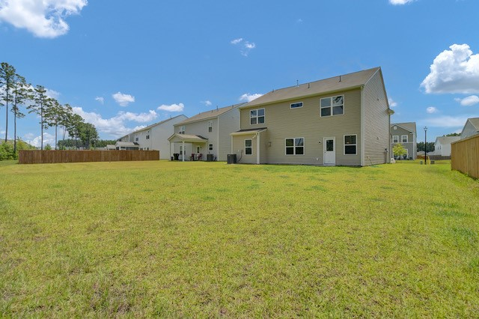


New Listing and Open House | Best Floorplan EVER! Open House Sunday 7/24 from 12-3 pm
436 Silent Bluff Drive
Cane Bay Plantation
Summerville, SC 29486
MLS# 22019441 | $444,900
One year young home with tasteful finishes and numerous upgrades! This is a 5 Bedroom PLUS Bonus Room floor plan with 3 Full Baths. Talk about a house that will adapt ot your changing needs! Whether you need all 5 bedrooms an a second living space, exercise room, home office, or playroom for the kids OR you want the option to have a couple home offices plus 4 bedrooms… the possibilities are ENDLESS!
A bedroom on the main level has a bathroom adjacent- would make a great mother-in-law suite or guest room for those who prefer no stairs. This home has a DREAM KITCHEN with huge center island, granite, tile backsplash and stainless steel appliances. Located near the cul de sac this home has little drive by traffic and a GREAT BIG back yard. Ready for new owners just in time for the start of the new school year!!!
3D Matterport Tour | Video Tour
Ellen O'Neil
Broker/Owner, ABR, e-PRO, CNE
Charleston Realtor of Distinction
(843) 300-8530
www.EllenONeilProperties.com

