Slide 1

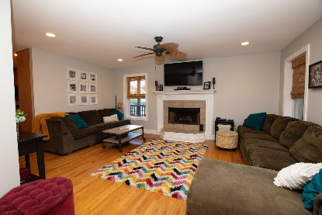
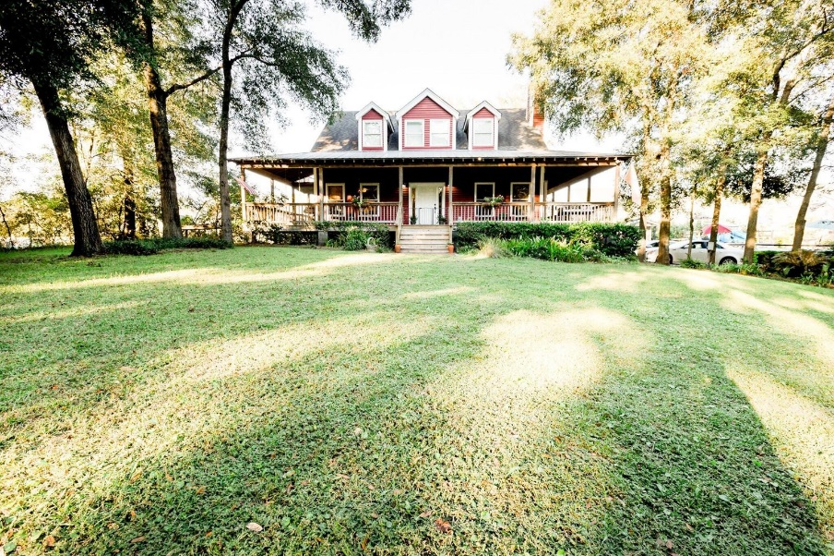
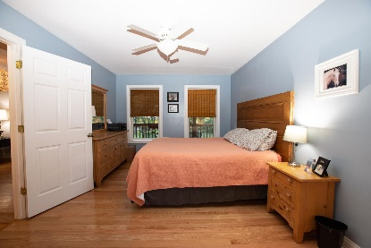
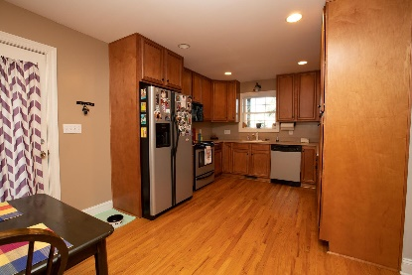
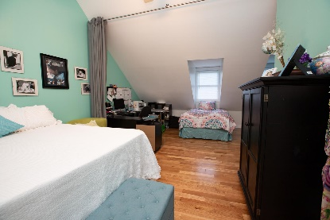
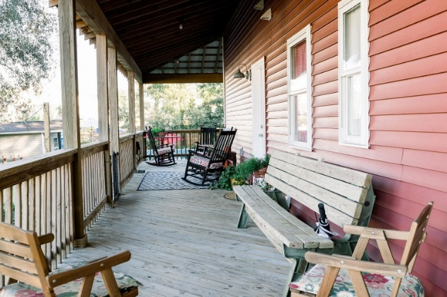
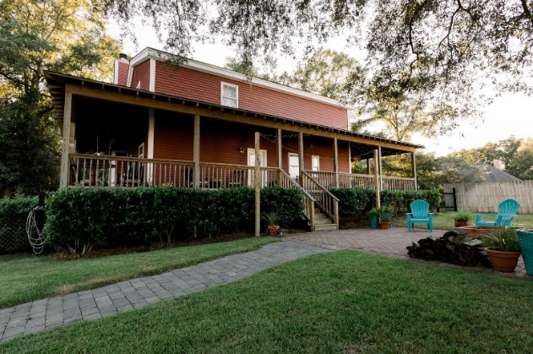
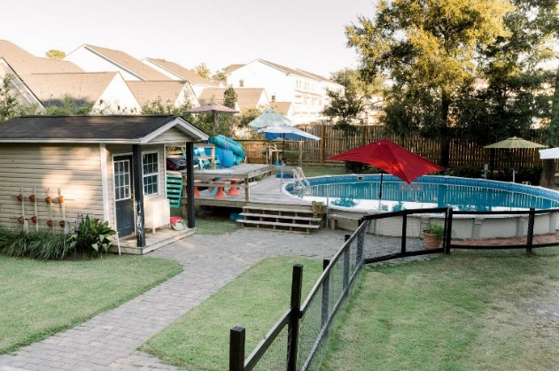

Open House· Saturday, Nov 13th · 1-4
Light Refreshments Provided· Drawing For Two Gas Cards
436 Yellow House Place · Wando· MLS# 21028592 · $599,000
If you're looking for a quiet retreat, this home is for you!
Located off of Clements Ferry Road, just a little over a mile from I-526, this 1-acre property is on a private road with large lots. It is in close proximity to downtown Charleston, Mt. Pleasant, Daniel Island, as well as Sullivans Island and Isle of Palms. The house was built by the current owner in 2006. It has 3 large bedrooms and 2.5 bathrooms. Built with structurally insulated panels which are energy efficient and provide great resistance to hurricanes, it is a must see! This home has been meticulously and lovingly maintained. Some of the many features include: hardwood floors, central vac, separate wells for the house and pool, and an oversized wrap-around porch. The yard has plenty of mature oaks, a large above-ground swimming pool with lots of deck space, and a patio complete with a fire pit.
Don't miss this private getaway!
Atlantic Real Estate Services, LLC
1250 Fairmont Ave
Mt Pleasant, SC 29464
Lisa Barrington
843-814-3674
lbarrington@valbridge.com

