Slide 1
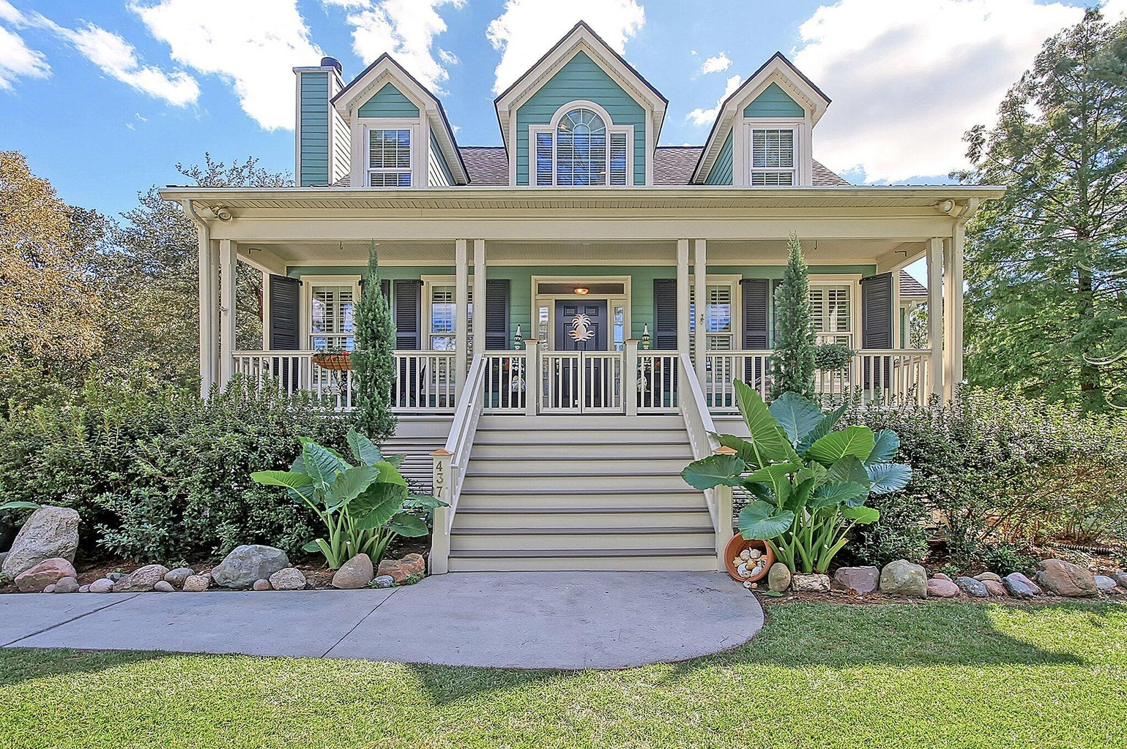
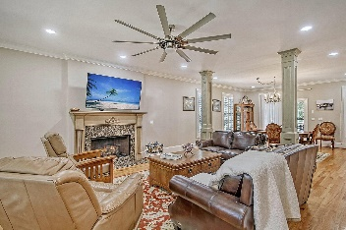
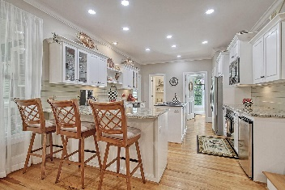
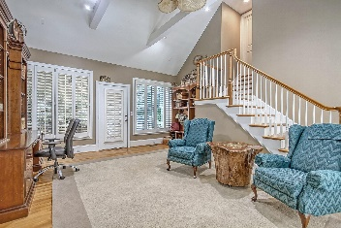
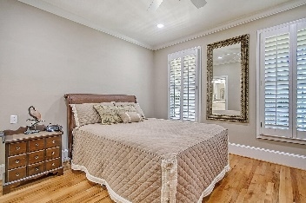
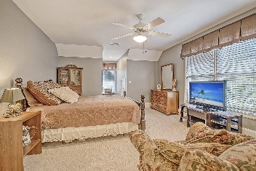
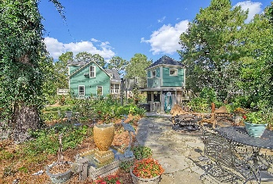
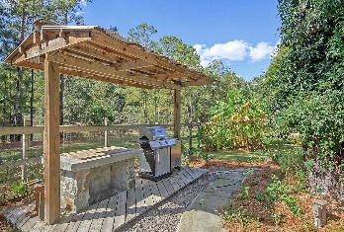
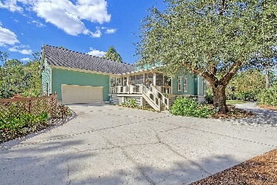

437 Commonwealth Road
Darrell Creek · Mount Pleasant, SC 29466
MLS# 23023861 · $995,000
New Price in Darrell Creek
Show and Sell!
GORGEOUS .59 acre pond lot 4-bedroom, 4-bathroom Lowcountry-style home in the beautiful neighborhood of Darrell Creek is an entertainer's and gardener's dream! Upon entering the home from the delightful full front porch, you are greeted with an open floor plan, red oak hardwood floors, plantation shutters, 9-foot ceilings, and an abundance of natural light. Continuing in is the family room with gas fireplace that is open to the dining room and chef-inspired gourmet kitchen. The kitchen features granite countertops, counter seating, under cabinet lighting, island with a 36'' and a 5 burner Wolf gas cooktop with downdraft ventilation. The open kitchen area is perfect for entertaining family and friends as you can cook and socialize at the same time. Walk out onto the large screened back porch and deck from both the dining area and a separate den/office/flex room with an adjoining fourth bedroom above the garage; this area is ideal for an in-law suite or multi-generation living. The primary bedroom suite is on the main level and features a spa-inspired en-suite bathroom with dual vanity sinks, a stunning tile shower, and an oversized walk-in closet. Two additional spacious bedrooms are located upstairs, each with a private full bathroom, walk-in closet, and access to adjoining attic space. The bedroom on the right features a small nook perfect for a playroom, craft space, or additional storage. At the top of the stairs is an open area that could be used as a reading spot, computer area, or just enough room for a Peloton! The crawl space is acclimated making it great for storage! The private exquisite big fenced-in backyard is a nature lover's delight with multiple flowers, numerous fruit trees, berries, gardening beds, a fire pit, a sitting area, a food prep station, a quaint raised shed, and a flagstone patio to host BBQs! Butterflies, bees, and hummingbirds frequent the garden and are a joy to watch. The driveway is long, and the front yard is lush with a large grass area, beautiful landscaping, and breathtaking oak trees. Darrell Creek has a neighborhood pool, mature landscaping and is just minutes from Mount Pleasant schools, Costco, shopping centers, and a local hospital. This home is a must-see!
Stan Huff
843-670-2835
stan.huff@agentowned.com
Jill Marcacci
843-297-5590
jill@agentowned.com
www.agentownedrealty.com
AgentOwned Realty Co. Preferred Group, Inc. | 824 Johnnie Dodds Blvd | Mt Pleasant, SC 29464

