Slide 1
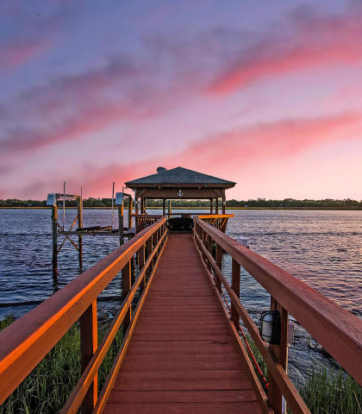
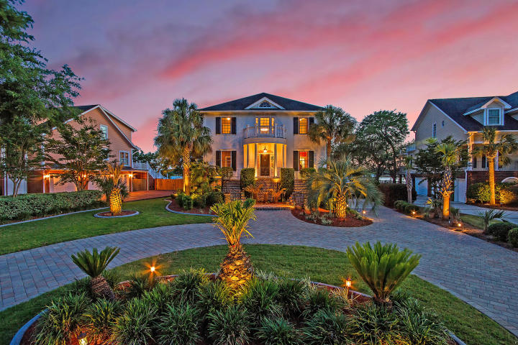
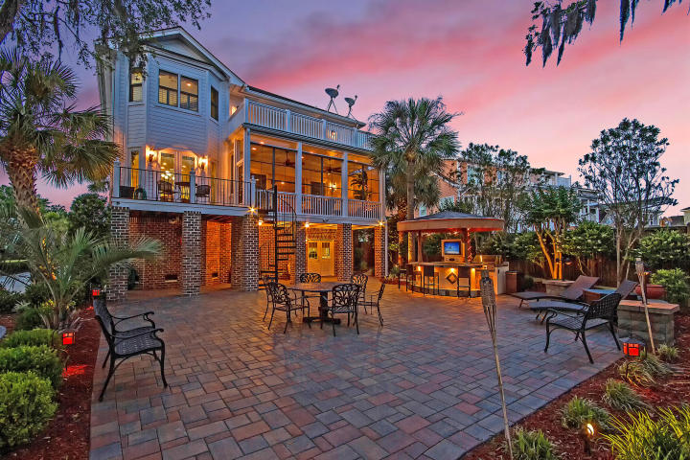
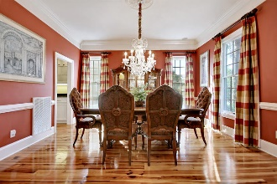
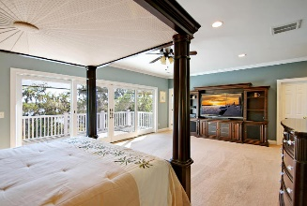
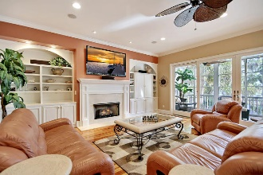

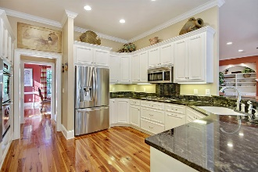
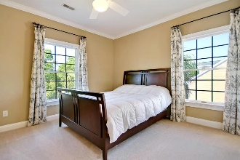
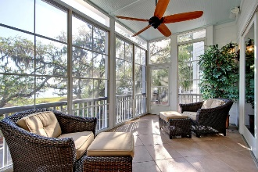
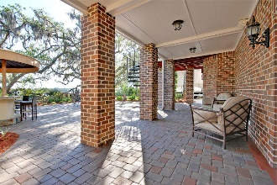
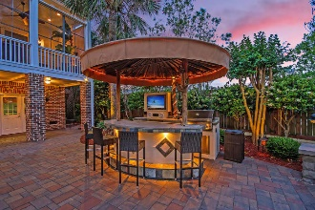
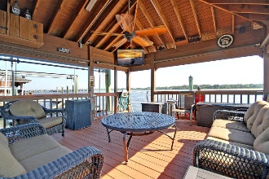
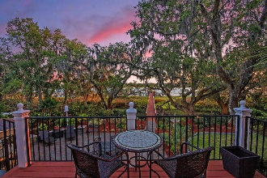

Ashley River DEEP WATER
in Private Gated Community
$25,000 Price Reduction!
4385 Stoney Poynt Court
Plantation Isle ~ North Charleston, SC 29405 ~ MLS# 19001823 ~ $1,399,900
Discover this DEEP WATER paradise in exclusive, gated Plantation Isle. Built for entertaining & low country relaxation, this home feat. an impeccably-maintained dock, boat lift, floating dock, & large covered pier head w/ a TV hookup, fridge, etc.; stunning vistas & outdoor space; a cabana bar/grill; exquisite low-maintenance landscaping; shady paths through enchanting live oaks, & a private brick paver patio. Immaculately-kept, this home gives new meaning to "move-in ready" & boasts 4 BRs w/ ensuite BAs, a 3-stop elevator, granite counters, SS appliances, gas cooking, tons of built-ins, high-quality molding, & gorgeous heart pine flooring. Once welcomed by its circular brick paver driveway & grand brick staircases, this home & outdoor oasis will captivate & you'll never want to leave!
Additional details include:
True deep water property with a depth of 10 feet at low tide and 16 feet at high tide.
Main floor boasts a 2-story foyer, 10-ft. ceilings, a bedroom suite with built-in cabinets, a powder room, elevator access, a large formal dining room that walks through to the butler's pantry and then into the kitchen and eat-in area, a great room with a fireplace and wet bar, a screened-in porch/sunroom, and a deck overlooking the backyard and the water.
Elevator access on each of the three floors.
Built-in stereo and alarm system.
Cabana/outdoor covered bar and grill area features a T.V. hookup, speakers, a BBQ grill, a fridge, and bar seating.
Backyard features exquisite landscaping, custom landscape lighting, privacy fencing, outdoor storage space, amazing live oak trees, brick paver patio and walkways, a cabana with a bar/grille area, and access to the deep water dock.
Deep water dock has been meticulously-maintained and recently-resurfaced. It features a dock, a boat lift, a gangway, a floating dock, and a large covered pier head with a T.V. hookup, mini fridge, dual sinks, and storage -- the perfect place for watching your favorite sports teams or relaxing with friends and family.
Incredibly clean, painted 3-car garage offers epoxy-coated floors, elevator access, workout/exercise/flex space, a separate workshop room (not included in square footage), and a large room with a bar area and access to the paver patio (also not included in square footage), which is currently used as an office, but would make a great game room or man cave.
Circular brick paver driveway and side parking pad offer ample space for guest parking or boat storage.
Julie Nims julie@mattoneillteam.com 843-580-6310

