Slide 1
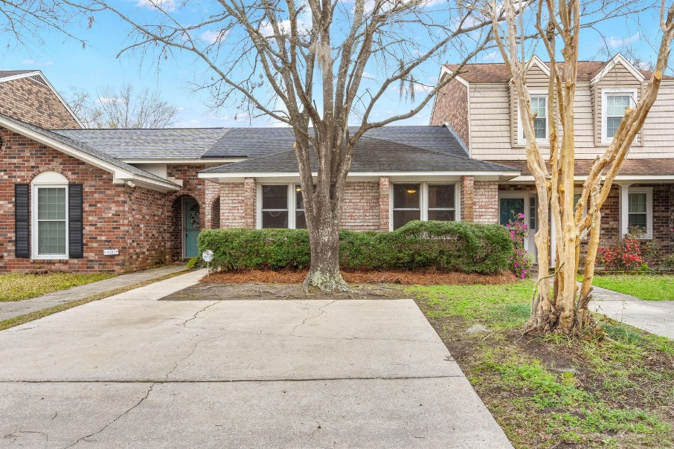
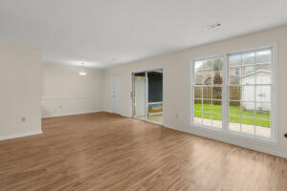
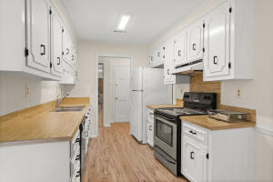
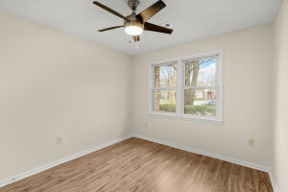
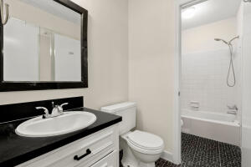
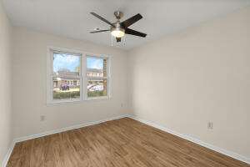
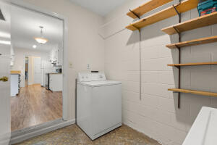
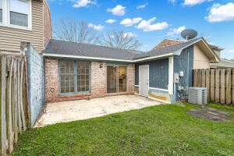
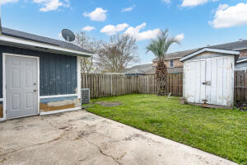



Charming Townhome for $200,000
4398 Purdue Drive Ashley Villas
North Charleston, SC 29418
MLS# 22007032
$200,000
2 Bed | 1½ Bath | 1,051 sf
Welcome home! Renovated townhome in the Ashley Villas neighborhood. All new laminate wood flooring, fresh paint throughout, new baseboards, new fixtures, newer hot water heater, new landscaped front yard, all kitchen appliances included, shed in the back of the yard does convey with the sale and much more! You'll truly love what this townhome has to offer. It's a very nice layout featuring 2 bedrooms and 1.5 bathrooms with a Jack and Jill type setup. Enjoy the outdoor patio area with a privacy fence, perfect for outdoor hosting and relaxing! Perfect short term rental (STR) as there are no rental restrictions in this neighborhood! There's no regime fee for the neighborhood, but only a $100 PER YEAR HOA fee!
Located close to Tanger Outlets, Charleston Airport, Boeing, the Air force base, I-526 and plenty of restaurants, shopping, etc! Come see this charming home!
Nick Mazzilli (843) 640-5575
nick@nickmcharleston.com www.mavenrealtysc.com
Maven Realty
2180 McMillan Ave
#71672
Charleston, SC 29405

