Slide 1
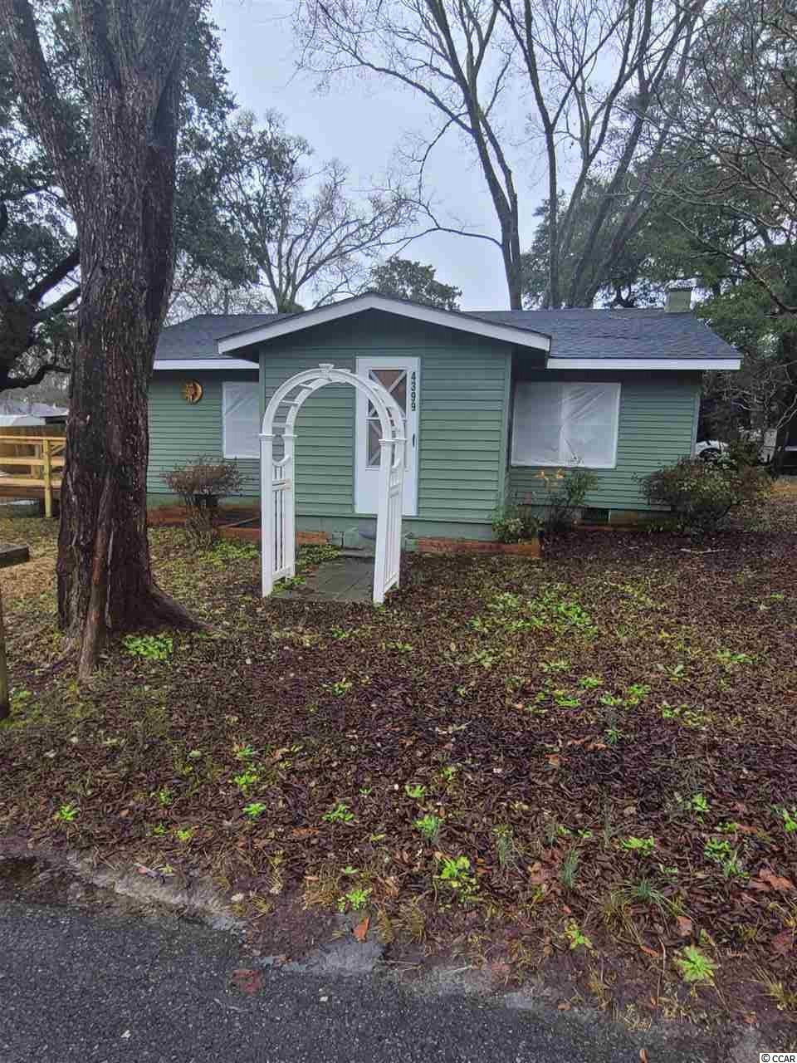
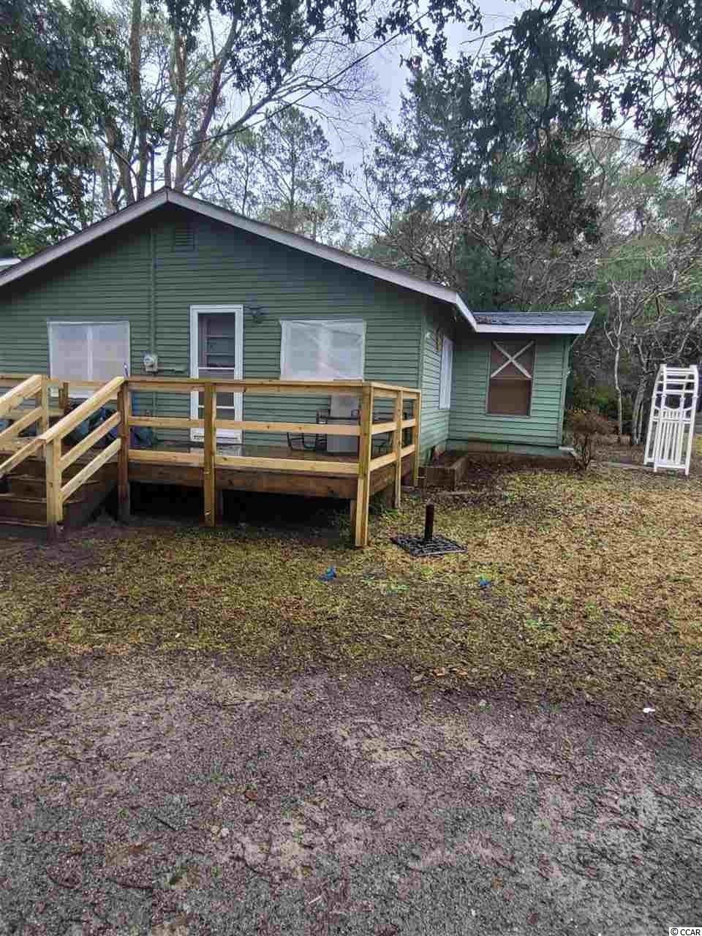


Walkable To The Casino Boats, Great Restaurants, The Historic District, And The Riverfront/Intracoastal Waterway Where Development Is Expected Soon
4399 McCorsley Ave
Little River, SC 29566
MLS# 2103496
$199,900
2 Beds | 1 Bath | 7,405 sf lot
This attractive 2 bedroom/1 bath, with additional four-season room (from the side entrance and just off the living area), residential home is located near many businesses and is in the desirable Hamlet of Little River, Horry County's second oldest town, which is renown for its proximity to the Atlantic Ocean via the ICW and rich nautical history including being a notorious, popular pirate port. For boaters, there are several marinas nearby to buy or to rent boat slips. For golfers, there are numerous signature golf courses, plus restaurants, antique and thrift trails, recreation, shopping, access to major highways and medical services, and good schools and parks. It adjoins North Myrtle Beach, which was recently named one of the safest cities in the nation and with one of the best beaches in the U.S., the nearby Cherry Grove Beach, minutes away. However, taxes are levied at low Horry County rates. View this inviting, well-priced, charming property of nearly 1/5th-acre, for a personal residence, rental or with potential for investment. It is located near the casino boats, great restaurants, the historic district with its magnificent live oaks and the riverfront/Intracoastal Waterway where development is expected soon and may include a fishing-village-inspired concept as well as a marina. This is a spacious corner lot with a coveted detached one-car garage with plenty of room for storage and a workbench, 432 sq. ft.. The yard features signature indigenous trees, nice seclusion in the front, fencing from neighbors to the north and a firepit off a nice, newer rear deck. It is cottagy and has many unique interior and exterior features also, therefore, such as porches, one enclosed as that four-season room which could be a sunroom, office or day-bedroom; arbor; and rustic appeal. There is a brick planter, for instance, that goes partially around the home for a decorative garden. Bedrooms are spacious, have closets; and there is a larger jack 'n jill bath which is modernized with a walk-in shower, new vanity, light fixture and mirror -- quite appealing. Entrance is from the rear or the side porch. The main living area is open and the great, dining area adjoins the roomy kitchen. All appliances convey. The floorplan is workable and is homey, with wall heaters and air conditioners/dehumidifier, and an elecric fireplace; however, a wood-burning fireplace is presumed workable but closed off behind the new electric one. The whole interior boasts an industrial/retro fun and very livable atmosphere...See today. Properties in this location and with numerous options at such a compelling price are rare!
Deborah Collins
843-424-9013
dctidewater@yahoo.com
Connie Ross-Karl
702-306-2643
conniesross@aol.com
NEW WAY PROPERTIES MYRTLE BEACH

