Slide 1
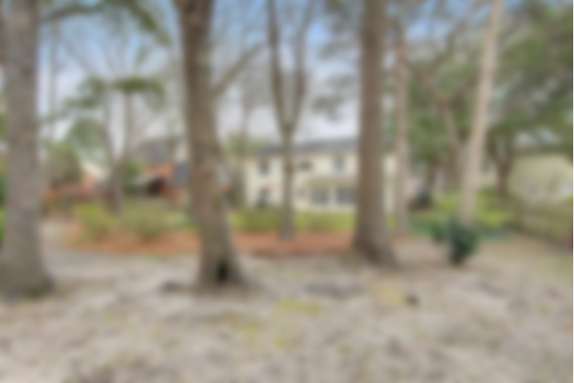
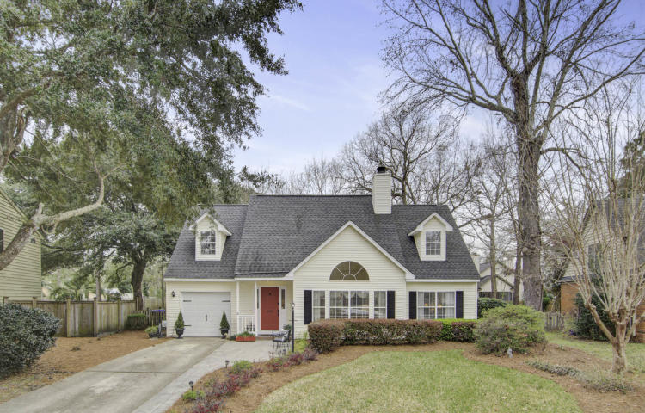
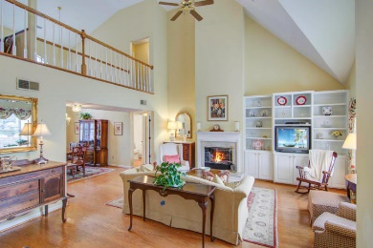
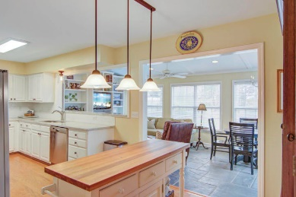
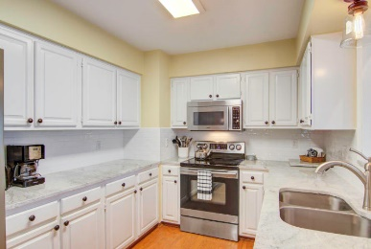
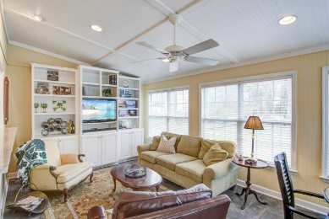
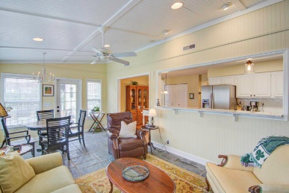
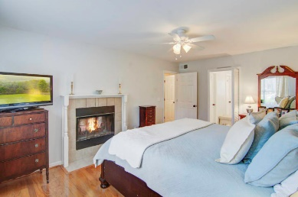
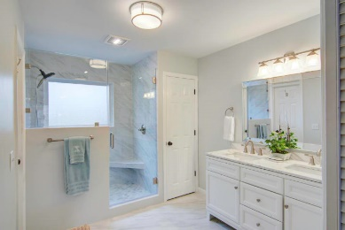
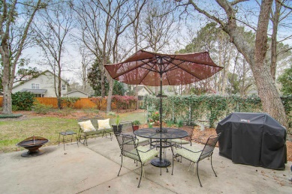


$2000 Agent Bonus & $2500 Buyer Credit*
439 Springfield Road
Longpoint ~ Mount Pleasant, SC 29464 ~ MLS# 19005882 ~ $494,500
Nicely updated four bedroom home with downstairs master featuring a new en-suite bath with walk-in shower and double vanity. Nicely updated kitchen with granite counters, subway tile, newer appliances, new fixtures and lighting. This home lives large with a nice great room with wood floors, vaulted ceilings and a double sided fireplace (master BR shares other side) . A sunny den has been added and is open to the kitchen. Upstairs you will find new wood flooring in the loft and hallway, a second bath and three nice bedrooms with brand new carpet. A termite bond, all appliances and window treatments convey. Longpoint has a junior Olympic neighborhood pool, 2 tennis courts, playground and soccer field. Palmetto Island County Park and Splash Zone are also just a few blocks away!
*Agent Bonus Is Contingent Upon A Ratified Contract By April 7th
Lori Claussen loric@nvrealtygroup.com | (843) 224-8506
NV Realty Group | 91 Broad St, Ste A | Charleston, SC 29401
www.LoriClaussen.NVRealtyGroup.com

