Slide 1
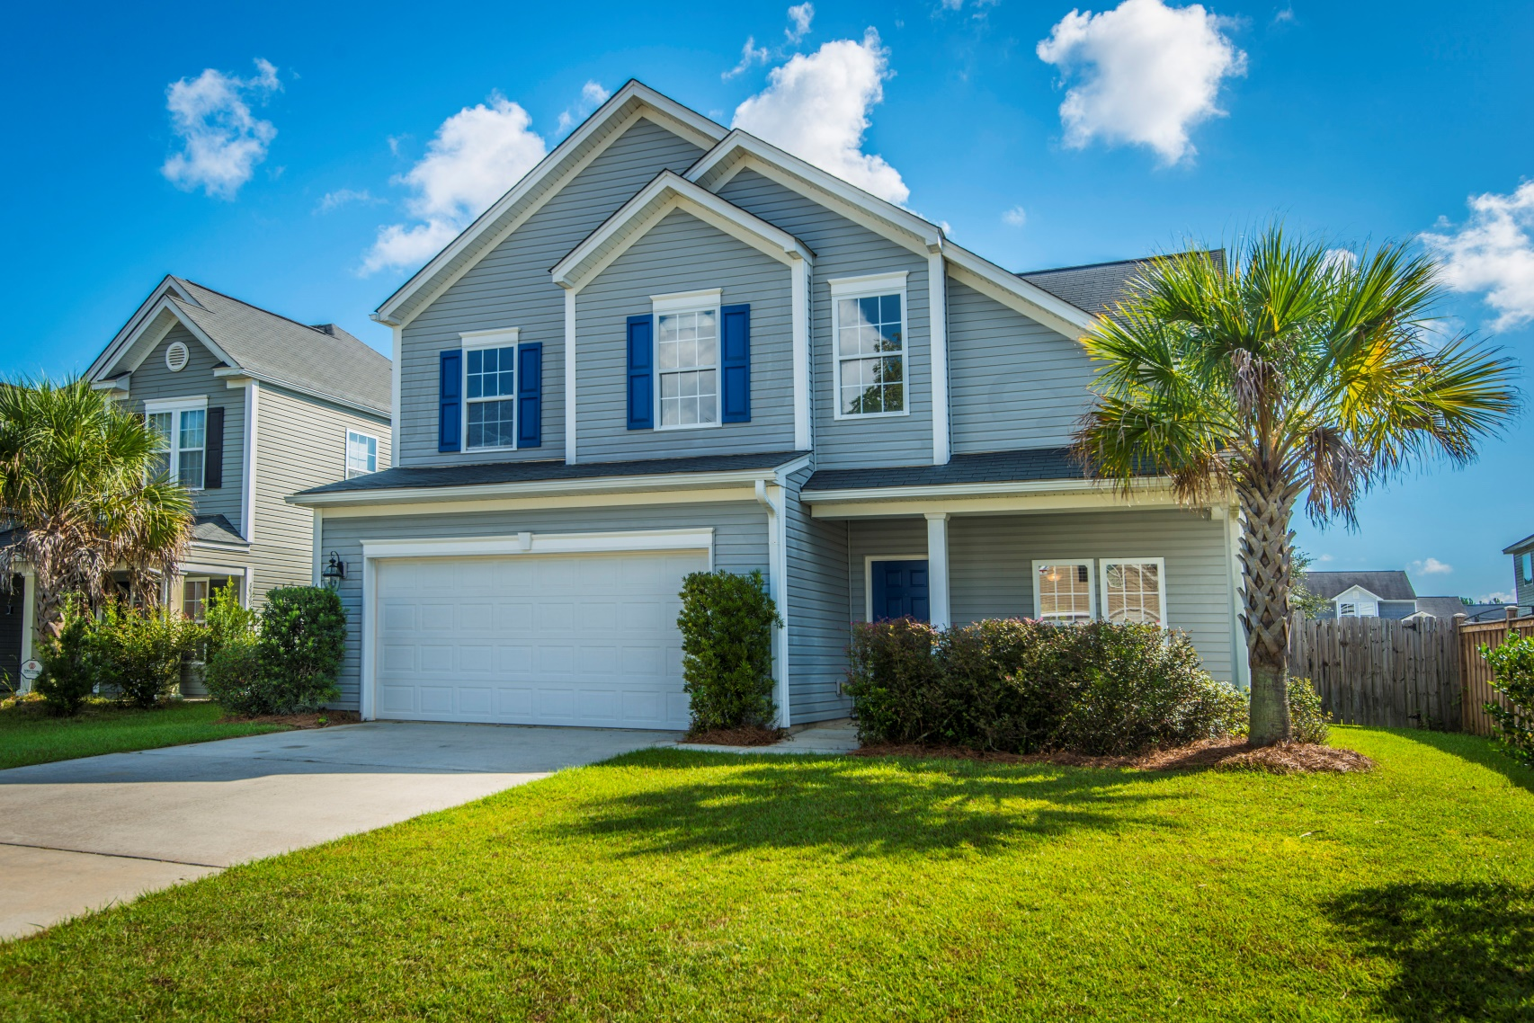
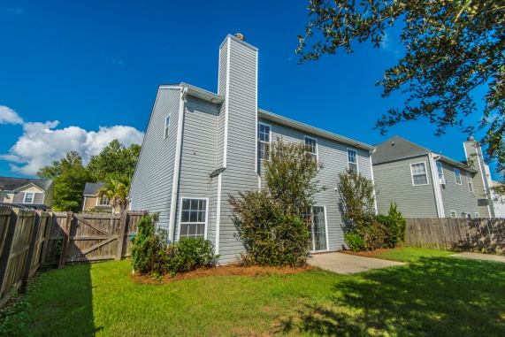
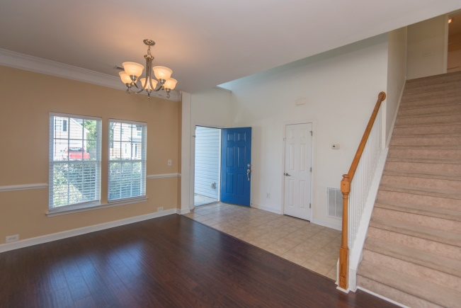
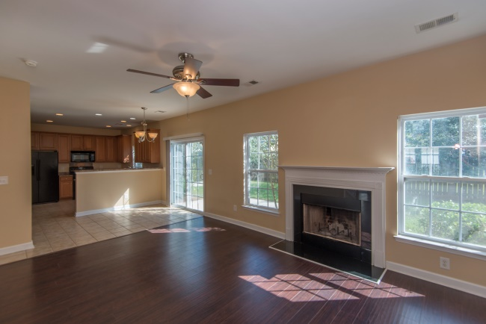
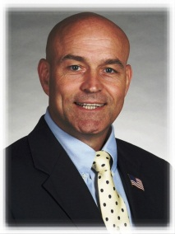

439 Stoney Field Dr
Moncks Corner, SC 29461
Low $200s
BACK ON MARKET due to financing fall-
through. Aggressive price for this HOT property!
4 BR, 2.5 BA
1856 SF
A great home, great price, great location…move-in ready.
Hand-scraped laminate flooring & ceramic tile in main living spaces
Fresh carpet upstairs
42 inch maple cabinets
Two-car garage w extra 240V outlets
Move-in ready, includes fridge
STEVE ROWE
,Realtor®
Retired Military. Active Agent.
(843) 303-7438
srowe@carolinaone.com
www.SteveRoweHomes.com

