Slide 1
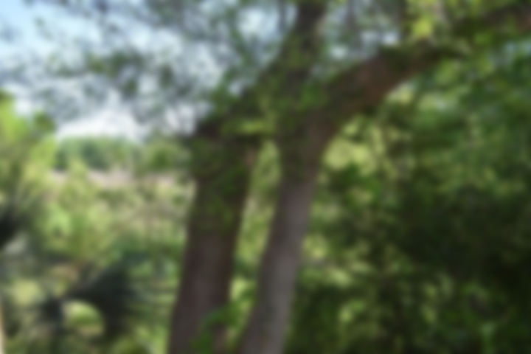
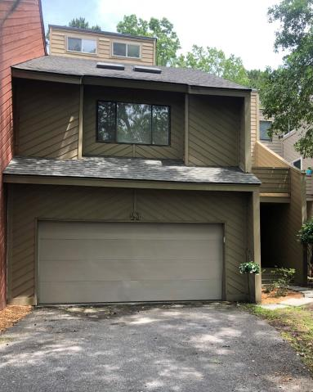
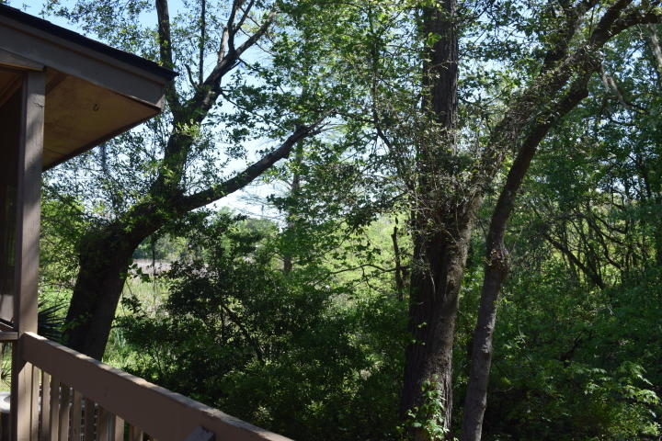
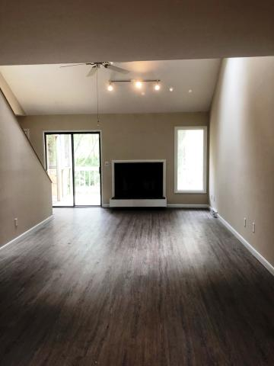
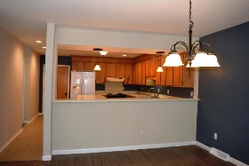
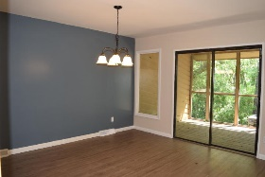
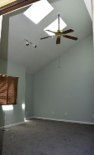
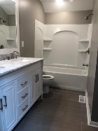
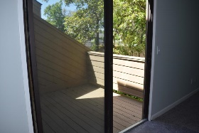
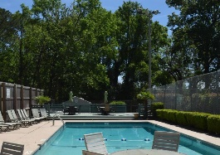


Buyers Agent Bonus Offered
PLUS 1-Year AHS Warranty
43 Arabian Drive
Marsh Cove • Charleston, SC 29407 • MLS# 19010651 • $293,000
Move in ready! This townhome is located in a convenient secluded quiet neighborhood. Many updates have been completed. New roof, newly painted interior, all 3 bathrooms have been updated, new carpet upstairs, new flooring downstairs. Large great room with vaulted ceiling, has wood burning fireplace, skylights that add a lot of natural light and sliding glass doors leading to deck and screened in porch. Kitchen has lots of cabinets for storage and an island for added counter and storage space. Plus a breakfast bar that opens up to the dining room. The master bedroom has a private balcony, large walk in closet and skylights. Master bath has dual vanity with granite countertops. The loft is an added bonus area you can use as office or extra living area. This home backs up to the marsh and woods so you can relax and enjoy the privacy on the screened in porch or deck. Community amenities include swimming pool, tennis court and club house. Conveniently located near I-526, I-26, dining, shopping, hospital and airport. The information herein is furnished to the best of the Listing Agent's knowledge. All information herewith is subject to verification by the purchaser and their agent. Listing Agent assumes no responsibility for correctness thereof, nor warrant the accuracy of the information or the condition of the property. If square footage is important - measure! Buyer to verify schools and any and all information deemed important.*
Christina Garvin
(843) 270-7667 | cgarvin63@gmail.com
Elaine Brabham and Associates, LLC • 1890 Sam Rittenberg Boulevard, Suite 217 • Charleston, SC 29407

