Slide 1
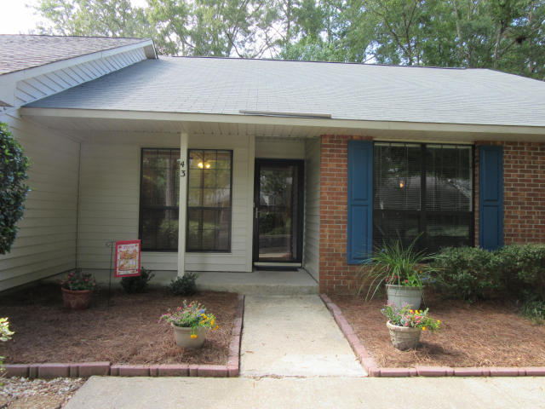
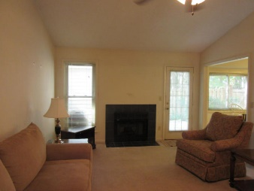
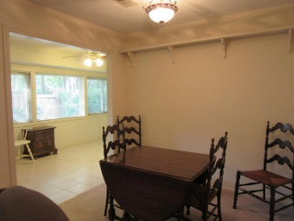
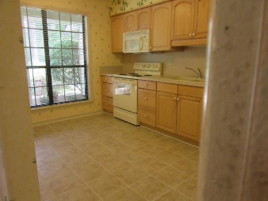
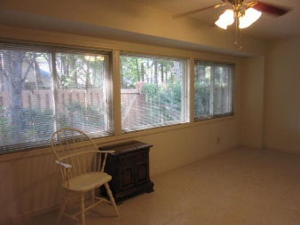
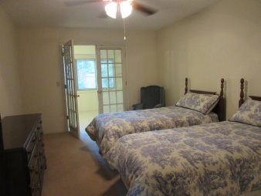
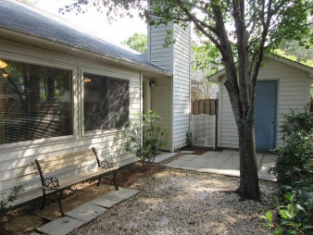
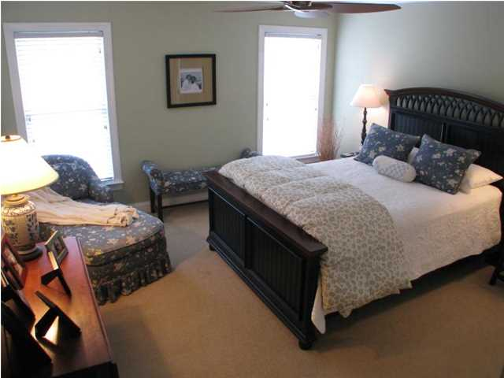
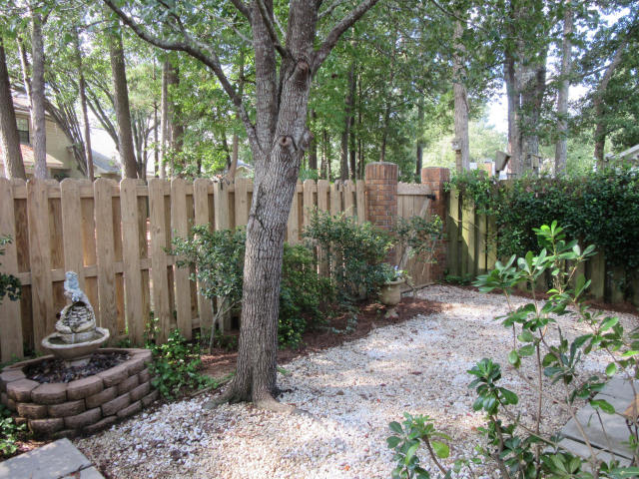
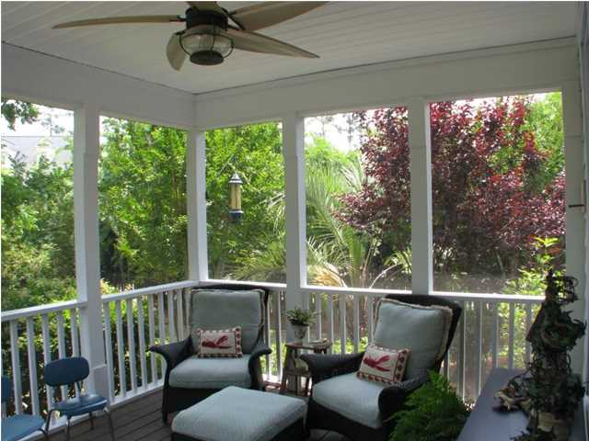


43 Indigo Lane
Crowfield Plantation
Goose Creek, SC 29445
MLS# 15021509
$125,000
2 Bedrooms | 2 Baths | 1,220 sf
2 bedroom, 2 bath townhouse in Crowfield Plantation. Ready to Move in!
Single story, open floor plan with eat-in kitchen, microwave, refrigerator, Porcelain tile in entrance, hallway, and kitchen. Separate dining room, fireplace, new plumbing, A/C less than one year old, new shingles, beautiful sun room, with a wall of windows, and ceramic tile.
French doors to master bedroom, pleasant patio with privacy fence and storage shed, loads of attic storage. Immaculate and completely ready to move in.
The Townes At Planters Walk
Debbie Toombs
843-345-7895
debbie.toombs@cbunited.com
www.cbunited.com

