Slide 1
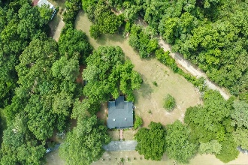
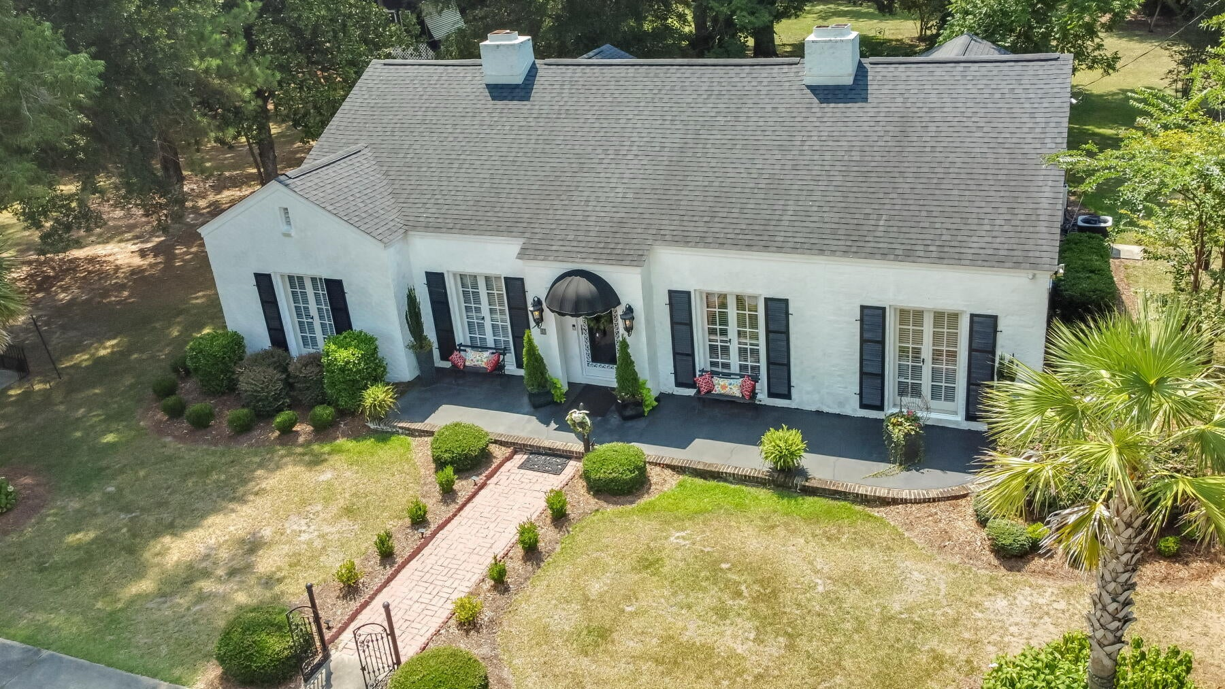
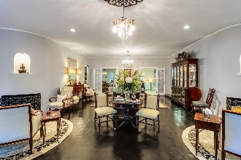
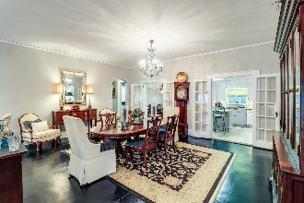
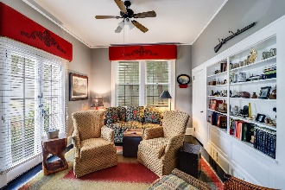
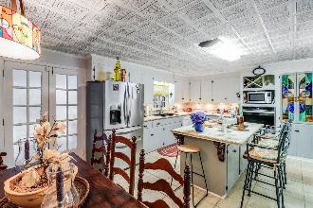
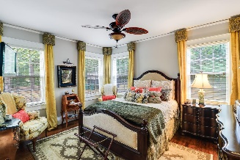
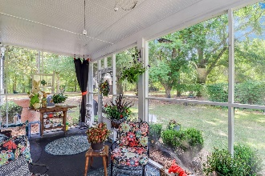
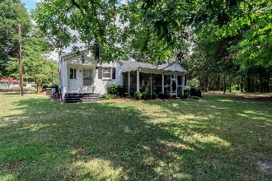
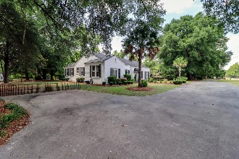


43 S Church Street
Summerton, SC 29148
MLS# 24017704 | $425,000
1938 Brick Ranch on 3 + Acres Near Lake Marion!
Open House
Wednesday, 7/20
3-5PM
Step into timeless elegance with this charming and unique white brick ranch home, that has a rich history dating back to 1938. Situated on a generous 3.30-acre lot, this picturesque property offers a serene sanctuary surrounded by mature landscaping and meticulously cared-for grounds, setting the scene for a lifestyle of sophistication and tranquility. Upon arrival, you are greeted by the inviting entry that leads you into the heart of the home, the great room. Here, the ambiance comes alive with the warmth of two fireplaces, distinctive curved walls, and a spacious living area that seamlessly transitions into a large dining space, perfect for hosting gatherings, and dinner parties with loved ones. This home has charm at every turn, with attention to detail evident in the door hardware, built-ins, and architectural features that grace the interior. Discover a versatile bedroom, ideal for use as a den or media room, offering a cozy retreat for relaxation. Continuing through the great room, two sets of glass French doors open to reveal a kitchen. Unique touches such as stained glass insets, wood cabinets, a decorative tin ceiling, tile countertops, and a large island create a culinary haven, while an eat-in area and a window overlooking the backyard infuse the space with natural light.
Step outside through the patio door to the wonderful screened porch, providing the ideal spot to enjoy the outdoors while being sheltered from the elements. The home features a thoughtful split-bedroom floor plan, with the master suite offering a private oasis on one side. The master bedroom exudes luxury with a cozy fireplace, a remarkable walk-in closet complete with a ladder for easy access, and a spa-like en-suite bathroom featuring a large soaking tub and a tiled walk-in shower.
Completing this homes layout, two generously sized bedrooms on the opposite side of the home share a full bathroom with a tub-shower combo, ensuring comfort and convenience for all family and guests. With a laundry room equipped with a sink and ample storage just steps away from the master suite, the flow of this home is as practical as it is luxurious. Indulge in a lifestyle of refined comfort and sophistication in this charming white brick ranch residence, where every detail speaks to a timeless elegance that transcends generations. Located just 15 minutes from Lake Marion and just over an hour from Charleston and Columbia! Schedule your exclusive showing TODAY!
VIDEO TOUR | VIRTUAL TOUR
Brandon Ray
(843) 499-1928
brandon.ray@carolinaone.com
www.lakelifescstyle.com
Carolina One Real Estate
900 N Main St
Summerville, SC 29483

