Slide 1
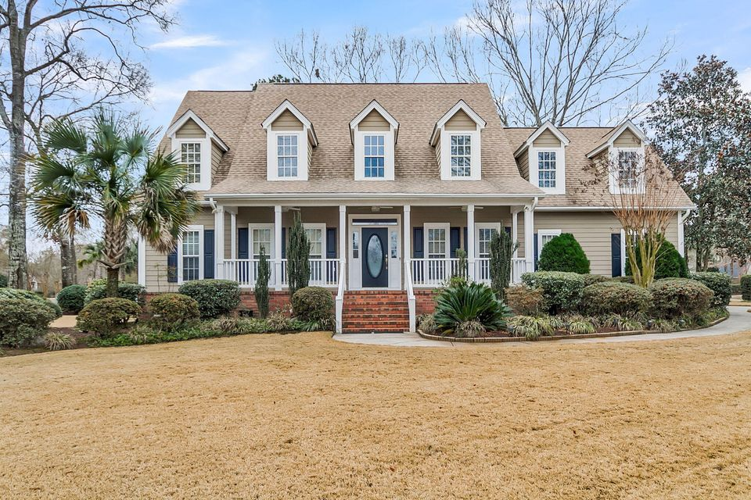
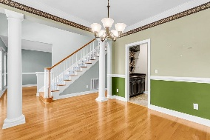
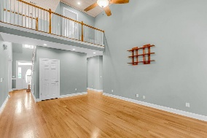
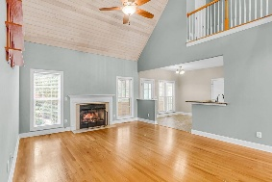
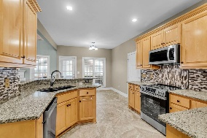
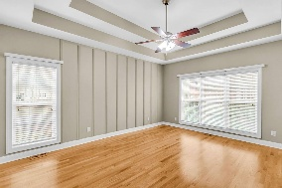
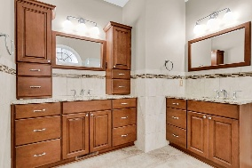
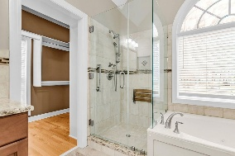
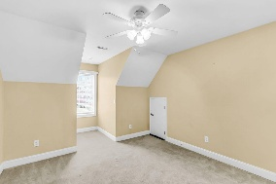
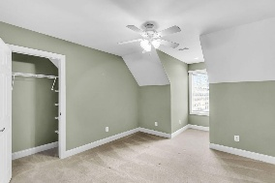
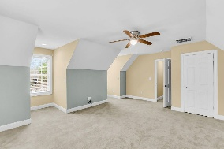
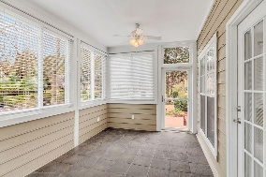
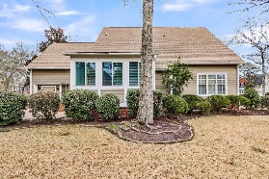
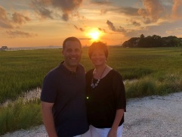

New LOW Price in Gated Golf Course Community!
4403 Wild Thicket Lane
Coosaw Creek Country Club
North Charleston, SC 29420
MLS# 26003310
$550,000
4 Bedrooms | 2½ Baths | 2,486 sf
Welcome home to 4403 Wild Thicket Lane! From the moment you step onto the large, welcoming front porch, you'll feel the charm and comfort this home offers. Inside, a formal dining room with classic columns sets the stage for entertaining, while the formal living room provides flexibility as a home office or sitting room. The heart of the home features a well appointed kitchen with granite countertops, tile flooring, overlooking the eat in kitchen area, complemented by a butler's pantry with shelving-perfect for extra storage. A laundry room with cabinetry adds everyday convenience. The main living room offers wood floors, a gas fireplace and beautiful vaulted ceilings, creating a warm yet airy gathering space. Just beyond, the sunroom opens to the back patio, ideal for morning coffee or relaxing evenings. The primary suite on the main level is a private retreat with tray ceilings, primary bath with dual vanities, linen closet and a spacious walk in closet with custom built ins. The en-suite bath is complete with a jetted tub and separate shower. A half bath on the main floor adds convenience for guests. Upstairs you'll find exceptional versatility and storage. Bedroom one offers an incredible amount of storage with access to a walk in attic-truly abundant space. Bedroom two is generously sized, and bedroom three can easily serve as a bonus room if needed. A full hall bath features dual sinks and glass enclosed shower. Coosaw Creek is a great place to live! The neighborhood has 24 hour 7 day a week gated security, unlimited golf for all household members, and the location, wow...close to it all! Boeing, Bosch, AFB, Mercedes, Volvo are all a short drive away. Come live the good life in a golf course community that has tons of activities and events, a clubhouse restaurant with delicious food, great community pool, tennis courts, pickle ball courts and the most beautiful golf course you'll ever play on! Located in the Dorchester District 2 school zone, your high school student can walk to school! This neighborhood has gate entry to the campus. Also in walking distance is a brand new public library and aquatics center!! Don't miss your chance to make this house your dream home!
Larry & Kathy Mazalatis
Larry Cell 843-693-0529
Kathy Cell 843-693-0159
mazteamrealty@gmail.com
AGENTOWNED REALTY | 1800 TROLLEY RD | SUMMERVILLE, SC 29485

