Slide 1
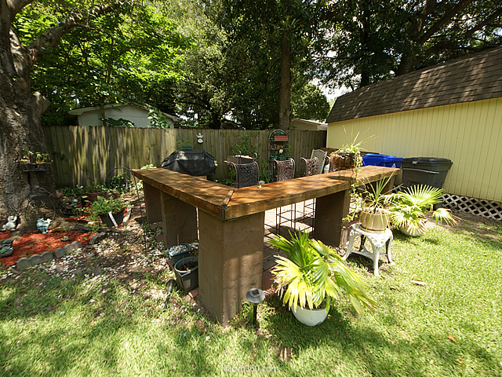
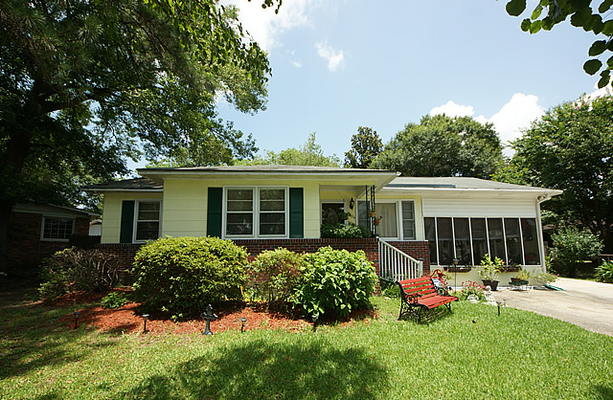
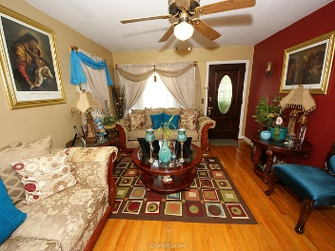
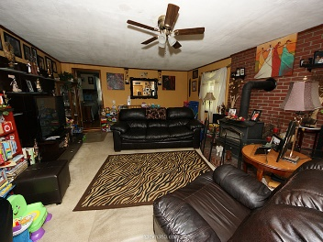
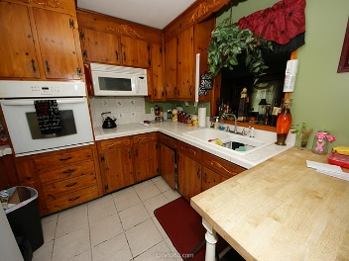
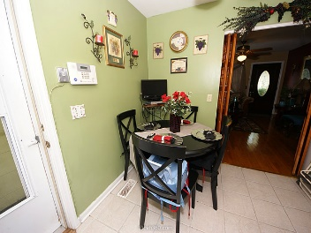
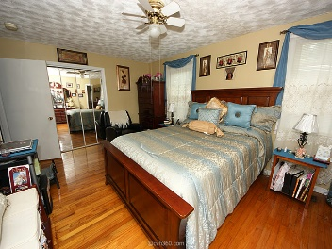
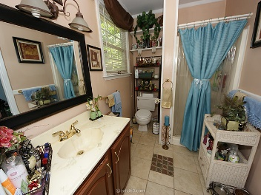
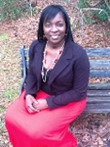
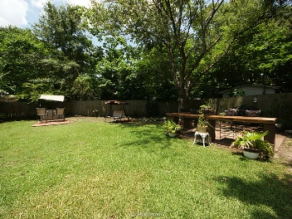
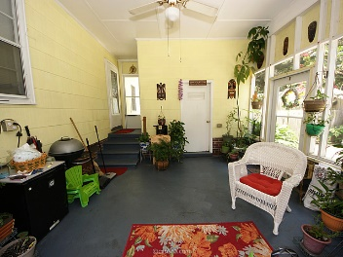
Perfect First Home
4404 Spur Street
Brentwood
North Charleston
MLS# 15017007
$125,000
First time home buyers look no further. This home has all the bells and whistles. Lots of space. Well maintained brick home with three bedrooms, two bathrooms. All appliances including washing and dryer included original hardwood floors throughout except in den. Large master bedroom off den. Carport closed in for additional privacy and additional storage. Nicely manicured backyard perfect for all your entertaining. Storage shed in backyard doesn't convey.
Renata Stinson
Mobile 843-864-3990
Office 843 577-2676
stinsonspace@bellsouth.net

