Slide 1
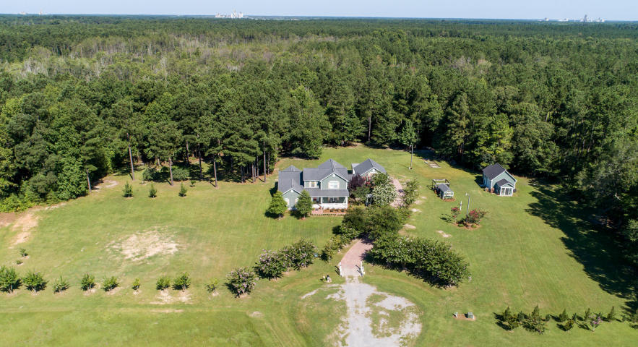
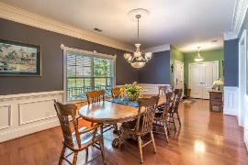
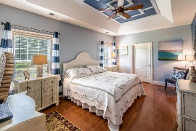
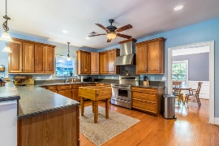
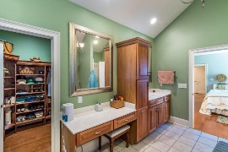
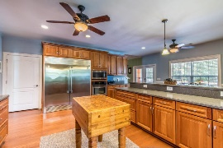
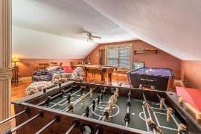
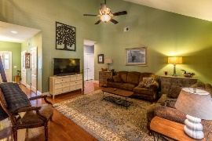
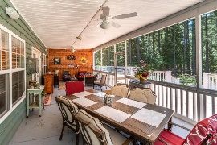
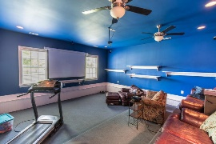
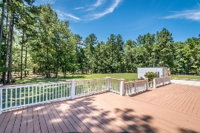
Beautiful Home in Paddock Point
OPEN HOUSE SUNDAY FROM 2-5
4408 Peanut Lane
Harleyville, SC 29448
MLS# 18019470
$439,900
A front porch for sipping tea welcomes you to a 2-story luxury home. Once stepping in you will notice the beautiful upgrades; classic hardwood floors with 7-in baseboards, wainscoting in the dining room and breakfast nook, beautiful window casings and 3 feet wide doors. This high-end kitchen is a dream featuring a commercial grade refrigerator, a pot filler on the 5-burner stove, 3 ovens, a 3-rack dish washer, granite counter tops and recessed lighting. This beautiful home proudly has a home generator, a tankless water heater and a top of the line water filtration system. The large master bedroom boasts tray ceilings, built in shelves and a luxury master suite with a jetted tub and large shower. This home has a game room over the garage and a theatre room with a Bose surround sound system. The unbelievable outdoor living is perfect for entertaining featuring a large screen patio with speakers, 2 large decks, a 24x24 2 car garage and a tree house that can be used as a deer stand to hunt on your very own 4.59 acres of land. In addition to this amazing home, there is also a detached structure that contains a 100 sq ft green house, 144 sq ft tool room and a 20x20 shop.
Kenold Claude
kclaude76@gmail.com | (315) 486-2253 | www.mkassociatesteam.com
Brand Name Real Estate | 4 Carriage Lane, Suite 106 | Charleston, SC 29407

