Slide 1
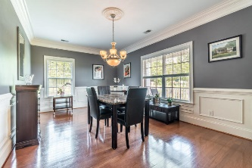
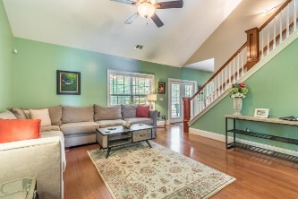
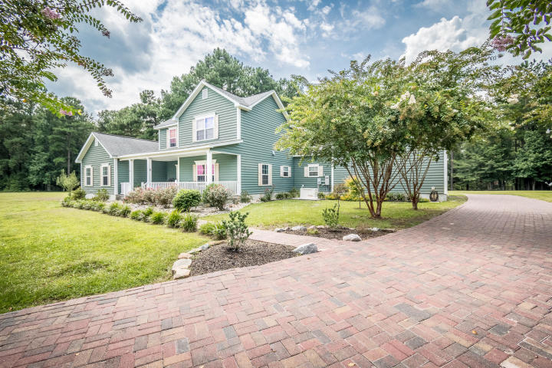
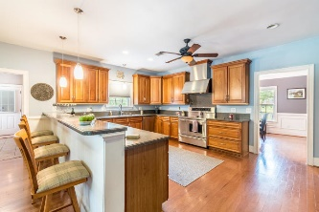
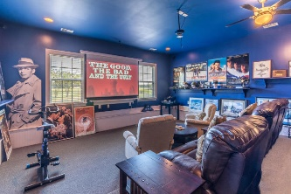
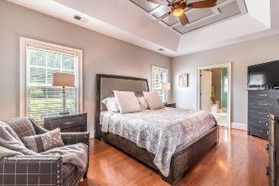
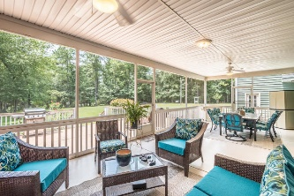
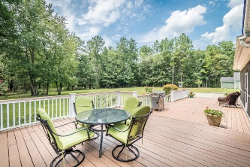
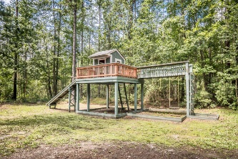
Beautiful Home in Paddock Point
THIS SATURDAY!!
BROKER OPEN HOUSE 11-12
PUBLIC OPEN HOUSE 12-3
4408 Peanut Lane
Harleyville, SC 29448
MLS# 18019470 ~ $480,000
This amazing property greets you with a long, tree-lined driveway to the magnificent home. the relaxing front porch, great for sipping tea, welcomes you to a 2-story luxury home. Upon arriving at 4408 Peanut Lane, you will notice the beautiful upgrades, starting with the pristine landscaping, which includes 6 tons of river rock professionally installed in front and side gardens. This prestigious 4 bedrooms 2.5 bathroom home is graced with classic hardwood floors, elegant 7-in baseboards, wainscoting in the dinning room, and large breakfast nook . this specious gourmet kitchen includes a commercial grade refrigerator, two ovens, 5 burner electrical stove, 3 rack Bosch dishwasher, Granite counter-top, recessed lighting and oversize walk-in pantry. The Master bedroom boasts a tray ceiling.
Luxury master suite with jetted tub, oversized shower, and custom built walk-in closet. Let's not forget the unique THEATER ROOM, fully loaded to include Epson projector, Boise DVD player, surround sound system, and retractable movie screen. Game room over the garage will include all 3 gaming tables; pool table, Air Hockey, and Foosball table. The home has been recently professionally painted, new carpeting the theater room, upgrade modern half bath with an aqua blue tiled backsplash. The home also includes a brand new 22k BTU home generator system, tankless water heater, top of the line water filtration system, and 3 ft wide doors and stairway.
Extra features:
14 ft X 33ft screened back porch including dinning table and 6 chairs.
24ftX24ft two-car garage
Large treehouse
Detached structure contains 100 sqt green house, 144 sqt tool room, and a 20X20 workshop.
This spectacular home is moving ready
Kenold Claude
kclaude76@gmail.com | (315) 486-2253 | www.kclaudeteam.com
Claude & Associates, LLC | 1231 Boone Hill Rd. Suite B | Summerville, SC 29483

