Slide 1
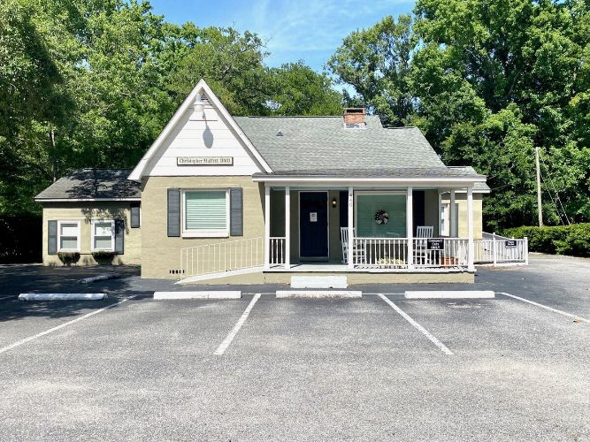
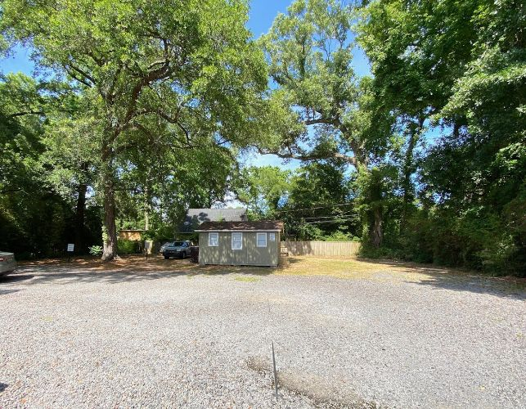


James Island Office Building
Great Price!
440 Folly Rd
Charleston, SC 29412
CMLS# 30735267 · $1,100,000
Michael Dew
O 843-769-5100
M 843-870-7000
michaeledew@gmail.com
www.michaeldewrealestate.com
Located on the busiest traveled road on James Island. 440 Folly Rd. is a 2887 sq.ft. office building with 3 units. 1 unit currently occupied. 1 vacant unit. 1 residential apartment rented. Plenty of parking in front as well as behind the building. Average daily traffic volume is over 45, 000. The are offers a variety of residential development, shopping, dining, and recreation spots. The site provides convenient access to West Ashley and downtown. It is close to the James Island connecter and I26 is easily accessible.
AgentOwned Charleston Group
902 Savannah Hwy
Charleston, SC 29407
Real Estate ● Mortgage
Insurance ● Business Brokerage

