Slide 1
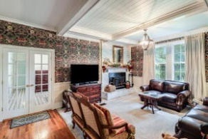
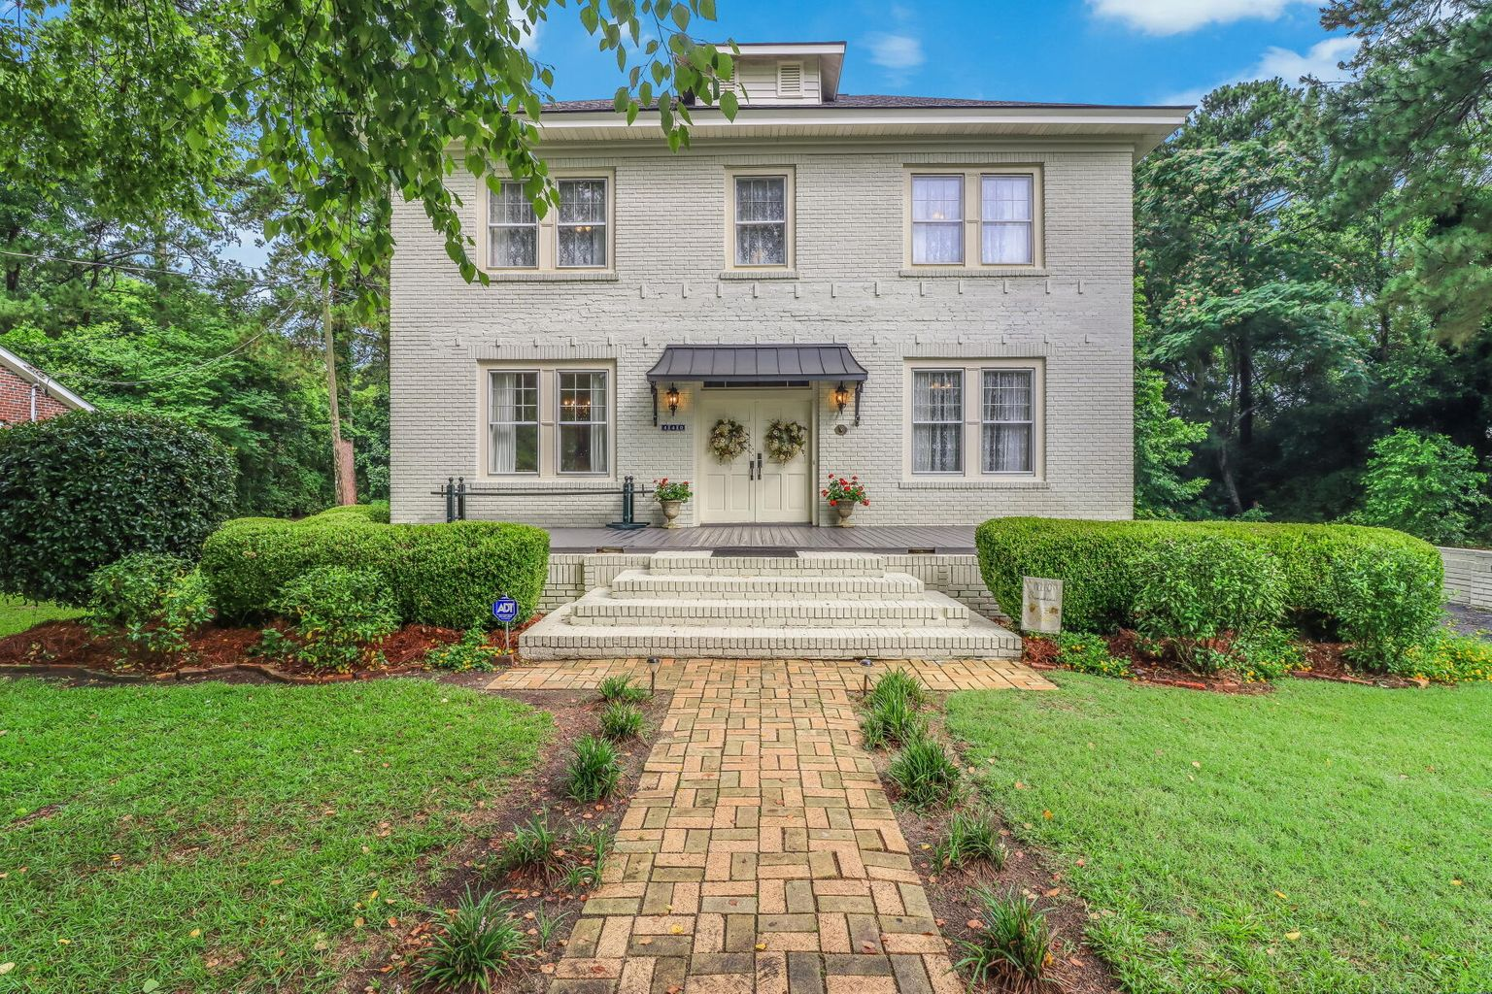
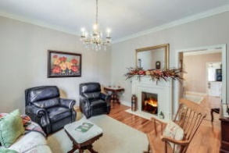
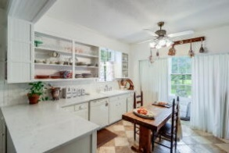
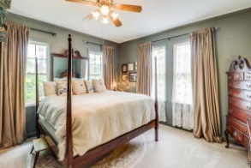
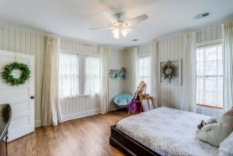
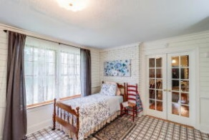
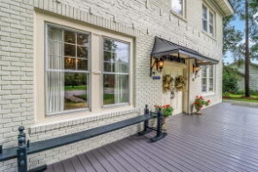
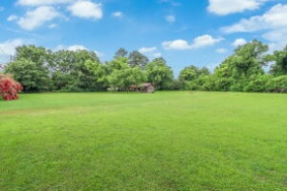
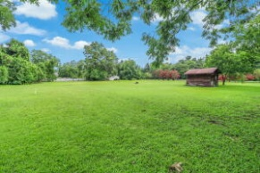


440 Hampton Street
Elloree, SC 29047 | MLS# 22017548 | $492,000
Welcome
home!
SCHEDULE YOUR SHOWING TODAY!
This wonderful two-story brick home offers, 4 bedrooms, 3 full bathrooms with 2,968 sq ft of living space on two lots totaling 1.19 acres! This home has been well maintained with attention to detail. Situated on just over an acre in town, this absolutely charming home has withstood the test of time and is more beautiful than ever! Romabio painted brick, the bronze Juliet awning and French chateau fixtures draw your eye to the entrance of this stately home. The main floor features original, refinished red oak floors, awe inspiring William Morris wallpaper, shiplap and Farrow and Ball paint colors. Ceiling fixtures sure to draw conversation include imported crystal Spanish chandeliers and antique milk glass. Next, you'll find the kitchen has a new Kitchen Aid gourmet double oven, quartz countertops, travertine tile flooring, and board and batten walls. The living room has a wood burning fireplace, perfect for those cold winter nights, custom coffered ceilings and large windows allowing ample light to fill the space. The first-floor master bedroom features large his and her closets and its own private en suite. A secondary bedroom, also located on the first floor, has Parisian tile floors and its own full en suite. The second story has 11' ceilings and has been tastefully renovated for that new, yet classic feel. Two more generously sized bedrooms and a shared bathroom are included on the second floor. The bedrooms have full closets, shiplap walls and custom trim. Floors on the second story are scratch free laminate and tile in the bathroom. The mature landscaping has been carefully manicured featuring crape myrtles, camellias, boxwoods and pecan trees, perfect for gathering for fall pies! The pole barns and a large shed on the property offer potential areas for storage or outdoor entertaining.
Located less than 10 minutes from Lake Marion and just over an hour's drive from Charleston or Columbia! You don't want to miss the opportunity to own this wonderful home on over an acre of land! Schedule your showing today before it's gone!
Brandon Ray
(843) 499-1928
brandon.ray@carolinaone.com
www.therightrayhome.com
Carolina One Real Estate
900 N Main St
Summerville, SC 29483

