Slide 1
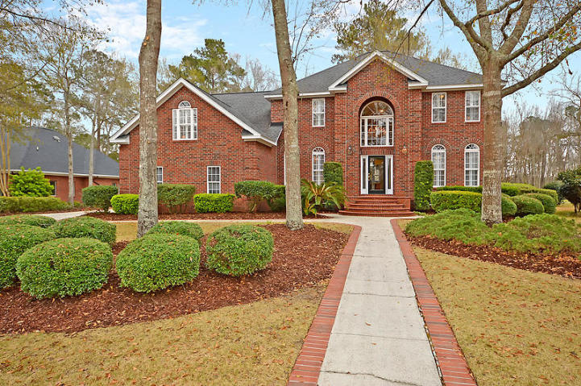
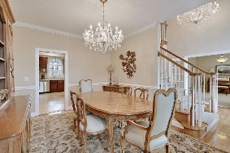
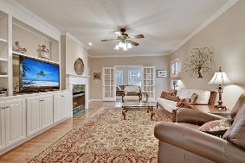
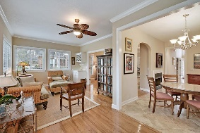
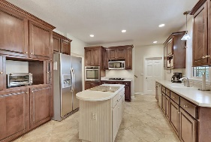
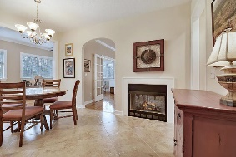
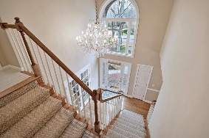
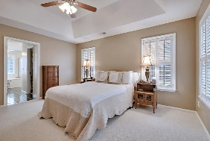
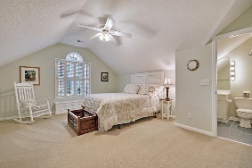
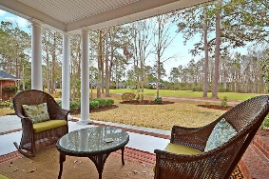
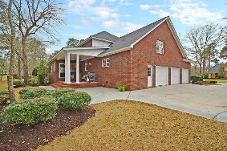
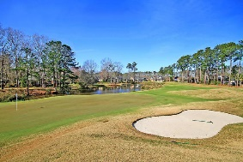
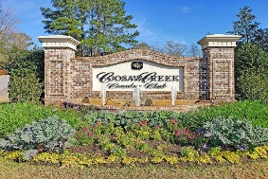


Gorgeous Golf Course Home in Gated Community!
4412 Club Course Drive
Coosaw Creek Country Club
North Charleston, SC 29420
MLS# 20004970
$449,000
4 Bedrooms | 3½ Baths | 3,542 sf
Elegant 4br, 3.5ba, 3,542 Sq. Ft. brick, executive, custom built home overlooking the golf course in the desirable gated community of Coosaw Creek. Hardwood floors in foyer, family room, dining room, & sunroom. Awesome golf course views! Custom plantation shutters thru-out. Two-sided ventless gas fireplace can be enjoyed from the kitchen, family room and sunroom. The gourmet kitchen has a central island, gas cooktop and stainless appliances. Formal living room or home office features elegant French doors for charm and privacy. Formal dining room features pocket door, chair rail and beautiful chandelier. Master bedroom & bath features include his & her closets, whirlpool tub and built-in shelves. Huge finished FROG could be game room / media room / multipurpose room. 4th bedroom has its own full bathroom and is perfect for a guest suite, mother-in-law suite or older child. The laundry room opens to a spacious 3 car garage! The roof, one HVAC and water heater are all fairly new so no large replacement costs anytime soon! This home has been well maintained and is move in ready. Buyers will be impressed! The neighborhood has 24 hour 7 day a week gated security, unlimited golf for all household members, and the location, wow...close to it all! Boeing, Bosch, AFB, Mercedes, Volvo are all a short drive away. Come live the good life in a golf course community that has tons of activities and events, great food in the restaurant, great community pool with an award-winning swim team, and the most beautiful golf course you'll ever play on!
Larry & Kathy Mazalatis
Larry Cell 843-693-0529
Kathy Cell 843-693-0159
Office 843-871-9133
AGENTOWNED PREMIERE GROUP | 1800 TROLLEY RD | SUMMERVILLE, SC 29485

