Slide 1
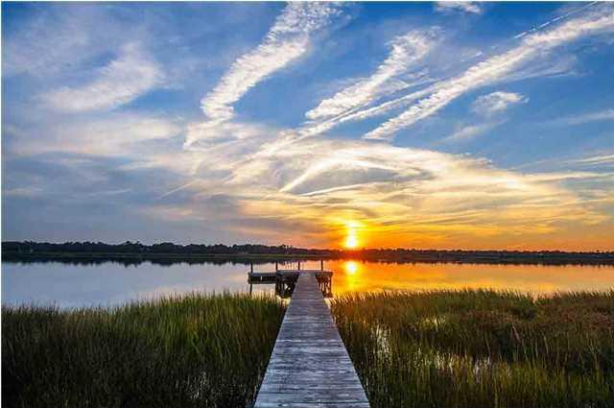
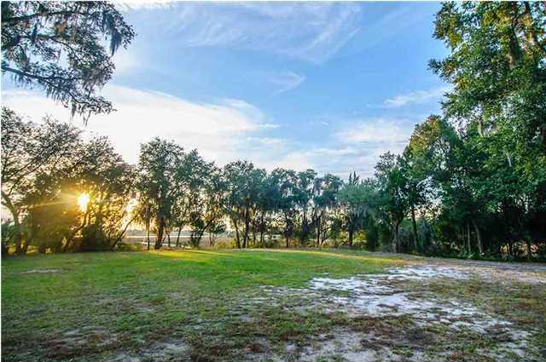
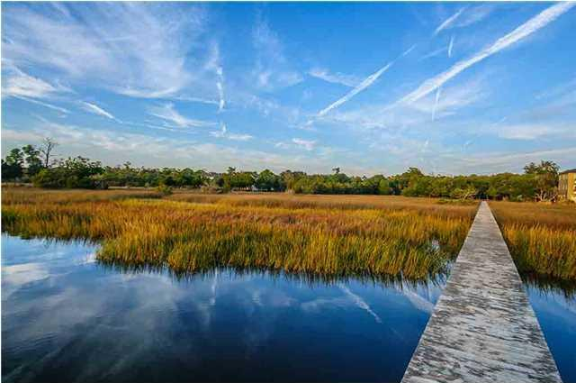
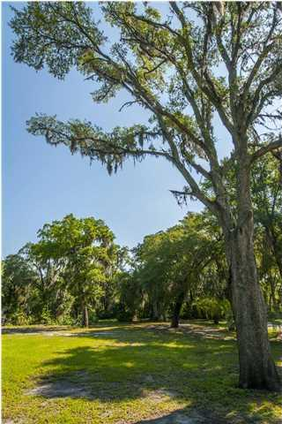
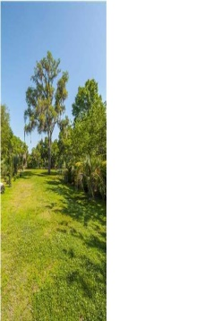
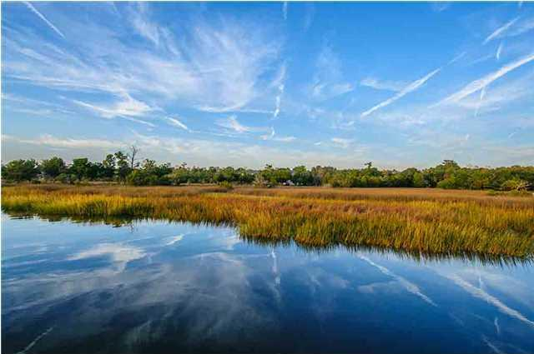


Commanding Views & Stunning Sunsets!
4424 Stoney Poynt Court
Plantation Isle | North Charleston, SC 29405 | MLS# 15005658 | $650,000
Stunning waterfront private lot in a gated community on the historic Ashley River with private dock, open pier head, floating dock and 8 Feet at low tide! This is a very unique lot with 5.72 acres of marsh surrounding it, in addition to unobstructed privacy on a .50 acre buildable highland with 5 feet of surcharge on it and tucked away at the end of the island. This exquisite property has expansive waterfront views and riverfront deep water access. Plantation Isle is a gorgeous quiet family oriented neighborhood 3.5 miles to The Boeing Company and Charleston Airport. You can be downtown, shopping or at one of the many beaches in minutes. Multi-million dollar homes grace this waterfront community on the Ashley River. This is a very unique opportunity to build in an elegant and secure riverfront subdivision with the builder and architect of your choice. Beautiful neighborhood with very low regime fees. Robert Bosch 7.3 miles Blackbaud Inc. 10.2 miles St. Francis Hospital 5.4 miles. Come and preview this property at dusk and enjoy the breathtaking sunsets!
Patricia Lehman Byrne
Mobile - (973) 868-1039
Patricia@kwluxuryhomes.com
luxurypropertiesincharleston.com
Keller Williams Realty Charleston West Ashley
1180 Sam Rittenberg Ste 105
Charleston, SC 29407

