Slide 1
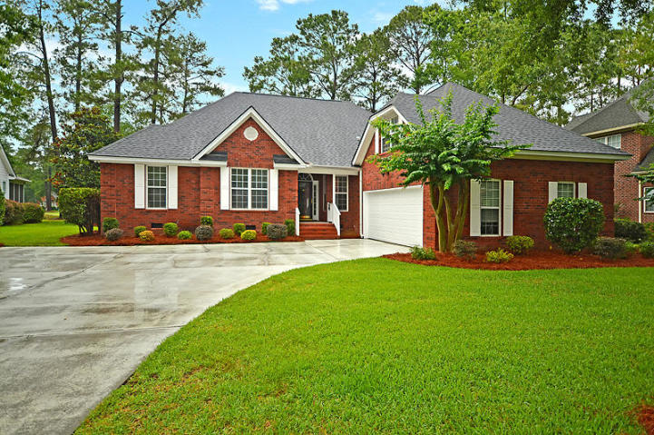
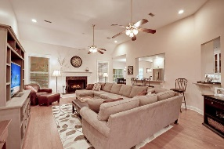
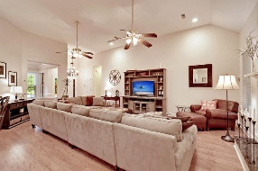
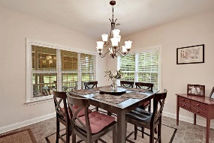
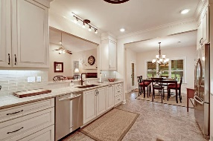
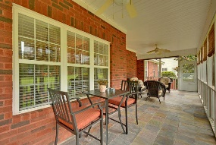
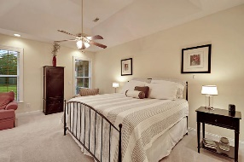
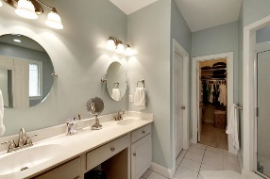
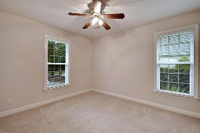
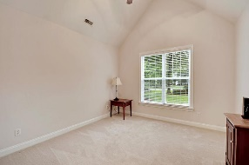
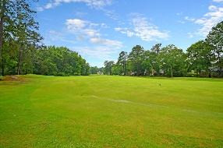



One Story on Golf Course!!
4424 Wild Thicket Lane
Coosaw Creek Country Club
North Charleston, SC 29420
MLS# 19017646
$379,000
4 Bedrooms | 3 Baths | 2,612 sf
One story living at its best! This 2,612 Sq. Ft. brick, custom built, golf course home is a MUST SEE! This gem of a home is located on the 14th fairway, on a quiet cul de sac street and is in IMMACULATE, move-in condition! You will immediately be impressed with the curb appeal of this home. Upon entering, you'll know you are home! The dining room is to your right and is a great space for entertaining. On the way to the kitchen, you'll see a butler's pantry and wine rack. The kitchen has been completely renovated and offers ample custom cabinetry, granite countertops, sleek backsplash and gas cooktop all overlooking the family room with vaulted ceilings and gas fireplace. Offering plenty of storage, off the kitchen is a huge pantry as well as a laundry room with additional cabinetry.
The eat in kitchen area is a large space that gives you access to the spacious screened in porch that has sweeping views of the 14th fairway. Sit back, relax and watch the golfers! Back inside, the master bedroom is a dream with great golf course views as well as a large sitting area that could be an office space if needed. The master bath has a dual vanity, separate jetted tub, shower and large walk in closet. Two additional large bedrooms as well as a full bath complete the first floor. But wait there's more! Need space for a teen or out of town guests? Head upstairs to the fourth bedroom which has a full bathroom, attic storage and a large closet. This home has been well maintained. Everything is freshly painted, (even the garage!) some new carpeting, newer roof, it has it all and it's ready for you to move in! The neighborhood has 24 hour 7 day a week gated security, unlimited golf for all household members, and the location, wow...close to it all! Boeing, Bosch, AFB, Mercedes, Volvo are all a short drive away. Come live the good life in a gated golf course community that has tons of activities and events, great food in the restaurant, great community pool with an award winning swim team, and the most beautiful golf course you'll ever play on!
Larry & Kathy Mazalatis
Larry Cell 843-693-0529
Kathy Cell 843-693-0159
Office 843-871-9133
AGENTOWNED PREMIERE GROUP | 1800 TROLLEY RD | SUMMERVILLE, SC 29485

