Slide 1
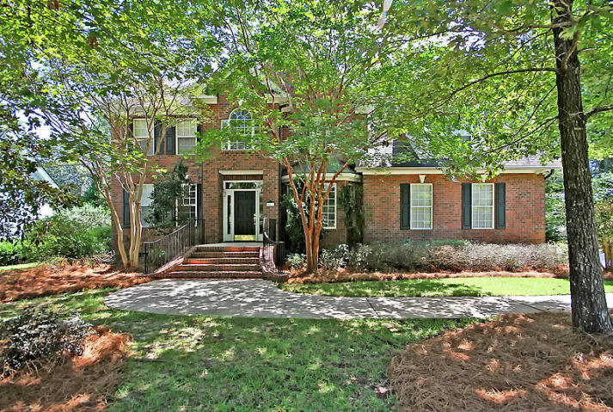
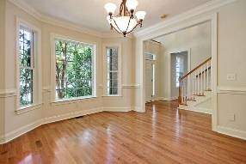
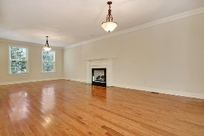
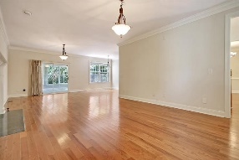
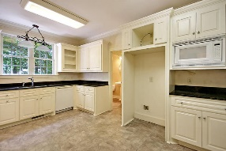
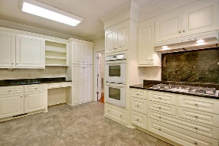
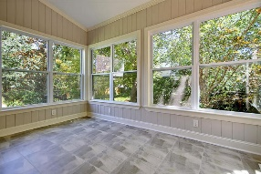
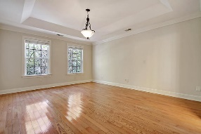
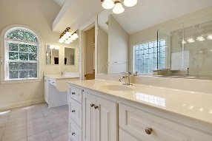
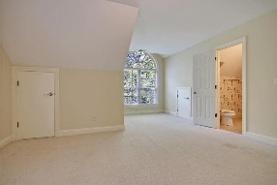
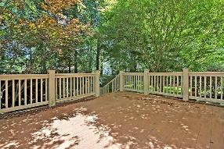
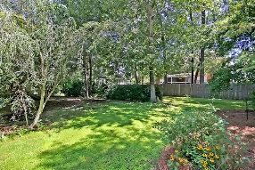



Gated Golf Course Community Home under $350k!
4427 Wild Thicket Lane
Coosaw Creek Country Club
North Charleston, SC 29420
MLS# 18023341
$349,000
4 Bedrooms | 3½ Baths | 2,737 sf
Great home in a great gated golf course community!! Move right in to this cul-de-sac home in the beautiful Coosaw Creek Country Club! This home has much to offer! Upon entering, you'll notice the beautiful wood floors. To your right is the large dining room, perfect for entertaining. The left side of the home is the living room/family room with a gas fireplace. This is a great open floor plan with access off the living room to the lovely sunroom! The kitchen offers tons of cabinetry and gas cooktop. The first floor also has a half bath and laundry room. Upstairs you'll find the master suite. The master bedroom has wood floors and tray ceilings. The master bath has just been renovated and has a separate tub and shower as well as dual vanities and a large walk in closet with built ins.
Down the hall is bedroom #2 with two closets and access to the jack and jill bath. The next bedroom, attached to the jack and jill, is a great size and has a huge walk in closet. The fourth bedroom, has its own full bath and offers attic storage. This room is huge! There is a also a flex room upstairs that can be used as a 5th bedroom if needed or an office! Back downstairs off the sunroom is a large deck, perfect for grilling! The backyard is private and peaceful. The neighborhood has 24 hour 7 day a week gated security, unlimited golf for all household members, and the location, wow...close to it all! Boeing, Bosch, AFB, Mercedes are all a short drive away. Come live the good life in a golf course community that has tons of activities and events, great food in the restaurant, great community pool with an award winning swim team, and the most beautiful golf course you'll ever play on!
Larry & Kathy Mazalatis
Larry Cell 843-693-0529
Kathy Cell 843-693-0159
Office 843-871-9133
AGENTOWNED PREMIERE GROUP | 1800 TROLLEY RD | SUMMERVILLE, SC 29485

