Slide 1
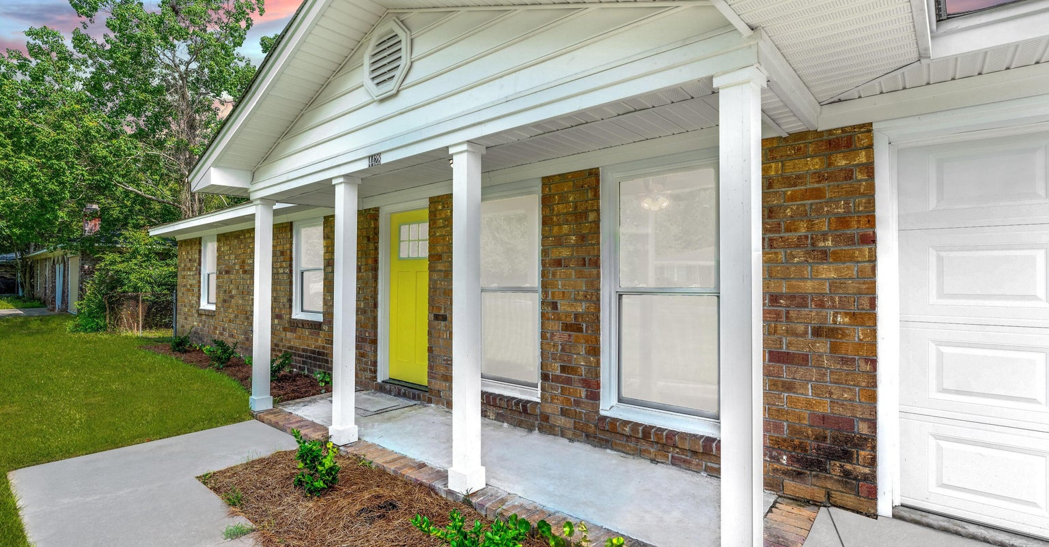
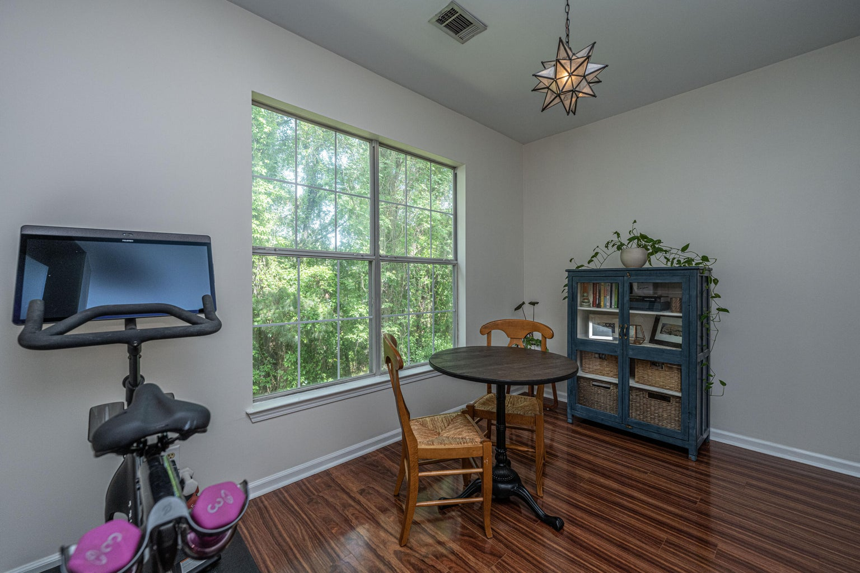
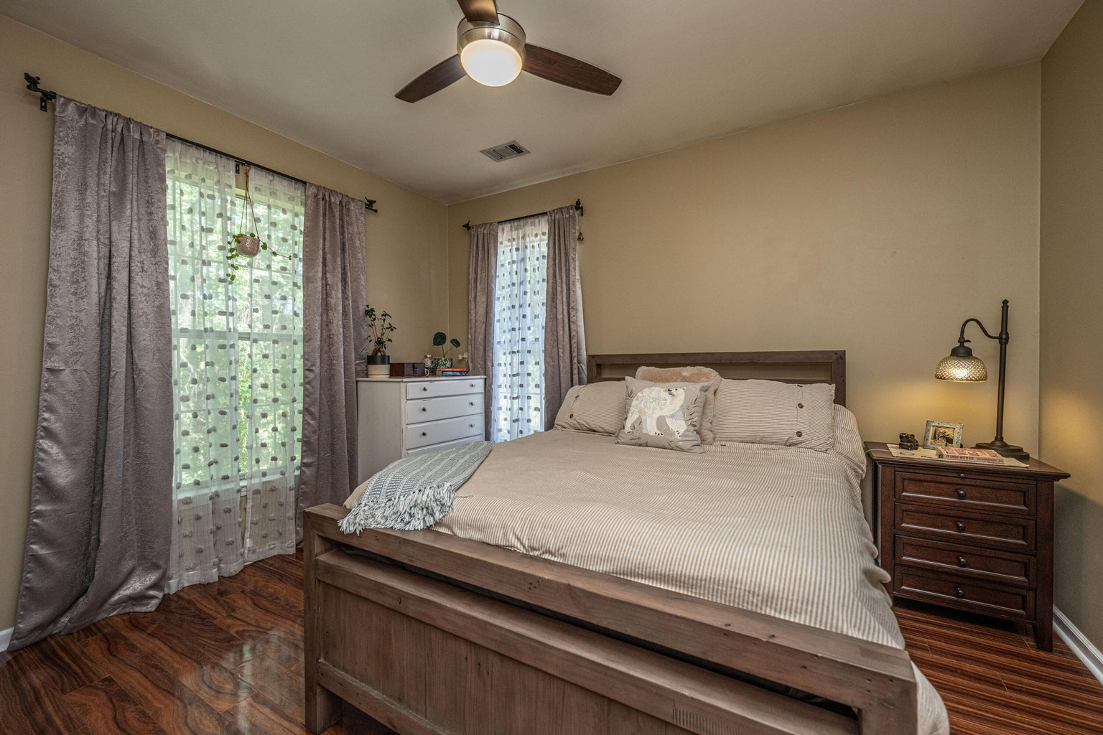
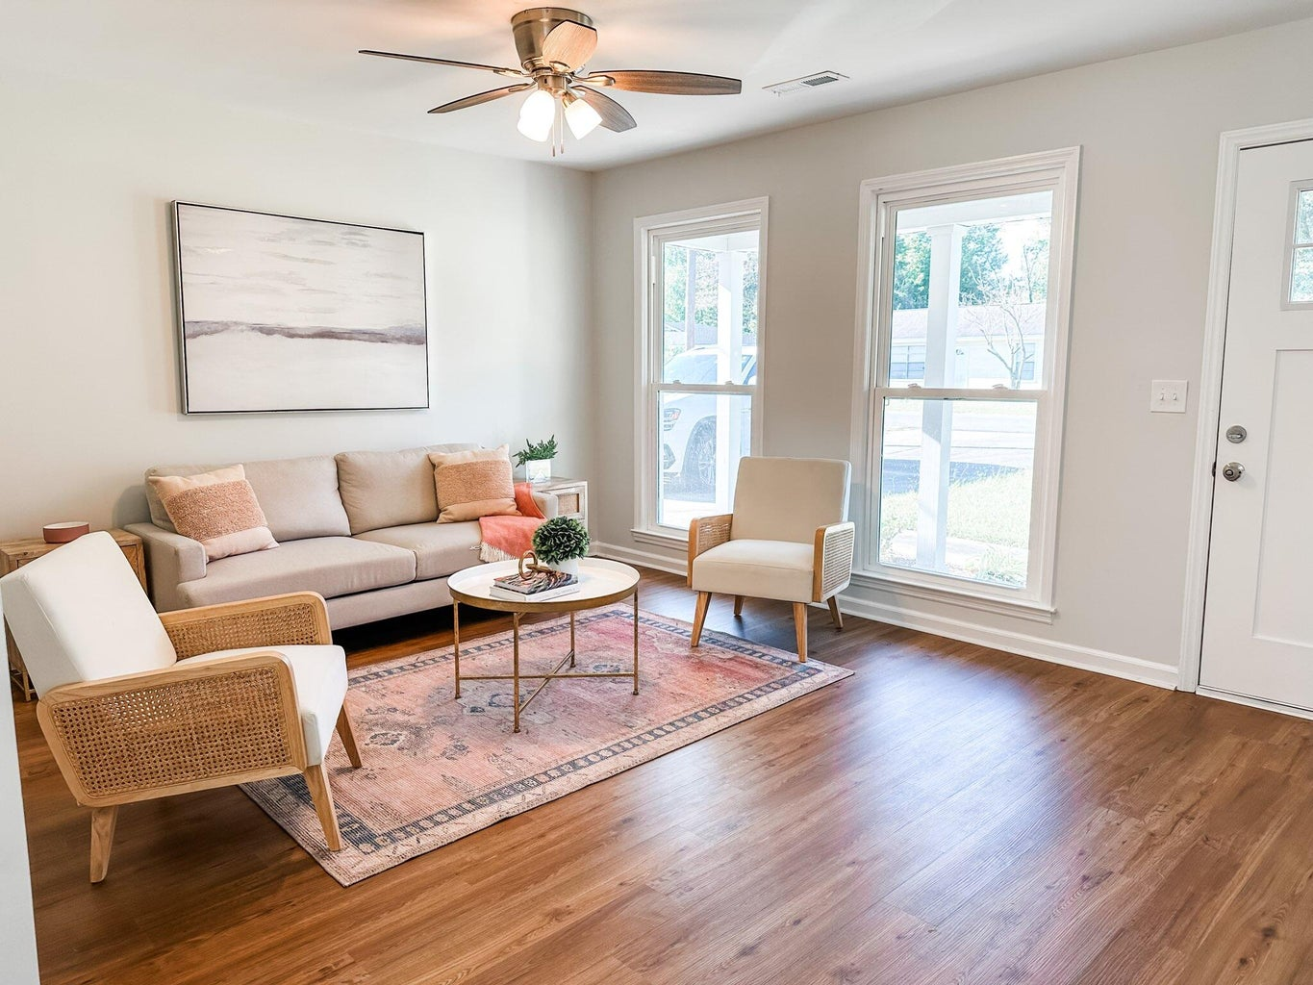
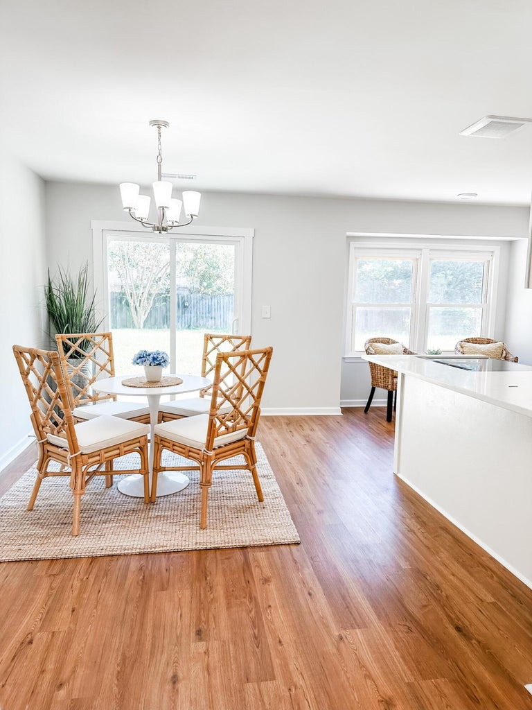
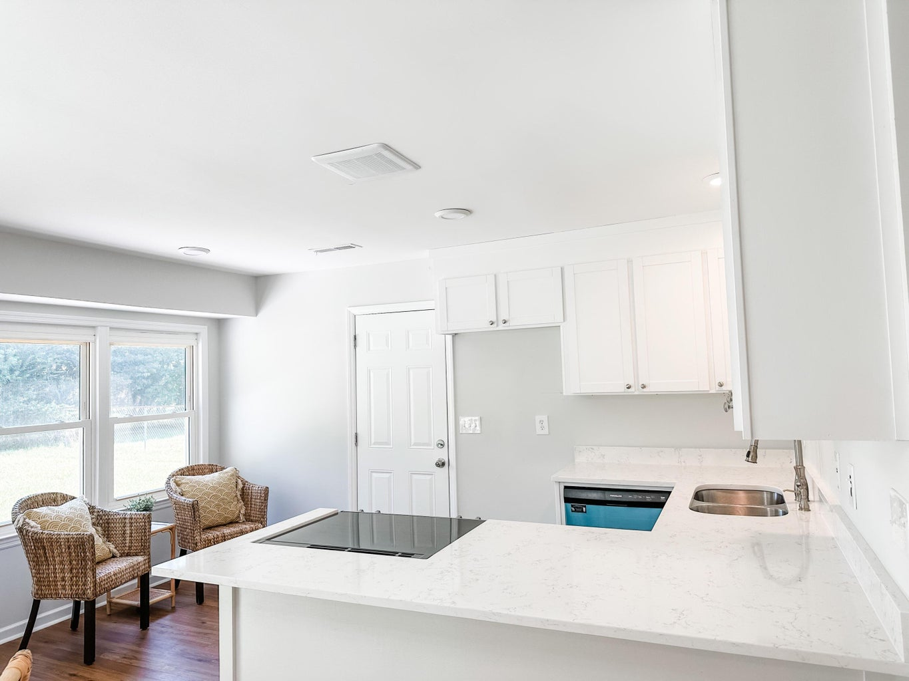
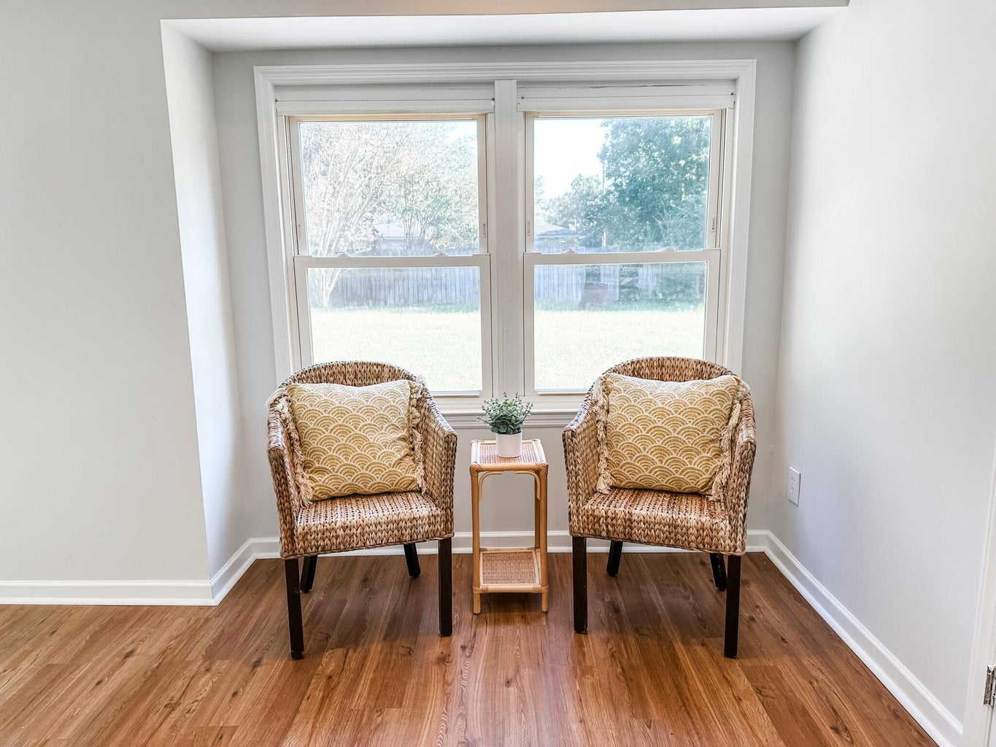
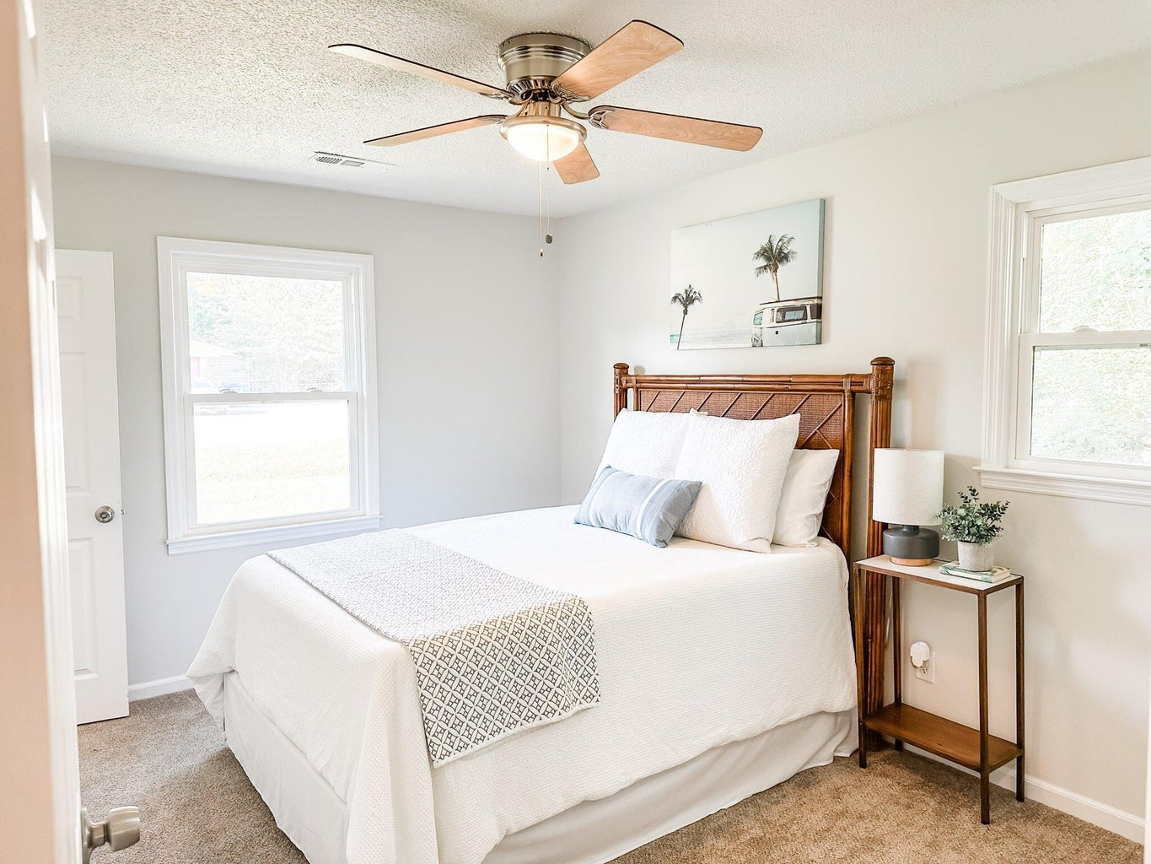



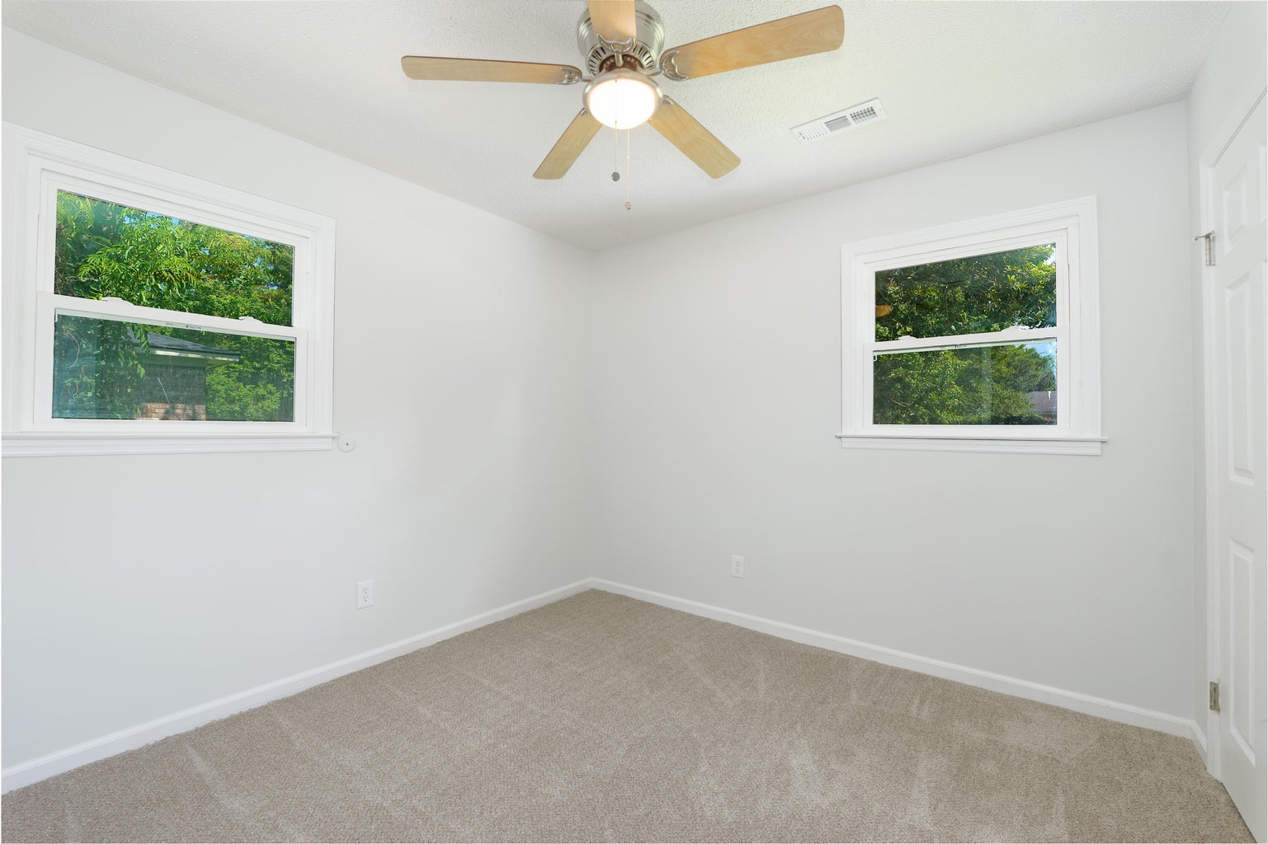
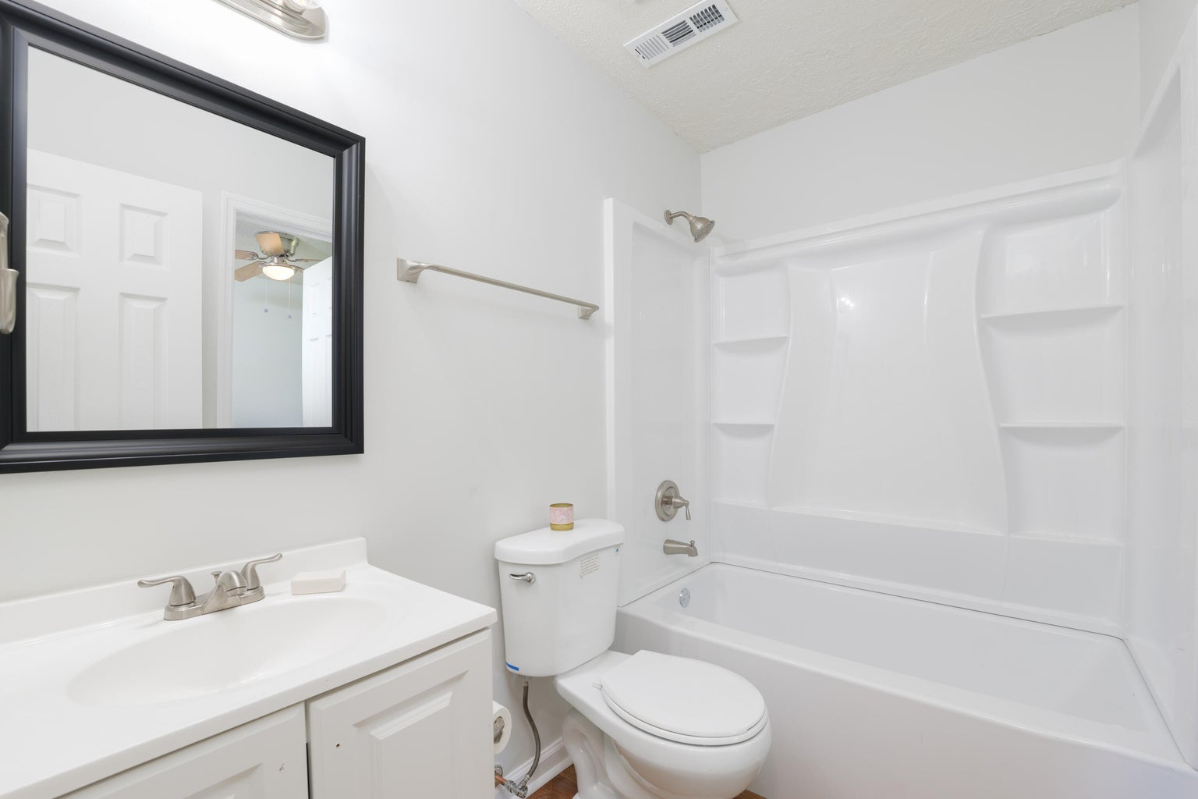
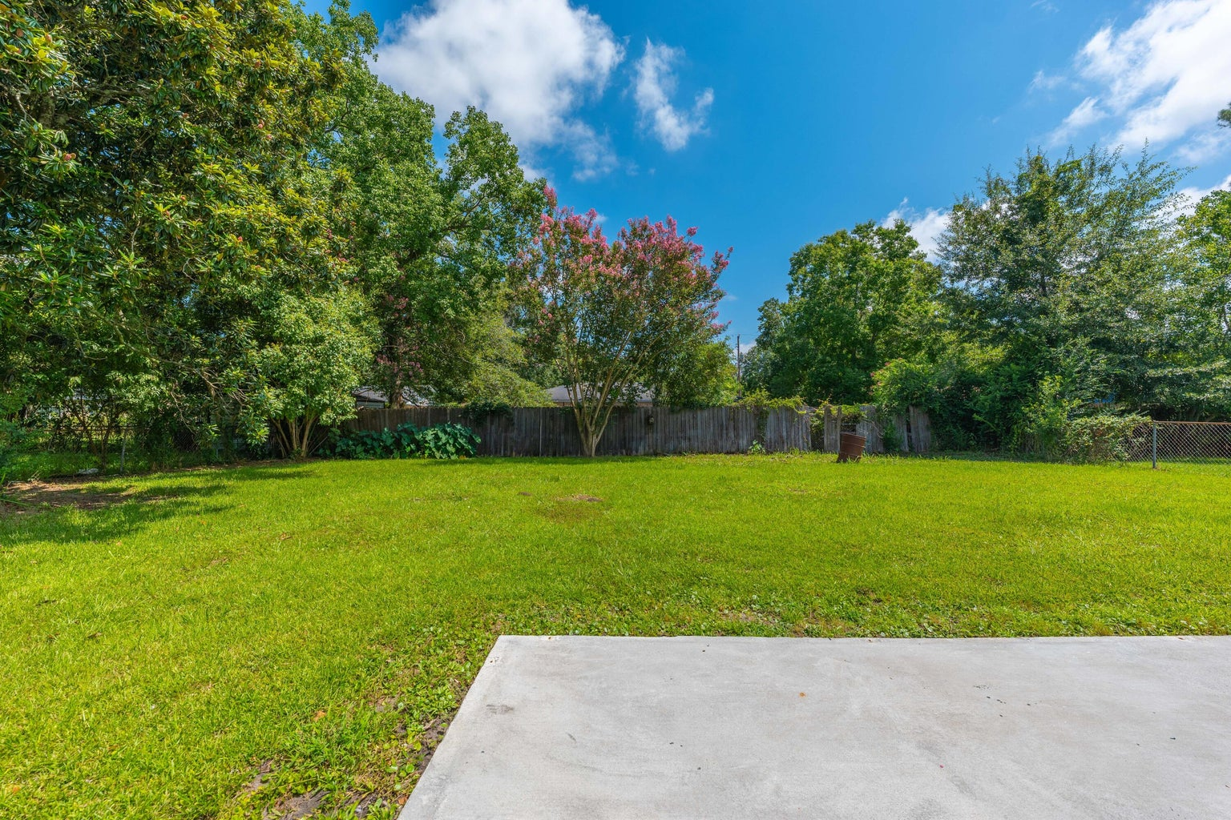
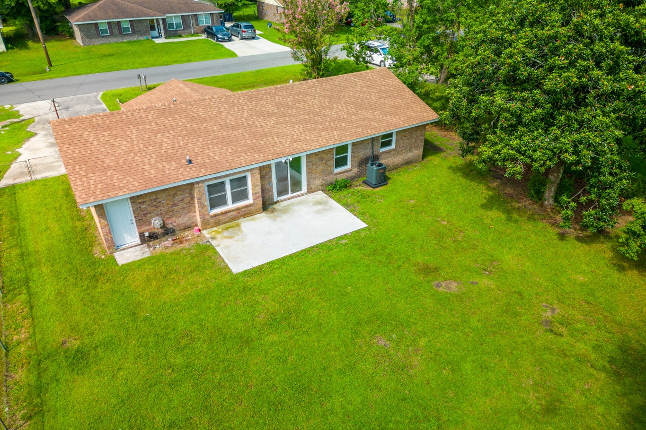


COMPLETELY REMODELED
Custom 5br, 4.5ba 4700 Sqft Of Flex Space
10’ Smooth Ceiling
Heart Pine Flooring
Master Bedroom Suite On First Level
Second Master On Upper Level
Two Dens With Gas Fireplaces
Formal Dining Room
Gourmet Kitchen With Second Den/Warming Room And Breakfast Room
Walk-in Pantry
Large Bonus/Game Room Above Oversized Two Car Garage
Screen Porch & Outdoor Firepit
Large Pond Lot With Mature Trees And Irrigation System
3 Separate AC Units
Gas Hot Water Heater
New 35-year Roof
Private Gated Community With Community Pool, Clubhouse, Boat Launch And Dock
4428 Jenwood Street
Woodside Manor | Ladson, SC 29456
MLS# 23017508 | $274,700
4 bedroom, 1 and half bath all brick ranch home minutes to Summerville and I-26. The home is freshly painted with new windows, doors and flooring. The HVAC recently installed, along with a new garage door. The kitchen boasts new cabinets, appliances and quartz countertop. The fenced in back yard is ready for outdoor entertaining and family gatherings. The home is minutes to downtown Summerville, I-26, the airport and many conveniences.
4
3
1,844
Telecia Bilton 843-412-3586
tmbilton@rogcoastal.com
Realty ONE Group Coastal
1510 Trolley Rd
Summerville, SC 29485

