Slide 1

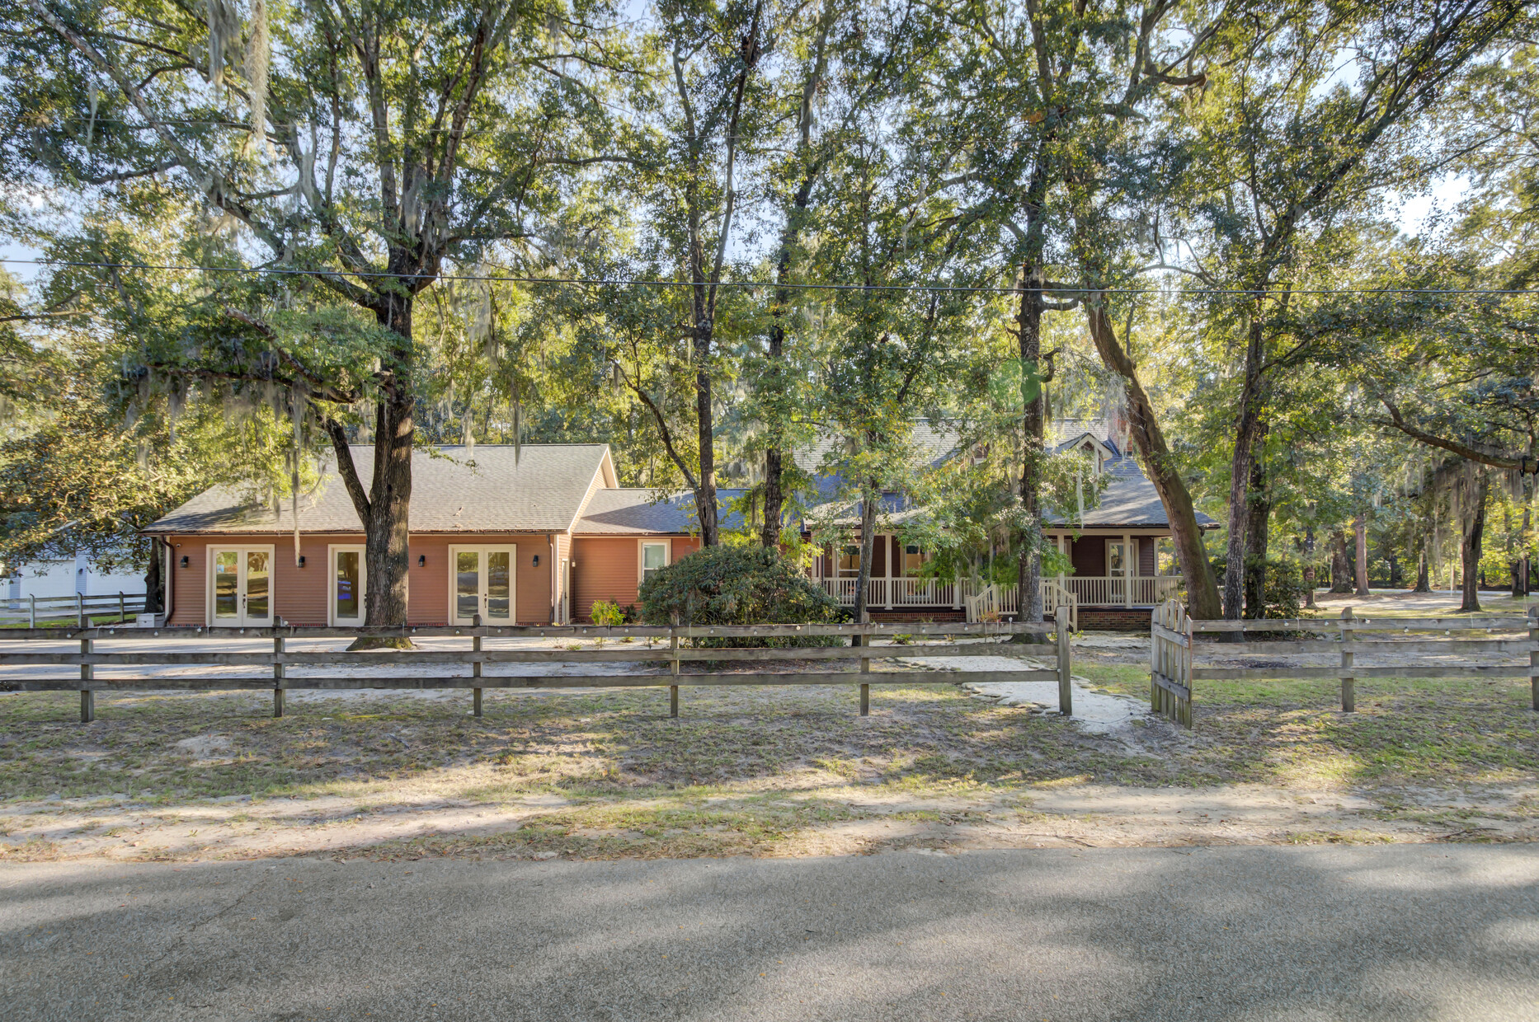
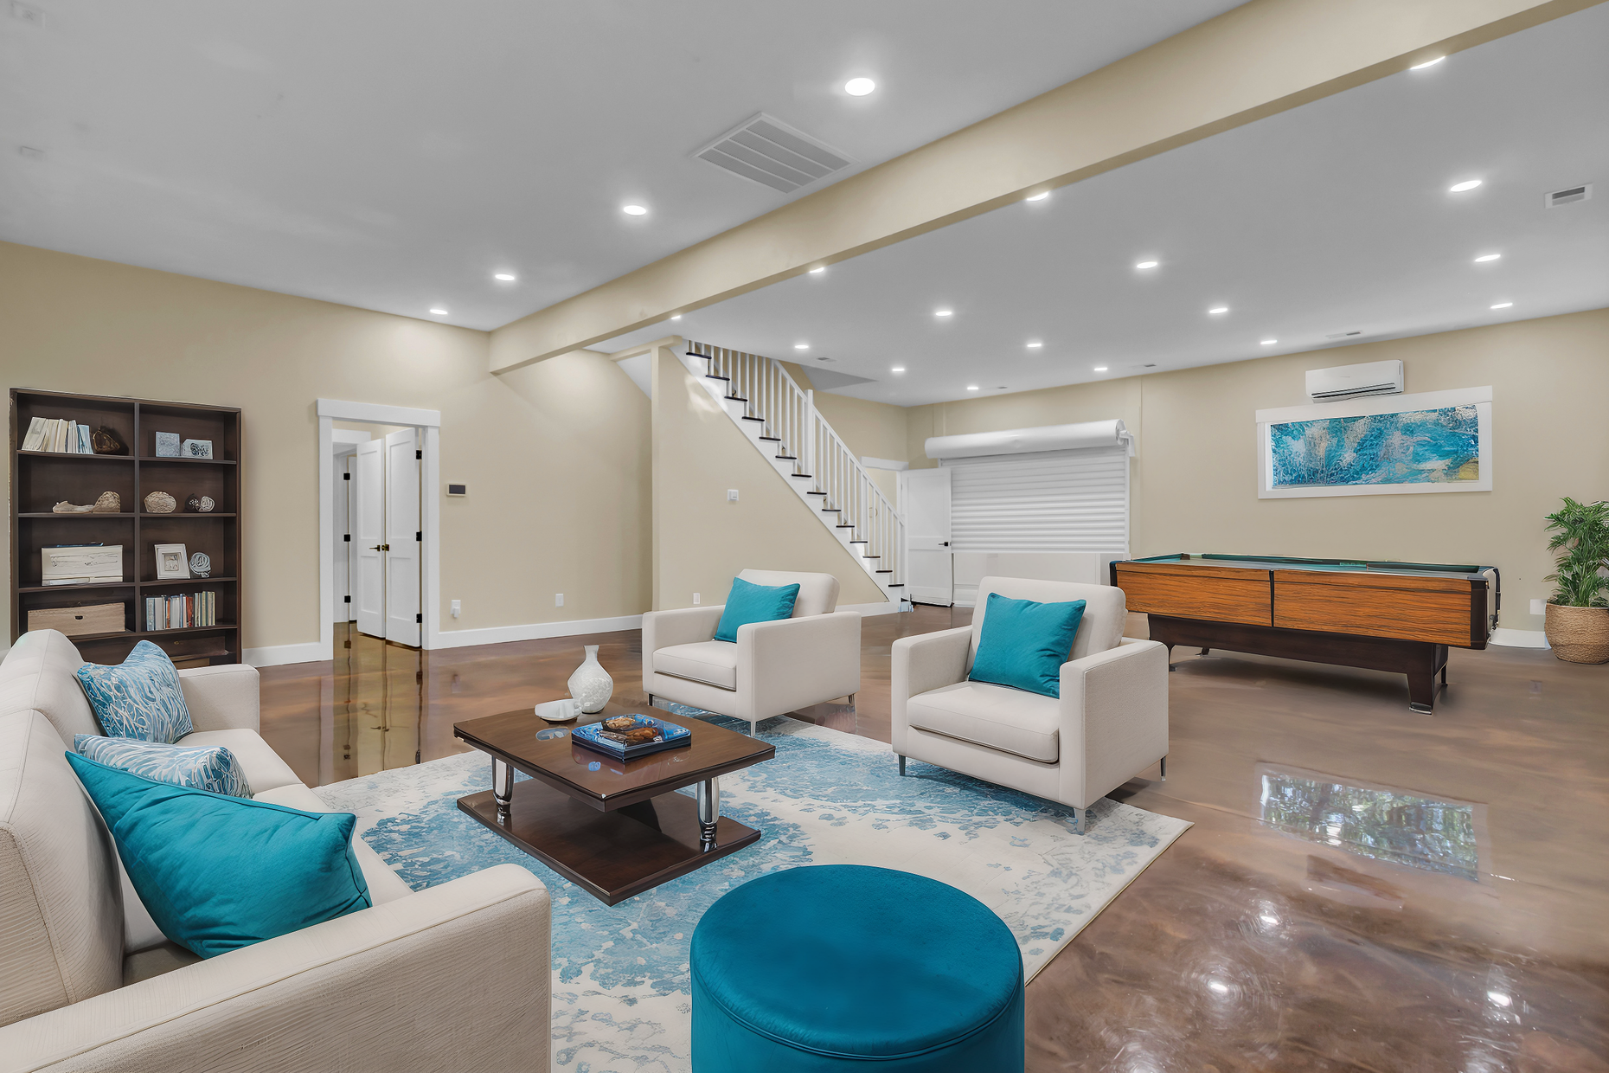
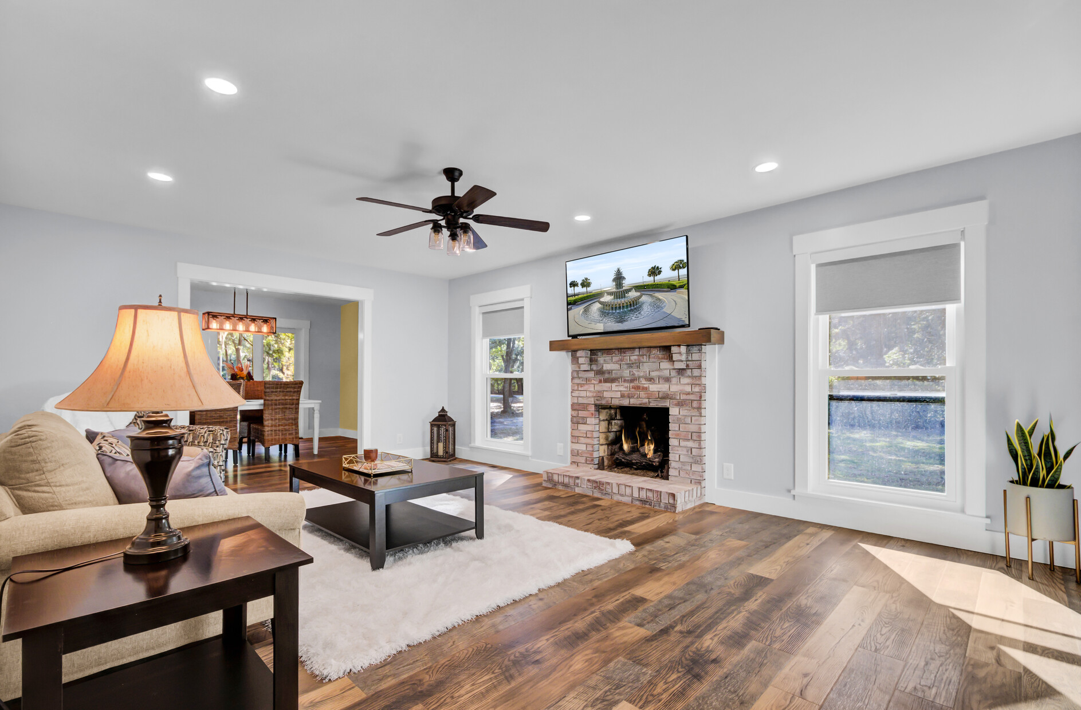
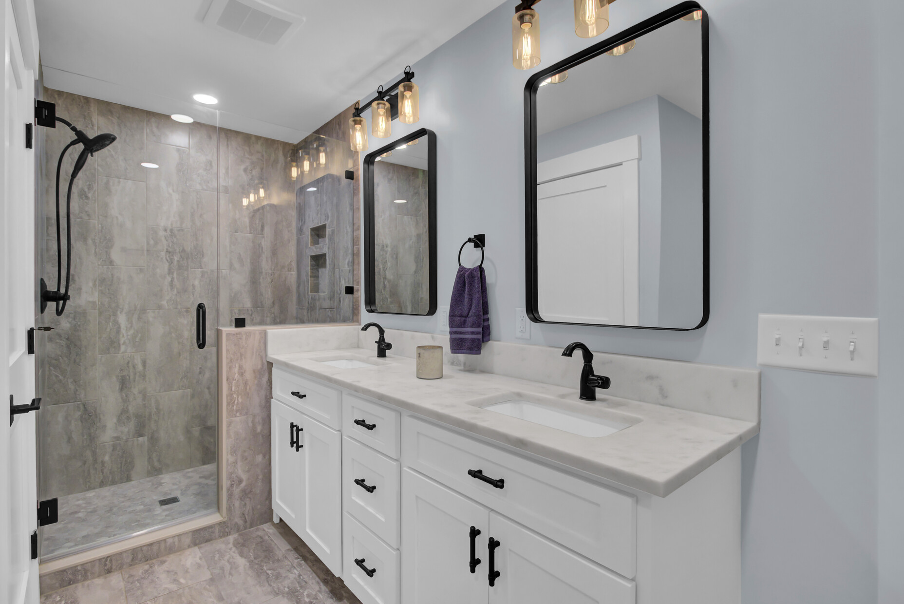
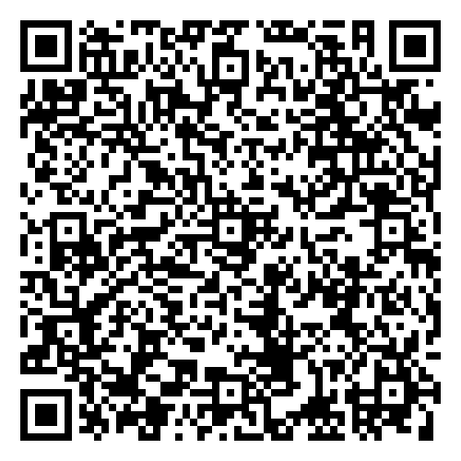
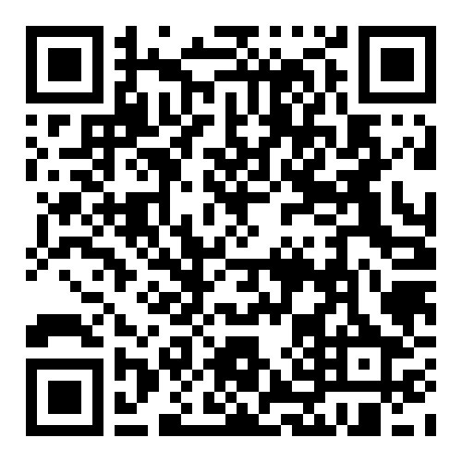


Stunning 4300+ Sq Ft Renovated Home with Endless Possibilities! Flexible In-Law Suite/Home Based Business
VIRTUAL TOUR
VIDEO TOUR
4429 Francis Younge Way
Log Bridge
Hollywood, SC 29449
MLS# 24027574 | $1,190,000
🏡 Fully Renovated & Move-In Ready!
Don’t miss this rare opportunity to own a fully renovated 4,300+ sq. ft. home in one of Hollywood’s most serene communities—offering the perfect blend of luxury, flexibility, and convenience! It’s perfect for an RV owner because they have an RV hook-up on property
✨ Property Highlights:
✔ 4,300+ sq. ft. of impeccable living space
✔ 1,600 sq. ft. attached flex space – ideal for an in-law suite or home business
✔ Brand-new renovations including a new roof, windows, HVAC & whole-house water filtration system
✔ Chef’s dream kitchen with a Bertazzoni gas range, quartz countertops & stylish backsplash
✔ Primary suite on the main level + two large bedrooms upstairs
✔ Expansive family room with fireplace & multiple flex spaces for an office, playroom, or studio
✔ Metallic epoxy flooring & new full bath in flex space
📢 Join us for an Open House on Saturday, Feb 22, from 2-4 PM!
Come tour this one-of-a-kind home and experience its endless possibilities. Whether you’re looking for multi-generational living, a home office setup, or a beautifully upgraded forever home, this is the perfect fit!
📩 Schedule a private showing or visit us at the Open House – Contact us today!
VIDEO TOUR
Ellen O'Neil
Broker/Owner, ABR, e-PRO, CNE
Charleston Realtor of Distinction
843-300-8530
www.EllenONeilProperties.com

