Slide 1
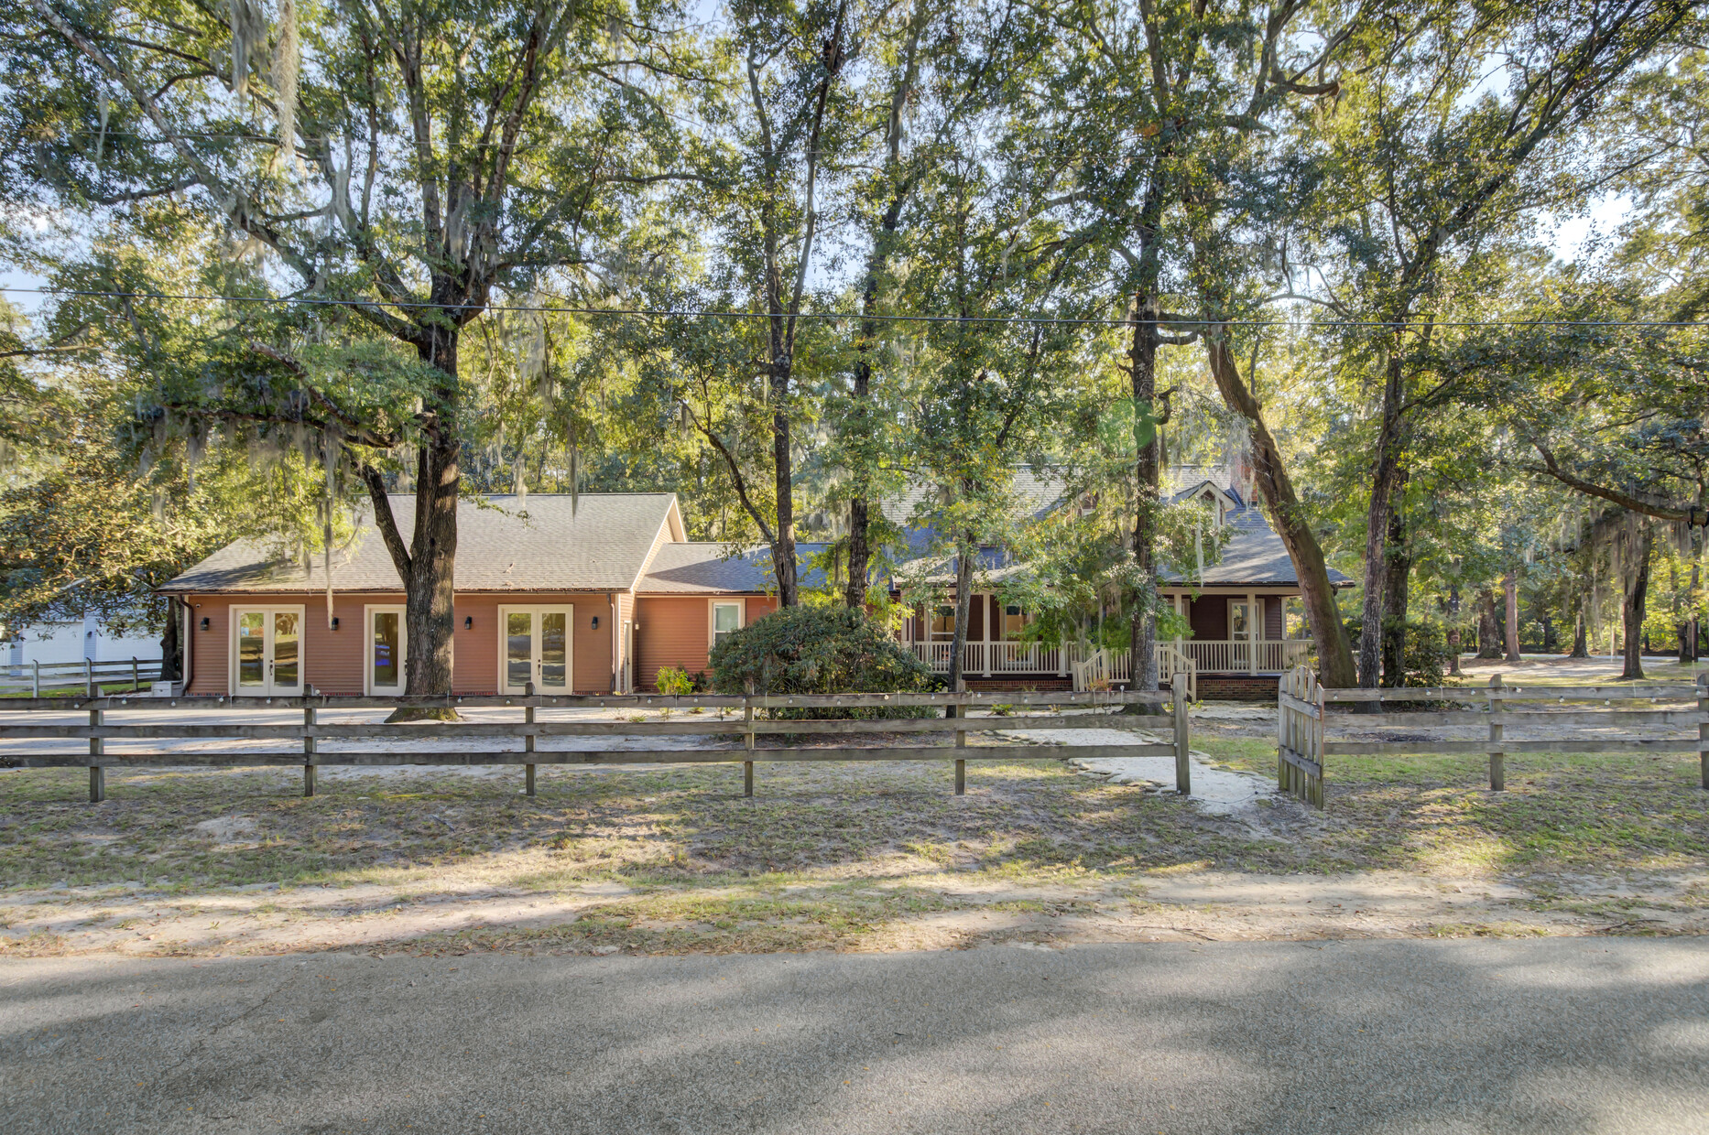
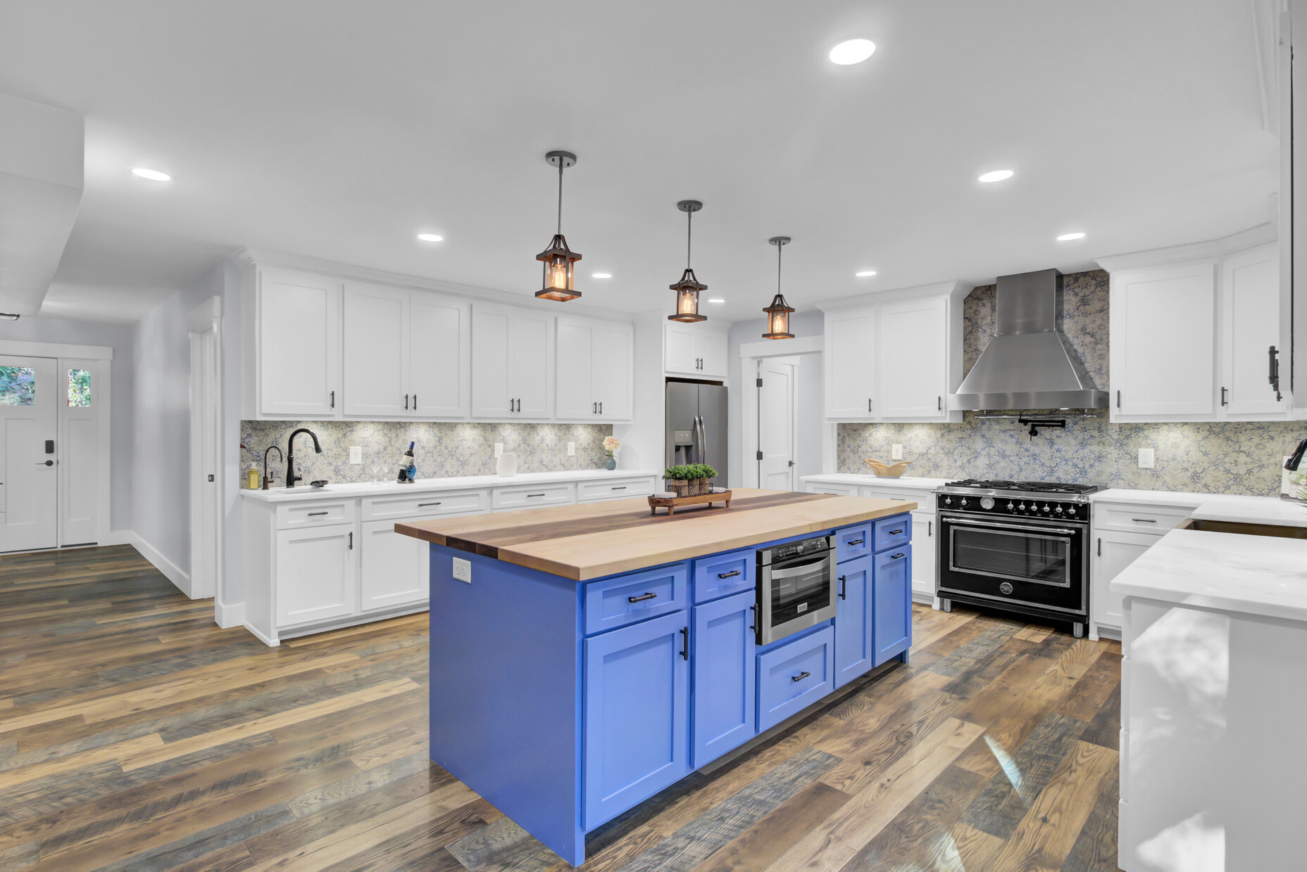
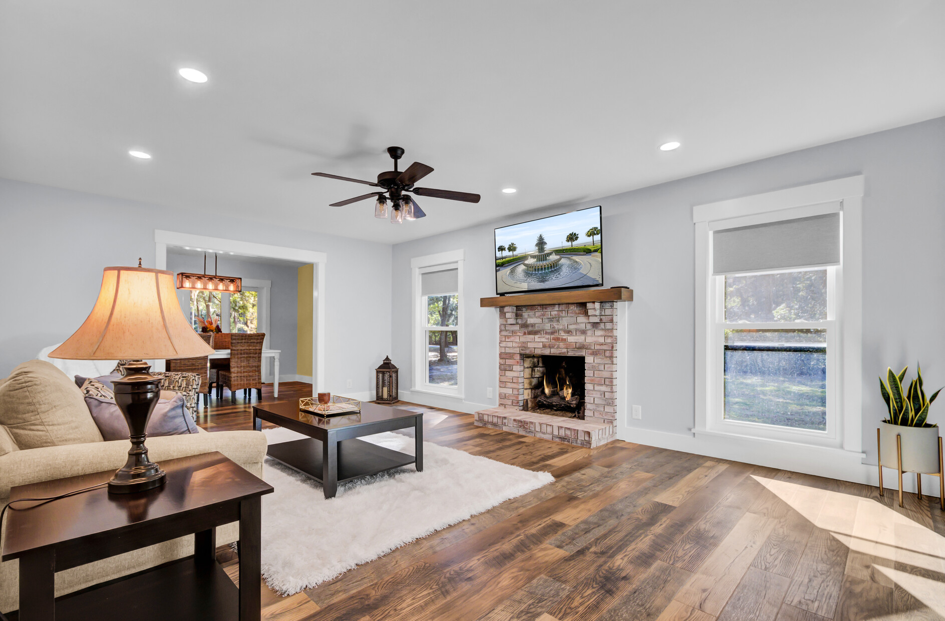
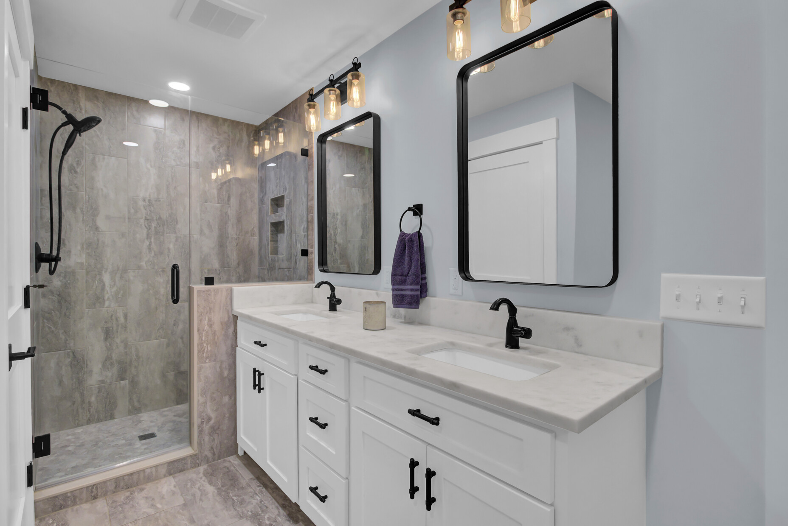
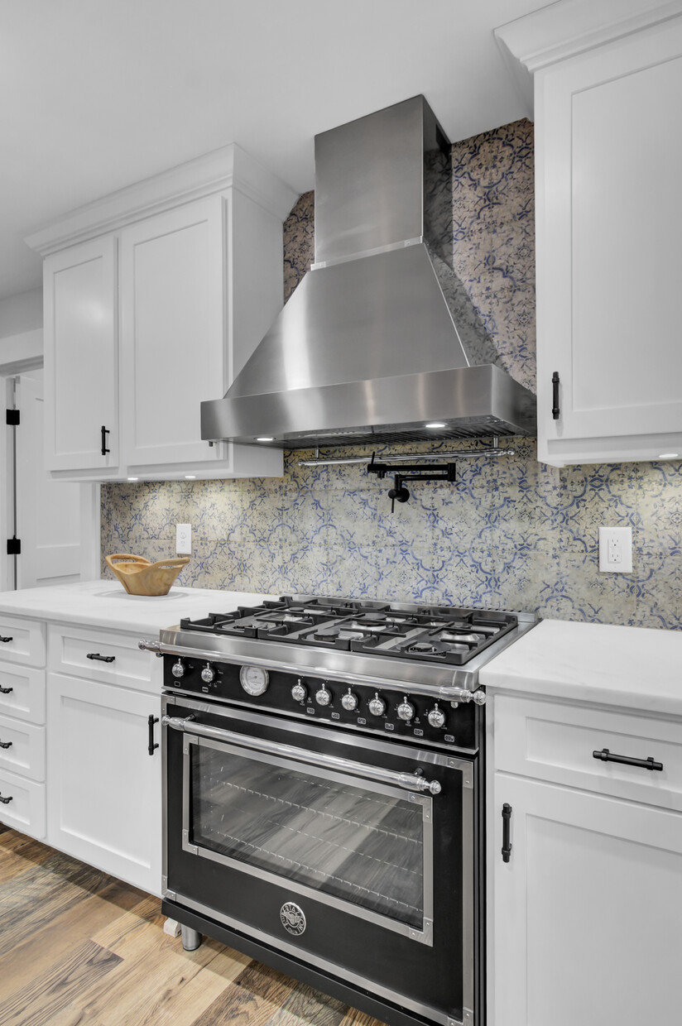
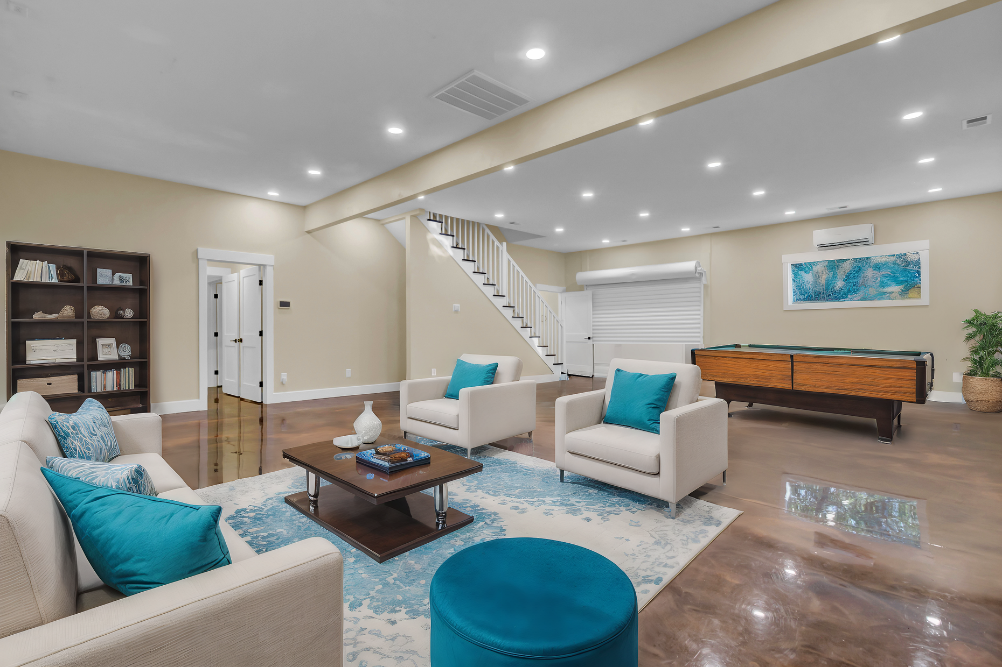
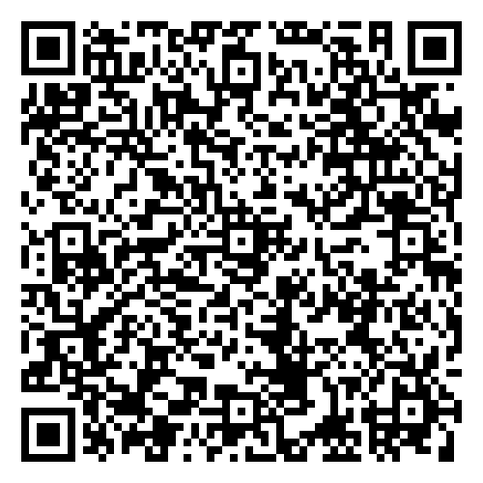
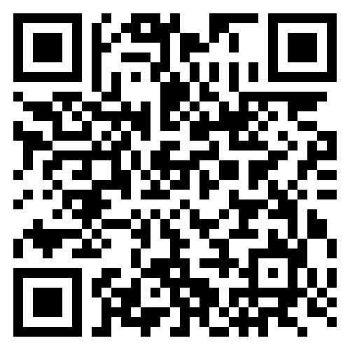


Dream Home with RV Parking, Home Business Space & More Don't Miss Out!
4429 Francis Younge Way
Log Bridge Landing
Hollywood, SC 29449
MLS# 24027574 | $1,190,000
Virtual Tour
Video Tour
Agents- Do you have a client who LOVES their RV but hates paying for storage? This gorgeous a completely renovated home offers the ability to park the RV on site. It even offers water and electricity for the RV!!! Located a mere two minutes from the West Ashley Town line it is a quick and easy ride to stores and businesses in town. Speaking of businesses, this home ALSO offers the owners the ability to WORK FROM HOME. A 1600 sf FLEX space was completely renovated and built out as a photography studio. It could be used for MANY types of home-based business OR can be converted to an in-law apartment for anyone looking for MULTIGENERATIONAL LIVING. The primary suite is already built out and the remaining space could be converted to an open concept kitchen and living area. It would also make one AMAZING RECREATION space for people who love to throw parties. This is LIKE NEW CONSTRUCTION throughout. Rarely do you see such a versatile home that appeals to buyers with various desires. Live in complete serenity among the scenic oaks yet enjoy the benefits of being so close to town.
Schedule your tour NOW while this opportunity remains!
Virtual Tour | Video Tour
Ellen O'Neil
Broker/Owner, ABR, e-PRO, CNE
Charleston Realtor of Distinction
843-300-8530
www.EllenONeilProperties.com

