Slide 1
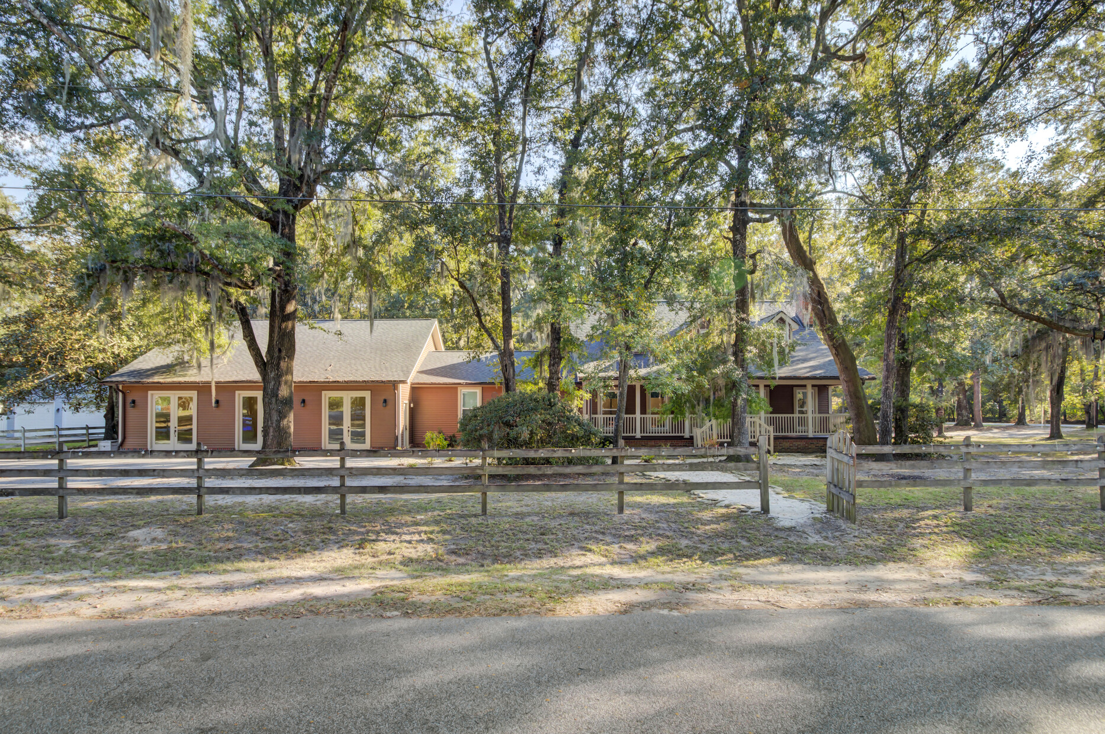
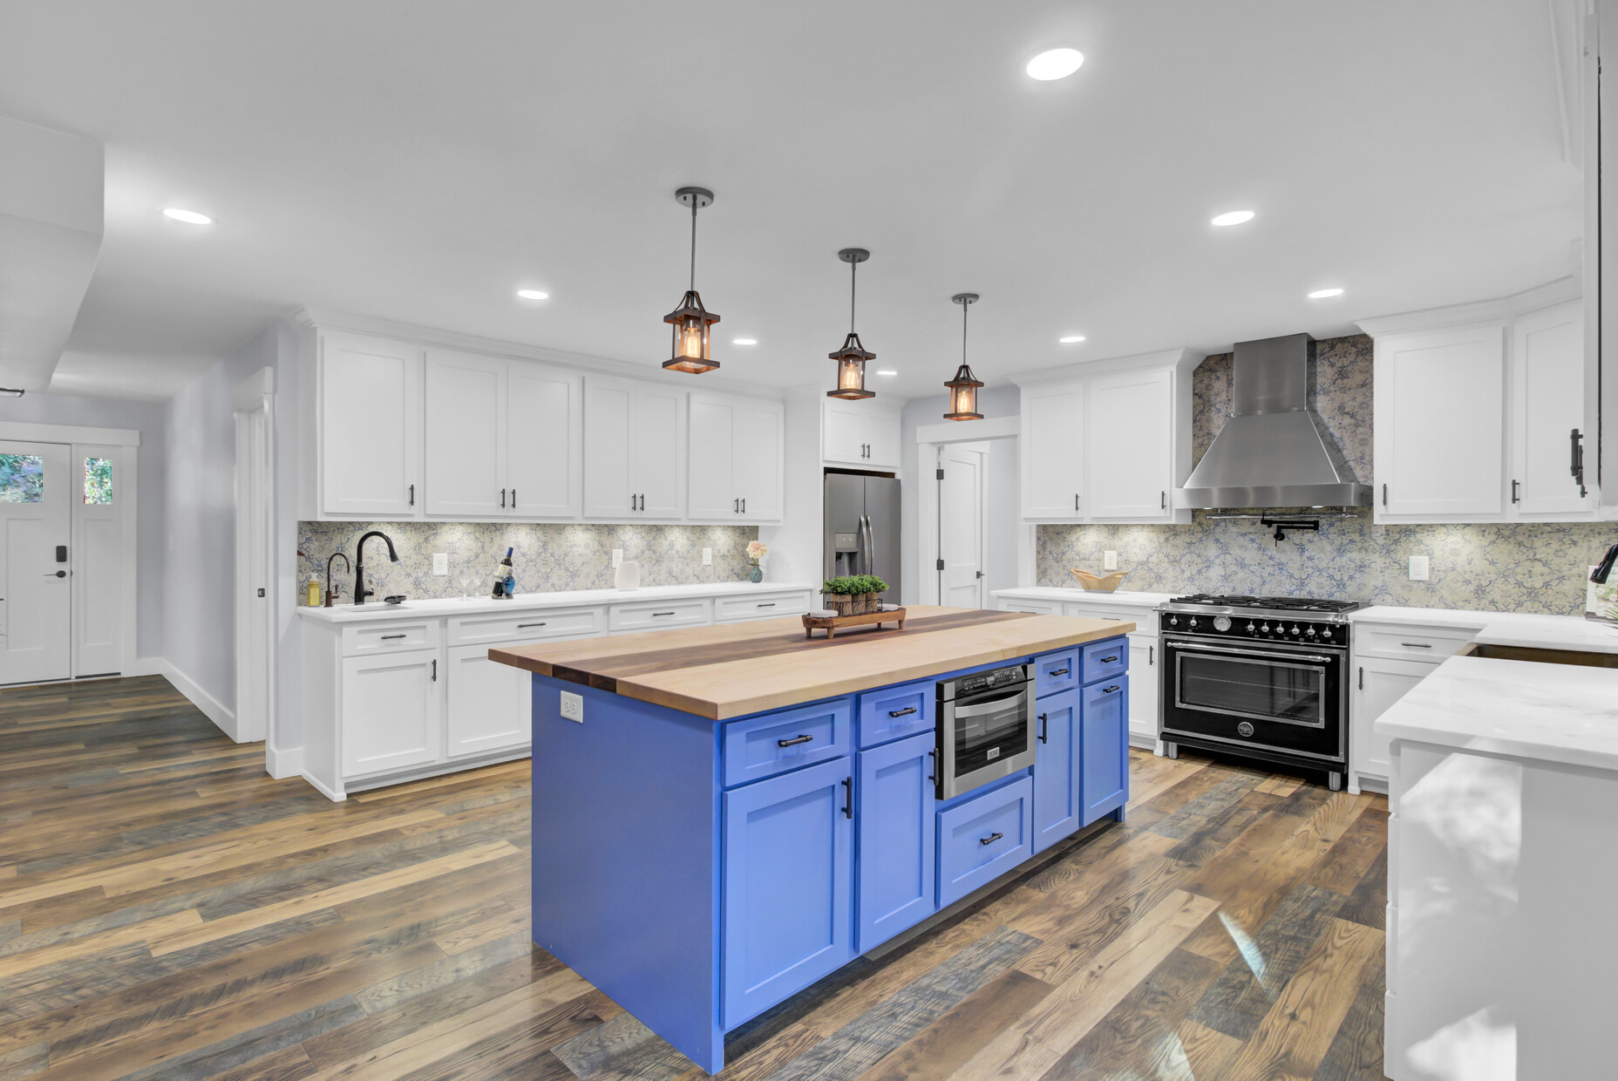
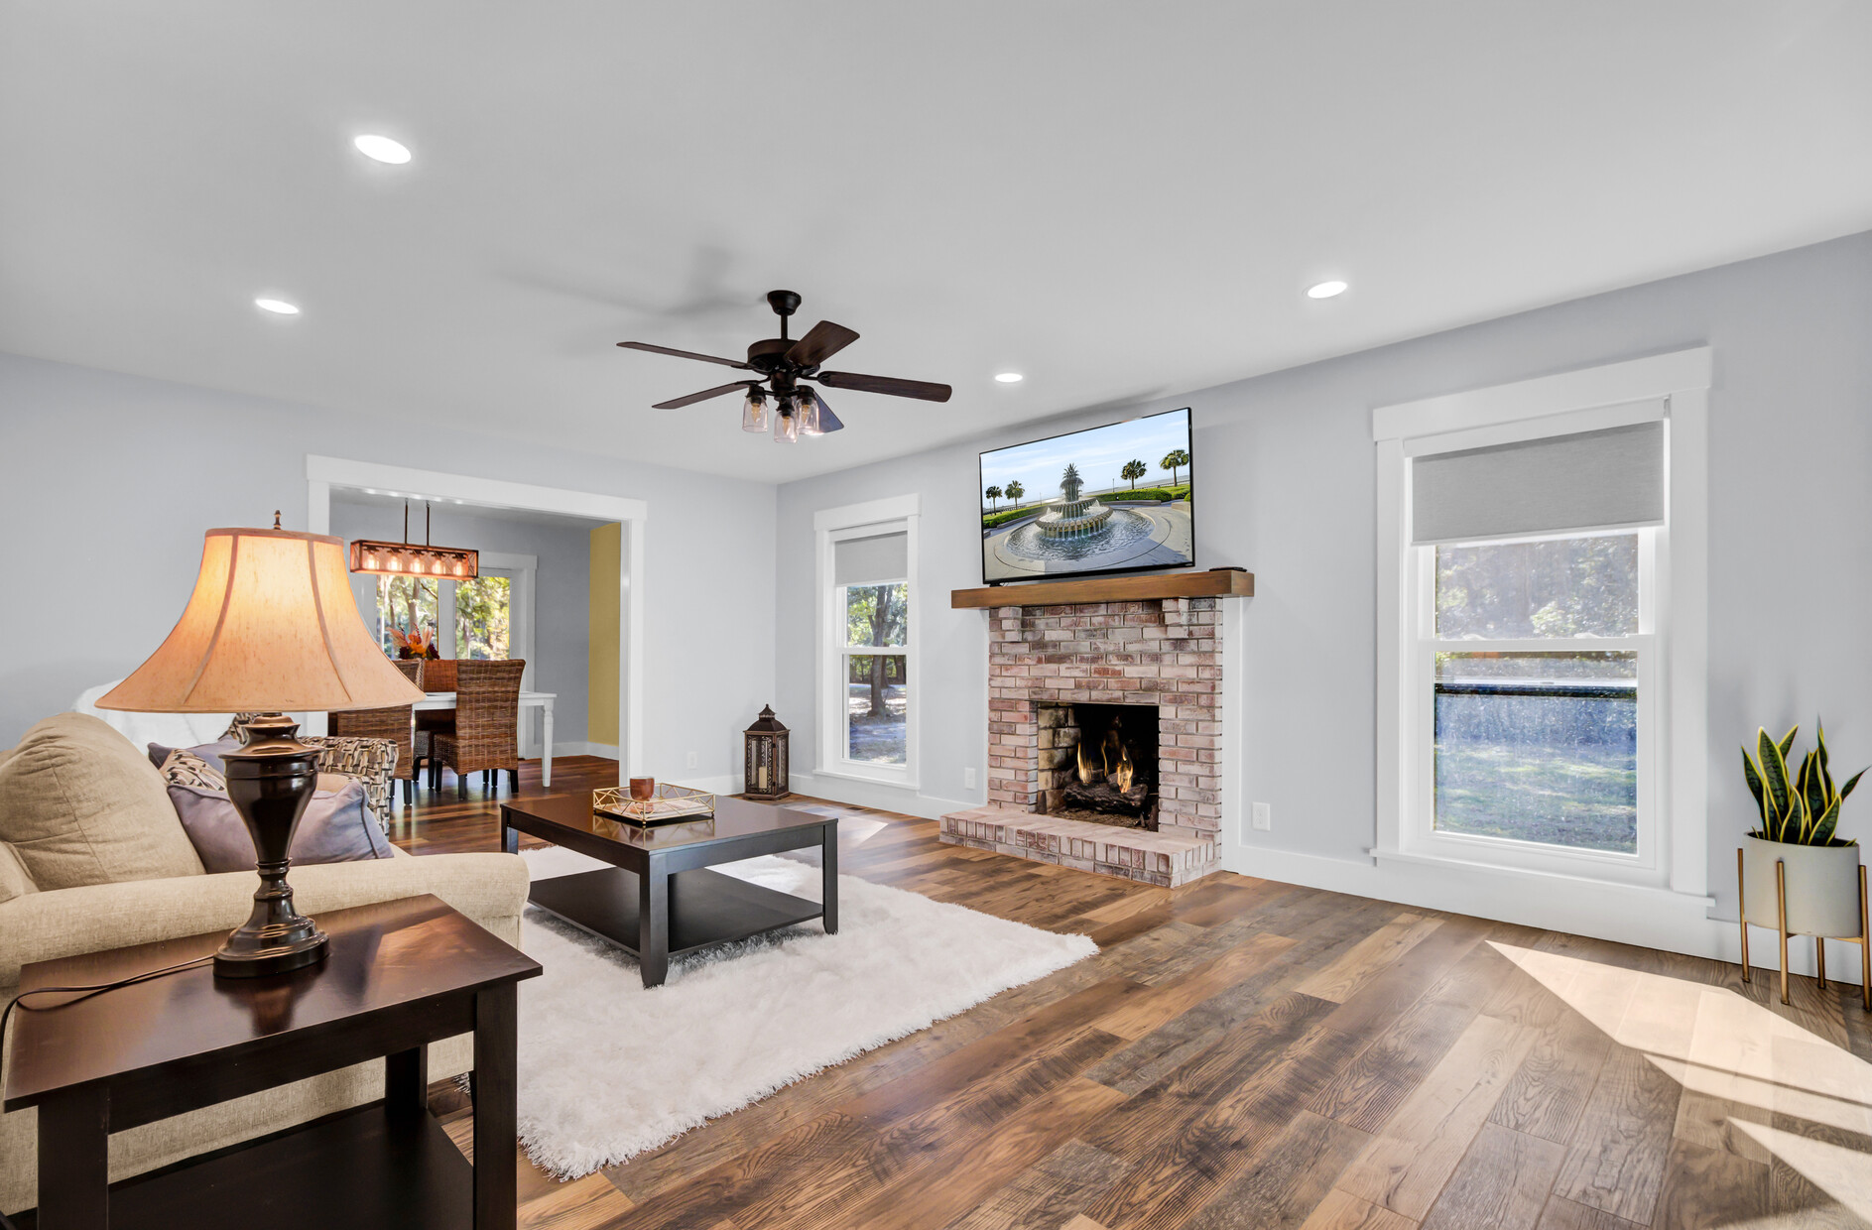
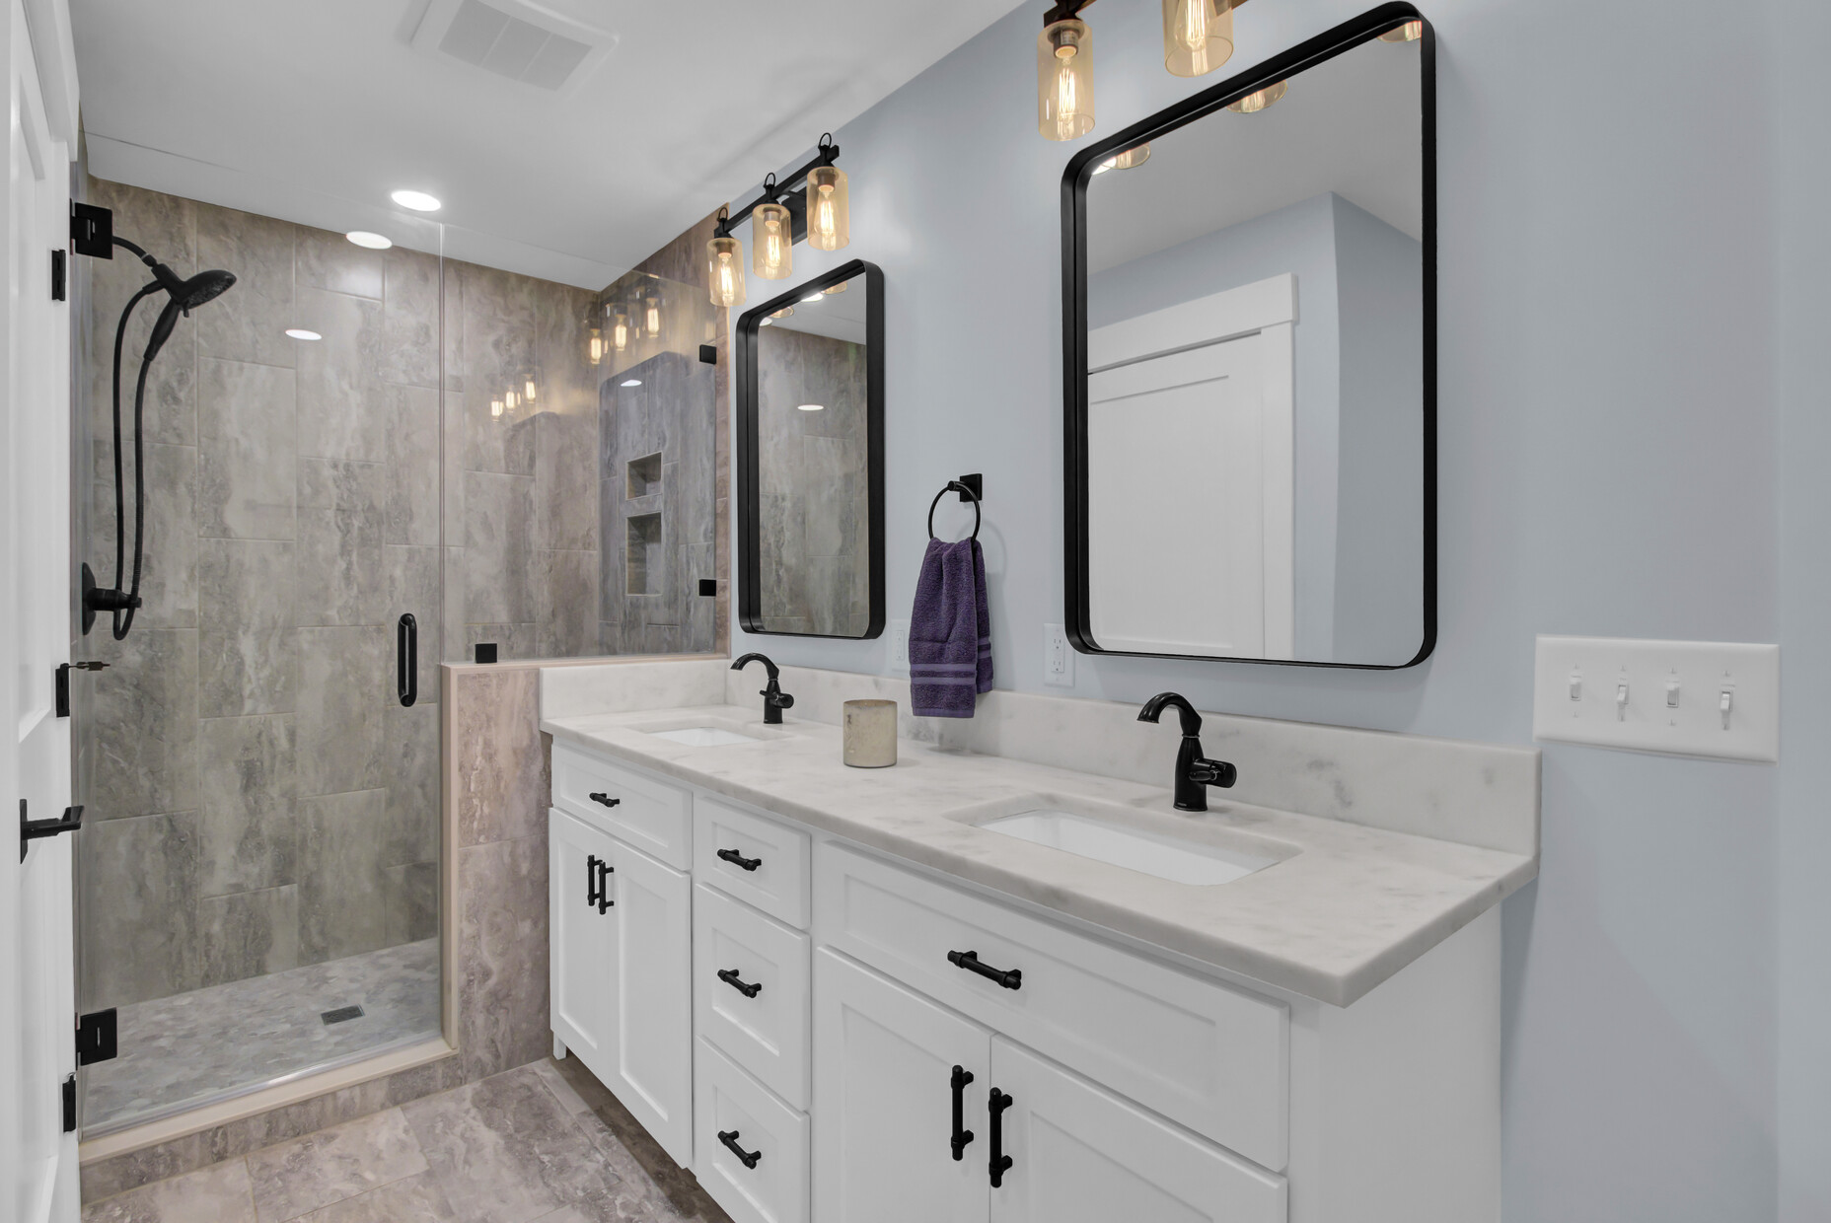
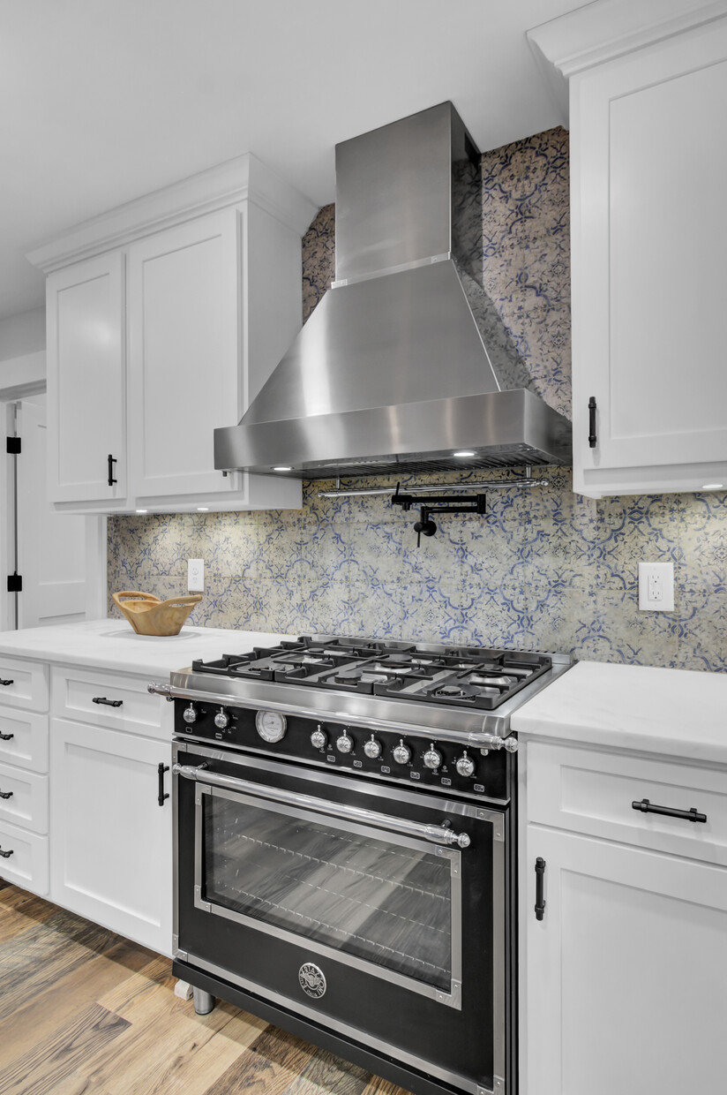
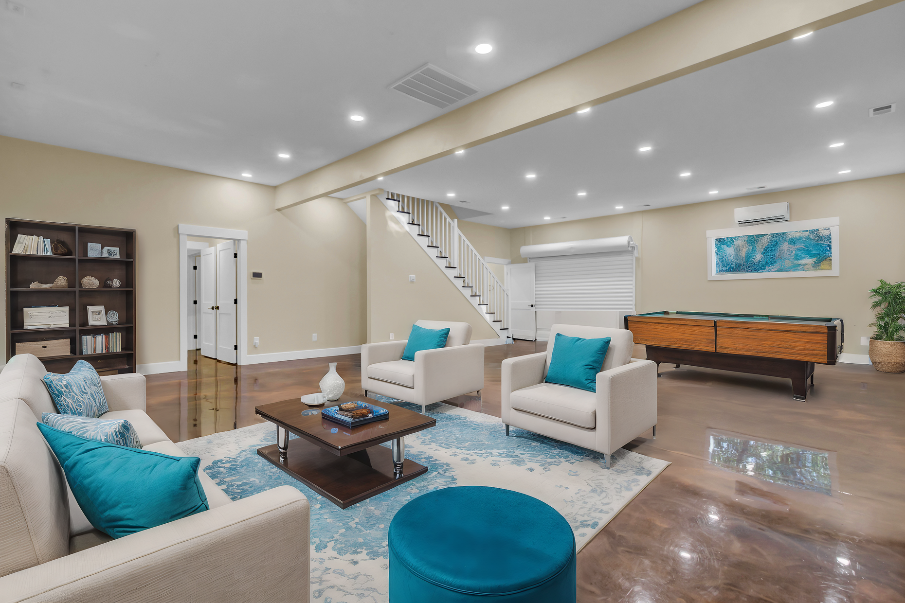
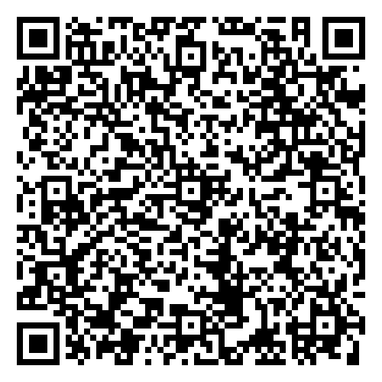



Massive Price Improvement and Huge Instant Equity Opportunity
Sellers are offering 2.5% by agent compensation!
4429 Francis Younge Way
Log Bridge Landing
Hollywood, SC 29449
MLS# 24027574 | $995,000
Virtual
Tour
Video Tour
New Price is $995,000 with an appraisal at $1,180,000 in hand.
The only thing better than the price is the house itself! This stunning home is fully renovated and lives like new construction. No HOA so bring your boat and RV- there is even an RV hook up at the house!
The huge flex space is perfect for in-law suite or home based business. You won't find a more peaceful setting, yet you are so close to town! This opportunity is incredible! So book a tour now!
Virtual Tour | Video Tour
Ellen O'Neil
Broker/Owner, ABR, e-PRO, CNE
Charleston Realtor of Distinction
843-300-8530
www.EllenONeilProperties.com

