Slide 1
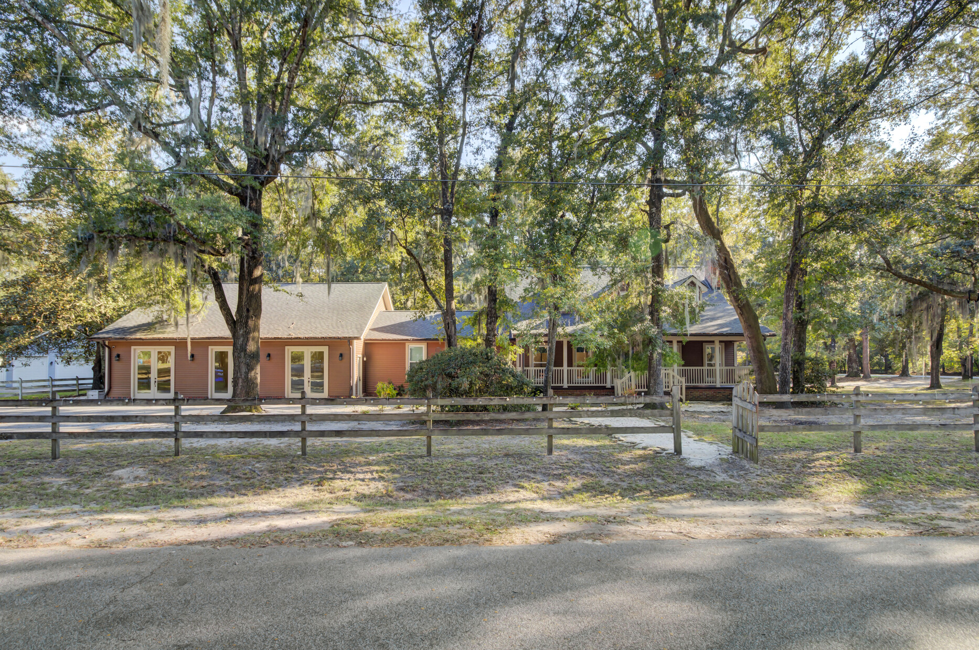
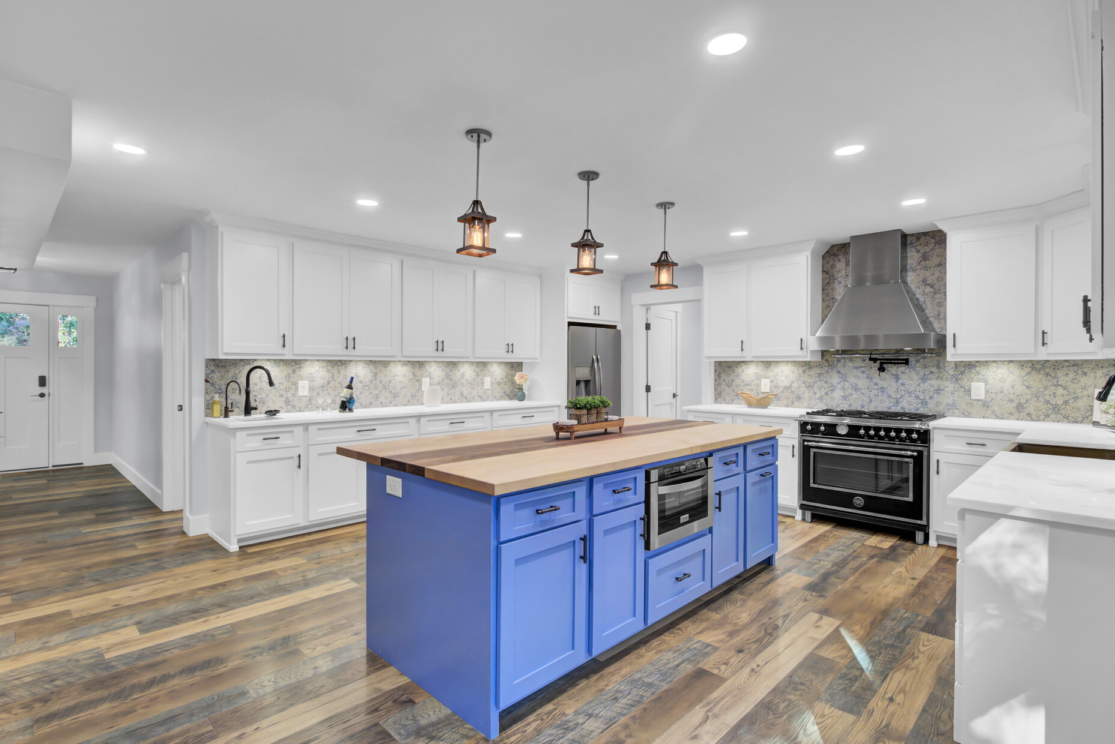
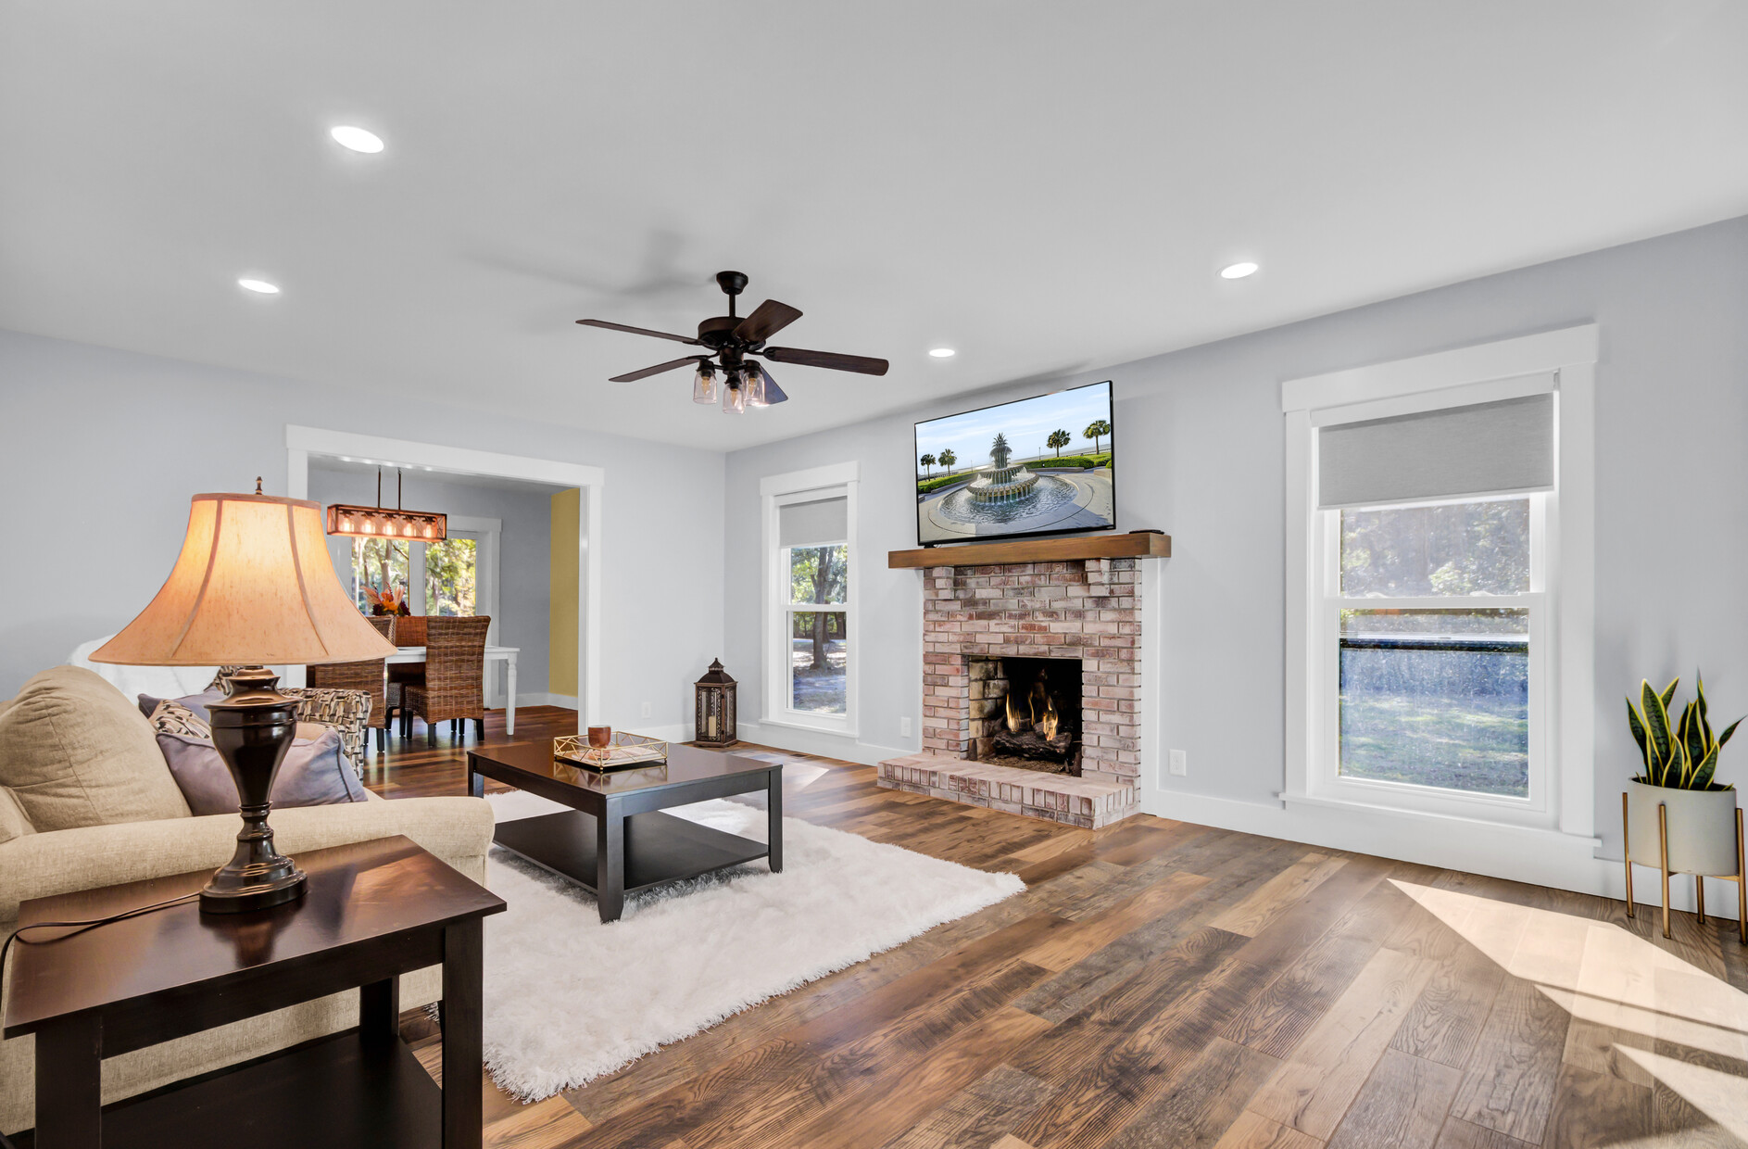
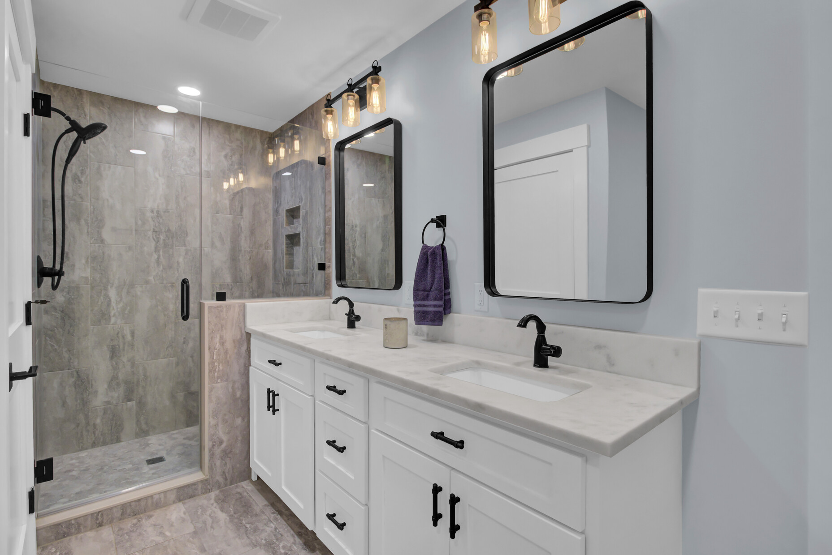
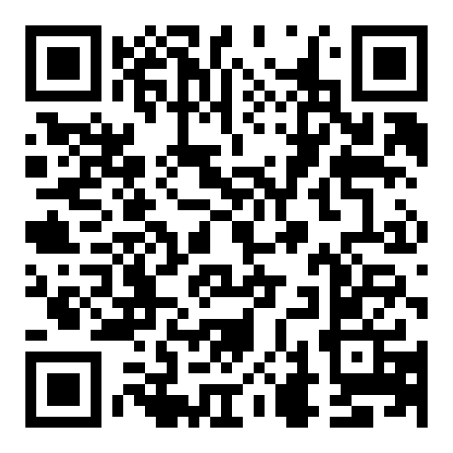
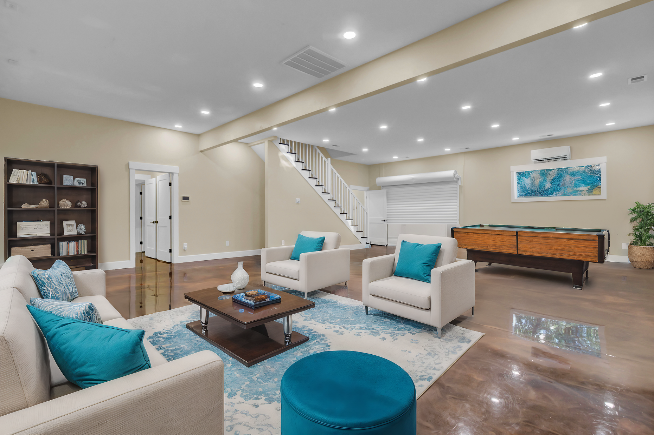
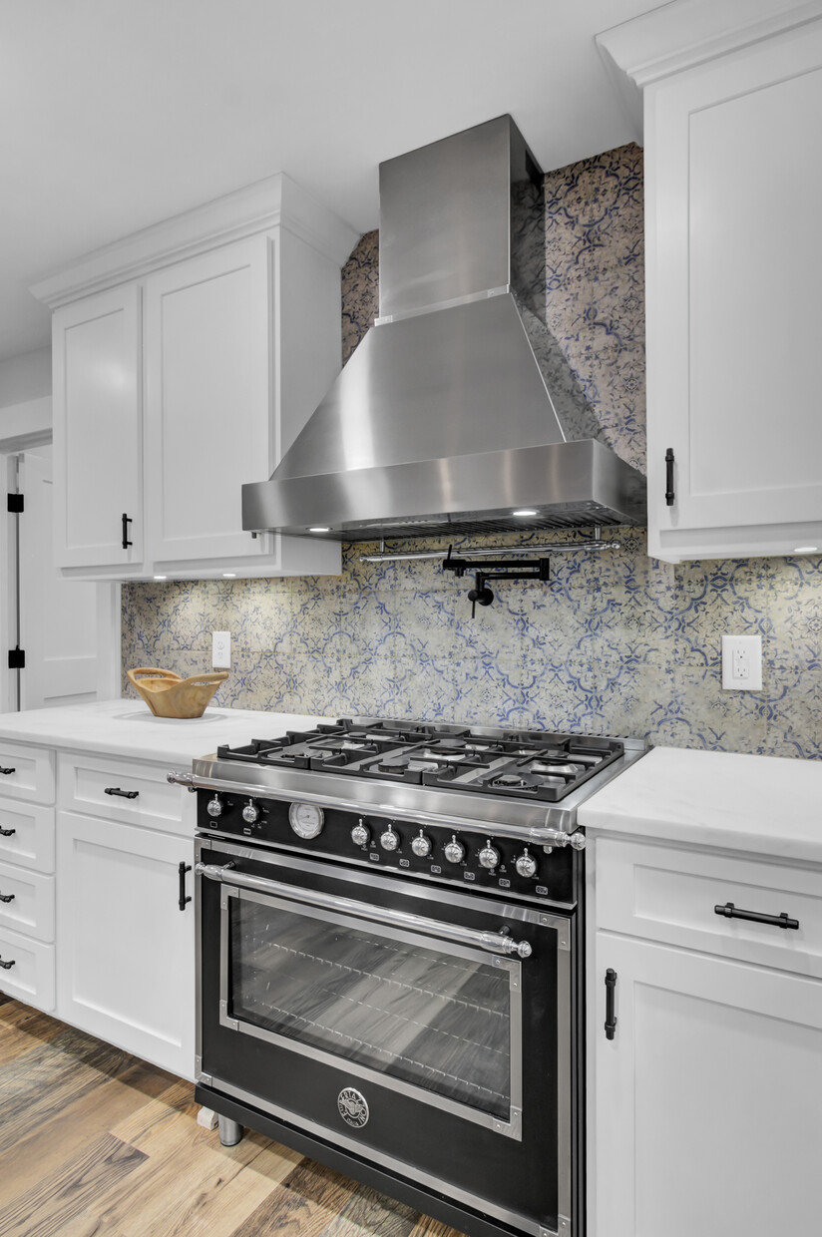
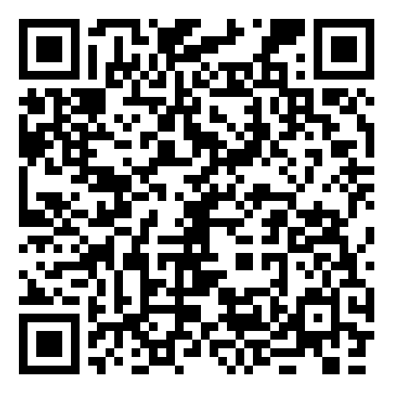
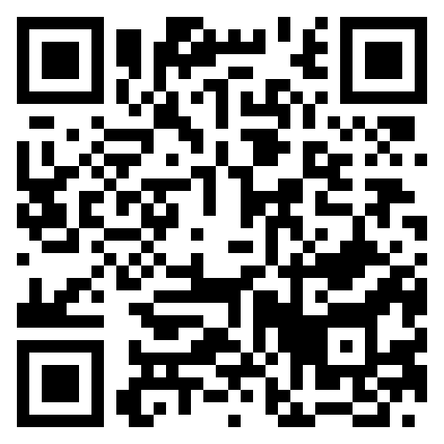


Huge Price Reduction – Instant Equity + Versatile Living!
Storybook
4429 Francis Younge Way
Hollywood, SC 29449
MLS# 24027574 | $959,000
Property Site
Video Tour
Price Reduction!
Rare opportunity at 4429 Francis Younge Way. Recently appraised at $1,180,000—instant equity for the new buyer! This fully renovated home offers open living, a chef’s kitchen, and a luxurious primary suite.
The expansive Flex Space is perfect for a home-based business or a private in-law suite. With modern updates, impact windows, and no restrictive covenants, this property is truly one of a kind.
📲 Call Ellen O’Neil directly at 843-300-8530 to schedule your private tour today!
Property Site | Video Tour | Storybook
Ellen O'Neil
Broker/Owner, ABR, e-PRO, CNE
Charleston Realtor of Distinction
843-300-8530
www.EllenONeilProperties.com

