Slide 1
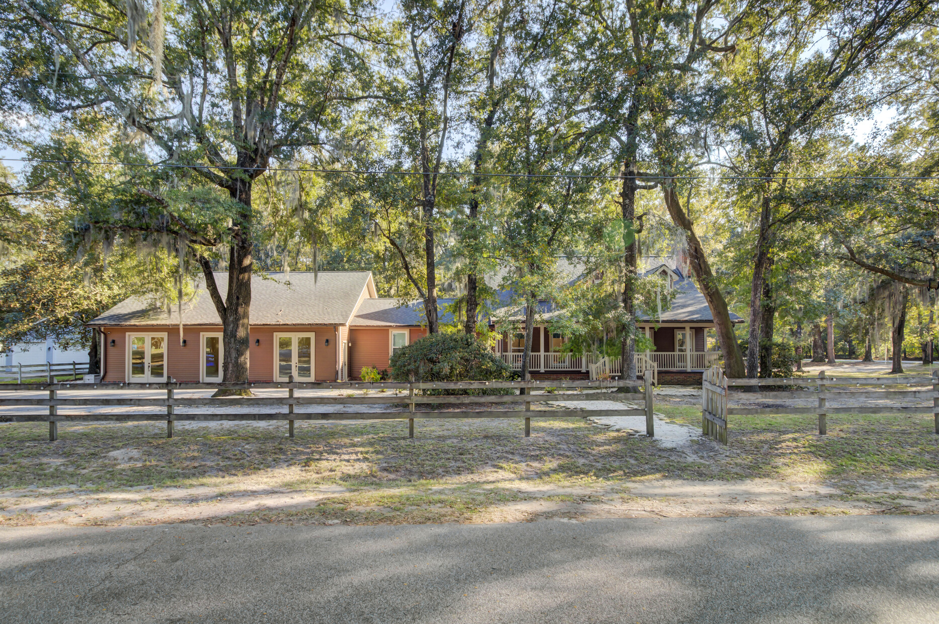
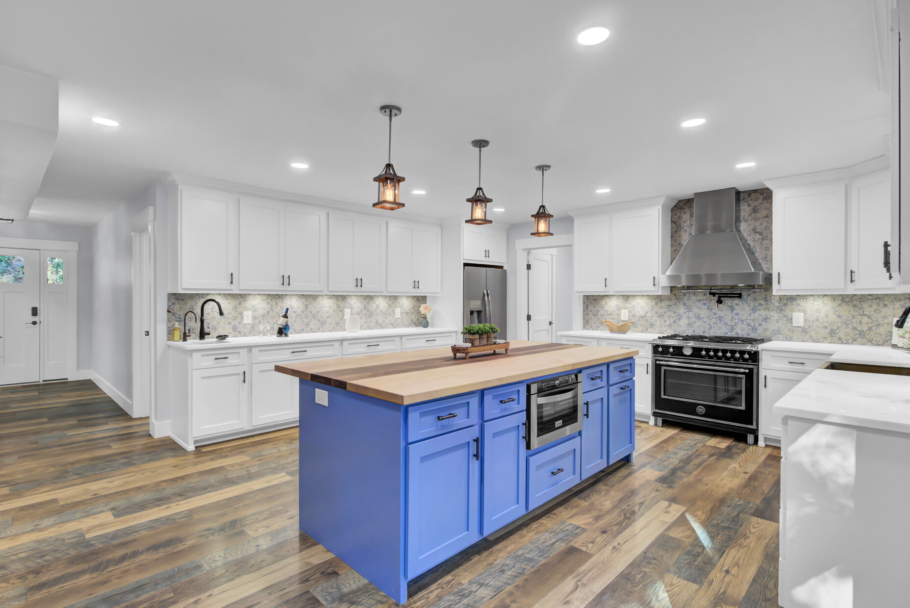
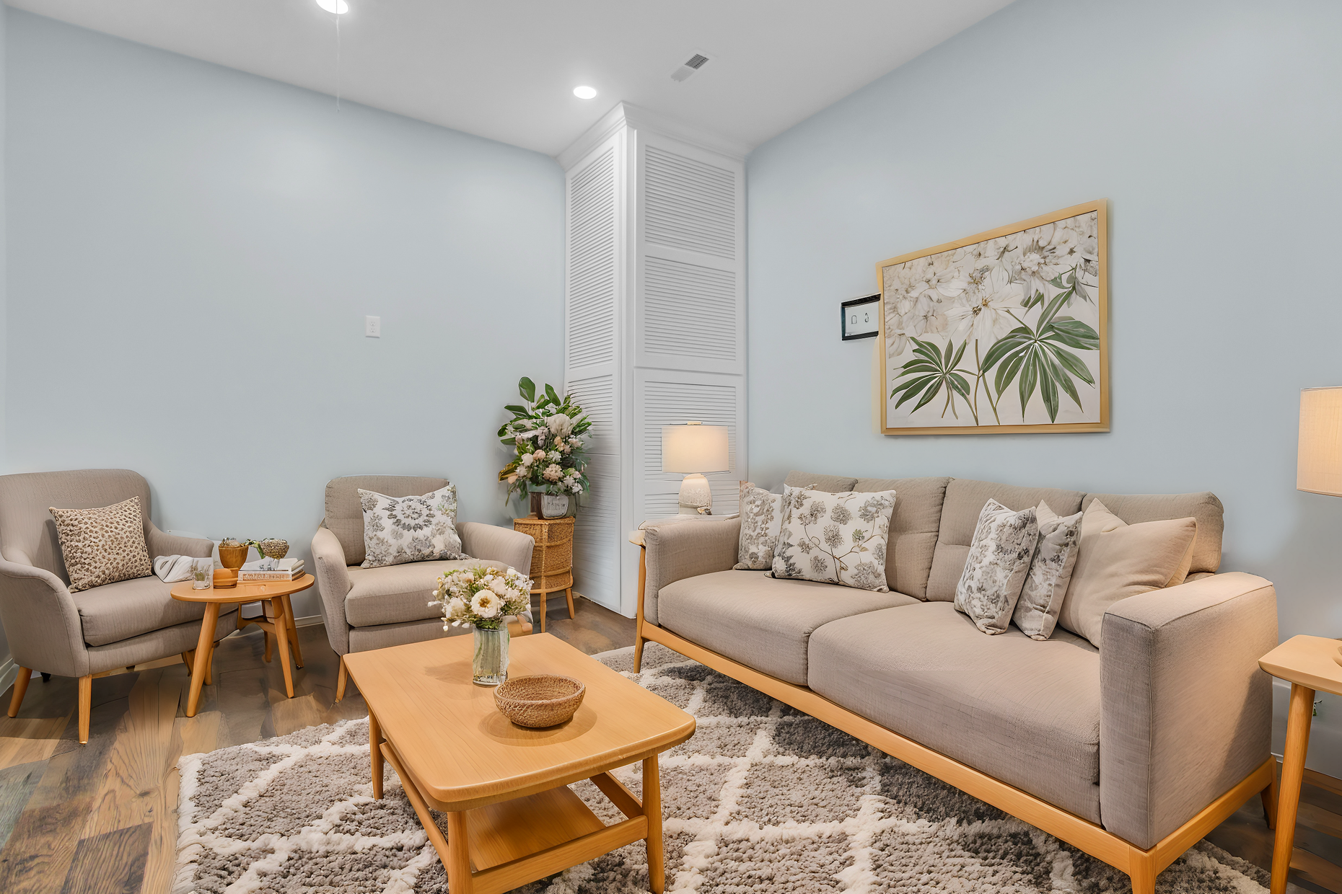
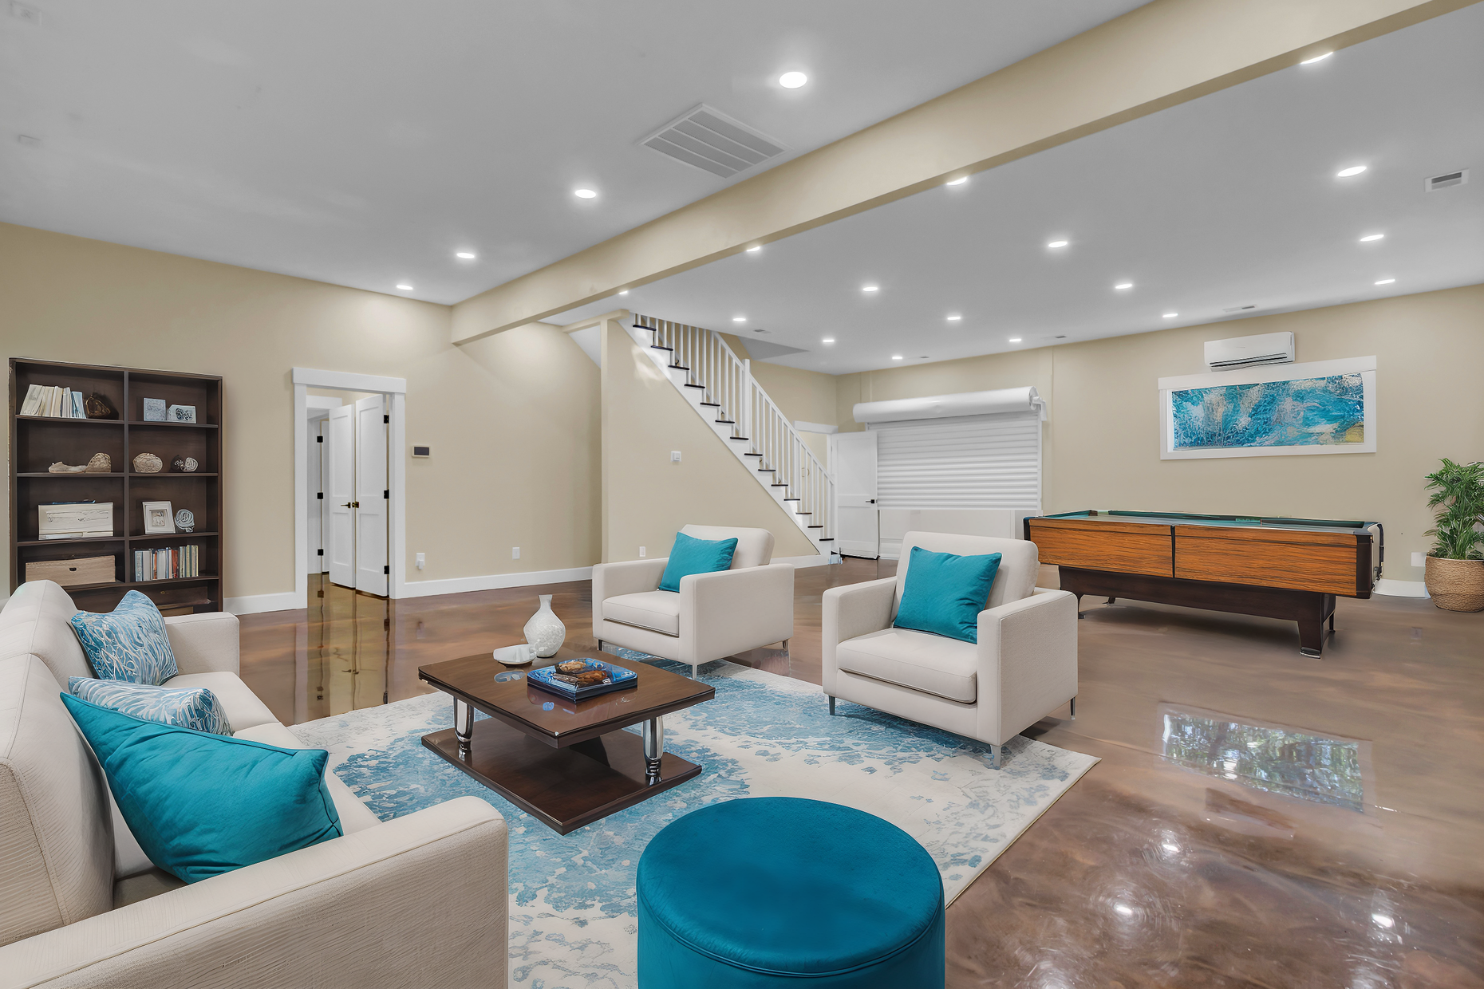
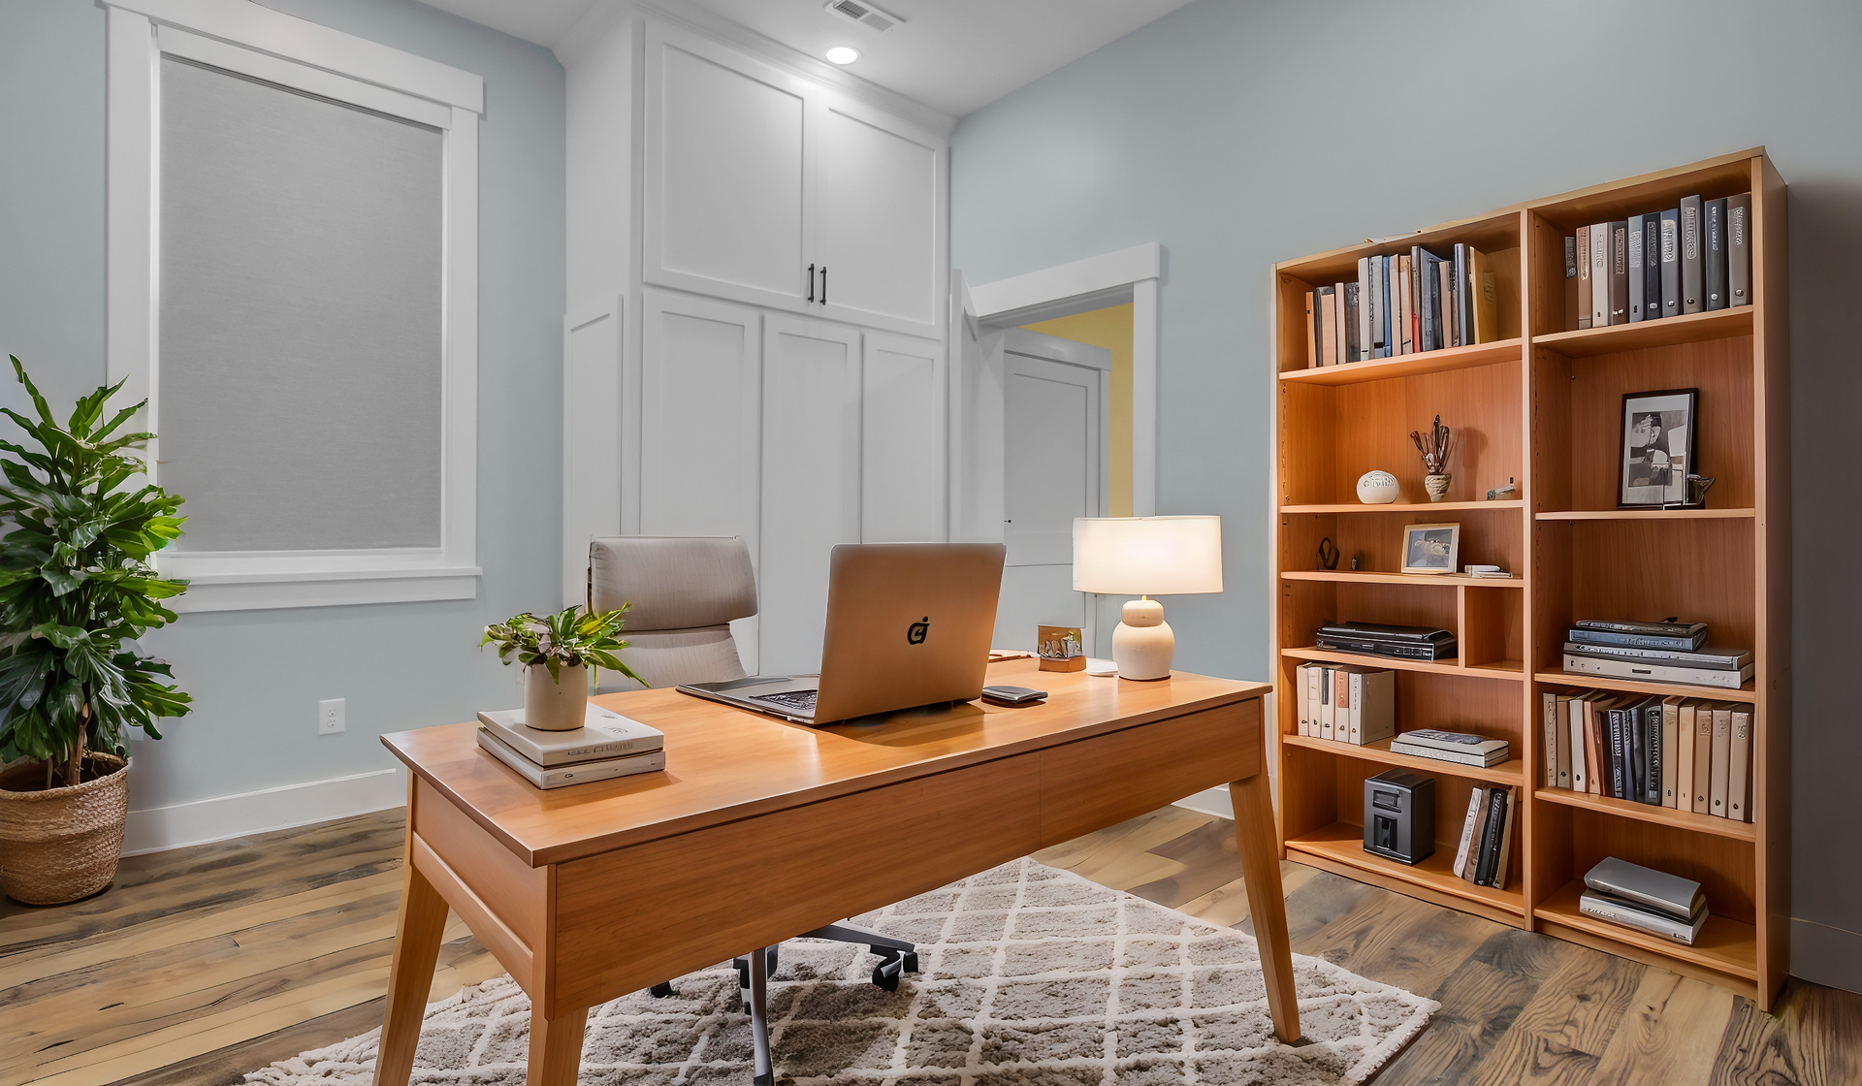

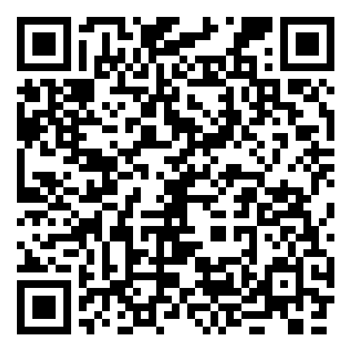
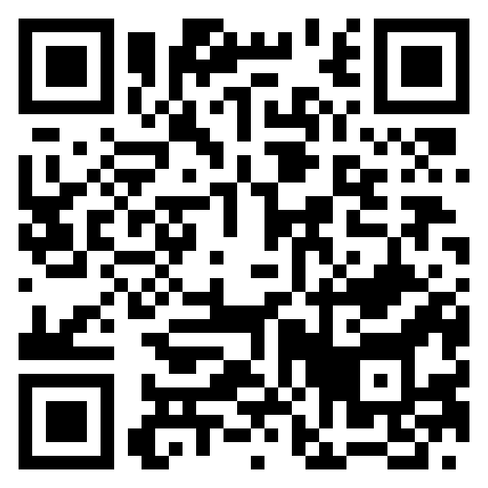
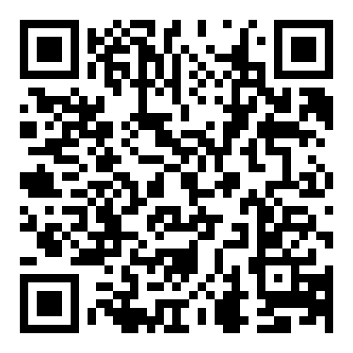



Special Opportunity You Don't Want to Miss!
Property Site
Video Tour
Storybook
4429 Francis Younge Way
Hollywood, SC 29449 | MLS# 24027574 | $959,000
Special Opportunity for Investors or Owners Seeking Cash Flow!
This fully renovated home consists of a stunning renovated 3 bedroom 2.5 bath primary residence with two additional flex rooms on the main level perfect for home office, playroom, mancave or whatever your lifestyle dictates.
Then there is a gorgeous 1600+ sf flexible space attached. This would make an ideal apartment for income generation! Short term rental opportunity awaits. Use the income to offset your living expenses!
The best news is that it is on a picturesque lot with mature oaks and is close to town! This is an opportunity you don’t want to miss!
Those who do not care to generate income–the flex space would be a phenomenal entertaining and recreation area OR lovely inlaw apartment for adult relatives who seek independence but need proximity.
See for yourself–the possibilities are endless!!!
Property Site | Video Tour | Storybook
*some photos were virtually staged
Ellen O'Neil
Broker/Owner, ABR, e-PRO, CNE
Charleston Realtor of Distinction
843-300-8530
www.EllenONeilProperties.com

