Slide 1
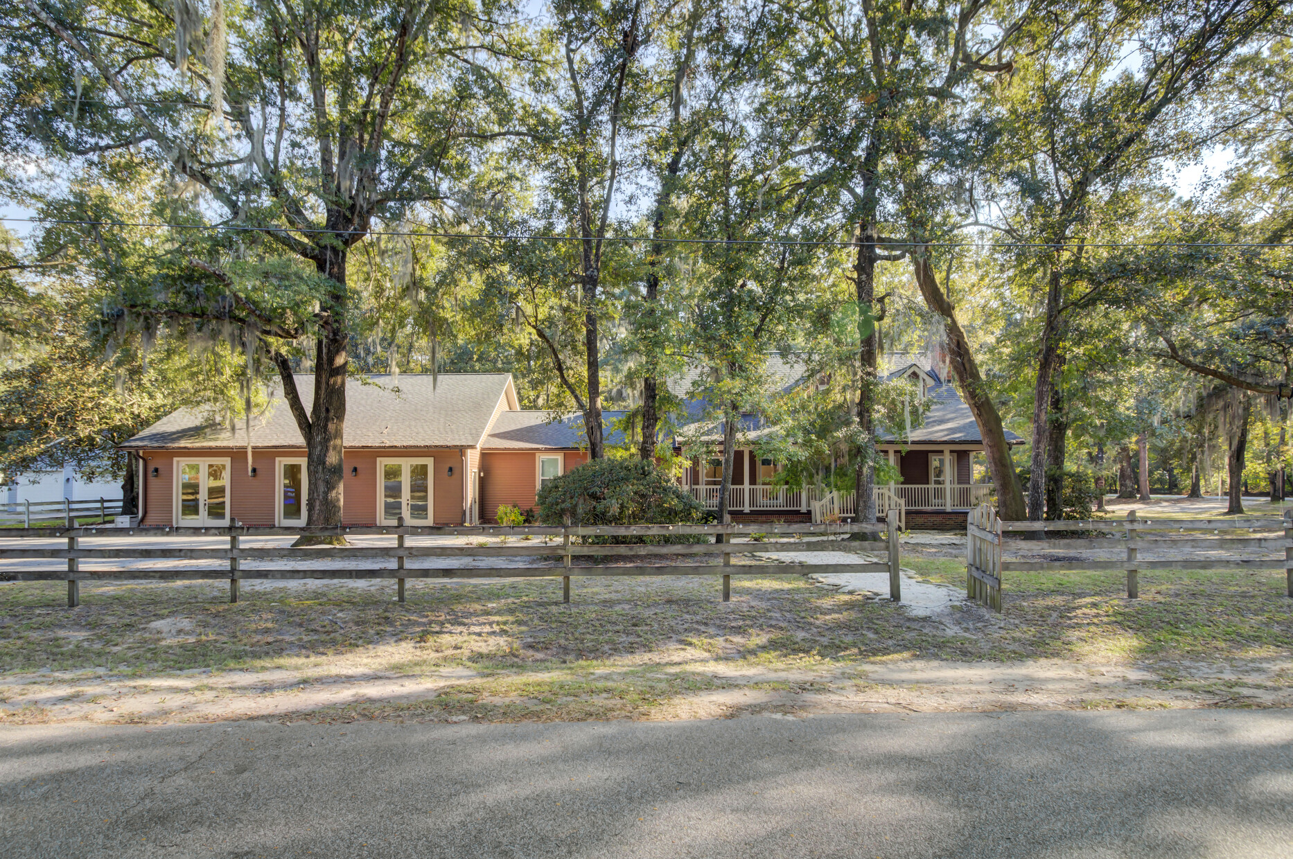
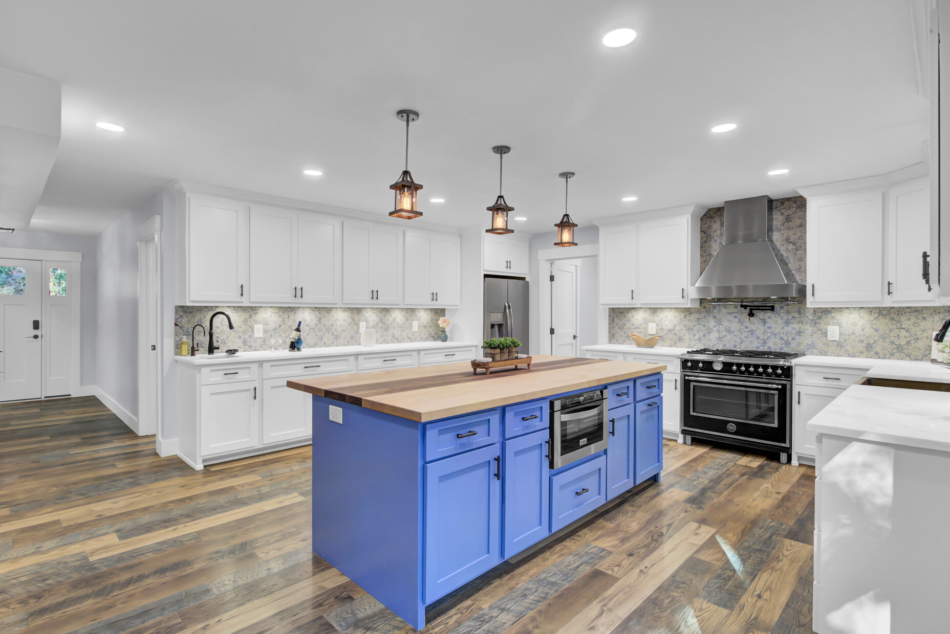
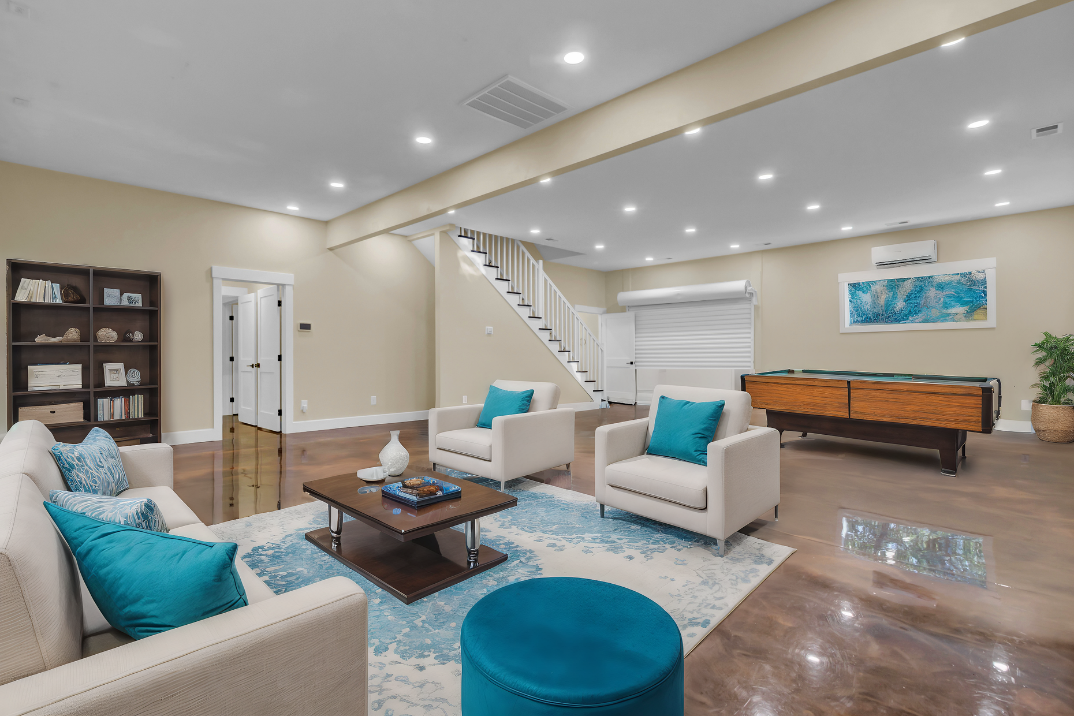
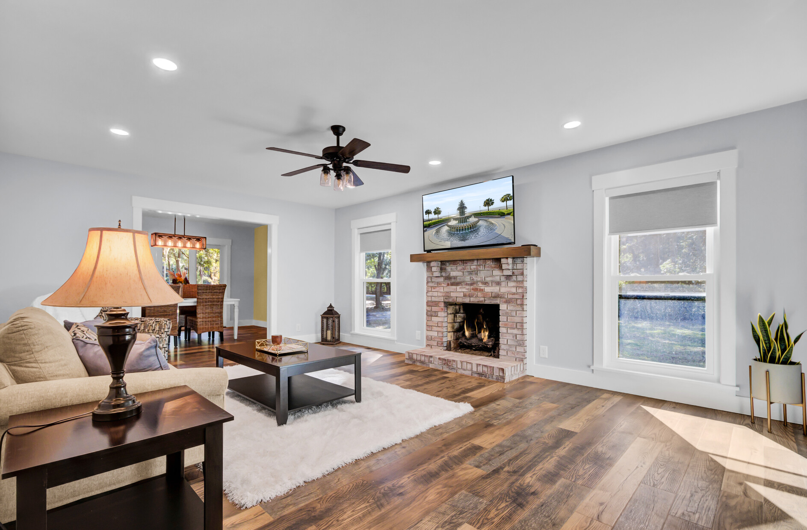
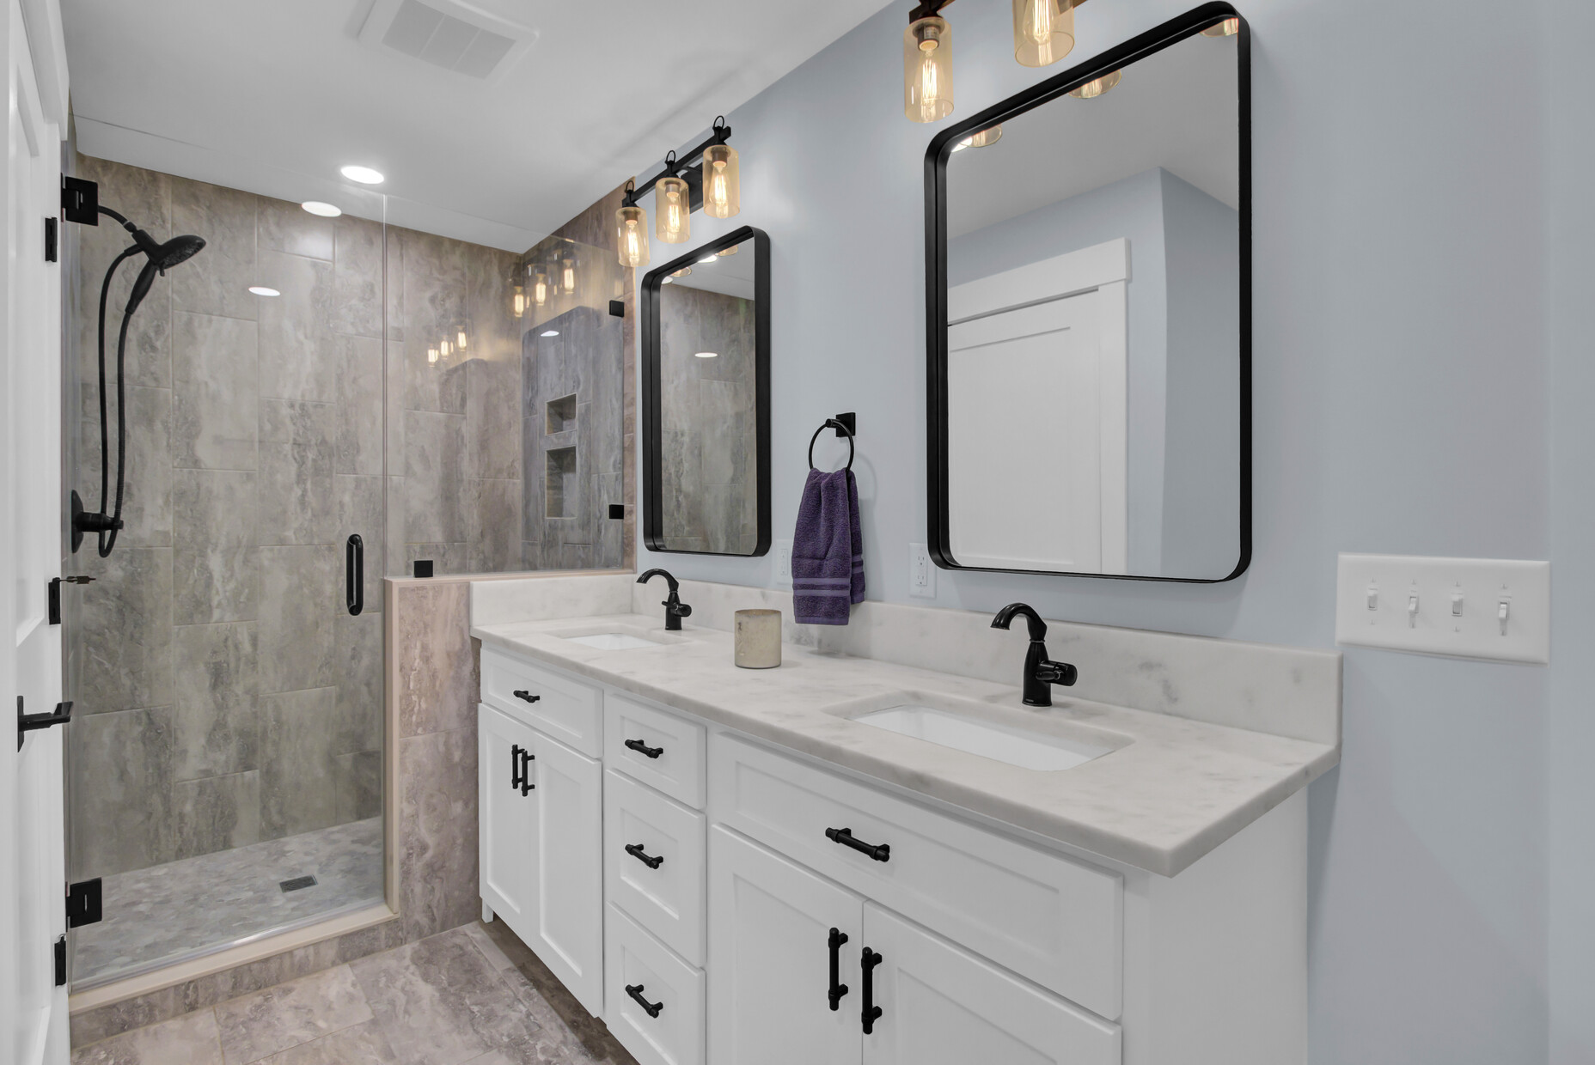




Stunning 4300+ Sq Ft Renovated Home with Endless Possibilities! Flexible In-Law Suite/Home Based Business
VIRTUAL TOUR
4429 Francis Younge Way
Log Bridge
Hollywood, SC 29449
MLS# 24027574 | $1,190,000
VIDEO TOUR
Absolutely stunning property offering unique opportunities for the new owner! This is a fully renovated home with 4300 + square feet of impeccable living space located in one of the most tranquil of Hollywood’s communities, yet convenient to shopping and attractions in nearby West Ashley and Johns Island.. The property has approximately 1600 square feet of flexible use living or working quarters attached, with its own entry making it perfect for an in-law suite or home business location. The current owner did a complete renovation to the home from new roof, new windows, new HVAC, new whole house water filtration system, and renovating every room in the house! The kitchen is a dream boasting high end appliances including a Bertazzoni gas range and oven, pot filler, and glass washers beside each sink. The island with butcher block top is stunning as are the quartz counters and stylish tile back splash. The main living quarters of the home offers a primary suite on the main level, two additional large bedrooms upstairs, a huge family room with fireplace and two additional rooms perfect for a home office, home schooling room, playroom, gaming room, or anything else your heart desires. The additional flex space boasts gorgeous metallic epoxy flooring throughout . A new full bath was added to this space. One very large open concept room is the heart of this area, but it also has two additional smaller rooms that could serve as a bedroom and closet if converted into living space, or for offices if the area was to be used to operate a home-based business. The possibilities are endless as are the list of enhancements, which are so numerous you will feel as if you are in a new home. There is an incredible amount of storage in the home with a full walk-up attic over the Flex Space side of the home, and storage in each eave upstairs in and between the bedrooms. No expense was spared in the quality craftsmanship of this transformation. Schedule your tour and see for yourself why this is such a unique opportunity.
VIRTUAL TOUR | VIDEO TOUR
Ellen O'Neil
Broker/Owner, ABR, e-PRO, CNE
Charleston Realtor of Distinction
843-300-8530
www.EllenONeilProperties.com

