Slide 1
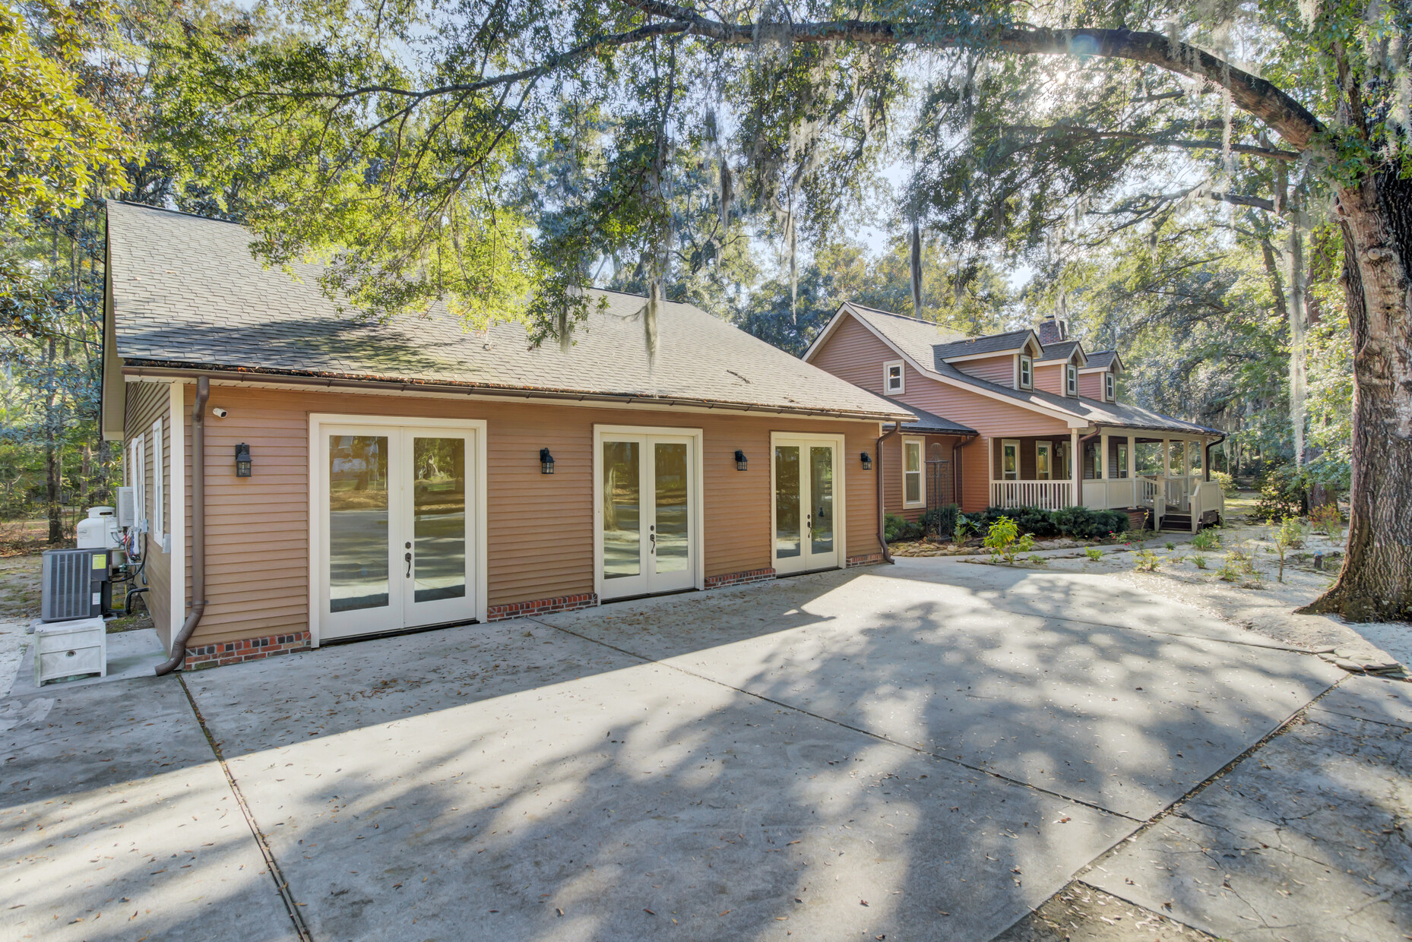
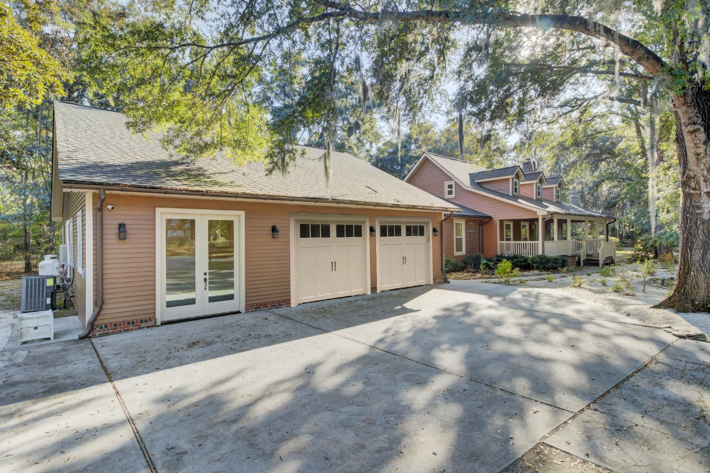
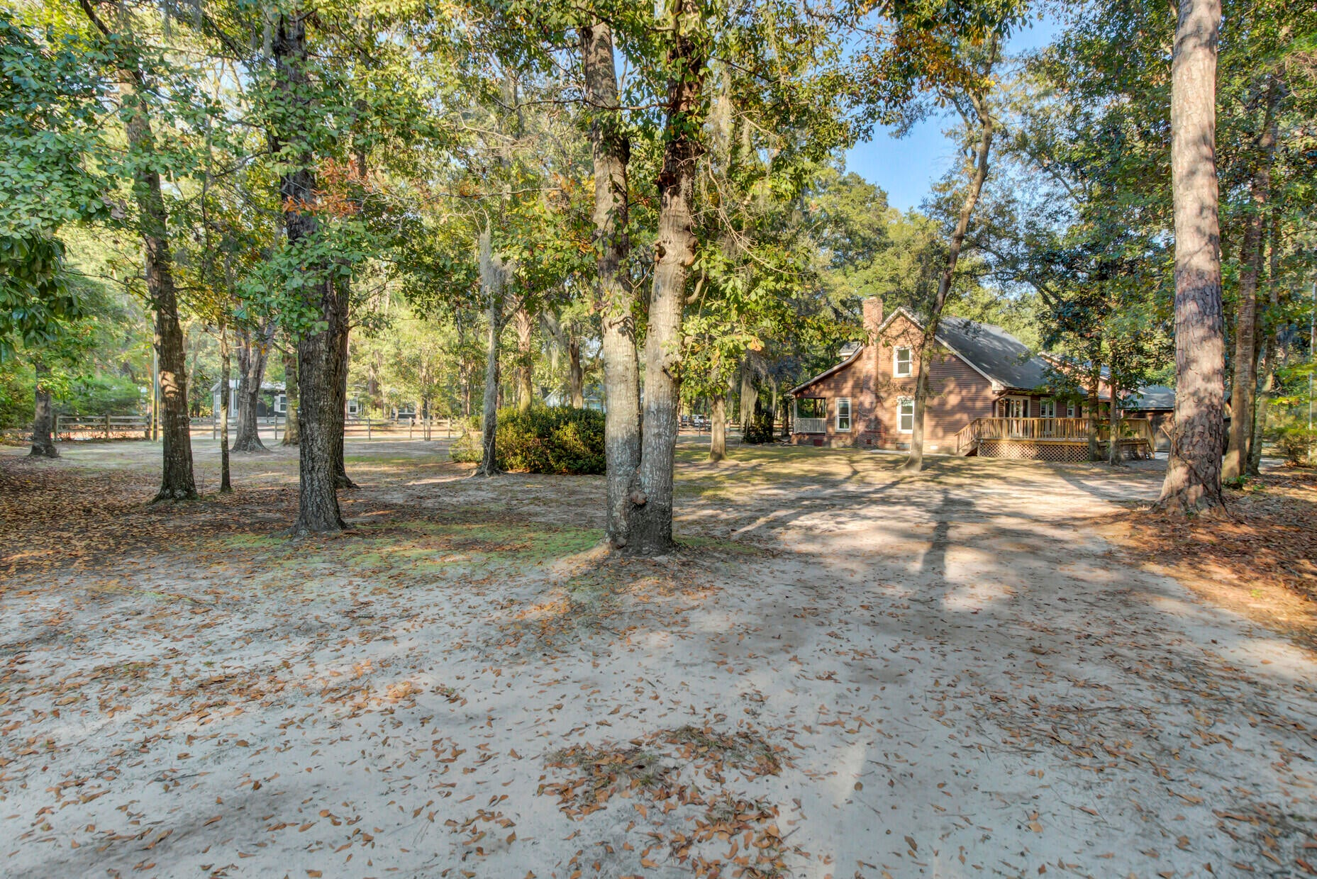
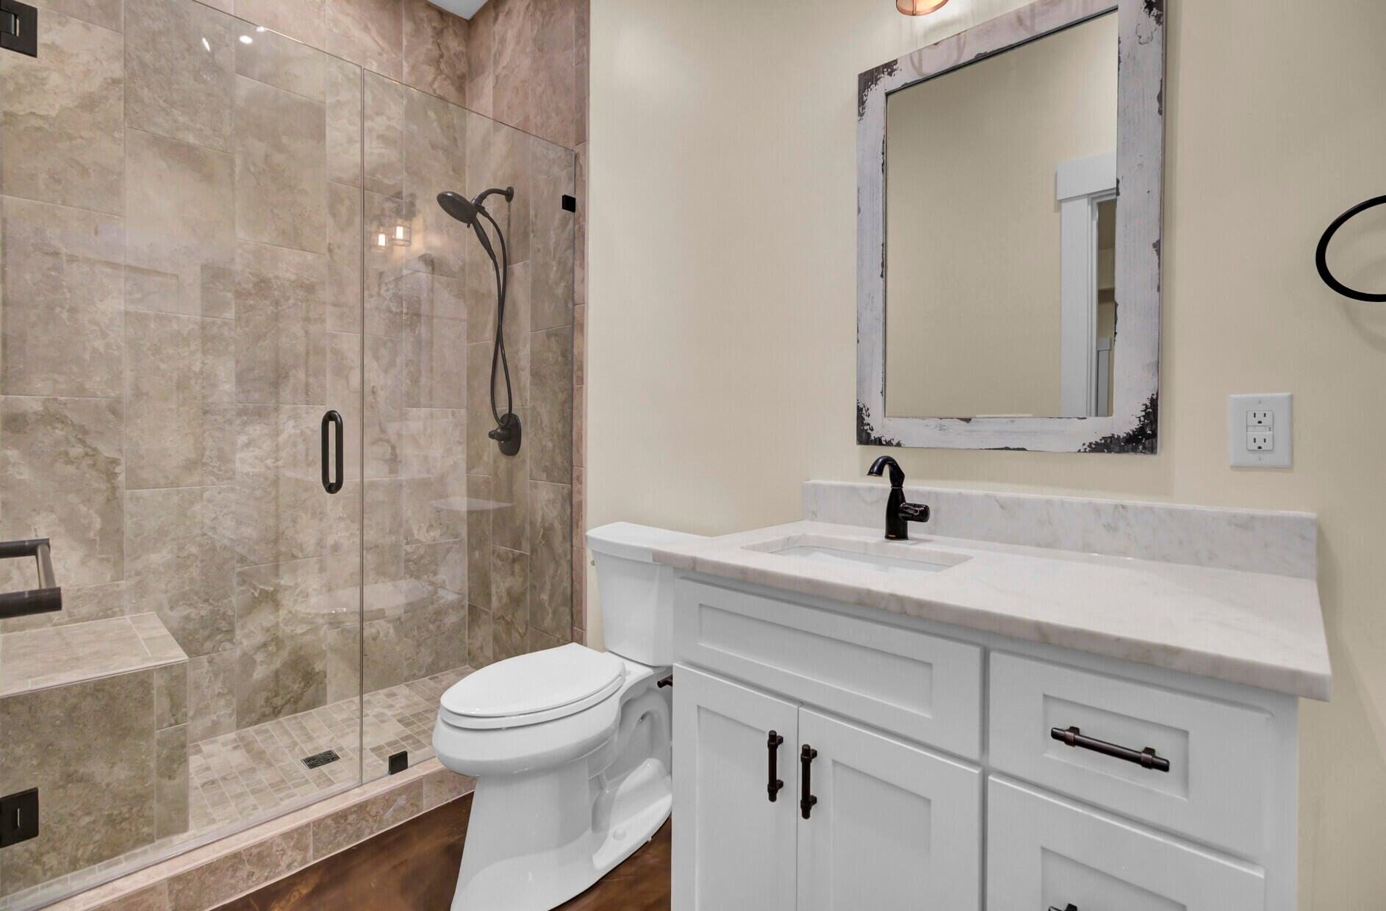
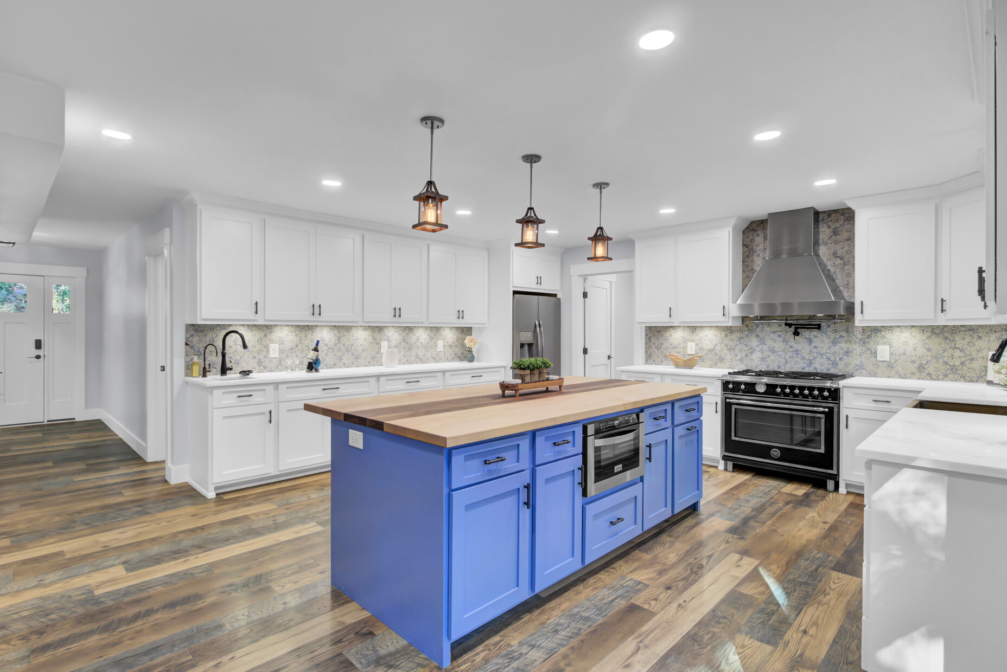
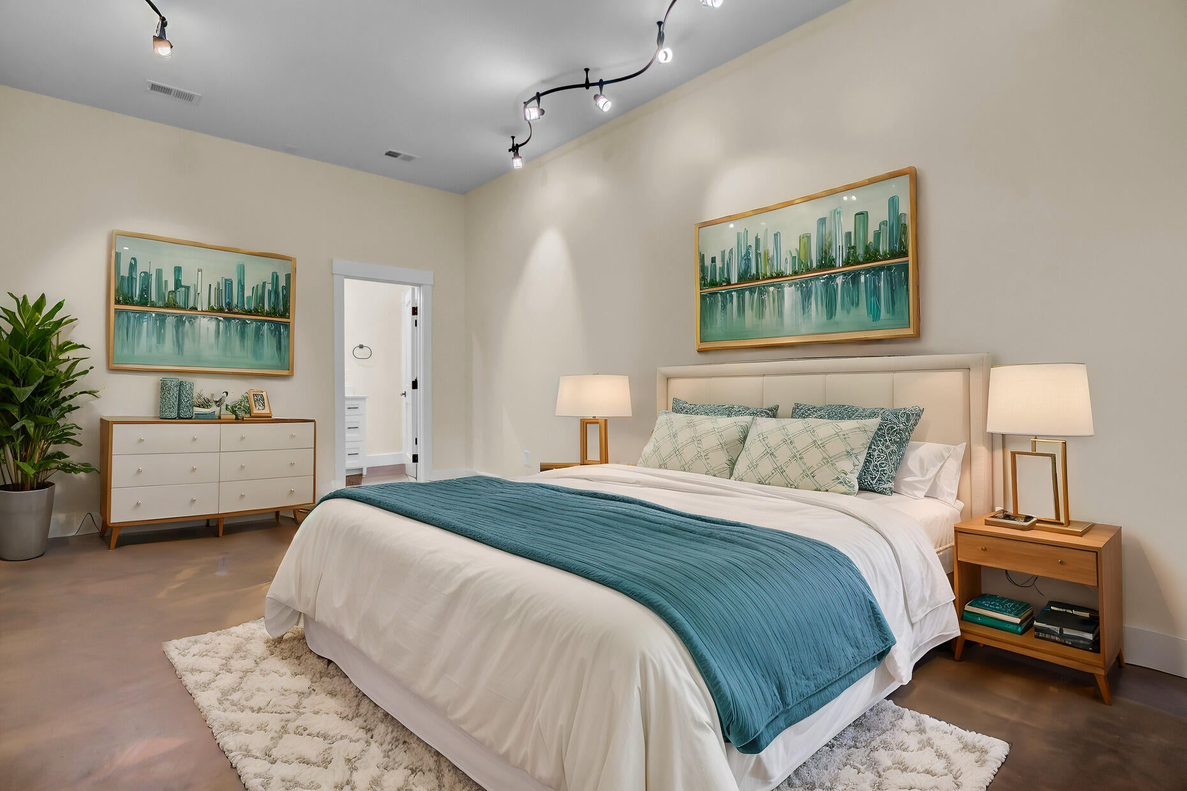



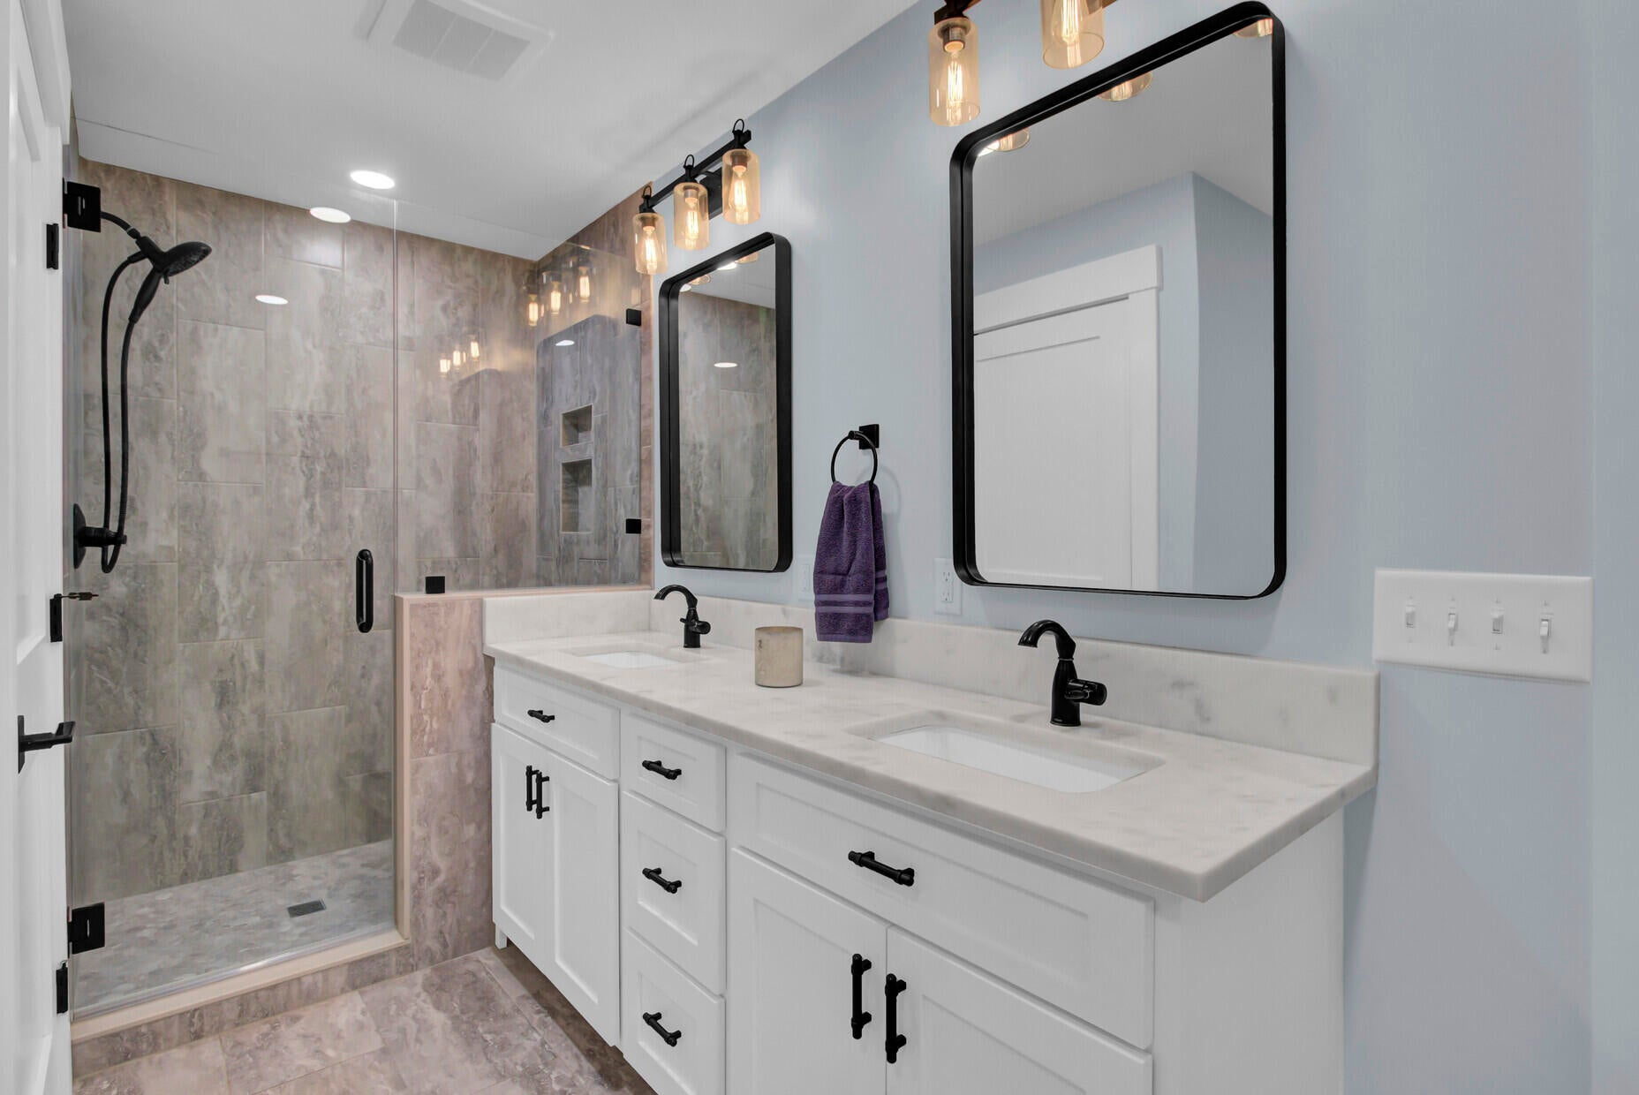


AMAZING SHORT TERM RENTAL OPPORTUNITY
Apartment Bath
Rendering with Garage
Property Site
Video Tour
Storybook
Apartment Bedroom
4429 Francis Younge Way
Hollywood, SC 29449 | MLS# 25030028
PRICE REDUCED! MOTIVATED SELLER. $895,000!!!
INSTANT EQUITY OPPORTUNITY with an appraisal of $1,160,000 in hand!
It is hard to find the perfect arrangement, and here it is! This fully renovated home with gorgeous finishes throughout includes an in-law suite on the main level. The home as it is now has loads of room for a 1600+ sf space for the in-laws, OR you can have a 2 or 4 car garage installed. That would leave the in-law apartment smaller in size but give you as the owner plenty of storage for your cars and belongings.
This magnificent home is an INSTANT EQUITY OPPORTUNITY with an appraisal of $1,160,000 in hand. Located in Hollywood, close to the West Ashley town line, it is super close to town but enjoys a private peaceful large lot that is oozing with Lowcountry charm. There is no HOA and so many benefits to this property.
SELLER IS MOTIVATED and with acceptable offer is willing to assist with providing the opportunity to have a garage for the new owner!
Main Home: 3 Beds, 2 full baths, two half baths, primary suite with luxury bath on main level, huge gourmet kitchen, plus two additional flex rooms
Flex Space / Inlaw Apartment: Buyer Chooses
Option 1: A 1600+ sf space with existing bedroom and luxurious full bathroom
Option 2: A TWO CAR GARAGE (for main house ) and the existing bedroom, luxurious bath,
and space for a kitchenette/living area
Option 3: A FOUR CAR GARAGE ( for main house ) plus the existing bedroom and luxurious
bath.
NEW OWNER HAS OPTIONS!!! CALL ELLEN FOR ADDITIONAL DETAILS!
Property Site | Video Tour | Storybook
*some photos were virtually staged
Ellen O'Neil
Broker/Owner, ABR, e-PRO, CNE
Charleston Realtor of Distinction
843-300-8530
www.EllenONeilProperties.com

