Slide 1
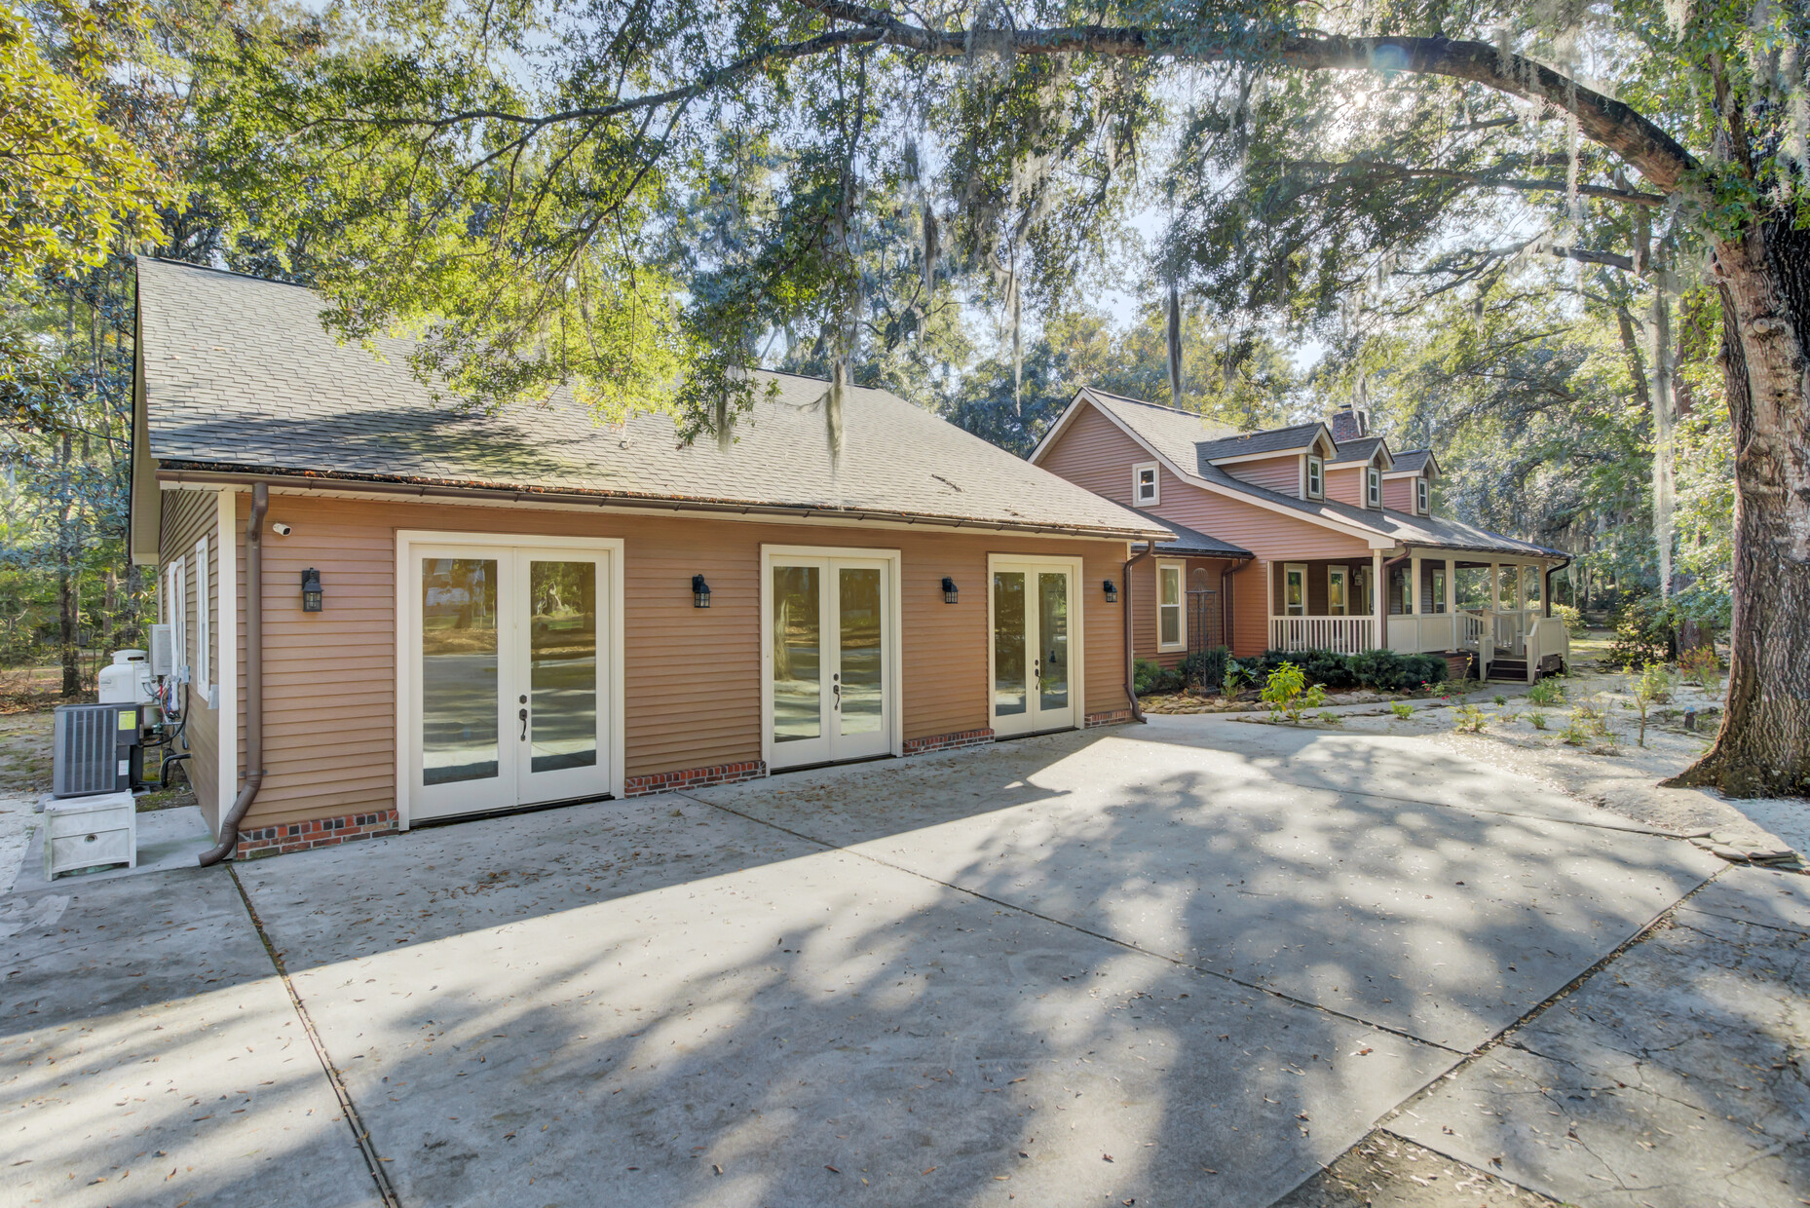
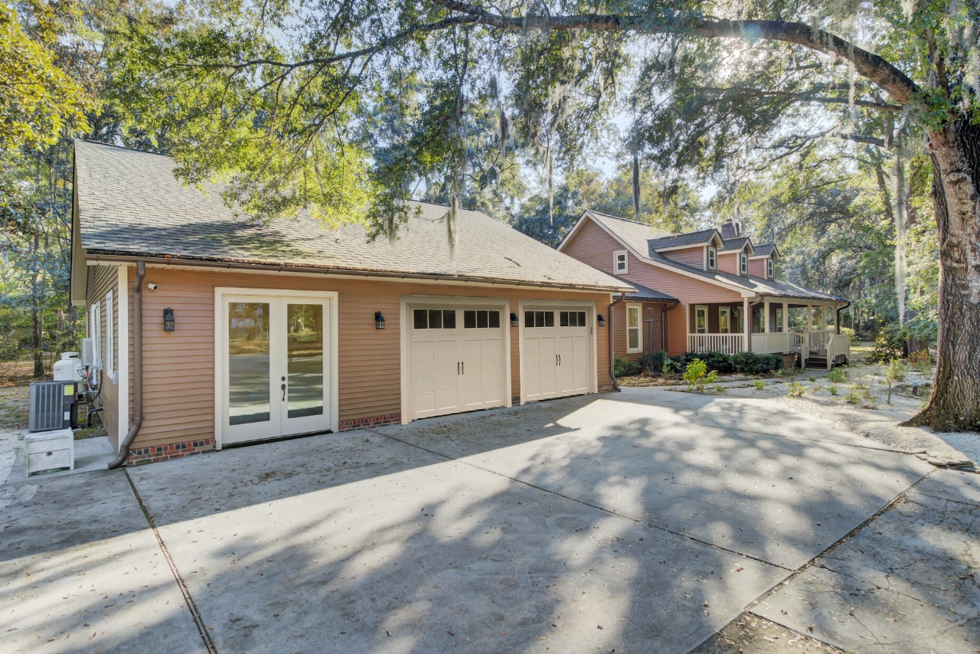
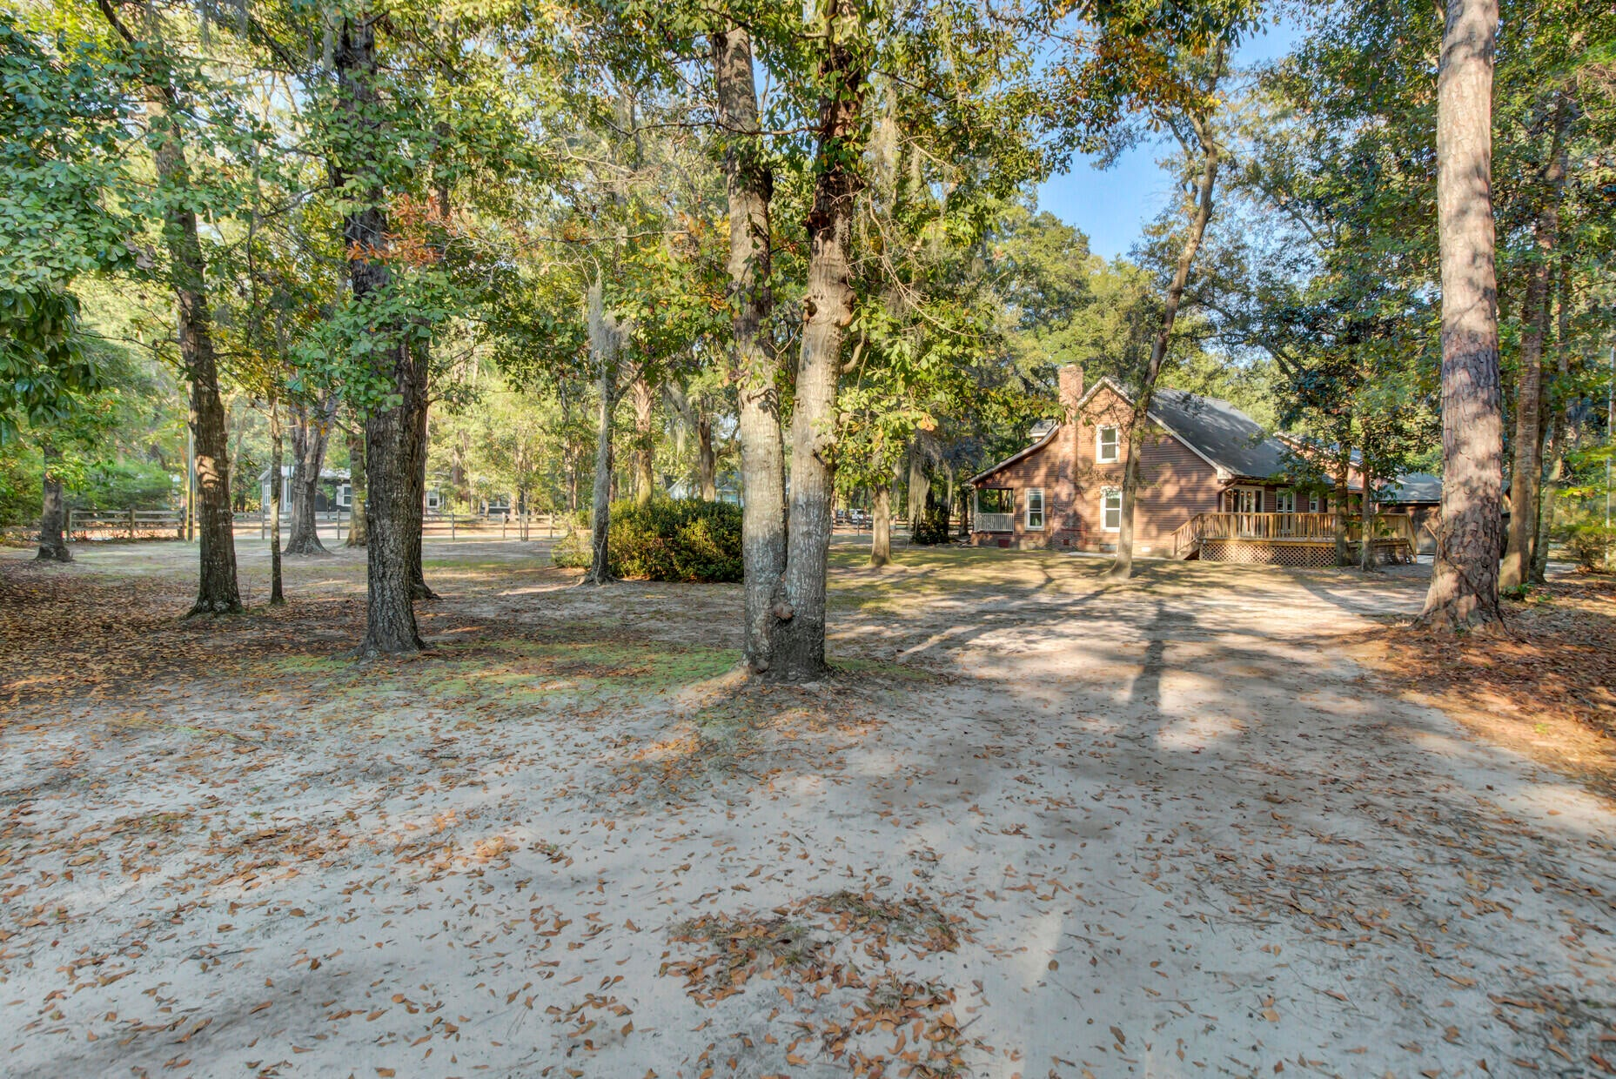
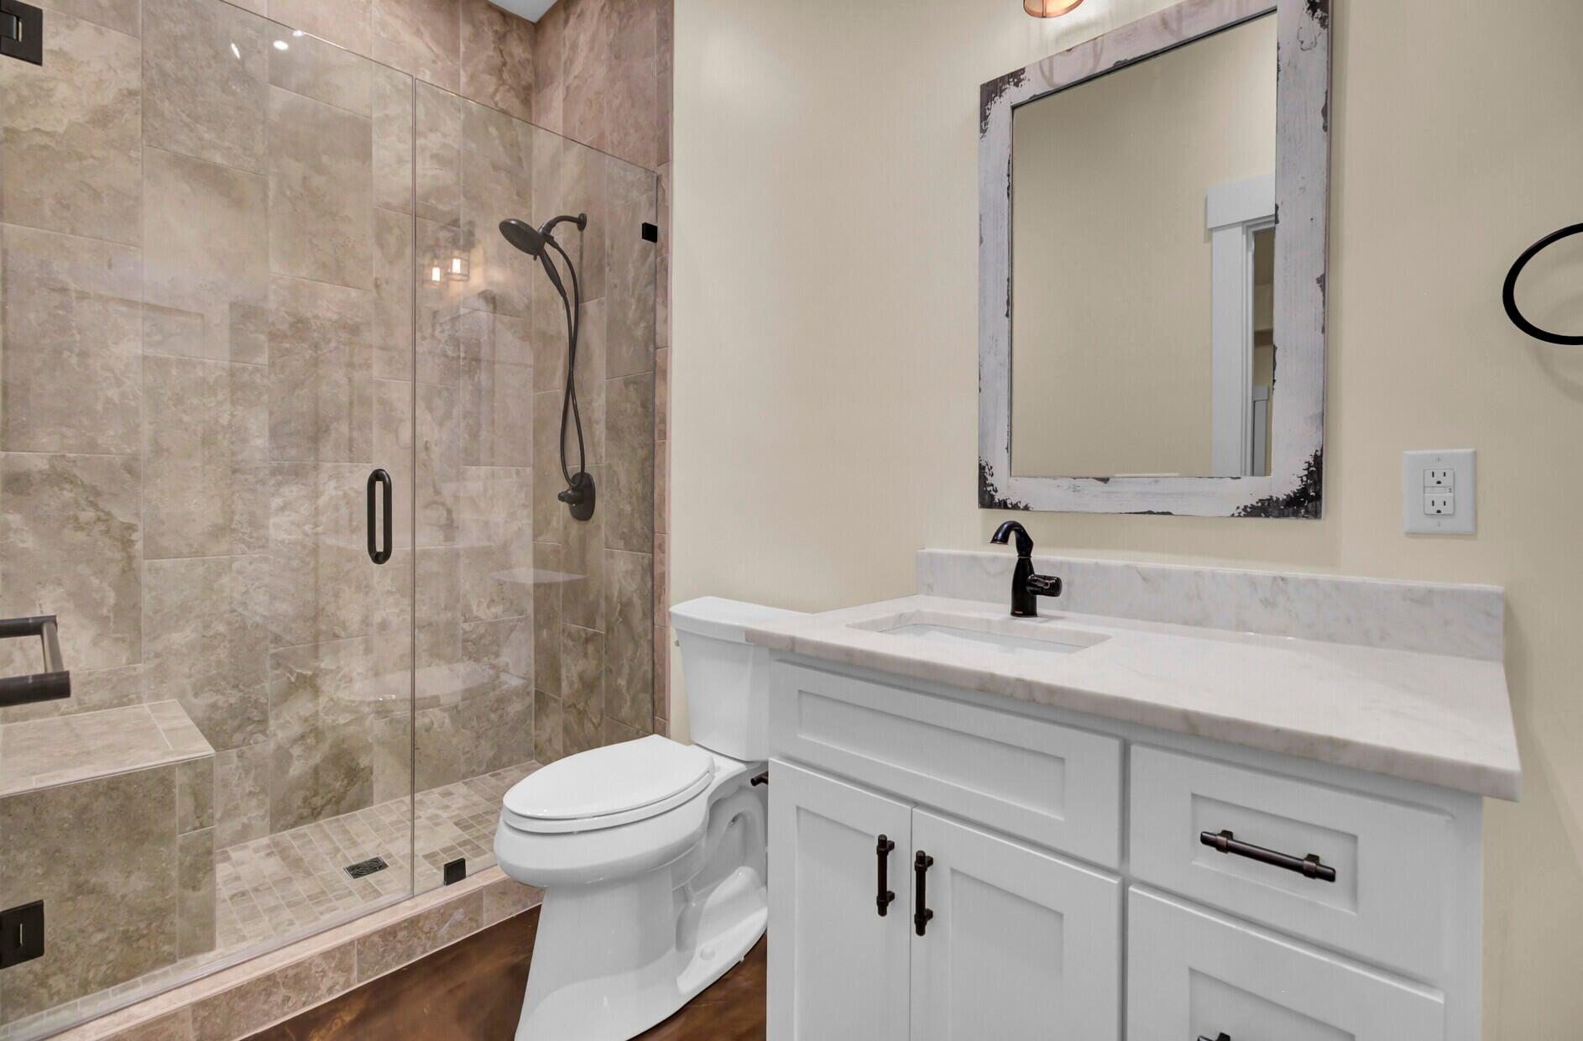
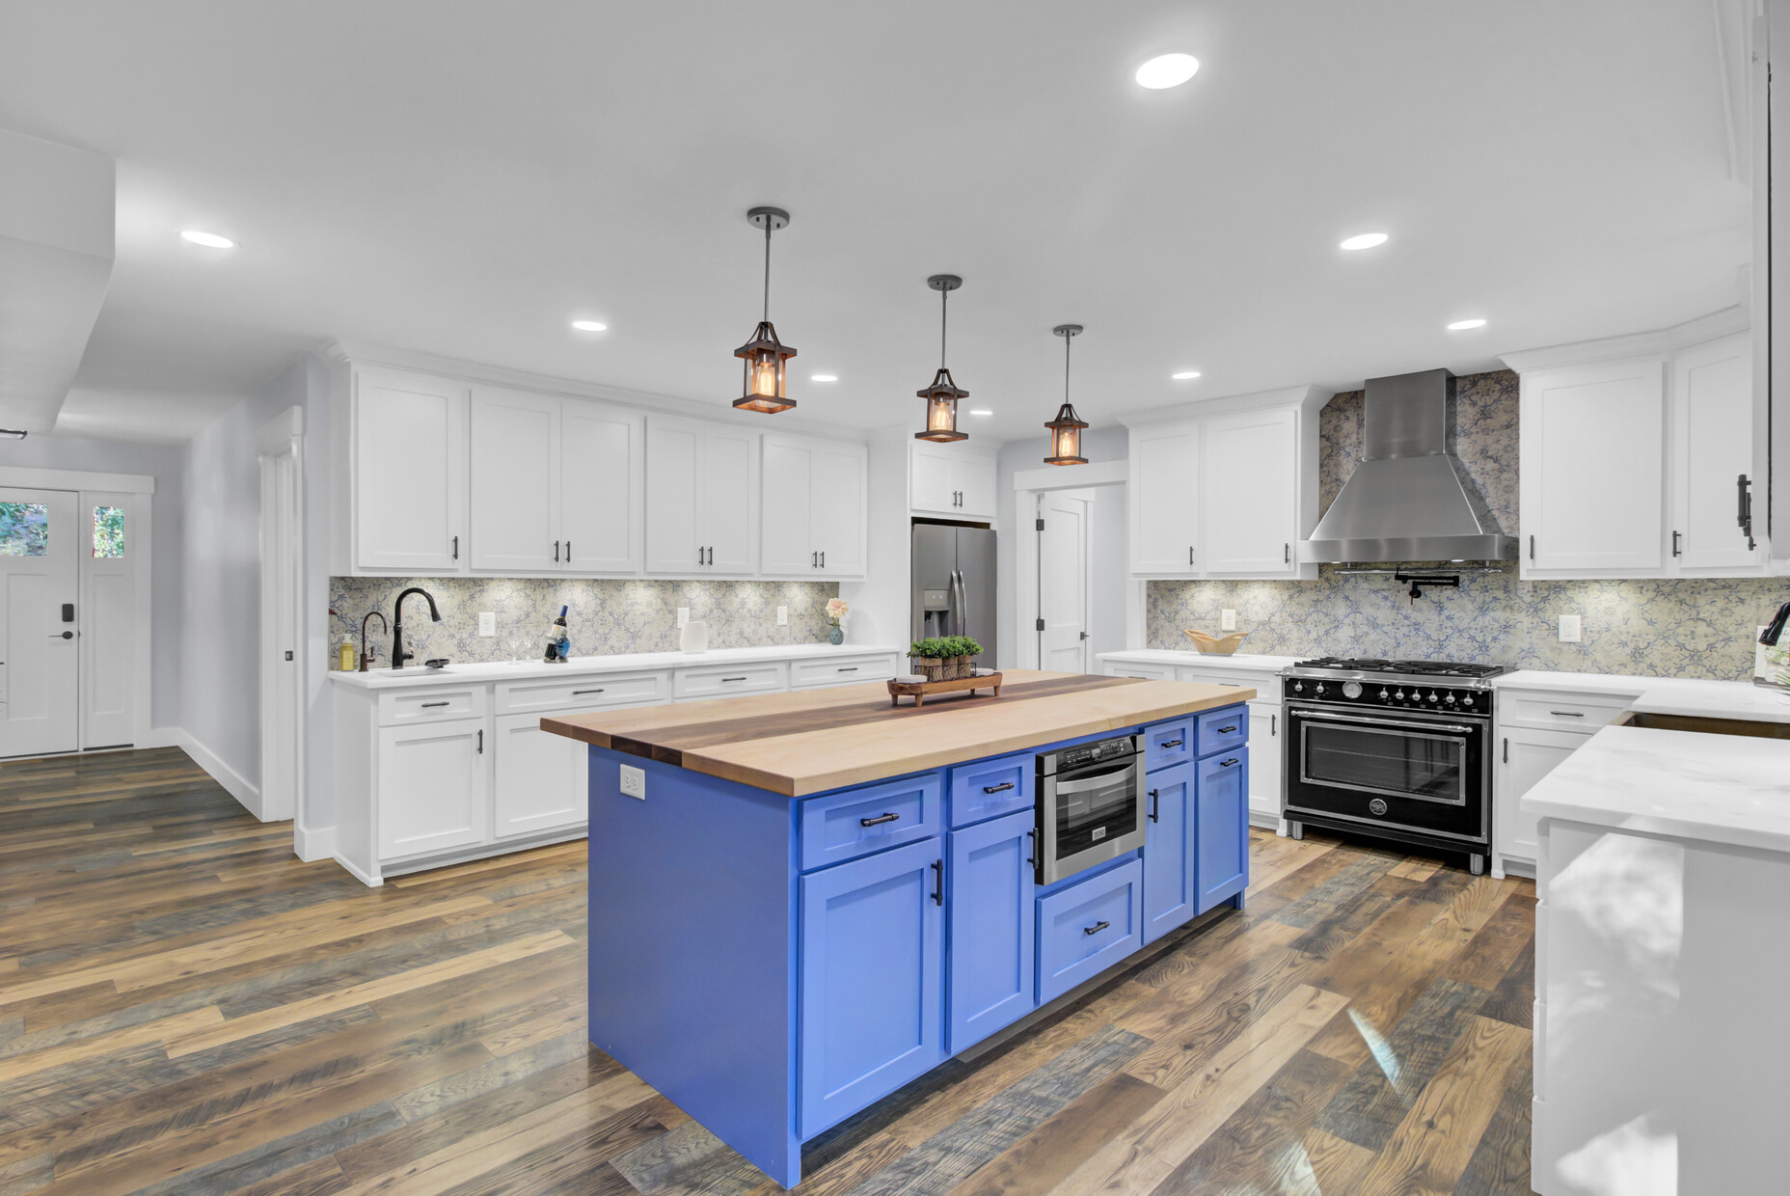
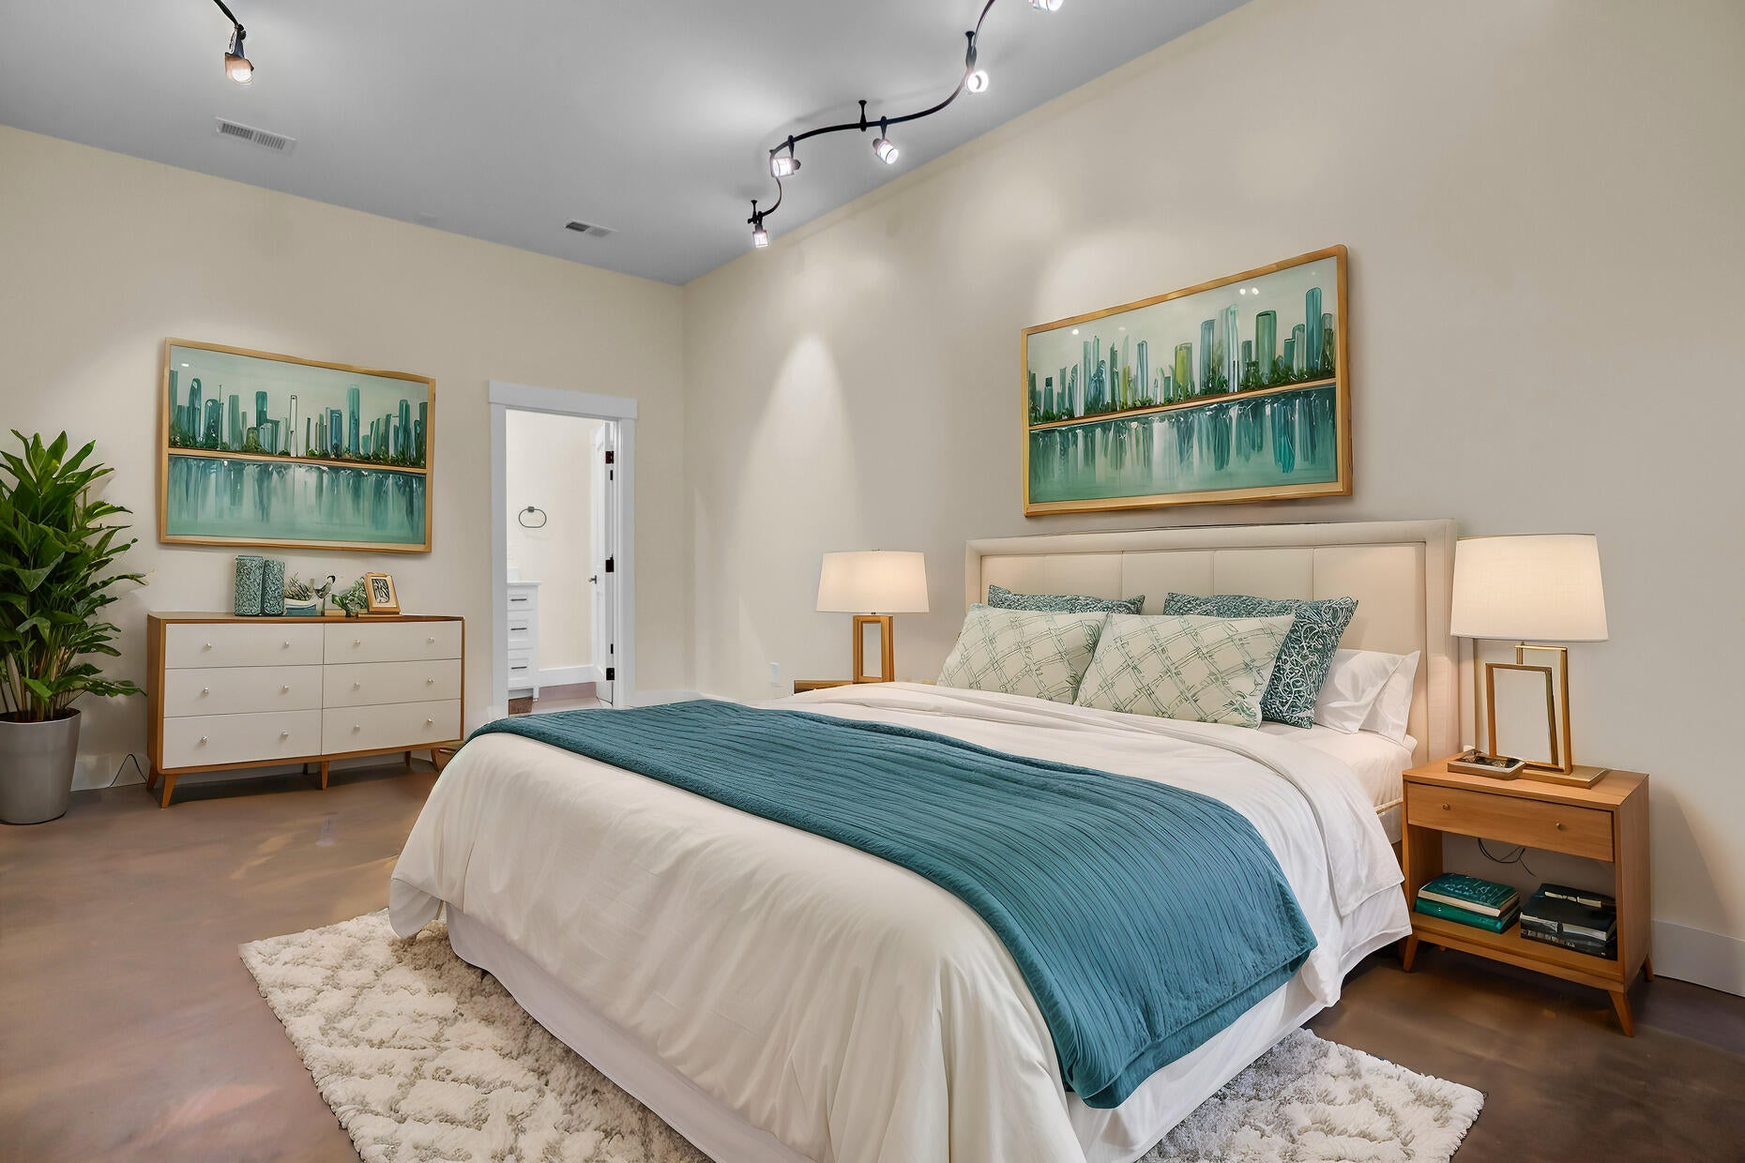
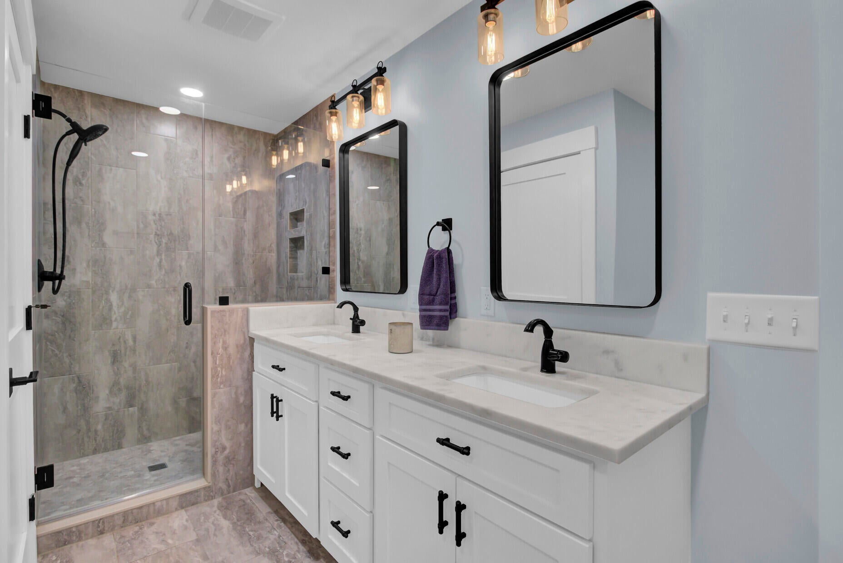





FULLY RENOVATED HOME WITH APARTMENT
Apartment Bath
Rendering with Garage
4429 Francis Younge Way
Hollywood, SC 29449 | MLS# 25030028
Property Site
Video Tour
Storybook
Apartment Bedroom
PRICE REDUCED! MOTIVATED SELLER. $895,000!!! INSTANT EQUITY OPPORTUNITY with an appraisal of $1,160,000 in hand! This community has NO HOA but ALL THE CHARM OF THE LOWCOUNTRY! You can have it all- live in the fully renovated stunning home AND earn income by renting out the suite / apartment that is attached. This magnificent home is an INSTANT EQUITY OPPORTUNITY with an appraisal of $1,160,000 in hand. Located in Hollywood, close to the West Ashley town line, it is a quick ride to Downtown Charleston, Folly Beach and Edisto Beach. The property is OOZING with Lowcountry charm and is unbelievably peaceful. SELLER IS MOTIVATED and with an acceptable offer is willing to assist with providing the opportunity to have a garage for the new owner! Main Home: 3 Beds, 2 full baths, two half baths, primary suite with luxury bath on main level, huge gourmet kitchen, plus two additional flex rooms Flex Space / Inlaw Apartment: Buyer Chooses Option 1: A 1600+ sf space with existing bedroom and luxurious full bathroom Option 2: A TWO CAR GARAGE (for main house ) and the existing bedroom, luxurious bath, and space for a kitchenette/living area for the renter. Option 3: A FOUR CAR GARAGE ( for main house ) plus the existing bedroom and luxurious bath for the renter. NEW OWNER HAS OPTIONS!!! CALL ELLEN FOR ADDITIONAL DETAILS!
Property Site | Video Tour | Storybook
*some photos were virtually staged
Ellen O'Neil
Broker/Owner, ABR, e-PRO, CNE
Charleston Realtor of Distinction
843-300-8530
www.EllenONeilProperties.com

