Slide 1
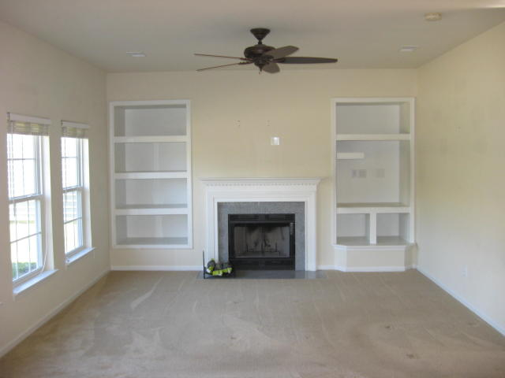
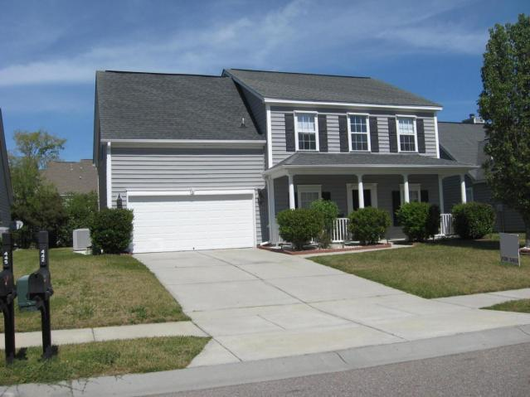
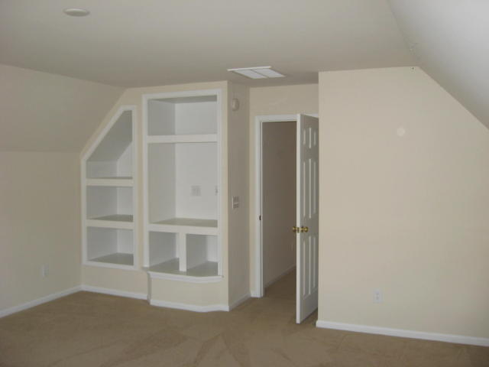
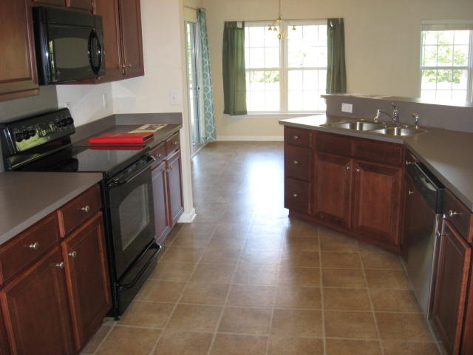
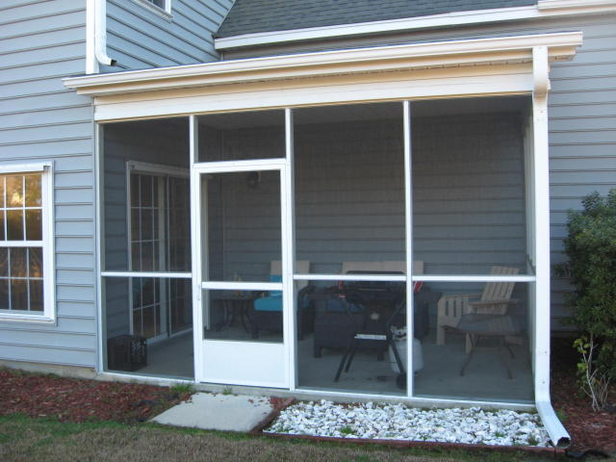
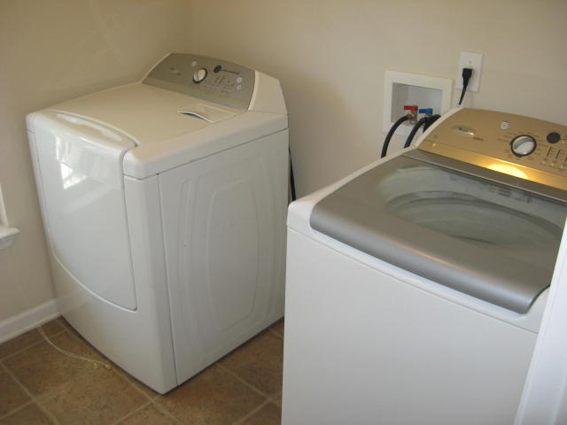
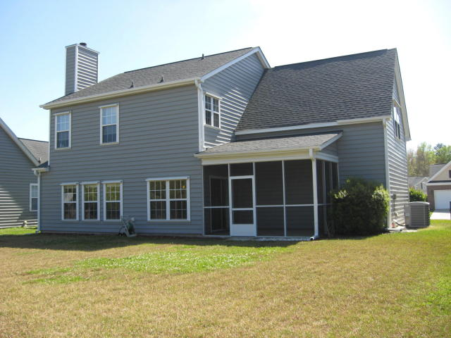


Grand Oaks Open House!
Sunday, April 22 ~ 2:30 - 5pm
Buy.......Build.....Begin
442 Sycamore Shade Street
Grand Oaks Plantation | Charleston, SC 29414
MLS# 18000594 | $306,900
This home is immaculate and ready to move-in!
Nice Bonus Room over garage and screened porch with a large backyard.
Brand new dishwasher installed 3/20/18.
Separate dining room, spacious kitchen overlooking the great room with wood burning fireplace and built-in-shelving.
Maria Latto
REALTOR, GRI
M (843) 327-1025 | O (843) 769-5100
maria@agentownedrealty.com | www.agentowned.com
The AgentOwned Realty Co. • 902 Savannah Hwy. • Charleston, SC 29407
Real Estate • Mortgage • Insurance

