Slide 1
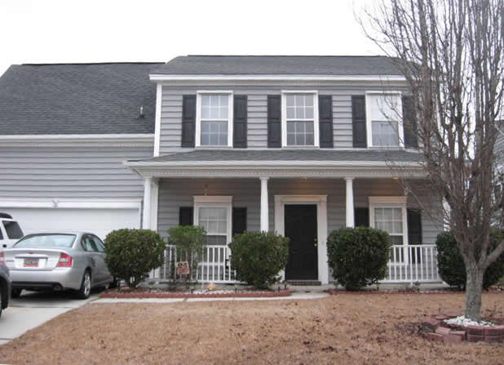


Just Listed in Grand Oaks!
Buy.......Build.....Begin
442 Sycamore Shade Street
Grand Oaks Plantation | Charleston, SC 29414
MLS# 18000594 | $309,900
Beautiful home in Grand Oaks with separate dining room, spacious kitchen overlooking the great room with wood burning fireplace and built-in shelving.
This home has been well maintained and ready for you to make it your own!
Nice screened porch with a large backyard.
Maria Latto
REALTOR, GRI
M (843) 327-1025 | O (843) 769-5100
maria@agentownedrealty.com | www.agentowned.com
The AgentOwned Realty Co. • 902 Savannah Hwy. • Charleston, SC 29407
Real Estate • Mortgage • Insurance

