Slide 1
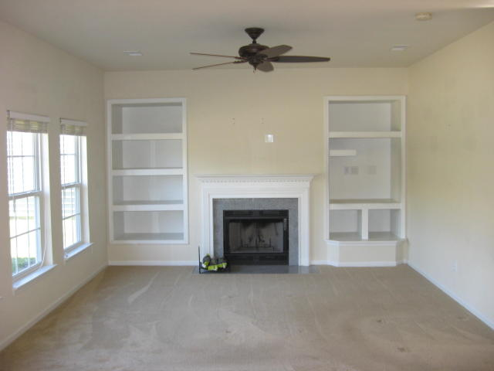
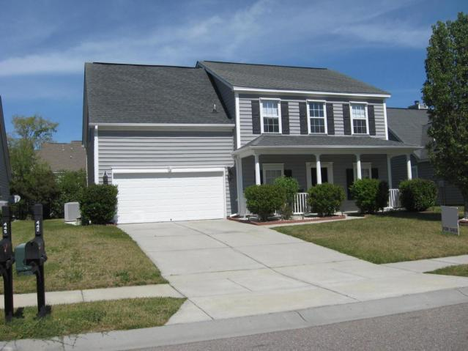
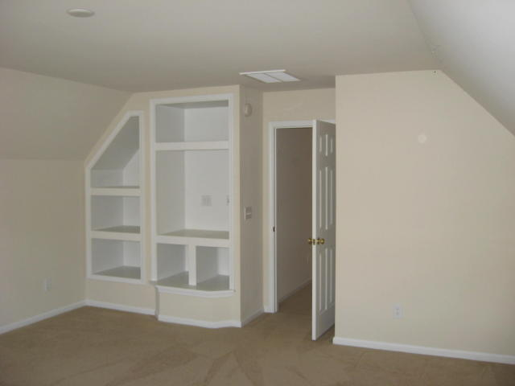
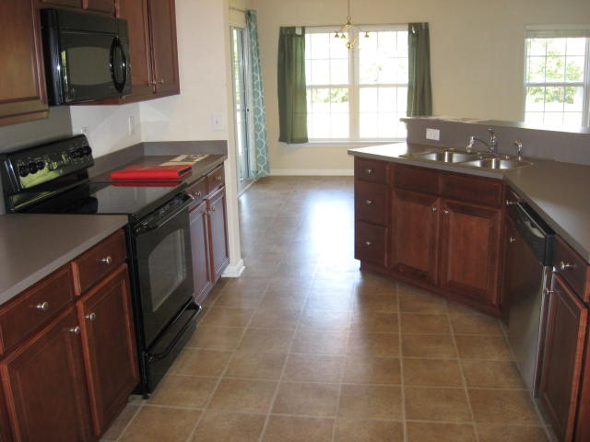
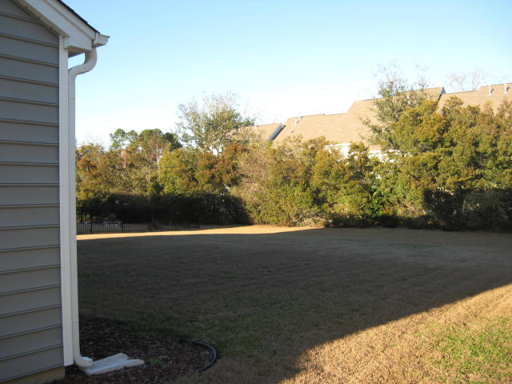
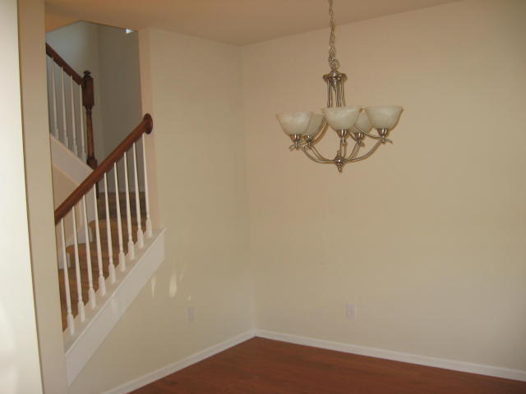
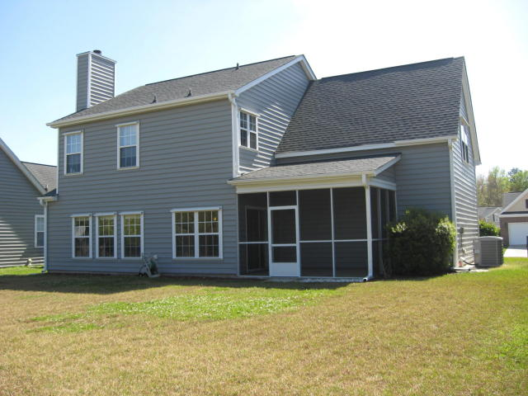


Price Reduced in Grand Oaks!
Better Than New ~ Move-in Ready
Buy.......Build.....Begin
442 Sycamore Shade Street
Grand Oaks Plantation | Charleston, SC 29414
MLS# 18000594 | $306,900
Beautiful home in Grand Oaks with separate dining room, spacious kitchen overlooking the great room with wood burning fireplace and built-in shelving.
Nice Bonus Room over garage. This home has been well maintained and ready for you to make it your own!
Nice screened porch with a large backyard. Brand new dishwasher installed 3/2018.
Maria Latto
REALTOR, GRI
M (843) 327-1025 | O (843) 769-5100
maria@agentownedrealty.com | www.agentowned.com
The AgentOwned Realty Co. • 902 Savannah Hwy. • Charleston, SC 29407
Real Estate • Mortgage • Insurance

