Slide 1
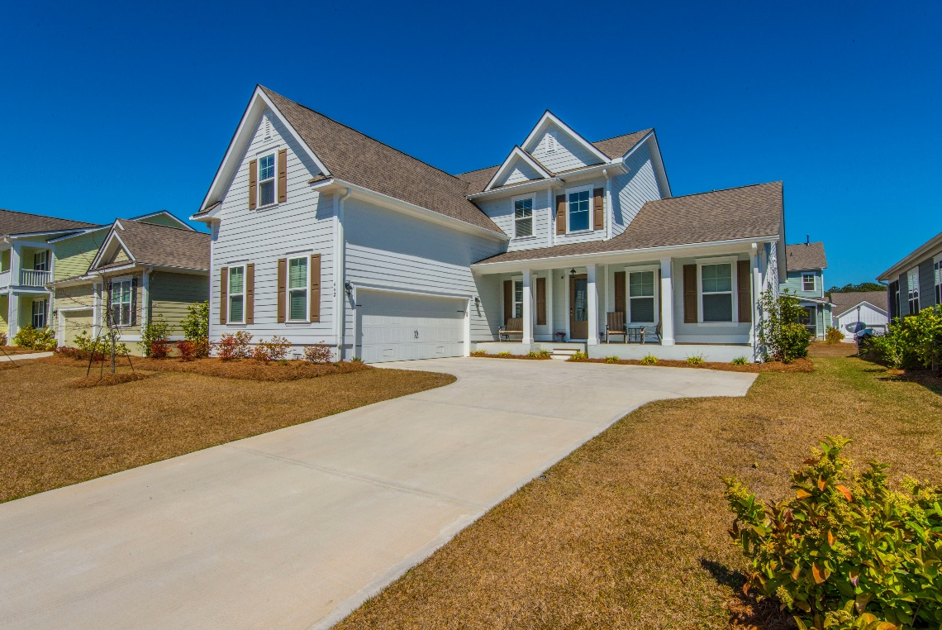
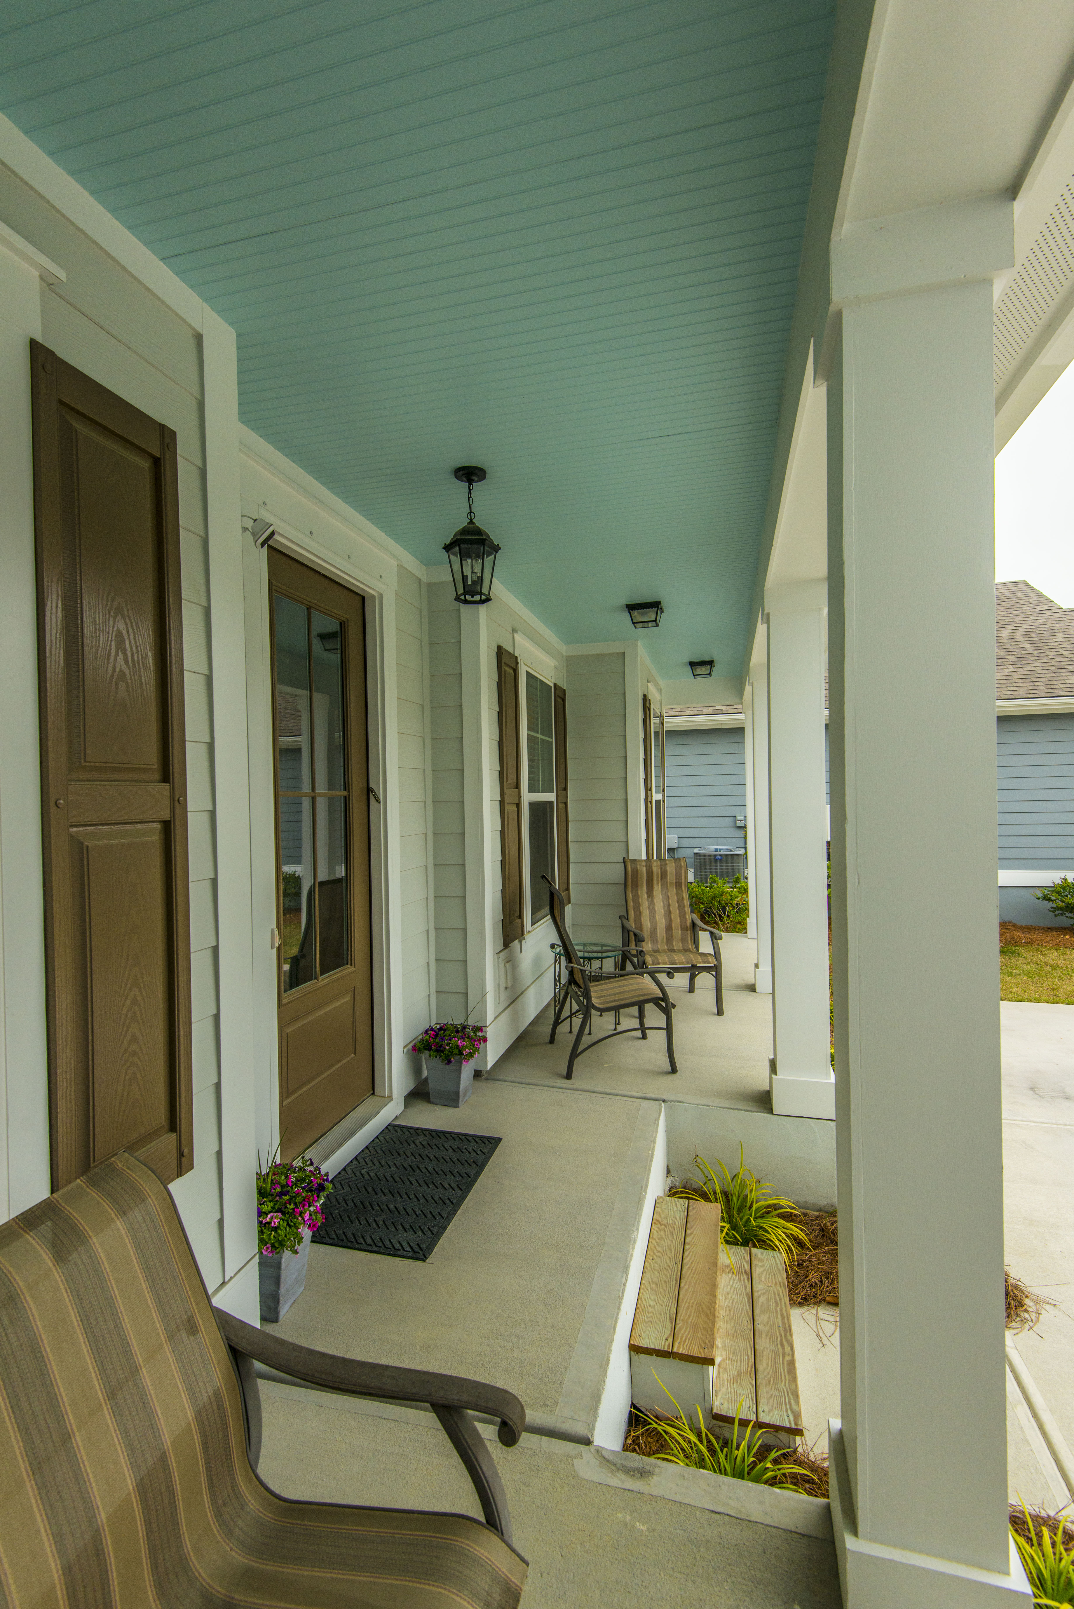
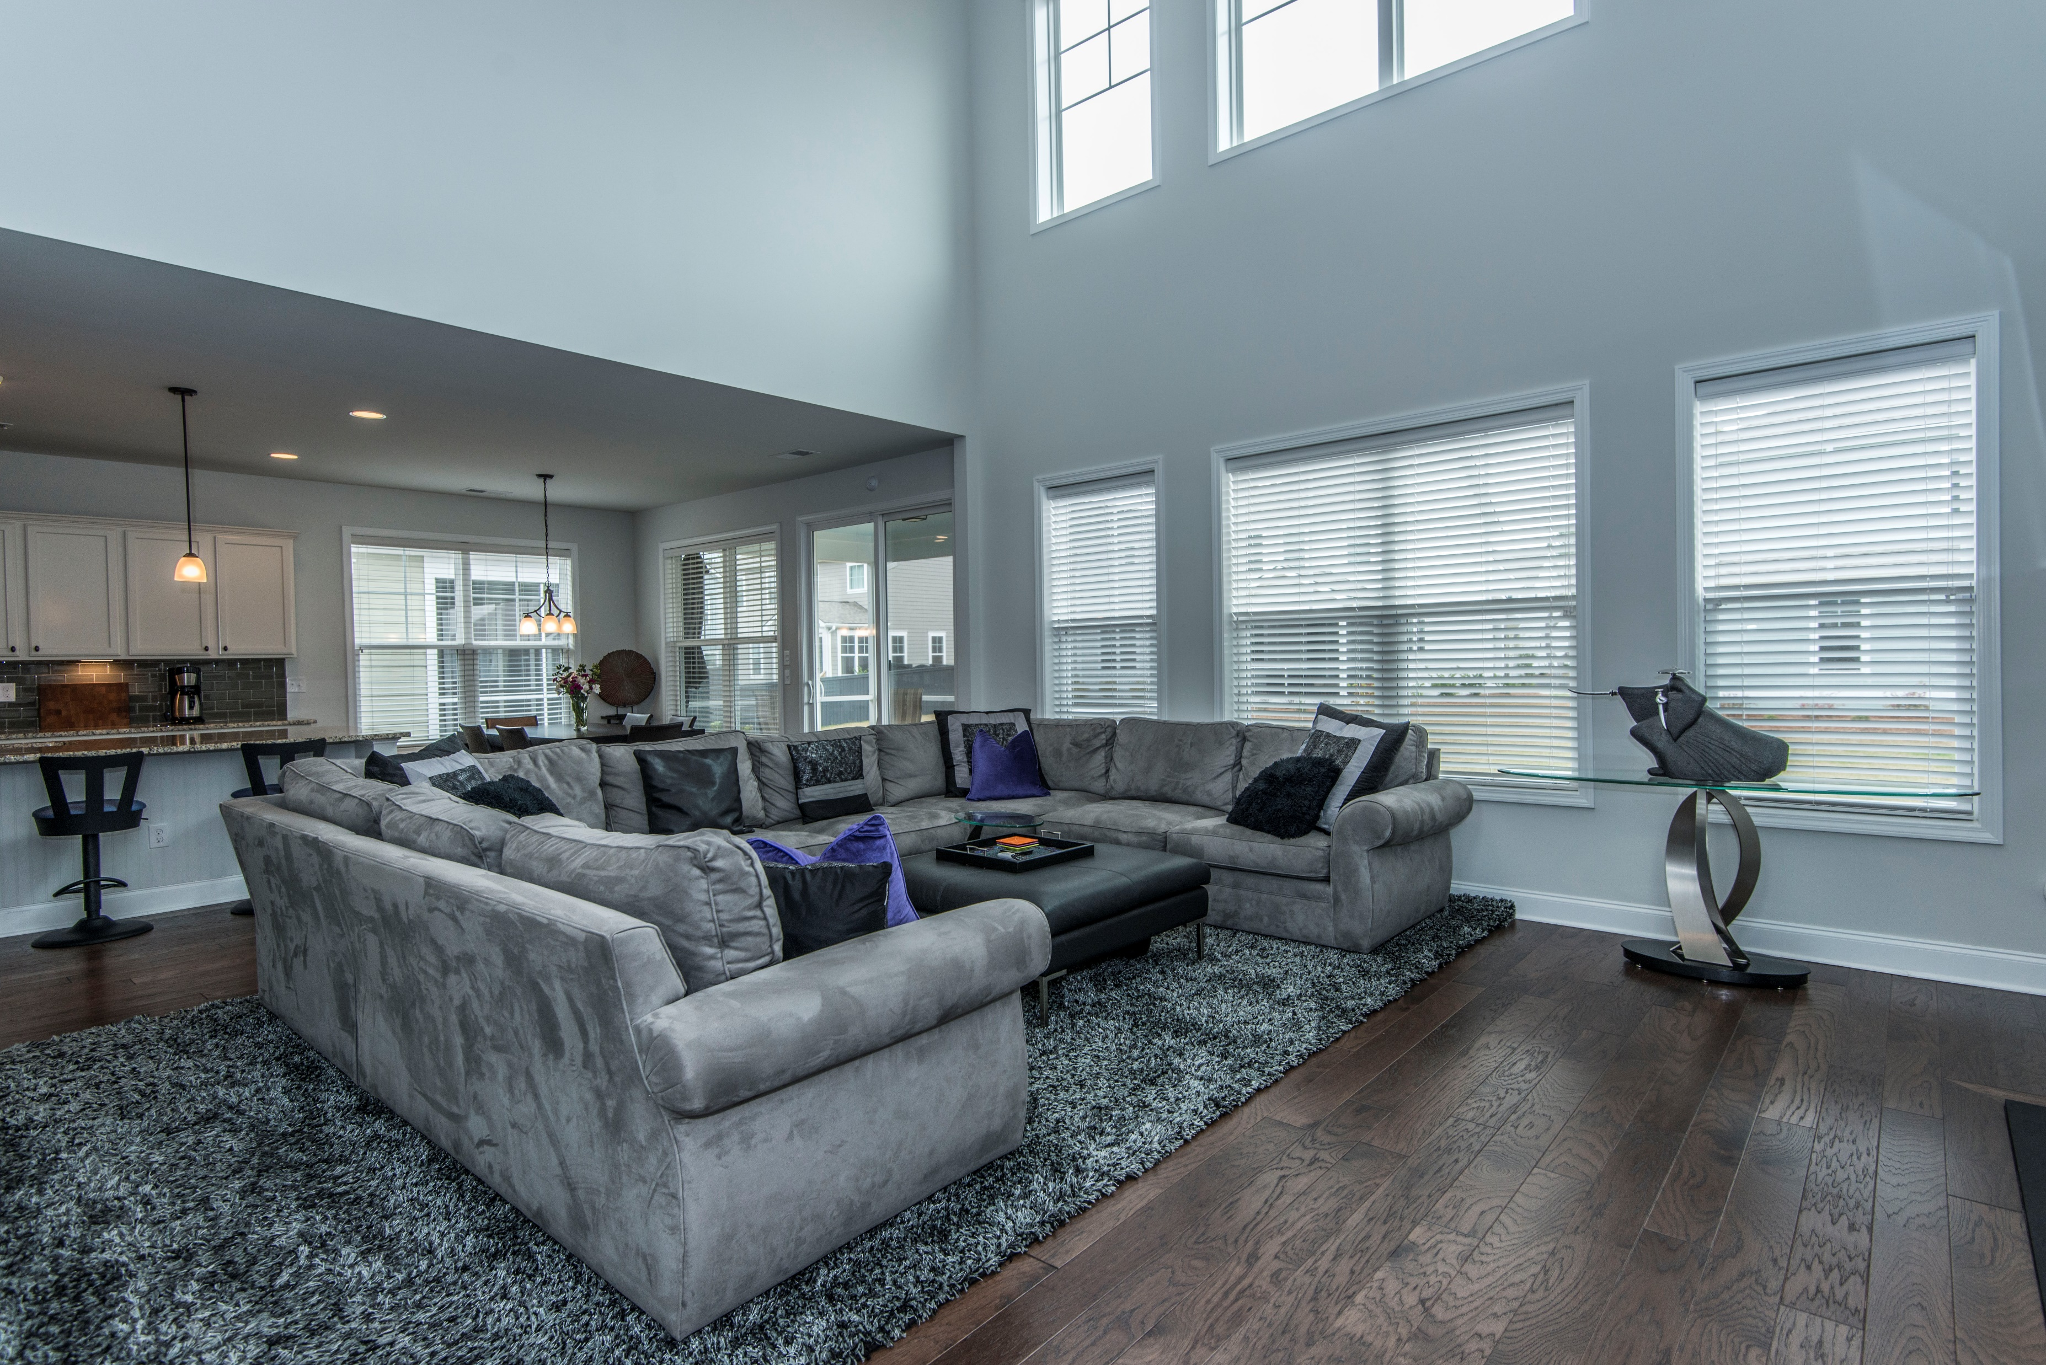
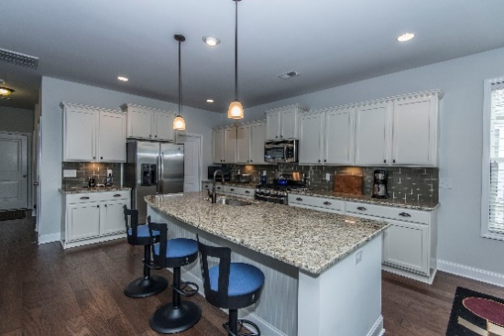


442 Turnstone Street Tidal Walk ~ Mount Pleasant, SC 29464 MLS# 17006184 ~ $525,000
Agent Open House Wednesday April 19th from 12-2
Please come by and see all the upgrades and extras the seller has added to this lovely home! Light snacks served.
$550,000
This beautiful home comes with many additions and improvements while only having been occupied less than a year! Please look at the SPECIAL FEATURES LIST IN DOCUMENTS! The bright and open floor plan is immaculate and flows beautifully. It includes a first floor master suite, gourmet kitchen, spacious laundry room and mud room. High end finishes are throughout the home. The foyer is spacious and welcoming, and the second floor has a huge bonus room! There are 3 full baths, large bedrooms, handsome hardwood flooring, a tankless hot water heater, gas fireplace, large screened porch, lawn irrigation and beautiful cabinetry. The garage is side facing and the owners have added high storage shelving. The home is perfect for entertaining and is a true value compared to new! HOME HAS BEEN PRE-INSPECTED!
Linda Ett M (843) 729-8718 | O (843) 884-1800
lett@carolinaone.com
www.lindaett.com
Carolina One Real Estate
195 W Coleman Blvd
Mt Pleasant, SC 29464-3495

