Slide 1
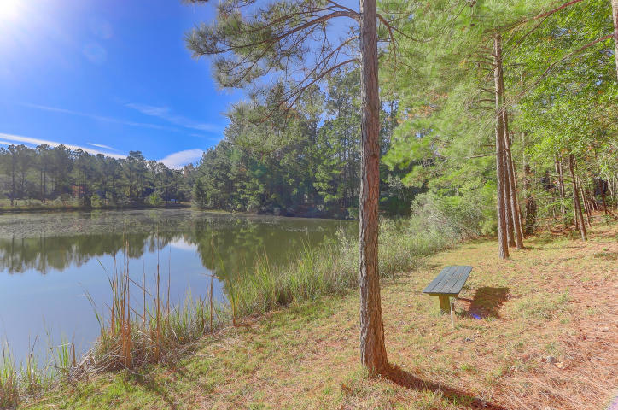
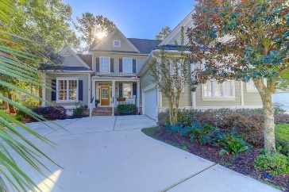
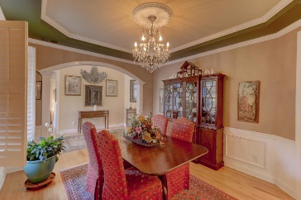
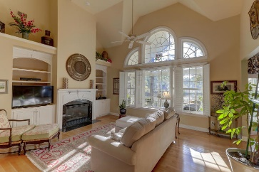
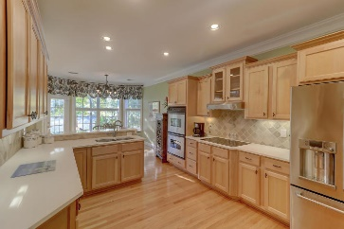
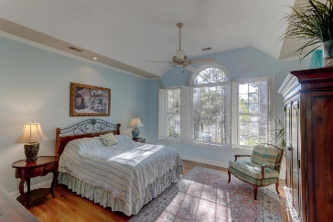
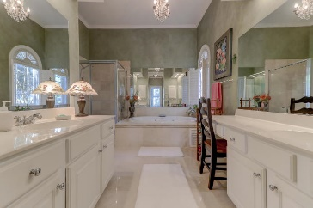
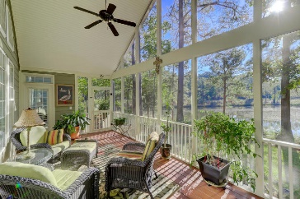
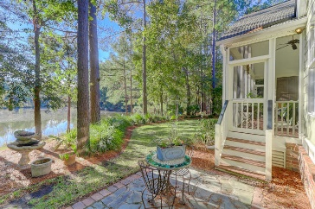


4439 Amesbury Court Dunes West Mount Pleasant, SC 29466 MLS# 18031718 $619,000
Just Listed
Stunning Views
Master Down
Don't miss the opportunity to own this charming home in Dunes West!! Enjoy the lovely views of the pond that is available from almost every room in this home! Great floor plan with a spacious master bedroom down, dual closets, and luxurious master bath. Large Great room with exceptional views, gas fireplace, and lovely built in cabinetry. Kitchen features a nice dining area, lots of cabinets, pantry, new countertops, new stove top, plus access to a spacious screened porch! Formal dining room and separate room for office/TV room. Hardwood floors throughout first floor. Beautiful custom front door with beveled glass. 3 bedrooms upstairs,2 additional baths. Walk in attic for extraordinary storage!
Professionally landscaped with lots of beautiful plants and trees on a premium lot!! This is one home you do not want to miss!!!
Darlene Smith Office - (843) 886-8110
Mobile - (843) 696-7824
darlenesmith@carolinaone.com
DarleneSmithTeam.com
Carolina One Real Estate
1503 Palm Blvd Ste
Isle of Palms, SC 29451

