Slide 1
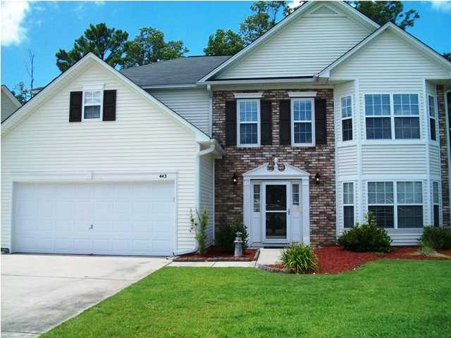
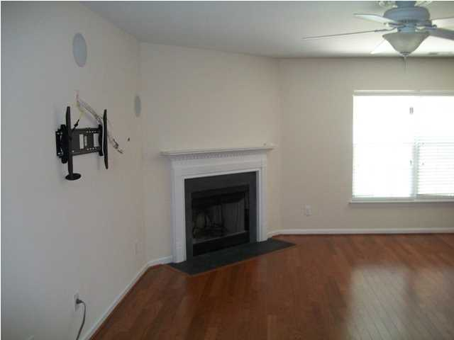
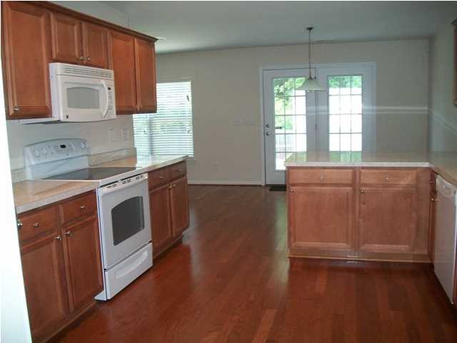
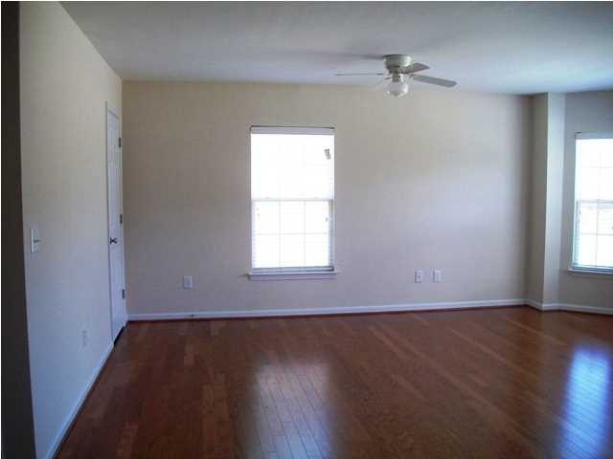
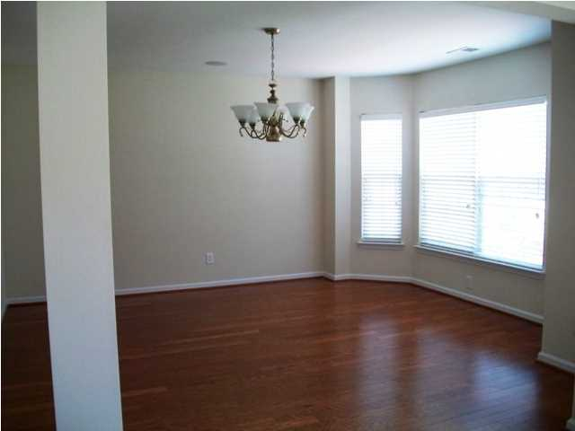
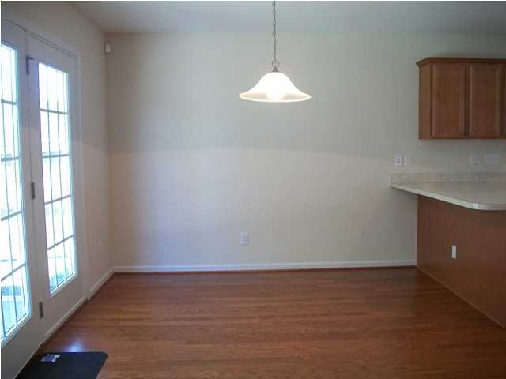
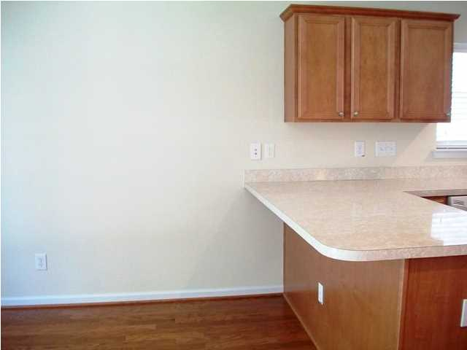
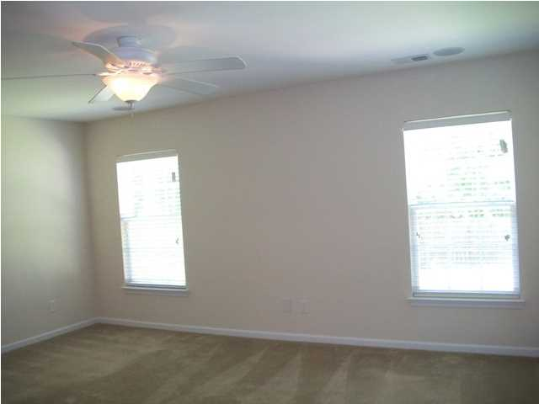
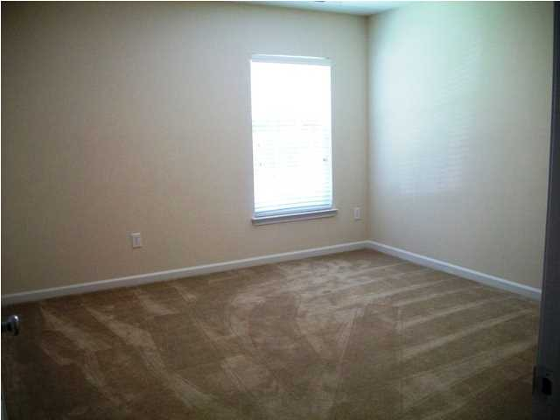
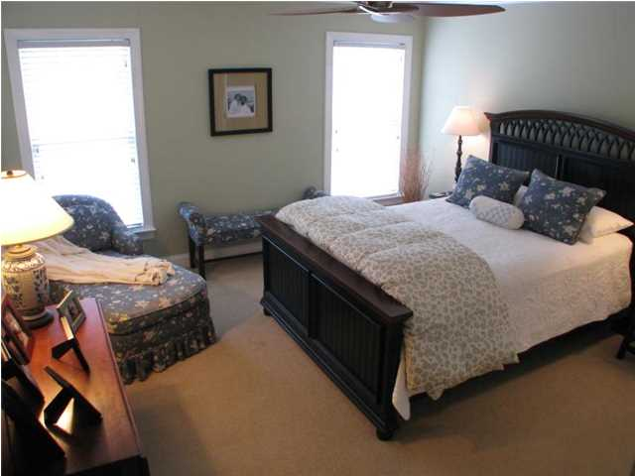
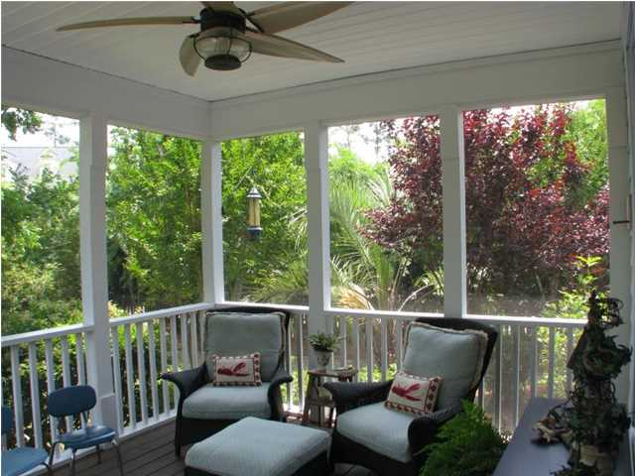
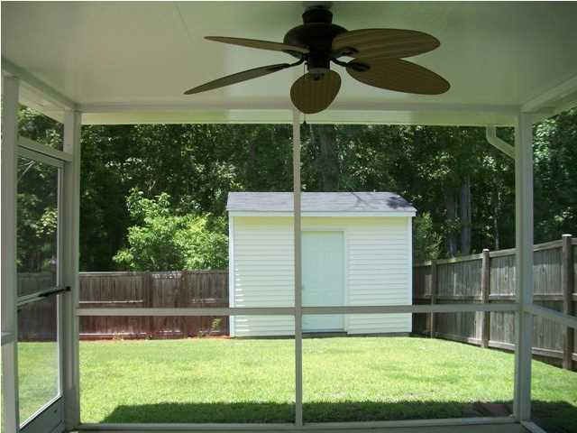
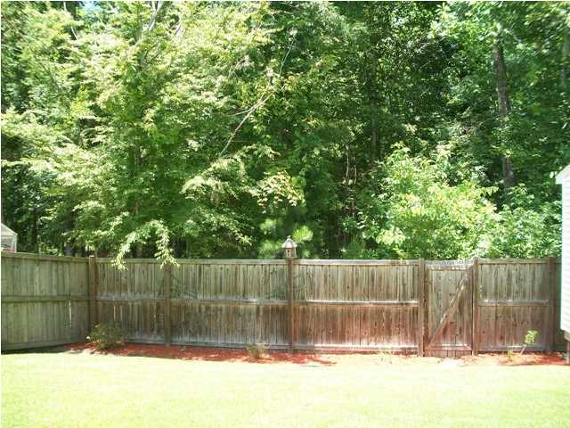


443 Green Park Ln Brickhope Greens Goose Creek MLS# 1417916 $279,900 5 Bedrooms | 3½ Baths | 3,316sf
Immaculate, spacious, like new, move in ready home with a backyard that backs up to wetlands in Brickhope Greens Subdivision. Your beautiful open floor plan home features 5 bedrooms, 3.5 bathrooms, foyer, formal dining room, living room, kitchen, walk-in pantry, bonus room, screened-in back porch, storage shed/workshop, fenced back yard and a 2 car garage. As you enter your new home you will notice the gleaming hardwood floors, smooth ceilings and many upgrades. The formal dining room is adjacent to the kitchen. Living room boasts a corner fireplace, lots of natural light and a ceiling fan. It is fully wired for TV and includes amazing surround sound with additional speakers and cable outlets in almost all the rooms. The open, large, bright kitchen has lots of cabinets, counter space, breakfast bar and a walk-in pantry. The downstairs master bedroom has a ceiling fan and large walk in closet. Master bathroom has double vanities, garden tub, separate shower and ceramic tile flooring. There is a mud room off the 2 car garage. Upstairs you will find 4 large bedrooms all with walk-in closets, spacious laundry room with ceramic tile flooring, 2 full bathrooms with ceramic tile flooring, and a HUGE bonus room with lots of natural light, a closet, 2 ceiling fans and hardwood floors. French doors from the breakfast area lead you to a 12 x 12 screened back porch with a ceiling fan, and a 12 x 16 patio, just right for outside grilling, dining and relaxing. Some upgrades include full security system, surround sound system, double driveway with additional parking space, underground sprinkler system, landscaping, electrically wired storage shed/workshop and fenced back yard. Great location-close to schools, Charleston Naval Weapons Station, Boeing, restaurants, shopping, Joint Base Charleston, Bosch, I-26 and I-526. Seller is also offering a one year home warranty. Your new home backs up to beautiful protected wetlands for additional privacy or to satisfy the adventurous nature lover in you. With all this home has to offer, it is ready for your personal touches.
Immaculate Move In Ready Home!
Debbie Toombs
843-345-7895 debbie.toombs@cbunited.com
www.cbunited.com

