Slide 1
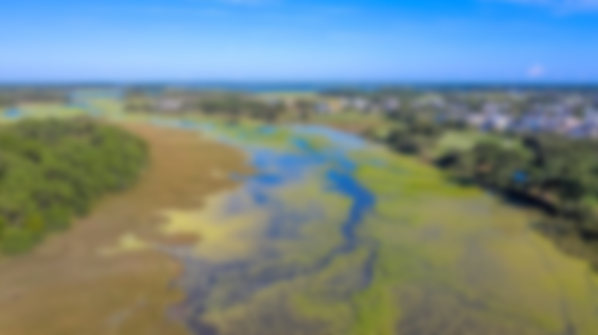
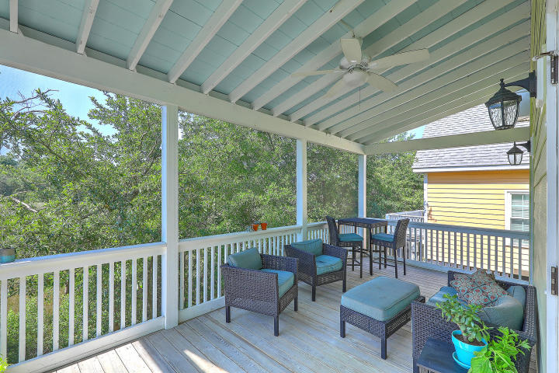
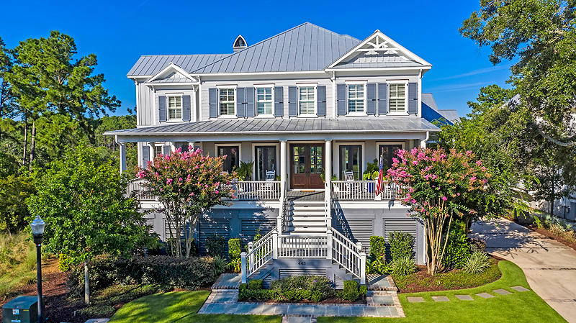
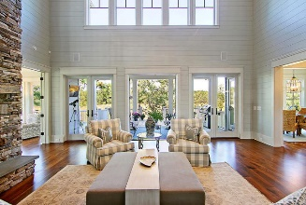
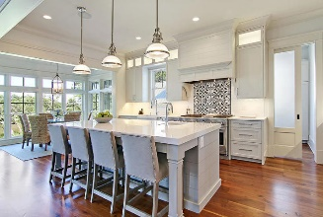
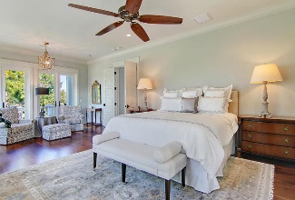
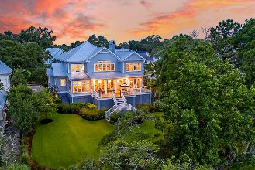
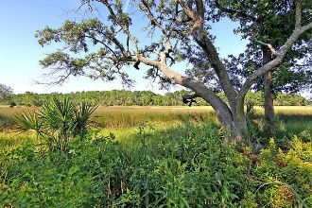

Open House Thursday 11a-2p Check Out This Beautiful New Home And Enjoy A Light Lunch
Marshfront Living On Daniel Island
5 Car Garage + Pool Incentive Offered By Seller
443 Lesesne Street
Daniel Island Park
Charleston, SC 29492
MLS# 20020134
$2,350,000
This custom designed home, located in the Lowcountry's favorite golf course community of Daniel Island Park, is perfectly situated on over half an acre plus lot that takes advantage of the magnificent and expansive marsh views. If a pool is a necessity, this large lot is perfect for an infinity or an in-ground design and the current owners will consider a credit to the buyers at settlement for the construction of your dream pool. Watch the ever changing colors of the low country marsh from early morning sunrise to beautiful colorful sunsets that make the marsh grasses shimmer as the sun sets. The home was crafted with great attention to detail and quality.
The dual master suite floor plan compliments the dramatic two story great room with floor to ceiling windows, stone fireplace wall, beamed cathedral ceiling and French doors that open onto an expansive deck. Filled with abundant natural light, this open concept home is the perfect blend of form and function lending itself to luxurious comfortable living for everyday, while also perfect for entertaining. The chef's kitchen has a large island with seating for 4, an eat-in area with marsh views, a walk-in pantry and elegant Butler's pantry with wine and beverage fridge. The first floor owner's retreat features a custom mirrored walk-in closet, luxurious master bath, and private access to the rear deck overlooking the marsh - perfect for watching the spectacular sunrises and sunsets each day. A second master suite upstairs boasts an en suite bath, walk-in closet and vaulted ceiling and more unparallel marsh views. This home has an elevator that services all floors, a first floor home office/den, flex space upstairs for a second home office or children's playroom, and a 2,400 SF garage that can hold 5+ cars and has limitless potential for other uses.
This property includes Daniel Island Club social membership privileges, with the opportunity to upgrade to a Sports membership or Golf Membership. Buyer pays a one time neighborhood enhancement fee of .5% x sales price to Daniel Island Community Fund at closing. Daniel Island resale addendum will be required on offer to purchase. Daniel Island Resale Addendum, Property Disclosure, Flood Disclosure and Community Fund Disclosure are attached. Buyer to confirm any information in this listing that is important in the purchase decision such as but not limited to associated membership/fees, square footage, lot size, taxes, and schools.
Virtual Tour: https://my.matterport.com/show/?m=fjjYHip5jtg
Paige Rhodes
843-830-3281
paige@charlestownerealty.com
Michelle Walsh
617-784-7800
michelle@charlestownerealty.com
Charlestowne Realty LLC · 73 Iron Bottom Lane · Daniel Island, SC 29492

