Slide 1
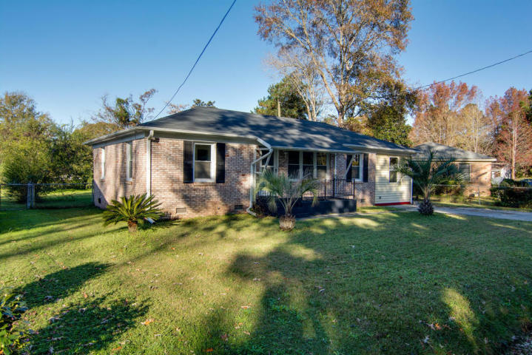
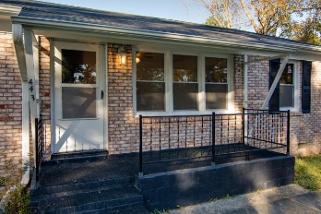
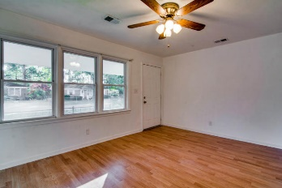
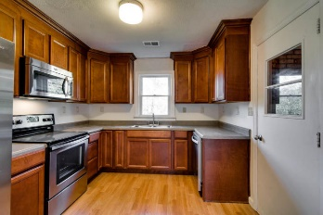
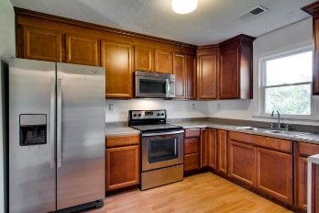
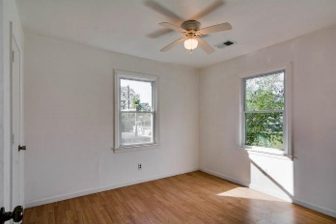
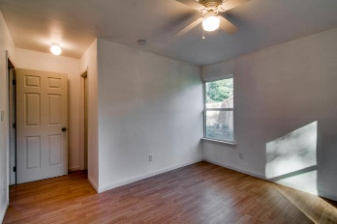
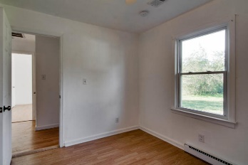
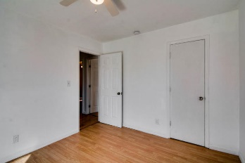
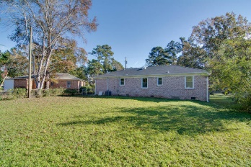
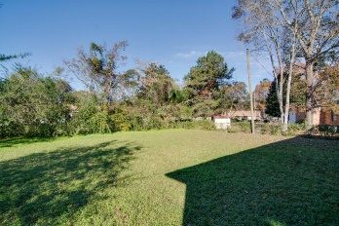


443 Mary Scott
Boulder Bluff
Goose Creek, SC 29445
MLS# 15030019
$129,900
4 Bedrooms | 2 Baths | 1,200 Sq Ft
Charming & Comfortable Living
Available
Nov 1st!
This move-in ready 4 bedroom,2 bath home has so much to offer.
It has been completely remodeled. Nothing to do but move in.
Wood floors through-out .All new kitchen and baths and be sure to check out the quality of the kitchen cabinets!
HVAC replaced this year and roof and windows were replaced in 2011. Freshly painted, ceiling fans, all appliances are new.
Need to come and check this one out.
Liz & Bob Simonds
843-437-9696
lizandbob@agentowned.com
AGENTOWNED REALTY CO. PREMIER GROUP, INC.
141-A N. MAIN STREET
SUMMERVILLE, SC 29483

