Slide 1
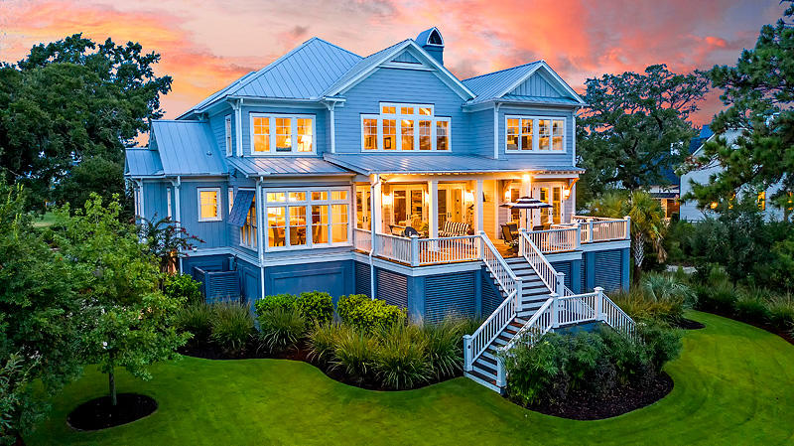

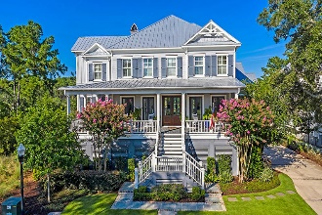
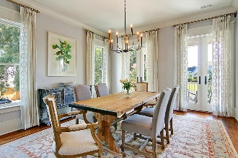
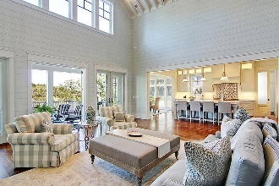
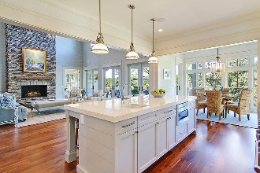
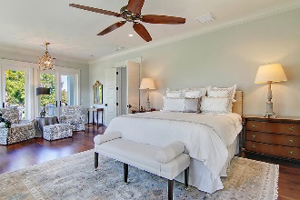
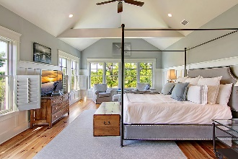
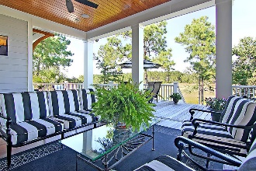
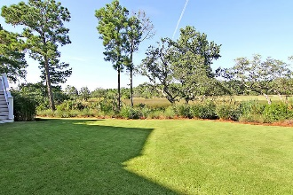
Open House Sunday 1-3pm
443 Lesesne Street
Daniel Island Park | Charleston | MLS# 20020134 | $2,250,000
This custom designed home, located in the Lowcountry's favorite golf course community of Daniel Island Park, is perfectly situated on a premier lot that takes advantage of the magnificent and expansive marsh views. Watch the ever-changing colors of the low country marsh from early morning sunrise to beautiful colorful sunsets that make the marsh grasses shimmer as the sun sets. The home was crafted with great attention to detail and quality. The dual master suite floor plan compliments the dramatic two-story great room with floor to ceiling windows, stone fireplace wall, beamed cathedral ceiling and French doors that open onto an expansive deck. Filled with abundant natural light, this open concept home is the perfect blend of form and function lending itself to luxurious comfortable living for everyday, while also perfect for entertaining. The chef's kitchen has a large island with seating for 4, an eat-in area with marsh views, a walk-in pantry and elegant Butler's pantry with wine and beverage fridge. The first floor owner's retreat features a custom mirrored walk-in closet, luxurious master bath, and private access to the rear deck overlooking the marsh - perfect for watching the spectacular sunrises and sunsets each day. A second master suite upstairs boasts an en suite bath, walk-in closet and vaulted ceiling and more unparallel marsh views. This home has an elevator that services all floors, a first floor home office/den, flex space upstairs for a second home office or children's playroom, and a 2,400 SF garage that can hold 5+ cars and has limitless potential for other uses. Large landscaped backyard could easily accommodate the in-ground pool you desire. An elevated pool is also an option.
Video Tour: https://vimeo.com/charlestonrem/review/445243140/bf39e076fb
3D Matterport Tour: https://my.matterport.com/show/?m=fjjYHip5jtg
Paige Rhodes 843-830-3281
paige.rhodes@carolinaoneplus.com

