Slide 1
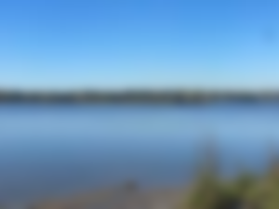
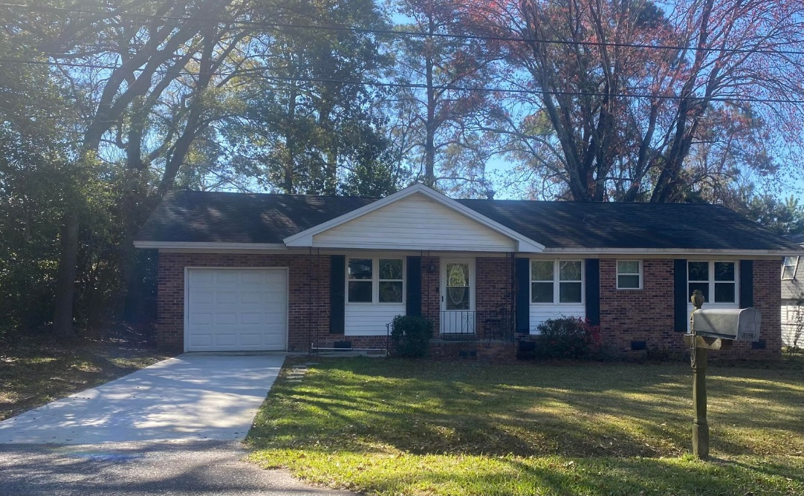
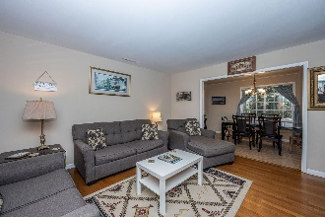
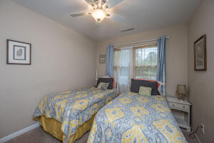
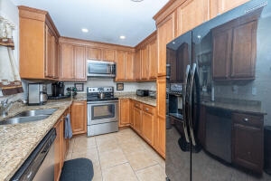
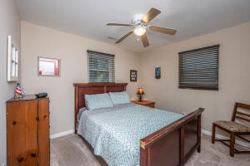
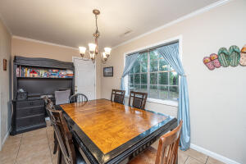
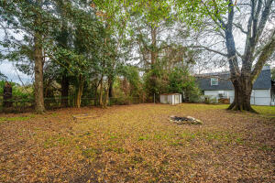
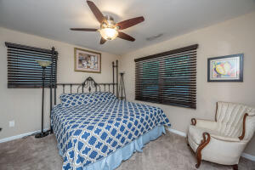
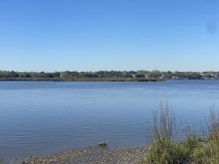



Why wait for new construction?
This Park Circle area home is LESS THAN 2 YEARS!
Coming Soon
Open House 3/21/22 5pm-7:30pm
4449 Ventura Drive
Wando Woods | North Charleston, SC 29405 | MLS# 22006331 | $300,000
Don't miss this beautiful updated Ranch home with large yard in sought after Wando Woods!
New vinyl windows in 2019-20 . New HVAC compressor 2018. New Driveway 2021.
Convenient location to Downtown and 526 and airport! NO FLOOD INSURANCE REQUIRED (X-Zone.) Ashley River public boat access located nearby.
Showings through ShowingTime.
Take a virtual walkthrough:
https://my.matterport.com/show/?m=gUR5Y25bXJc
Michelle Pulk
843-801-8178
michelle.pulk@carolinaone.com
191 Rutledge Ave
Charleston, SC 29403

