Slide 1
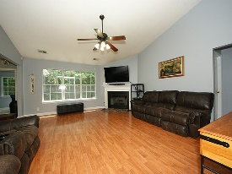
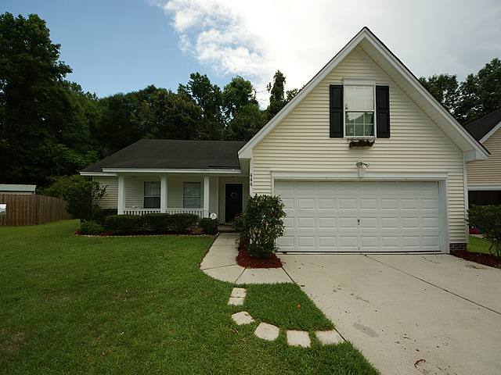
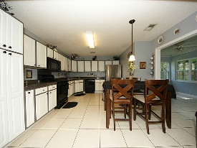
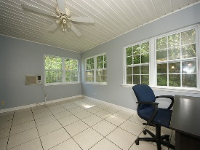
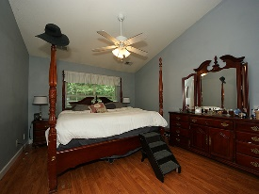
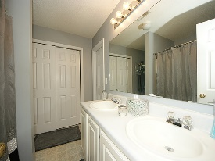
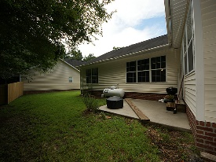
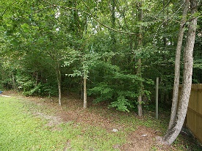


Move In Ready! Just Reduced!
444 Ashburton Drive
Devon Forest
Goose Creek, SC 29445
Open House Canceled!
Under Contract In 3 Days!
MLS# 16018501 | $176,500
2 Bed / 2 Baths
Prettiest home in Devon Forest! This home features an open floor plan with 3 bedrooms, 2 baths and FROG that could easily become a fourth bedroom. Seller has installed laminate wood flooring and ceramic tile down stairs adding to the clean, crisp features of the home. Painted with modern colors, this home is spacious, chic and ready for a new owner. Sunroom is not counted in square footage.
Connie White, Broker
C: 843-532-3356
conniesyouragent@gmail.com
Charleston Homes
111 Spring Hall Dr
Goose Creek, SC 29445

